Slide 1
INTRODUCTION TO FILM
Documentary Film

Slide 2
Key Terms:
Documentary – any film that is not entirely fictional. A film that records actual events, often creating dramatic impact through editing, camera work, and sometimes-performative interventions (e.g. Michael Moore’s films).
Realism – In documentary terms, realism describes a type of filmmaking in which fidelity to the nature of the subject itself is more important than the director’s attitude towards it. It also refers to a series of conventions that facilitate our perception of an unmediated (unembellished, true-to-life) representation.

Slide 3
Real time – the amount of time it would take for an event to occur in actuality, when the events depicted in a film occur in a linear and concurrent fashion as opposed to cutting to other times earlier or later than the action depicted, i.e. long take and minimal editing.
Location shooting – shooting in a place outside the studio, e.g. city street, the desert, an actual house or apartment.
Direct sound – sound recorded simultaneously with the image, at the moment of filming.
Contrapuntal sound – sound used in counterpoint, or in contrast to the visual images on the soundtrack.

Slide 4
Voice over – a voice track laid over the other track in a film’s sound mix to comment upon or counterpoints the images on the screen, it can be diegetic or non-diegetic
Pitch – the “highness” and “lowness” of sound
Timbre – the coloration or tonal quality of sound
Zoom – using a camera lens with variable focal length to create a gradual change in the size of an image and the relative distance between its foreground and background planes.

Slide 5
Hand held shot – shot made through the use of the camera operator’s body as a camera support, either holding it by hand or a mobile mount (e.g. Steadicam).
Cinéma vérité (“true cinema” French translation of kino-pravda) – a version of documentary developed by the French in the late 1950s and 1960s that attempted to capture everyday life without narration.
Direct cinema - emerged in the late 1950s and the 1960s in the United States. Its origin is partially attributed to the advent of lightweight cameras and transportable, synchronized sound recording devices. Associated with cinéma vérité but more strictly observational, direct cinema relies on an

Slide 6
agreement among the filmmaker, subjects, and audience to act as if the presence of the camera does not substantially alter the recorded event.

Slide 7
Documentary Genres:

Slide 8
Documentary Genres:
Compilation film

Slide 9
Documentary Genres:
Compilation film
Newsreel

Slide 10
Documentary Genres:
Compilation film
Newsreel
Interview / talking head

Slide 11
Documentary Genres:
Compilation film
Newsreel
Interview / talking head
Direct cinema / Cinéma vérité: precursor Vertov’s Kino-Pravda (film-truth)

Slide 12
Documentary Genres:
Compilation film
Newsreel
Interview / talking head
Direct cinema / Cinéma vérité: precursor Vertov’s Kino-Pravda (film-truth)
Nature documentary

Slide 13
Documentary Genres:
Compilation film
Newsreel
Interview / talking head
Direct cinema / Cinéma vérité: precursor Vertov’s Kino-Pravda (film-truth)
Nature documentary
Ethnographic film

Slide 14
Documentary Genres:
Compilation film
Newsreel
Interview / talking head
Direct cinema / Cinéma vérité: precursor Vertov’s Kino-Pravda (film-truth)
Nature documentary
Ethnographic film
Portrait

Slide 15
Documentary Genres:
Compilation film
Newsreel
Interview / talking head
Direct cinema / Cinéma vérité: precursor Vertov’s Kino-Pravda (film-truth)
Nature documentary
Ethnographic film
Portrait
Synthetic

Slide 16
Documentary Genres:
Compilation film
Newsreel
Interview / talking head
Direct cinema / Cinéma vérité: precursor Vertov’s Kino-Pravda (film-truth)
Nature documentary
Ethnographic film
Portrait
Synthetic
Mockumentary or fake documentary

Slide 17
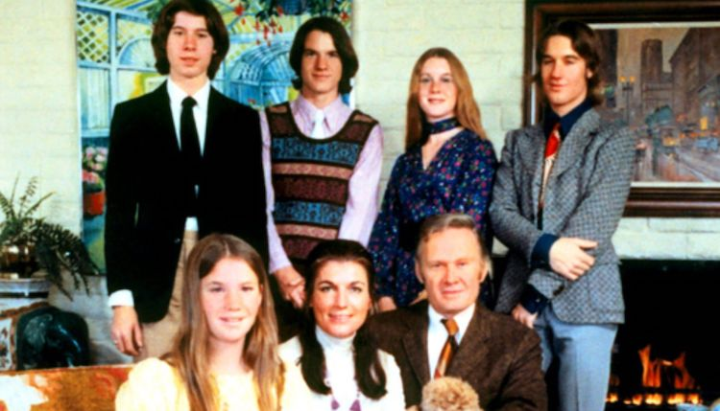
An American Family (1973) Craig Gilbert, series director, 12 episodes

Slide 18
Documentary Form:
Categorical form – conveys information, uses classification as a structuring principle
Rhetorical form – makes an argument, addresses the viewer openly and tries to convince them of an opinion or choice
Argument from source
Subject centered argument
Viewer centered argument

Slide 19
Modes of Documentary:

Slide 20
Modes of Documentary:
Expository

Slide 21
Modes of Documentary:
Expository
Observational

Slide 22
Modes of Documentary:
Expository
Observational
Interactive

Slide 23
Modes of Documentary:
Expository
Observational
Interactive
Reflexive

Slide 24
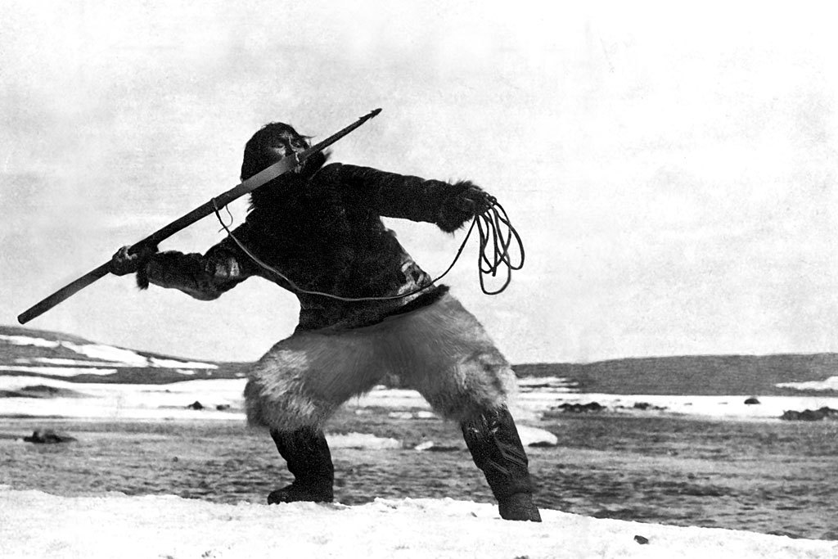
Nanook of the North (1922)
Dir. Robert Flaherty

Slide 25
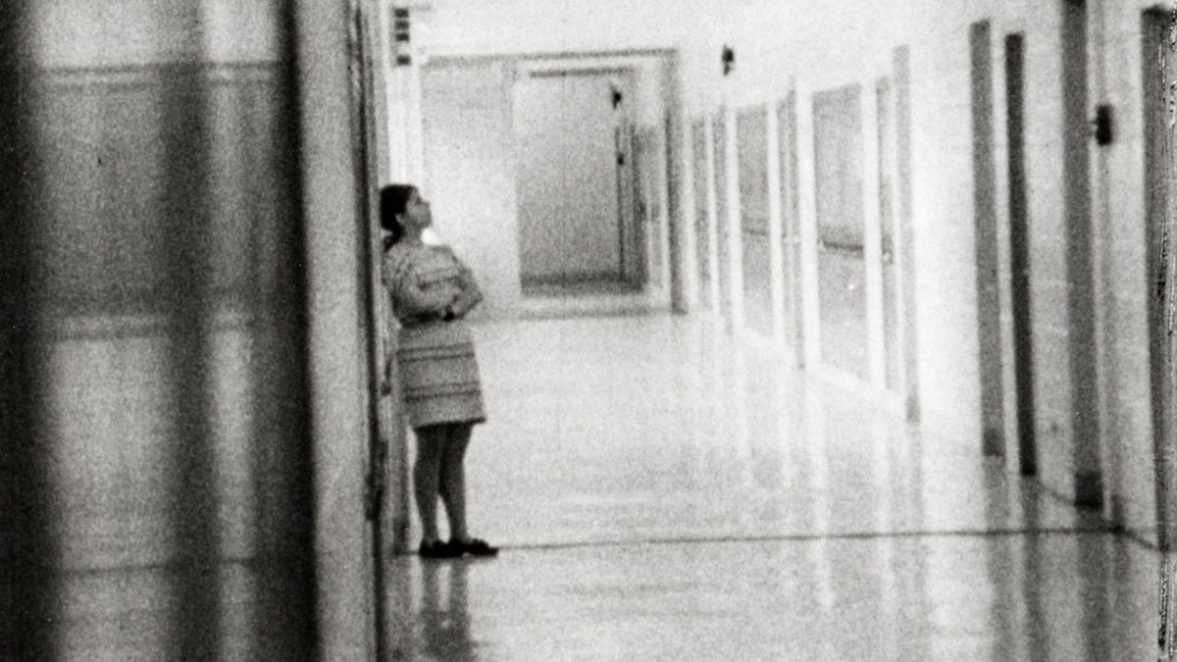
Highschool (1968) Dir. Frederick Wiseman

Slide 26
Documentary Analysis
Group work: divide into two groups based on which film you were assigned to watch. Each group will work together to:

Slide 27
Documentary Analysis
Group work: divide into two groups based on which film you were assigned to watch. Each group will work together to:
Select a representative scene from the film (use time stamps) as the focus of your analysis;

Slide 28
Documentary Analysis
Group work: divide into two groups based on which film you were assigned to watch. Each group will work together to:
Select a representative scene from the film (use time stamps) as the focus of your analysis;
Use Key Terms for this week to discuss and analyze this scene;

Slide 29
Documentary Analysis
Group work: divide into two groups based on which film you were assigned to watch. Each group will work together to:
Select a representative scene from the film (use time stamps) as the focus of your analysis;
Use Key Terms for this week to discuss and analyze this scene;
Identify the genre(s) of this documentary;

Slide 30
Documentary Analysis
Group work: divide into two groups based on which film you were assigned to watch. Each group will work together to:
Select a representative scene from the film (use time stamps) as the focus of your analysis;
Use Key Terms for this week to discuss and analyze this scene;
Identify the genre(s) of this documentary;
Relate your analysis to one of the documentary forms and/or modes of documentary

Slide 31
Documentary Analysis
Group work: divide into two groups based on which film you were assigned to watch. Each group will work together to:
Select a representative scene from the film (use time stamps) as the focus of your analysis;
Use Key Terms for this week to discuss and analyze this scene;
Identify the genre(s) of this documentary;
Relate your analysis to one of the documentary forms and/or modes of documentary

Slide 32
“All aspects of documentary filmmaking involve choice and are therefore manipulative. But the ethical... aspect of it is that you have to... try to make [a film that] is true to the spirit of your sense of what was going on...

Slide 33
My view is that these films are biased, prejudiced, condensed, compressed but fair.

Slide 34
I think what I do is make movies that are not accurate in any objective sense, but accurate in the sense that I think they're a fair account of the experience I've had in making the movie.”

Slide 35
I think what I do is make movies that are not accurate in any objective sense, but accurate in the sense that I think they're a fair account of the experience I've had in making the movie.” - Fred Wiseman quoted in American Film, 1991

