Slide 1
INTRODUCTION TO FILM
Feminist Film Theory

Slide 2
What does feminism have to do with cinema studies, and vice versa?

Slide 3
What does feminism have to do with cinema studies, and vice versa?
“Feminism is among the social movements and cultural-critical discourses that most definitively shaped the rise of Anglo-American film studies in the 1970s; in turn, film studies, a relatively young and politicized field, provided fertile ground for feminist theory to take root in the academy.” (White, OGFS, p. 117)

Slide 4
What does feminism have to do with cinema studies, and vice versa?
Critique and cultural production (like IMS!)

Slide 5
What does feminism have to do with cinema studies, and vice versa?
Critique and cultural production (like IMS!)
Intersectional (race, class, sexual identities)

Slide 6
What does feminism have to do with cinema studies, and vice versa?
Critique and cultural production (like IMS!)
Intersectional (race, class, sexual identities)
Postmodern

Slide 7
Key Approaches and Debates:
Reflection theory (Molly Haskell, Marjorie Rosen) film reflects social reality, stereotype analysis, positive/negative representations
Semiotics and ideology critique (Claire Johnson, Janet Bergstrom) “film must be seen as a language and woman as a sign,” (OGFS, p. 118) influenced by Marxist cultural theory, influence on feminist genre studies
Psychoanalysis (Laura Mulvey) Freudian and Lacanian theories, critique of phallocentrism, criticized for heterosexism and ethnocentrism

Slide 8
Areas of Study and Production:

Slide 9
Areas of Study and Production:
The woman’s film

Slide 10
Areas of Study and Production:
The woman’s film
Stars, reception studies, and consumer culture

Slide 11
Areas of Study and Production:
The woman’s film
Stars, reception studies, and consumer culture
Women in film (women’s film festivals)

Slide 12
Areas of Study and Production:
The woman’s film
Stars, reception studies, and consumer culture
Women in film (women’s film festivals)
Hollywood (e.g. Dorothy Arzner)

Slide 13
Areas of Study and Production:
The woman’s film
Stars, reception studies, and consumer culture
Women in film (women’s film festivals)
Hollywood (e.g. Dorothy Arzner)
Outside Hollywood

Slide 14
Areas of Study and Production:
The woman’s film
Stars, reception studies, and consumer culture
Women in film (women’s film festivals)
Hollywood (e.g. Dorothy Arzner)
Outside Hollywood
Art film

Slide 15
Areas of Study and Production:
The woman’s film
Stars, reception studies, and consumer culture
Women in film (women’s film festivals)
Hollywood (e.g. Dorothy Arzner)
Outside Hollywood
Art film
National cinemas

Slide 16
Areas of Study and Production:
The woman’s film
Stars, reception studies, and consumer culture
Women in film (women’s film festivals)
Hollywood (e.g. Dorothy Arzner)
Outside Hollywood
Art film
National cinemas
Third cinema

Slide 17
Areas of Study and Production:
The woman’s film
Stars, reception studies, and consumer culture
Women in film (women’s film festivals)
Hollywood (e.g. Dorothy Arzner)
Outside Hollywood
Art film
National cinemas
Third cinema
Avant-garde cinema (*Mulvey herself)

Slide 18
Areas of Study and Production:
The woman’s film
Stars, reception studies, and consumer culture
Women in film (women’s film festivals)
Hollywood (e.g. Dorothy Arzner)
Outside Hollywood
Art film
National cinemas
Third cinema
Avant-garde cinema (*Mulvey herself)
Counter-cinema

Slide 19
Areas of Study and Production:
The woman’s film
Stars, reception studies, and consumer culture
Women in film (women’s film festivals)
Hollywood (e.g. Dorothy Arzner)
Outside Hollywood
Art film
National cinemas
Third cinema
Avant-garde cinema (*Mulvey herself)
Counter-cinema
Documentary

Slide 20
“Psychoanalysis and the cinema were born at the end of the nineteenth century. They share a common historical, social, and cultural background shaped by the forces of modernity” (Creed, OGFS, p. 77)
Pre-1970s:
Surrealism (Freud and Jung)
Freud and cinema: unconscious, the return of the repressed, the Oedipal complex, subject formation

Slide 21
Post-1970s: post-structuralist criticism
Apparatus theory (Jean-Louis Baudry, Christian Metz) cinema as an institution that creates an “ideal, transcendental viewing subject”. (Baudry, p. 79) introduction of Lacan (mirror stage - the importance of screen-spectator relationship), does not address gender and sexuality (the viewing subject is assumed to be male)

Slide 22
Feminist film theory - Mulvey’s “Visual Pleasure and Narrative Cinema” established the psychoanalytic basis for a feminist theory of spectatorship which is still being debated (p. 82)
Feminist responses to Mulvey (Bergstrom, Mary Ann Doane, Richard Dyer, Annette Kuhn, Constance Penley, Kaja Silverman, and many others) 4 approaches: the Oedipal heroine (bisexual gaze), fantasy theory and the mobile gaze (film as fantasy), masculinity and masochism (eroticization of the male body), the monstrous woman (Kristeva and the abject)

Slide 23
Psychoanalysis in conjunction with other critical approaches, including post-colonial, queer, body theories (Homi Bhabha, Judith Butler, Rey Chow, Teresa de Lauretis, Lee Edelman, Stuart Hall, Judith Mayne)

Slide 24
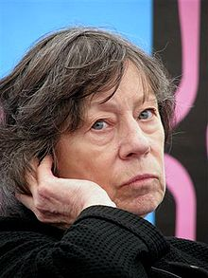
Laura Mulvey
Professor of Film and Media Studies at Birkbeck, University of London. She worked at the British Film Institute for many years before taking up her current position.
Mulvey has been awarded
three honorary degrees, from the University of East Anglia, Concordia University and University College Dublin.

Slide 25
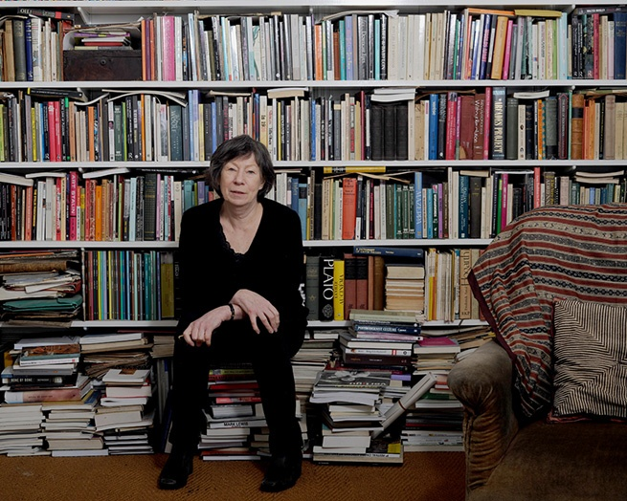
Her essay "Visual Pleasure and Narrative Cinema”, published in 1975, was one of the major works that shifted the orientation of film theory towards a psychoanalytic framework.
Mulvey was prominent as an avant-garde filmmaker in the 1970s and 1980s. She produced and co-directed six films with her husband Peter Wollen, including Riddles of the Sphinx (1977), AMY! (1980), and The Bad Sister (1982).

Slide 26
“This paper intends to use psychoanalysis to discover where and how the fascination of film is reinforced by pre-existing patterns of fascination already at work within the individual subject and the social formations that have molded him. It takes as its starting-point the way film reflects, reveals and even plays on the straight, socially established interpretation of sexual difference, which controls images, erotic ways of looking, and spectacle.

Slide 27
It is helpful to understand what the cinema has been, how its magic has worked in the past, while attempting a theory and a practice which will challenge this cinema of the past. Psychoanalytic theory is thus appropriated here as a political weapon, demonstrating the way the unconscious of patriarchal society has structured film form.” (p. 14)

Slide 28
“This paper intends to use psychoanalysis to discover where and how the fascination of film is reinforced by pre-existing patterns of fascination already at work within the individual subject and the social formations that have molded him. It takes as its starting-point the way film reflects, reveals and even plays on the straight, socially established interpretation of sexual difference, which controls images, erotic ways of looking, and spectacle.

Slide 29
It is helpful to understand what the cinema has been, how its magic has worked in the past, while attempting a theory and a practice which will challenge this cinema of the past. Psychoanalytic theory is thus appropriated here as a political weapon, demonstrating the way the unconscious of patriarchal society has structured film form.” (p. 14)

Slide 30
“This paper intends to use psychoanalysis to discover where and how the fascination of film is reinforced by pre-existing patterns of fascination already at work within the individual subject and the social formations that have molded him. It takes as its starting-point the way film reflects, reveals and even plays on the straight, socially established interpretation of sexual difference, which controls images, erotic ways of looking, and spectacle.

Slide 31
It is helpful to understand what the cinema has been, how its magic has worked in the past, while attempting a theory and a practice which will challenge this cinema of the past. Psychoanalytic theory is thus appropriated here as a political weapon, demonstrating the way the unconscious of patriarchal society has structured film form.” (p. 14)

Slide 32
Other Key Words and Concepts from the Essay:

Slide 33
Other Key Words and Concepts from the Essay:
Phallocentrism

Slide 34
Other Key Words and Concepts from the Essay:
Phallocentrism
Feminism

Slide 35
Other Key Words and Concepts from the Essay:
Phallocentrism
Feminism
Unconscious

Slide 36
Other Key Words and Concepts from the Essay:
Phallocentrism
Feminism
Unconscious
Pleasure

Slide 37
Other Key Words and Concepts from the Essay:
Phallocentrism
Feminism
Unconscious
Pleasure
Scopophilia

Slide 38
Other Key Words and Concepts from the Essay:
Phallocentrism
Feminism
Unconscious
Pleasure
Scopophilia
Male gaze / bearer of the look

Slide 39
Other Key Words and Concepts from the Essay:
Phallocentrism
Feminism
Unconscious
Pleasure
Scopophilia
Male gaze / bearer of the look
To-be-looked-at-ness

Slide 40
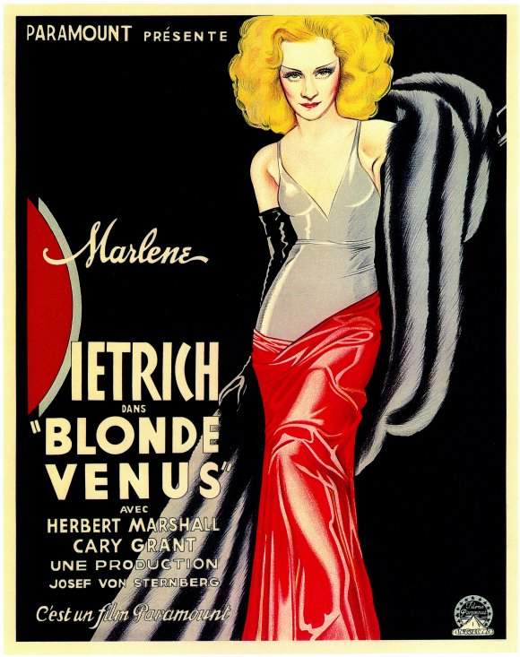
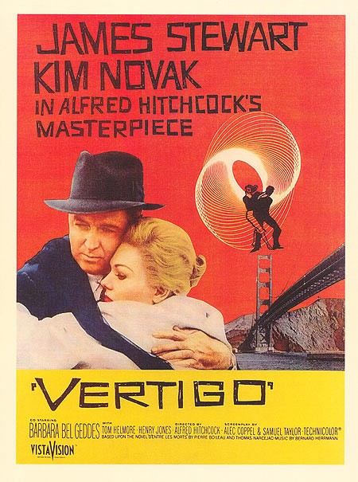
Comparative Analysis
Blonde Venus (1932) Dir. Josef von Sternberg
Vertigo (1958) Dir. Alfred Hitchcock

Slide 41
Comparative Analysis
Two groups: each group focus on one of the films, discuss and apply psychoanalytic film analysis to the gender and sexual relationships in these scenes. Focus on the dynamics of looking (scopophilia) and contextualize your observations and discussions with specific quotes from the Mulvey reading.

Slide 42
Concluding Thoughts and Remaining Questions:
“The place of the look defines cinema” - Mulvey critiques narrative cinema as “an illusion cut to the measure of desire.” (p. 25)
Contradiction: “the female image as a castration threat constantly endangers the unity of the diegesis…” (25)
3 different looks (camera, spectator, characters): she advocates for freeing the first two

Slide 43
Concluding Thoughts and Remaining Questions:
Female spectatorship – “What about the women in the audience?”

Slide 44
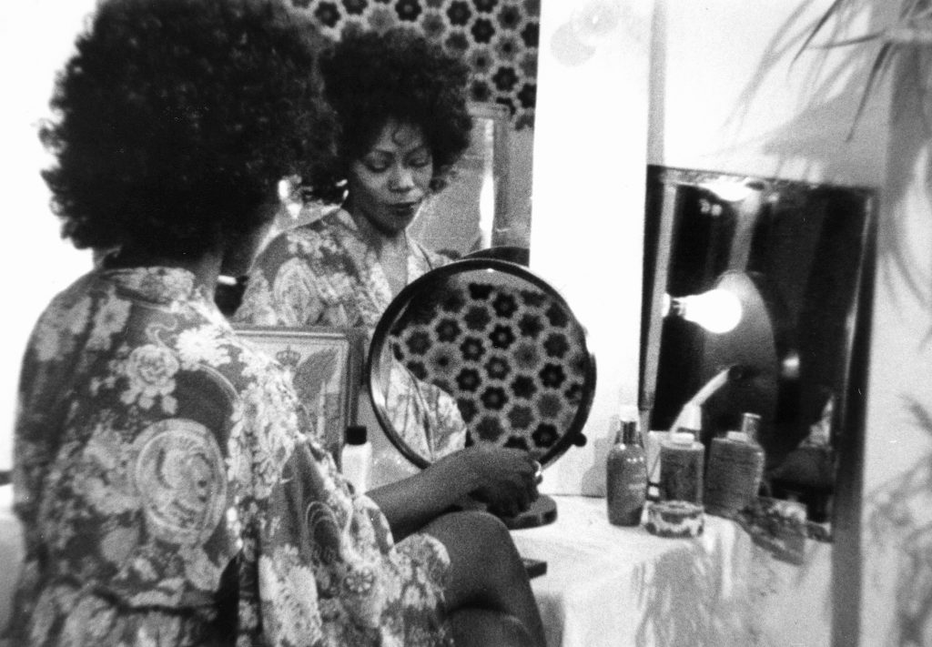
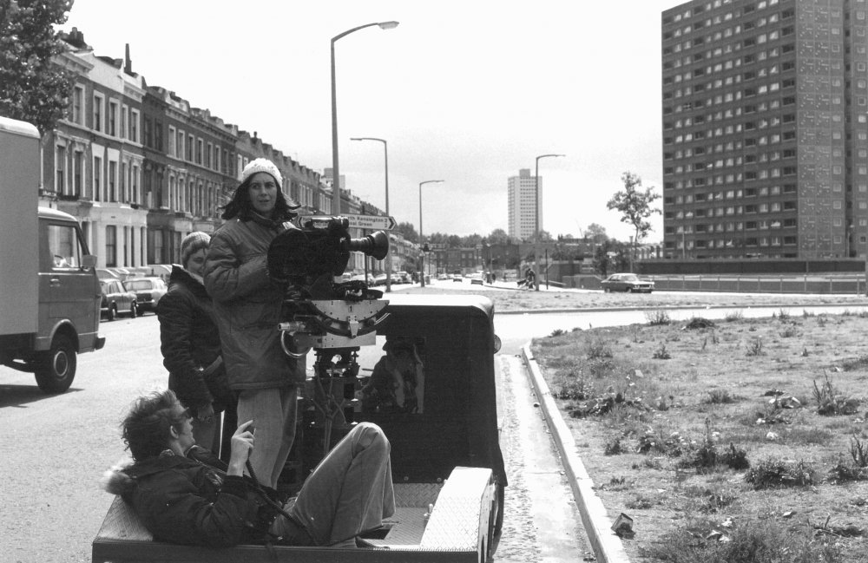
Riddles of the Sphinx (1977)
Dir. Laura Mulvey & Peter Wollen

Slide 45
“The first blow against the monolithic accumulation of traditional film conventions (already undertaken by radical film-makers) is to free the look of the camera into its materiality in time and space and the look of the audience into dialectics and passionate detachment. There is no doubt that this destroys the satisfaction, pleasure and privilege of the ‘invisible guest’, highlights the way film has depended on voyeuristic active/passive mechanisms. Women, whose image has continually been stolen and used for this end, cannot view the decline of the traditional film form with anything much more than sentimental regret ” (p. 26)

Slide 46
“The first blow against the monolithic accumulation of traditional film conventions (already undertaken by radical film-makers) is to free the look of the camera into its materiality in time and space and the look of the audience into dialectics and passionate detachment. There is no doubt that this destroys the satisfaction, pleasure and privilege of the ‘invisible guest’, highlights the way film has depended on voyeuristic active/passive mechanisms. Women, whose image has continually been stolen and used for this end, cannot view the decline of the traditional film form with anything much more than sentimental regret ” (p. 26)

Slide 47
Mary Kelly, Post-Partum Document,1973-79

Slide 48
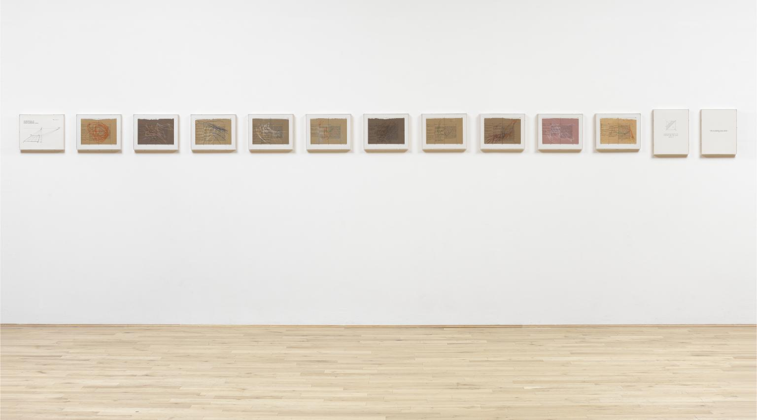

Slide 49
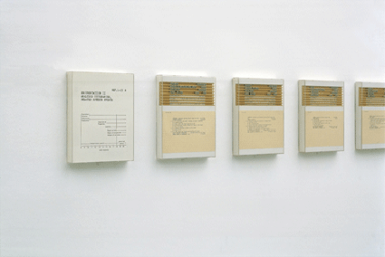
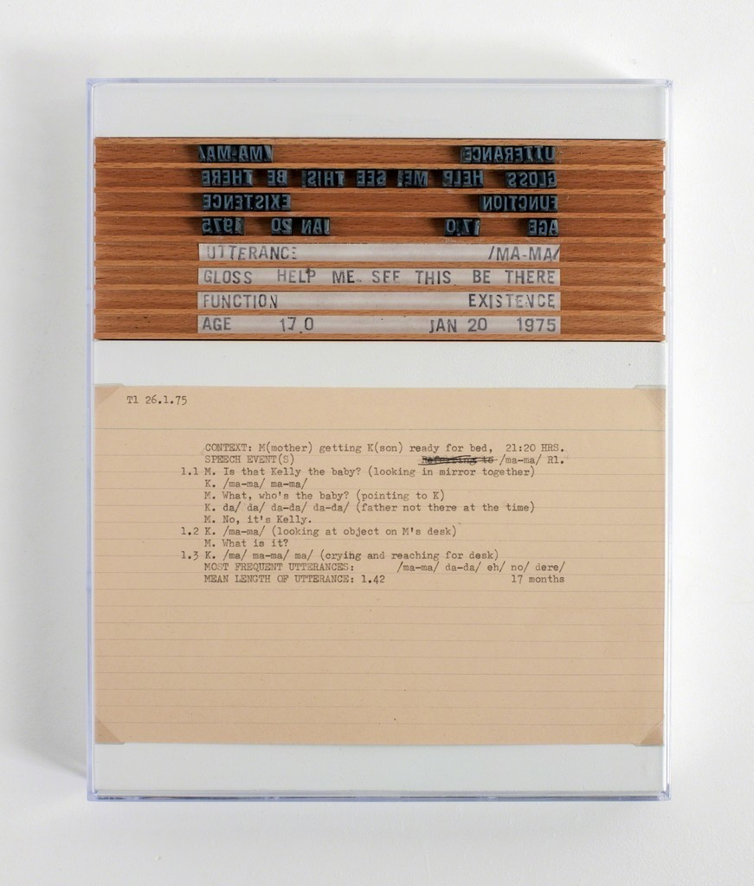
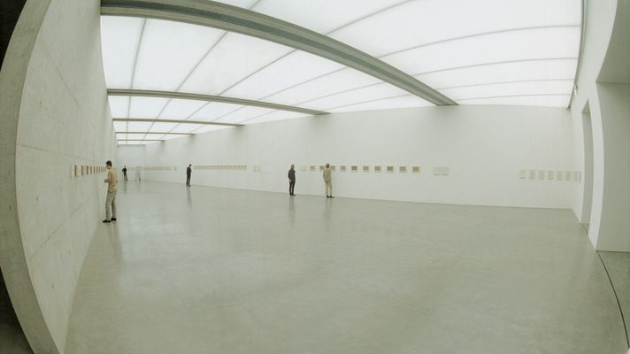

Slide 50
Criticism of psychoanalytic theory:

Slide 51
Criticism of psychoanalytic theory:
Monolithic spectator

Slide 52
Criticism of psychoanalytic theory:
Monolithic spectator
Not scientific

Slide 53
Criticism of psychoanalytic theory:
Monolithic spectator
Not scientific
Ahistorical

Slide 54
Criticism of psychoanalytic theory:
Monolithic spectator
Not scientific
Ahistorical
Spectator vs. viewer

Slide 55
Criticism of psychoanalytic theory:
Monolithic spectator
Not scientific
Ahistorical
Spectator vs. viewer (culturally-specific)

