Slide 1
INTRODUCTION TO FILM
Postmodernism & Film

Slide 2
Film as Culture:
Culture is the “text of our lives” – a coherent pattern of beliefs, acts, responses, and artifacts that we produce and comprehend everyday.
Culture can be read – and reading is a critical act. Coherence, system, and order are highlights of what constitutes a text.
Culture is not nature – it is made by people in history, for both conscious and unconscious reasons. It is the product of all we think and do
High culture, popular culture, sub-culture

Slide 3
Theories of Culture:
The Frankfurt School (Theodor Adorno, Walter Benjamin, Siegfried Kracauer, Herbert Marcuse) the culture industry, “The Work of Art in the Age of Mechanical Reproduction”; argued that popular culture turns its audience into willing tools of the ruling political party - the Nazis.
The Birmingham School of Cultural Studies (Paul Gilroy, Stuart Hall, Dick Hebdige, Angela McRobbie) cultural practice; interdisciplinary study of culture (race, class, gender); subcultures negotiate meanings with popular texts - a complex interaction of production and response and reception.

Slide 4
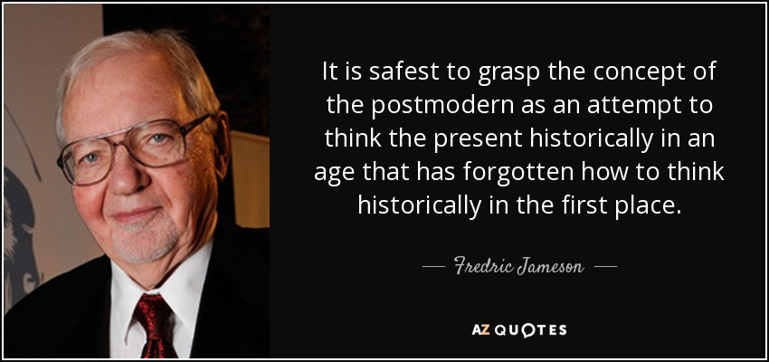

Slide 6
Fredric Jameson
Jameson is currently Knut Schmidt-Nielsen Professor of Comparative Literature and Romance Studies (French) and the director of the Center for Critical Theory at Duke University

Slide 7
He is best known for his analysis of postmodernity and capitalism. His books include Postmodernism, or, The Cultural Logic of Late Capitalism (1991) and The Political Unconscious (1981)
In 2012, the Modern Language Association gave Jameson its sixth Award for Lifetime Scholarly Achievement. He also received the Holberg International Memorial Prize in 2008, and the Lyman Tower Sargent Distinguished Scholar Award by the North American for Utopian Studies in 2009.

Slide 8
What is postmodernism?

Slide 9
What is postmodernism?
“The case for [postmodernism’s] existence depends on the hypothesis of some radical break or coupure, generally traced back to the end of the 1950s or the early 1960s. As the word itself suggests, this break is most often related to notions of the waning or extinction of the hundred-year-old modern movement (or to its ideological or aesthetic repudiation).” (p. 53)

Slide 10
What is postmodernism?
“…the effacement in them of the older (essentially high-modernist) frontier between high culture and so-called mass or commercial culture, and the emergence of new kinds of texts infused with the forms, categories and contents of that very Culture Industry so passionately denounced by all the ideologues of the modern…” (pp. 54-55)

Slide 11
What is postmodernism?
Post-industrial society, also consumer society, media society, information society, electronic society or ‘high tech’, and the like.

Slide 12
What is postmodernism?
Post-industrial society, also consumer society, media society, information society, electronic society or ‘high tech’, and the like.
Postmodernism is not a style, but rather a cultural dominant: “a conception which allows for the presence and coexistence of a range of very different, yet subordinate features.” (p. 56)

Slide 13
Shoes (1888) Vincent van Gogh

Slide 14
Shoes (1888) Vincent van Gogh
Diamond Dust Shoes (1980)
Andy Warhol

Slide 15
Key Words and Concepts in Postmodernism:

Slide 16
Key Words and Concepts in Postmodernism:
Commodity

Slide 17
Key Words and Concepts in Postmodernism:
Commodity
Globalization

Slide 18
Key Words and Concepts in Postmodernism:
Commodity
Globalization
The waning of affect

Slide 19
Key Words and Concepts in Postmodernism:
Commodity
Globalization
The waning of affect
The death of the subject

Slide 20
Key Words and Concepts in Postmodernism:
Commodity
Globalization
The waning of affect
The death of the subject
Pastiche & parody

Slide 21
Key Words and Concepts in Postmodernism:
Commodity
Globalization
The waning of affect
The death of the subject
Pastiche & parody
Simulacrum

Slide 22
Key Words and Concepts in Postmodernism:
Commodity
Globalization
The waning of affect
The death of the subject
Pastiche & parody
Simulacrum
Urbanism and mapping

Slide 23
Key Words and Concepts in Postmodernism:
Commodity
Globalization
The waning of affect
The death of the subject
Pastiche & parody
Simulacrum
Urbanism and mapping
Radical difference

Slide 24
Case Study: Architecture

Slide 25
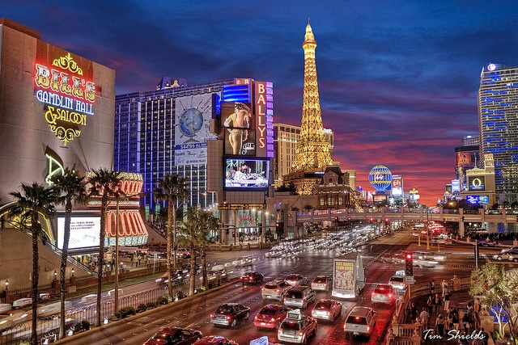

Slide 26
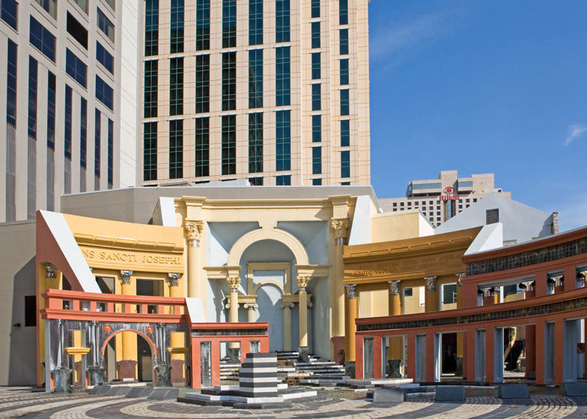
Piazza d’italia, New Orleans
Designed by Charles Moore (1978)

Slide 27
Portland Municipal Services Building
Designed by Michael Graves (1982)

Slide 28
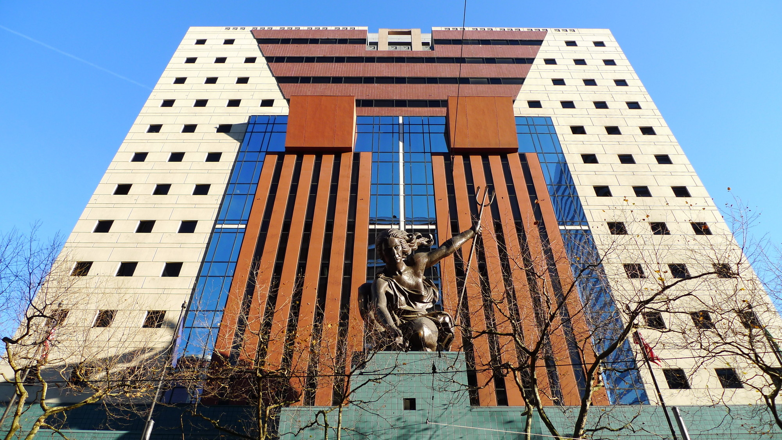

Slide 29
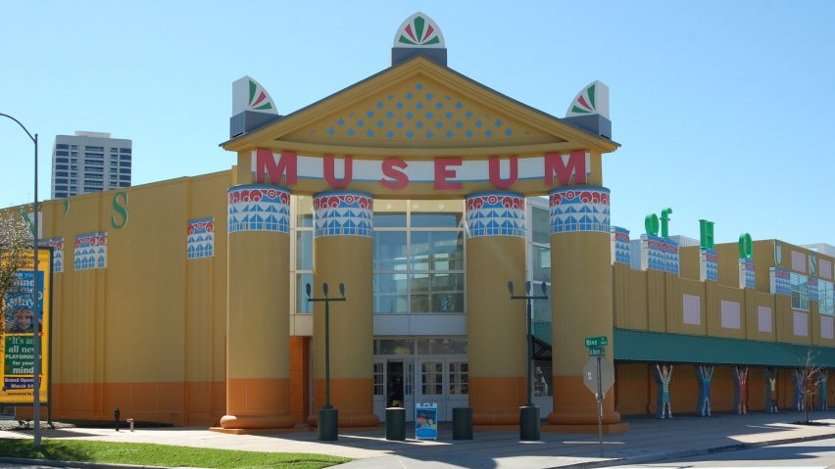
Children’s Museum of Houston
Designed by Robert Venturi (1984)

Slide 30
Gehry Residence, Santa Monica, CA
Designed by Frank Gehry (1977)

Slide 32
The Westin
Bonaventure Hotel,
Los Angeles
Designed by John C. Portman, Jr.
(1974-76)

Slide 33
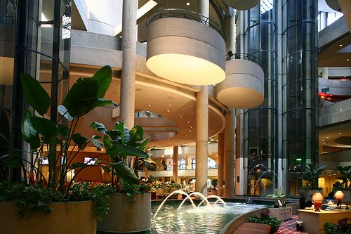

Slide 34
Postmodernist Debates:
1. Philosophical: “a growing ‘incredulity’ towards the (grand) meta-narratives of modern thought (Jean-Francois Lyotard); a suspicion of totalizing theories, rejection of absolutes and all embracing accounts of social and cultural phenomenon; “no fixed, essential or permanent identity, but rather, assuming different identities at different times” (Stuart Hall); criticized for a relativism which accepts the impossibility of adjudicating amongst different accounts of, or knowledge claims about reality.

Slide 35
Postmodernist Debates:
2. Socio-cultural: a globalized, post-industrial world; decline in manufacturing and rise of service industries (e.g. “gig” economy, social media, tourism), a shift away from the politics of mass movements to the politics of difference (race, gender, sexuality, nationality); communication and the circulation of signs (media technologies); simulacrum (a world of simulations and hyperreality); a television world.

Slide 36
Postmodernist Debates:
3. Aesthetic: a failure or exhaustion of modernist aesthetics, an erosion of aesthetic boundaries, eclecticism or pluralism (a declining emphasis of originality); a stylistic promiscuity (mixing of different styles, genres, artistic conventions, high/low cultures); appropriation and replication (use of parody, simulation, pastiche, and allegory)

Slide 37
Postmodernism & Film

Slide 38
Postmodernism & Film
Hollywood has gone postmodern!

Slide 39
Postmodernism & Film
Hollywood has gone postmodern!
Decline of the studios system, rise of media conglomerates, globalized production;
No more grand narratives - films themselves display aesthetic features of postmodernism, dystopic narratives and worlds;
Pastiche (empty / neutral, ideologically conservative) and parody (a critical use of references)

Slide 40
Postmodernism & Film
Affirmative postmodernism: in which resistance, critique and negation of the status quo were redefined in non-modernist and non-avant-garde terms
The opposition between avant-garde and commercial / industrial cinemas is blurred
The use of these strategies by third cinema, feminist, queer filmmakers to subvert the modernist, dominant cultural model.

Slide 41
Postmodernism & Film
Filmmaking and spectatorship as a means to “queer” historical narratives and representations (e.g. stereotypes and representations of African Americans and women)
The importance of voice and performance.

Slide 42
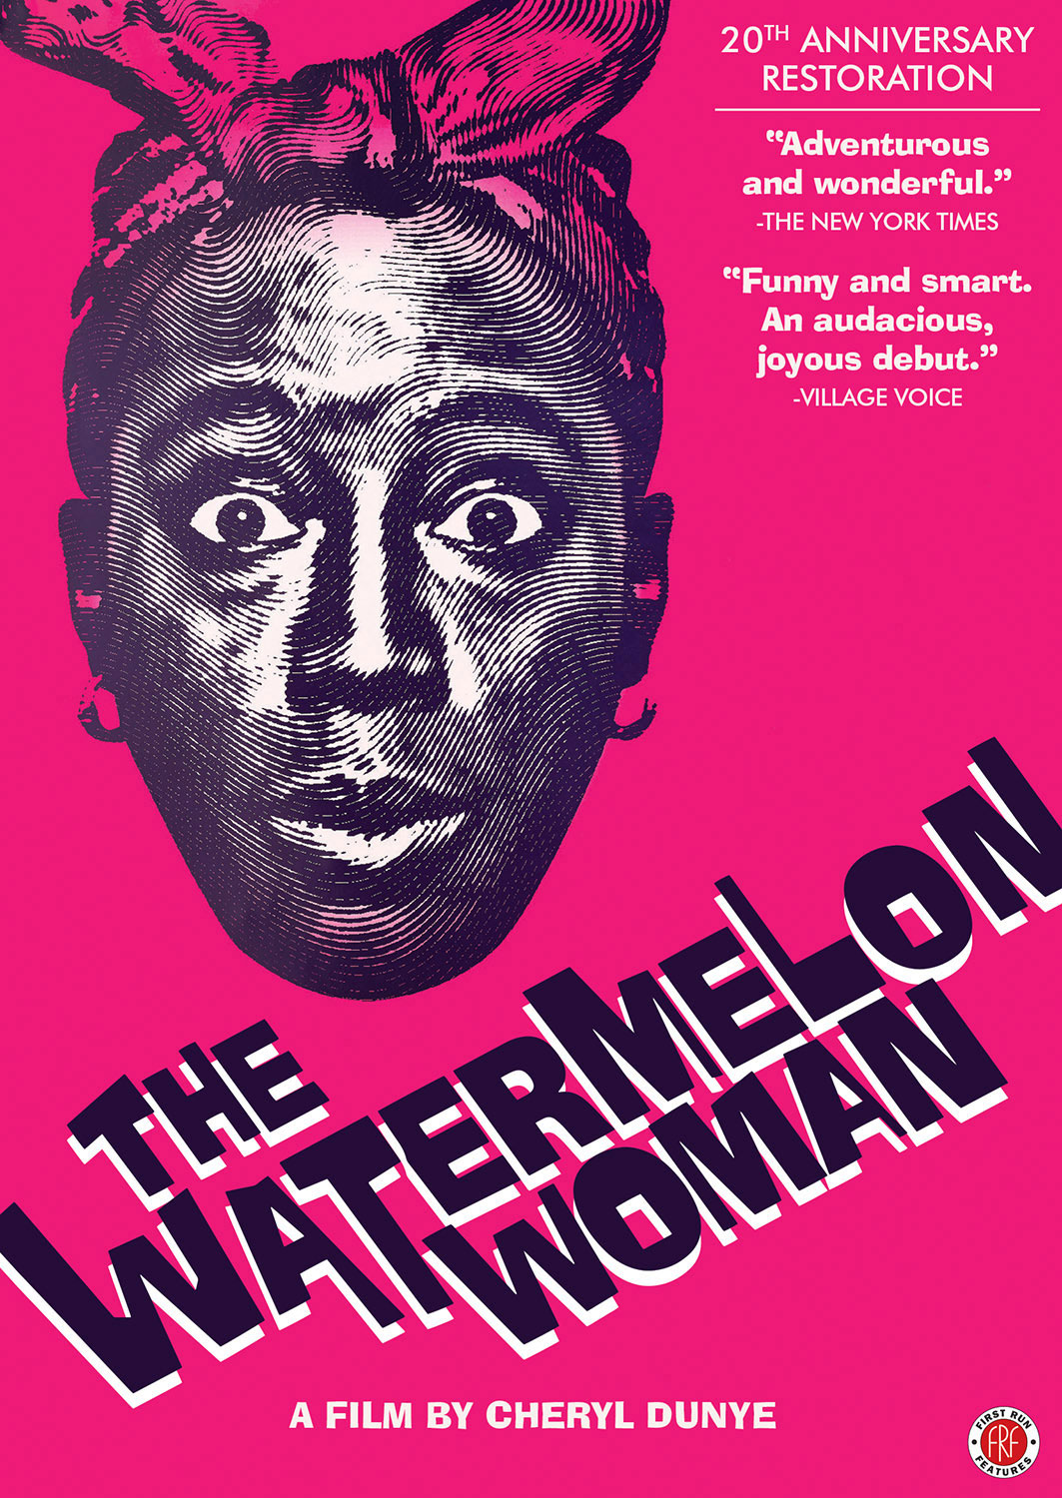
The Watermelon Woman (1996)
Dir. Cheryl Dunye

Slide 43
Group Discussion
Working in groups, select a scene or sequence from Dunye’s film (include time markers), and write an introduction to a film analysis paper in which you argue that this is a postmodernist film.
As we do in this class, start with a formal analysis. Here you maybe analyzing more than one filmic and other media languages (e.g. rom-com, fake documentary, music video)
Identify them first, and then think about how these different media forms interact in the film.

Slide 44
Group Discussion
Also consider the following questions:
Industrial / avant-garde / postmodern – where does Dunye’s film fit into these categories?
Can her film fit into more than one category? Can they adequately describe a film like this?
What is the influence of non-filmic forms (e.g. television, video, internet and digital media) on Dunye’s film?
Is her film pastiche, parody, or satire? Why?

Slide 45
Queering Postmodernism
Screening the Sexes by Parker Tyler (1973) and The Celluloid Closet by Vito Russo (1981)
Visibility
Mis-representation and stereotypes - the influence of feminist film theory
Criticized for its unproblematic view of history (OGFS, p. 135)

Slide 46
Queering Postmodernism
Postmodernism and the “death of the subject” - the dispersal and disruption of the modernist (heterosexual) subject

Slide 47
Queering Postmodernism
“At the historical moment when marginalized subjects—blacks, people of color, post-colonial subjects, women, lesbians, and gay men—claim their subjectivity, the white, middle-class, heterosexual male declares that very subject to be over and out.” (OGFS, p. 137)

Slide 48
Queering Postmodernism
“The questioning of essentialist identity politics, the rise of AIDS activism, and the debates surrounding ‘political correctness’ laid the groundwork for reappropriating the term ‘queer’ inside and outside the academy in the mid-1980s.” (OGFS, p. 148)

Slide 49
Queering Postmodernism
Are there political reasons for queer people hold on to authorship? (e.g. Judith Mayne’s work on Dorothy Arzner, OGFS, p.138-9)

Slide 50
Queering Postmodernism
Areas of study:
Gay and lesbian spectatorship - “queering” beyond gender and sexuality. (OGFS, p.150)
Representations of masculinity and camp
Films by gays and lesbians (avant-garde and underground films, queer new wave; the importance of gay and lesbian film festivals, archives, distributors, producers)

Slide 51
Queering Postmodernism
Areas of study:
Activism and identity politics
Intersectionality – queer POCs (the whiteness and maleness of the Queer New Wave)

Slide 52
Film Analysis Assignment 4: Postmodernism & Film
Choose one film from the following list (all are posted on the MS50 Sakai playlist):
A Girl Walks Home Alone at Night (2014) Dir. Ana Lily Amirpour
Jennifer’s Body (2009) Dir. Karyn Kusama
Kung Fu Hustle (2004) Dir. Stephen Chow
Run, Lola, Run (1998) Dir. Tom Tykwer
Surname Viet Given Name Nam (1989) Dir. Trinh T. Minh-ha
Tarnation (2003) Dir. Jonathan Caouette

Slide 53
Film Analysis Assignment 4: Postmodernism & Film
Choose one film from the following list (all are posted on the MS50 Sakai playlist):
Bonus Option! Everything Everywhere All at Once (2022) Dir. Daniel Kwan, Daniel Scheinert – if you choose to write about this film, you will have to watch it outside of Sakai

Slide 54
Film Analysis Assignment 4: Postmodernism & Film
Starting with a formal analysis of this film, describe its “postmodern voice” – does it engage with postmodern ideas, reflect the postmodern condition, or utilize postmodern cultural forms and stylistic devices?
Also consider the following questions: what is the film trying to say and how is it saying it cinematically?

Slide 55
Film Analysis Assignment 4: Postmodernism & Film
Who is subject of the film, and how is their subjectivity represented? How does that make this film postmodern?
In your conclusion, consider what you think are the postmodern politics of this film. Is it resistant, nihilistic, celebratory, conservative, queer, or some combination of these?

Slide 56
Film Analysis Assignment 4: Postmodernism & Film
Instead of trying to discuss the entire film in detail, it is a good idea to choose one scene from the film that best reflects its postmodern style and thematic content. Use this scene to create an argument about the film.
Even though this paper is focused on postmodernism, the key terms and concepts we learnt throughout this semester will help you perform your analysis – Use them.
Additional research outside of class readings is strongly encouraged. Remember to use proper citation (in footnotes for MLA style) and include a bibliography if using Chicago style.

Slide 57
Film Analysis Assignment 4: Postmodernism & Film
Additional research outside of class readings is strongly encouraged. Remember to use proper citation.

Slide 58
Your document should be in a MS Word format (.doc or .docx) only (i.e. no PDFs please)
Your essay should be about 3-5 pages, typed and double-spaced. It should contain about 5-6 paragraphs including introduction and conclusion. I suggest the following structure:
Introduction with a carefully constructed and powerful thesis statement, and summary of the main supporting arguments derived from formal analysis of the filmic language linked to the theories and debates on postmodernism;
3-4 Supporting Paragraphs that further discuss the supporting arguments outlined in the introduction, using specific examples from the film of your choice and citations (MLA or Chicago style) from the class reading as well as additional research;

Slide 59
Your document should be in a MS Word format (.doc or .docx) only (i.e. no PDFs please)
Conclusion summarizing your main argument with additional closing ideas based on your analysis and research on the film of your choice.
Please write your name, our class, and date in your document
Edit, spell-check, proof-read in addition to make sure factual information (e.g. film title, character names, etc.) are correct, as well as your usage of the key terms and other terminology
Please upload your assignment by 5PM PST of the due date to your Sakai Drop Box.

