Slide 1
INTRODUCTION TO FILM
Soviet Montage

Slide 2
Film Form

Slide 3
Film Form
All films have a form - the overall system of relations that can be perceived amongst the elements in the whole film.

Slide 4
Film Form
All films have a form - the overall system of relations that can be perceived amongst the elements in the whole film.
Perception and audience (perceivers)

Slide 5
Film Form
All films have a form - the overall system of relations that can be perceived amongst the elements in the whole film.
Perception and audience (perceivers)
Cueing / system

Slide 6
Film Form
All films have a form - the overall system of relations that can be perceived amongst the elements in the whole film.
Perception and audience (perceivers)
Cueing / system
Form and content (both function as part of the overall pattern)

Slide 7
Film Form
All films have a form - the overall system of relations that can be perceived amongst the elements in the whole film.
Perception and audience (perceivers)
Cueing / system
Form and content (both function as part of the overall pattern)
Expectations and conventions (genres)

Slide 8
Emotions

Slide 9
Form & Meaning

Slide 10
Form & Meaning
Referential

Slide 11
Form & Meaning
Referential
Explicit

Slide 12
Form & Meaning
Referential
Explicit
Implicit

Slide 13
Form & Meaning
Referential
Explicit
Implicit
Symptomatic

Slide 14
Criteria for evaluating film

Slide 15
Criteria for evaluating film
There is a difference between personal taste and evaluative judgment

Slide 16
Criteria for evaluating film
There is a difference between personal taste and evaluative judgment

Slide 17
Criteria for evaluating film
There is a difference between personal taste and evaluative judgment
Coherence / unity

Slide 18
Criteria for evaluating film
There is a difference between personal taste and evaluative judgment
Coherence / unity
Intensity of effect

Slide 19
Criteria for evaluating film
There is a difference between personal taste and evaluative judgment
Coherence / unity
Intensity of effect
Complexity

Slide 20
Criteria for evaluating film
There is a difference between personal taste and evaluative judgment
Coherence / unity
Intensity of effect
Complexity
Originality

Slide 21
Criteria for evaluating film
There is a difference between personal taste and evaluative judgment
Coherence / unity
Intensity of effect
Complexity
Originality
A matter of degree: “In applying the criteria, the analyst must often weigh one against another” (Film Art, p. 59)

Slide 22
5 Principles of Film Form

Slide 23
5 Principles of Film Form
“There are no absolute principles of form that all artists must follow. Artworks are products of culture. Thus many of the principles of artistic form are matters of convention.” (Film Art, p. 59)

Slide 24
5 Principles of Film Form
“There are no absolute principles of form that all artists must follow. Artworks are products of culture. Thus many of the principles of artistic form are matters of convention.” (Film Art, p. 59)
Function

Slide 25
5 Principles of Film Form
“There are no absolute principles of form that all artists must follow. Artworks are products of culture. Thus many of the principles of artistic form are matters of convention.” (Film Art, p. 59)
Function
Similarity and repetition (motif)

Slide 26
5 Principles of Film Form
“There are no absolute principles of form that all artists must follow. Artworks are products of culture. Thus many of the principles of artistic form are matters of convention.” (Film Art, p. 59)
Function
Similarity and repetition (motif)
Difference and variation (parallelism)

Slide 27
Development (process)

Slide 28
Development (process)
Unity / disunity

Slide 29
Development (process)
Unity / disunity
A set of questions that you can ask about any film (see Film Art, p. 66)

Slide 30
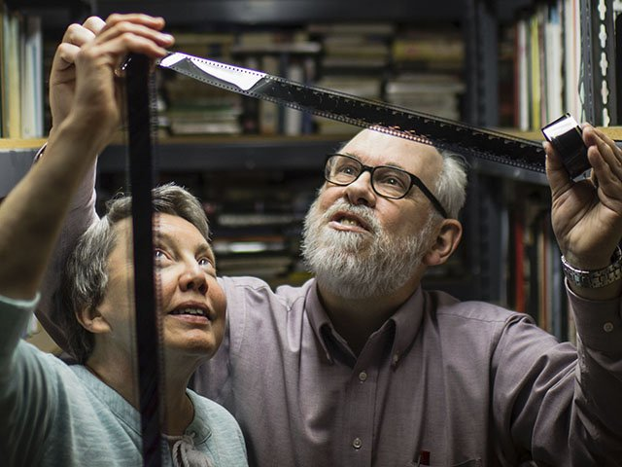
David Bordwell & Kristin Thompson

Slide 31
They are a married couple.
Bordwell spent nearly the entirety of his career as a professor of film at the University of Wisconsin–Madison, where he is currently the Jacques Ledoux Professor of Film Studies, Emeritus in the Department of Communication Arts.
Thompson has held teaching positions at the University of Wisconsin, the University of Iowa, Indiana University, the University of Amsterdam, and the University of Stockholm.

Slide 32
In addition to Film Art, which has ten editions and has been translated into seven languages, they also co-authored Minding Movies: Observations on the Art, Craft, and Business of Filmmaking (2011), as well as The Classical Hollywood Cinema: Film Style and Mode of Production to 1960 (1985) with Janet Staiger.
In addition to writing about film, Thompson has also written about television, Russian formalism, and the Lord of the Rings franchise. Her most recent book is Storytelling in Film and Television (2003).

Slide 33
Bordwell has published nineteen books to date, in addition to Classical Hollywood cinema, he has also written about Japanese, Hong Kong, and Russian cinema. He most recent book is Reinventing Hollywood: How 1940s Filmmakers Changed Movie Storytelling (2017)

Slide 34
Key Terms:
Reflexivity – reference, commentary, or analysis of a system that points back to, or lead to changes within the same system. In cinematic terms, films that point back to themselves as films, or to the history of cinema.
Editing – the selection, splicing or cutting together of the shots in a film to create a meaningful relationship between them.
Narrative film – a film whose structure follows a story line. The dominant cinematic form.

Slide 35
Inter-title – printed titles that appear within the main body of a film to convey dialogue or other narrative information.
Point-of-view shot – a shot taken in the position from which a character is looking, showing what the character would see. It is usually preceded or followed by a shot of the character.
Reaction shot – a shot that shows a character’s reaction to the events within a previous shot they have been witness to.
Crosscutting – editing that alternates shots of two or more lines of action occurring in different places, usually simultaneously.

Slide 36
Parallel action – two scenes occurring in different places showing one after another or crosscut together to create the illusion of simultaneity.

Slide 37
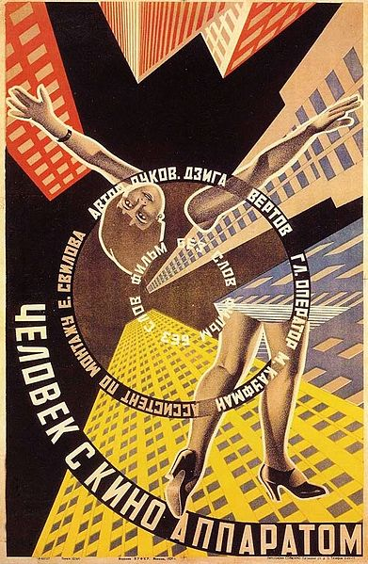
Soviet Montage
Russian Revolution (1917)
Revolutionary artists were driven by a desire to make aesthetics, culture, ideology and politics interact on a visible, formal level, and make them accessible to as many people as possible.
Poster for Man with a Movie Camera (1929) Dir. Dziga Vertov

Slide 38
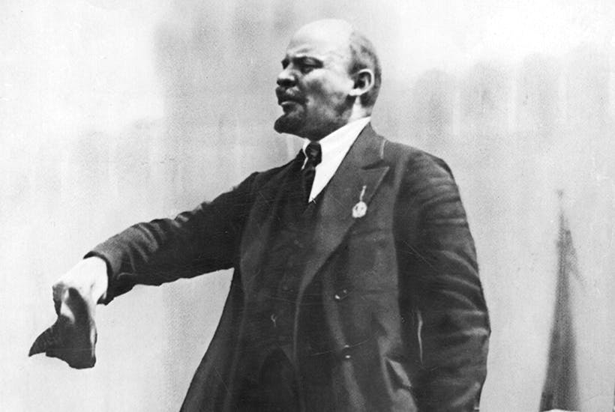
“Cinema for us is the most important art form.”
- Vladimir Lenin

Slide 39
The filmmakers: Lev Kuleshov, Alexander Dovzhenko, Sergei Eisenstein, Dziga Vertov, Esther Shub looked closely at U.S. cinema, especially the films of D.W. Griffith, to find out how they worked.
Developed the idea of montage as an oppositional filmic language to what became the Classical Hollywood style of continuity editing.
Opposed to continuity editing’s emphasis of closure and reconciliation, Soviet montage is meant to be visible, legible, and powerful.

Slide 40
Montage as a way to make the viewer sit up and take notice. (Eisenstein’s “kino-fist”)
Ideas and theories include: dialectical montage (Eisenstein), kino-glaz / cinema-eye (Vertov), Kuleshov effect (Lev Kuleshov)
Montage and sound film (contrapuntal use of sound, non-synchronization, Film Sound, p. 84)
By the late 1920s, Soviet leadership including Joseph Stalin increasingly favored socialist realism. By 1932, it became the official Soviet style.

Slide 41
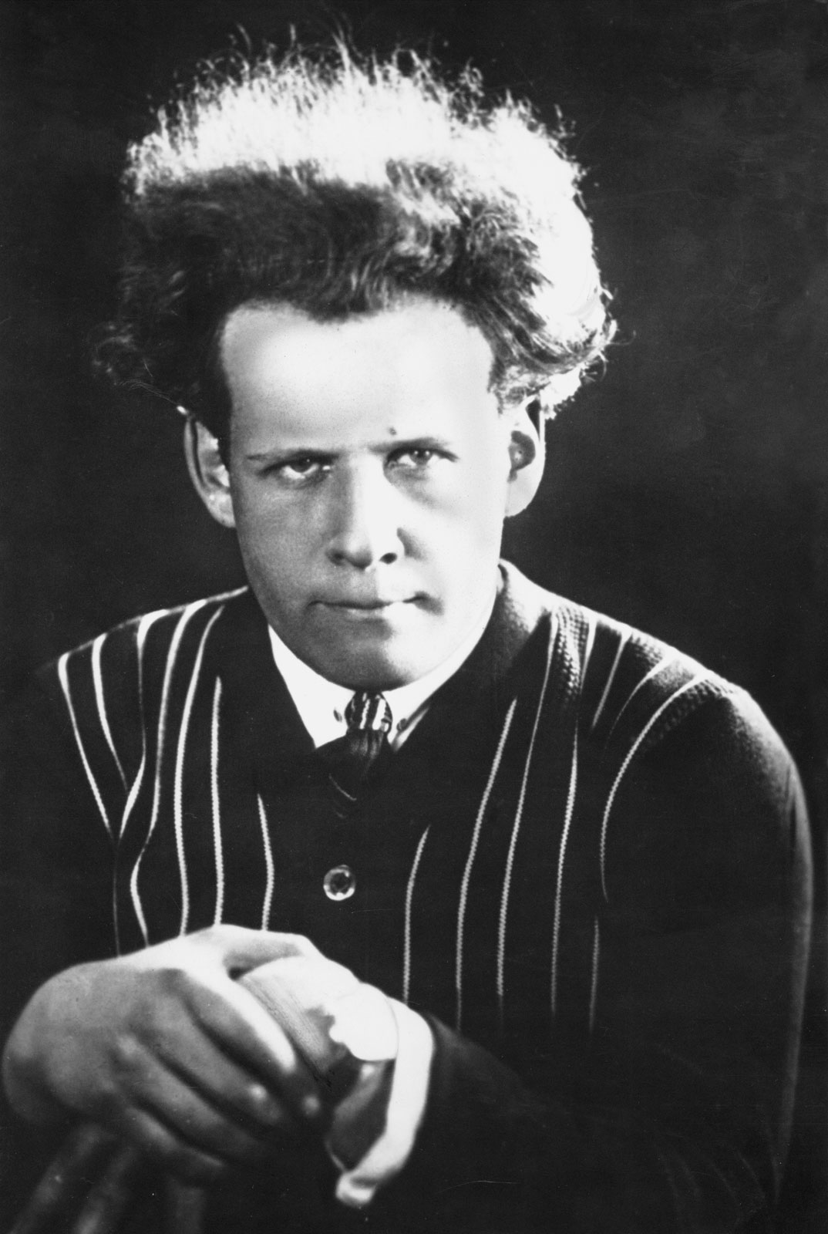
Sergei Eisenstein
Born in Latvia in 1898, Eisenstein trained as engineer and joined the Red Army in 1917.
He made posters and directed experimental political theater for the Moscow Prolekult Theater.
Made his first film Strike in 1924-5. Battleship Potemkin was made as a commemoration of the 20th anniversary of the abortive 1905 Revolution against Tsarism.

Slide 42
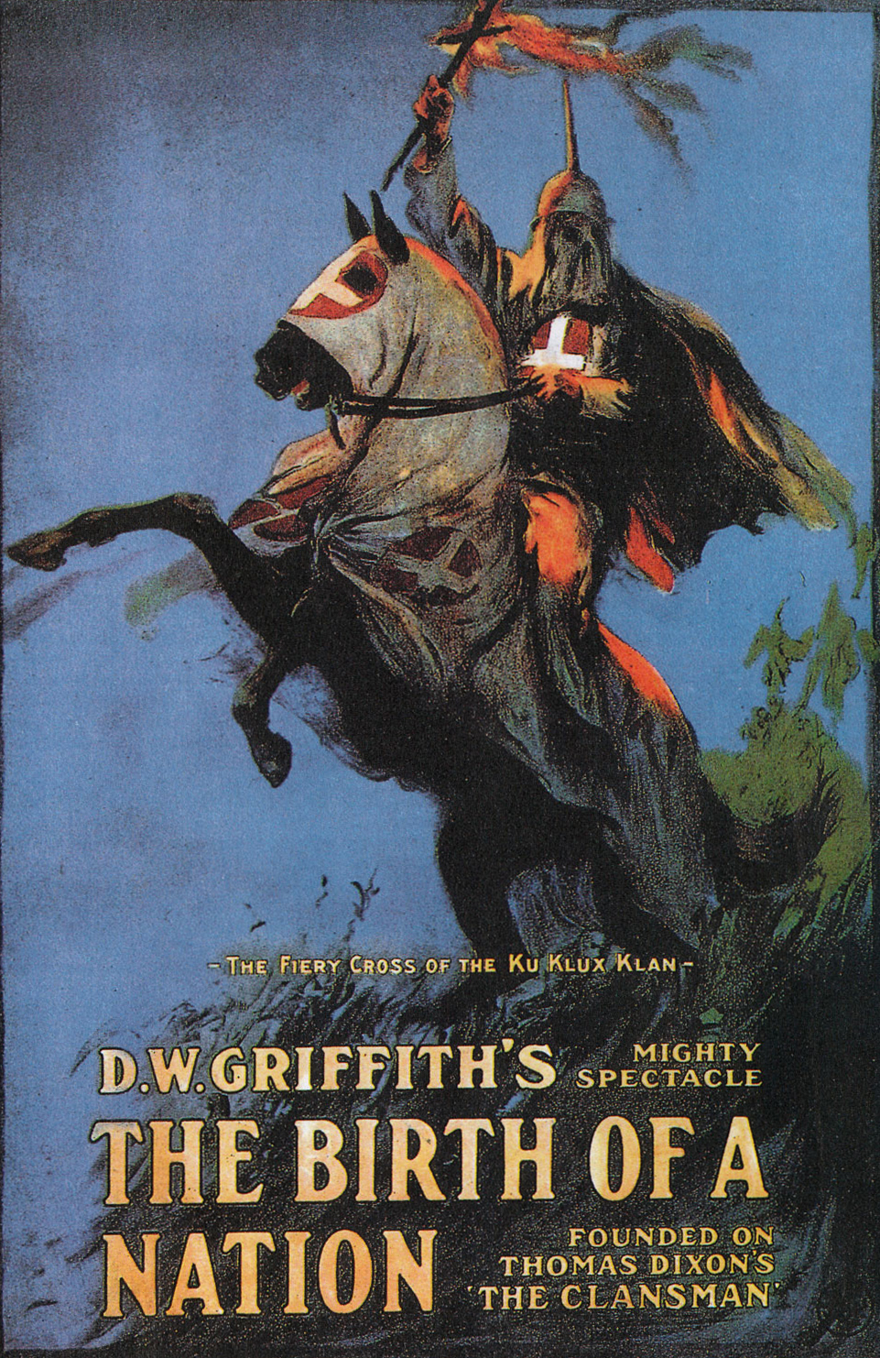
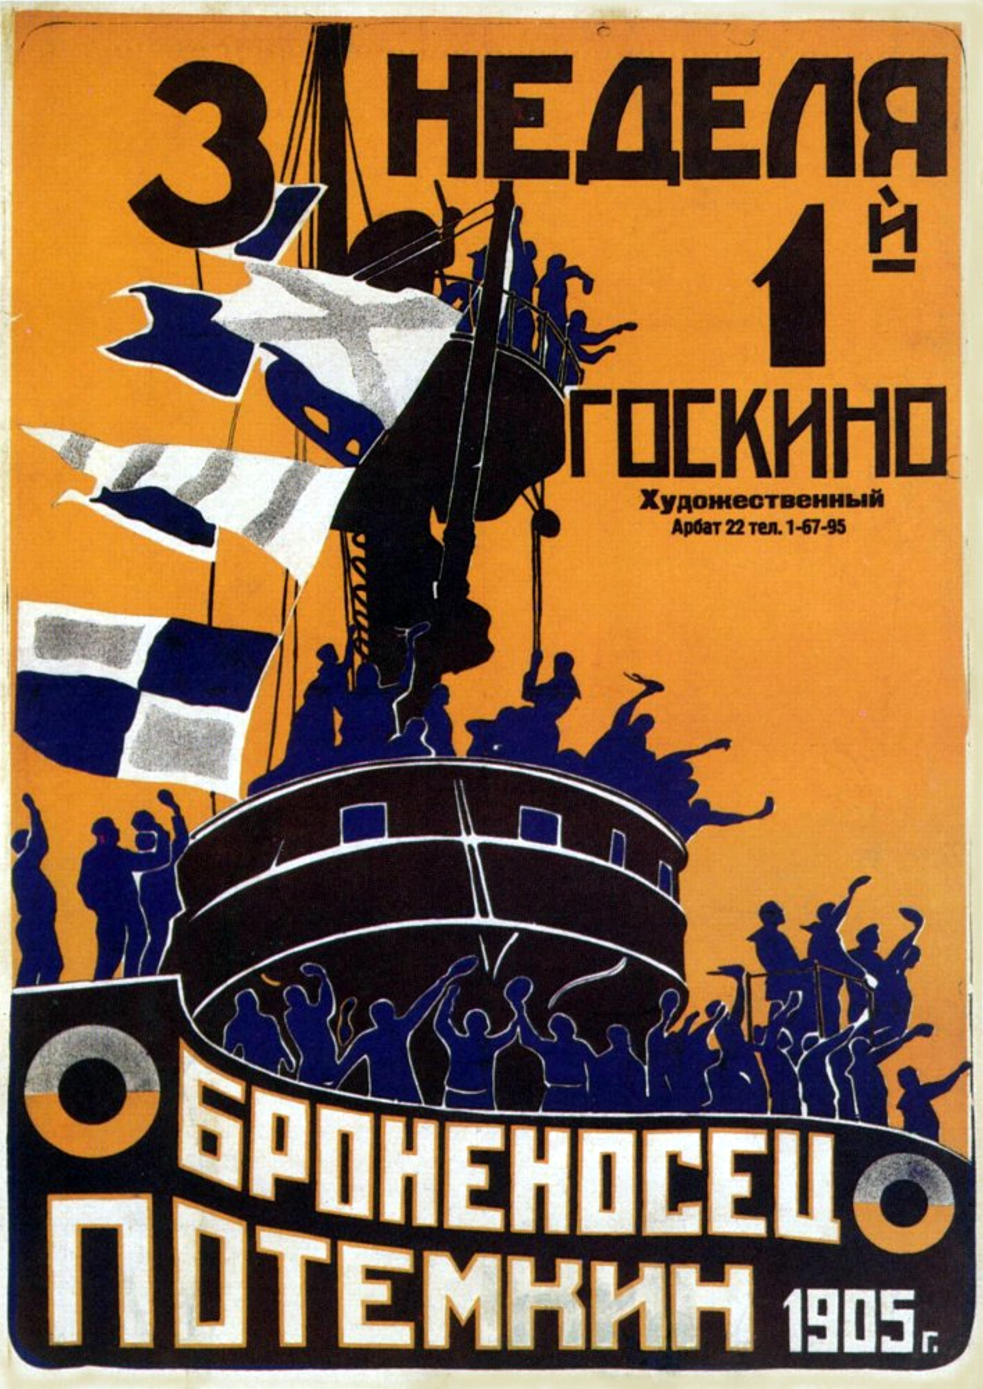
Comparative Analysis: Battleship Potemkin (1925) Dir. Sergei Eisenstein & The Birth of A Nation (1915) Dir. D.W. Griffith

Slide 43
Eisenstein believed the basic unit of the film structure is not the shot but at least two shots cut together.
The interaction between shots makes up the montage pattern.
His theory of dialectical montage - the juxtaposition of a shot (thesis) with another shot (antithesis) creates a synthesis. Using visual opposition and “the collision of independent shots” to create a totality. Montage as an expression of Marxist dialectics.

Slide 44
Eisenstein believed the basic unit of the film structure is not the shot but at least two shots cut together.
The interaction between shots makes up the montage pattern.
His theory of dialectical montage - the juxtaposition of a shot (thesis) with another shot (antithesis) creates a synthesis. Using visual opposition and “the collision of independent shots” to create a totality. Montage as an expression of Marxist dialectics.

Slide 45
Key Terms:
Soviet Montage – a form of editing developed by Soviet filmmakers in the 1920s, often discontinuous, which emphasizes the graphic, rhythmic, and conceptual relationship between shots. Developed in opposition to the continuity editing style of Classical Hollywood cinema.
Framing - the organization of the contents of the shot with respect to the edges of the screen, designates the boundaries of the image as an anchor for composition.

Slide 46
Centered framing – the arrangement of the person (or persons) in the image equidistant from the edges of the image.
Open framing – the arrangement of the person (or persons) in the image such that a wide area of space is visible between the figure and the edges of the frame.
Tight or closed framing – the arrangement of the person (or persons) in the image such that little space is visible between the figure and the edges of the image.

Slide 47
Canted framing – a slanting of the axis of the camera relative to the horizontal axis of the image, which causes the image itself to appear slanted.
High angle – a shot in which the camera looks down on a person (or persons) within the image from above a viewpoint relative to their eyeline.
Low angle – a shot in which the camera looks up at a person (or persons) within the image from below a viewpoint relative to their eyeline.
Overhead shot – a shot taken from immediately above the scene.

Slide 48
Full face shot – the framing of a person in frontal view
Side view – the framing of a person from the side.
Three-quarter view - the framing of a person at angle to the plane of the image.

Slide 49
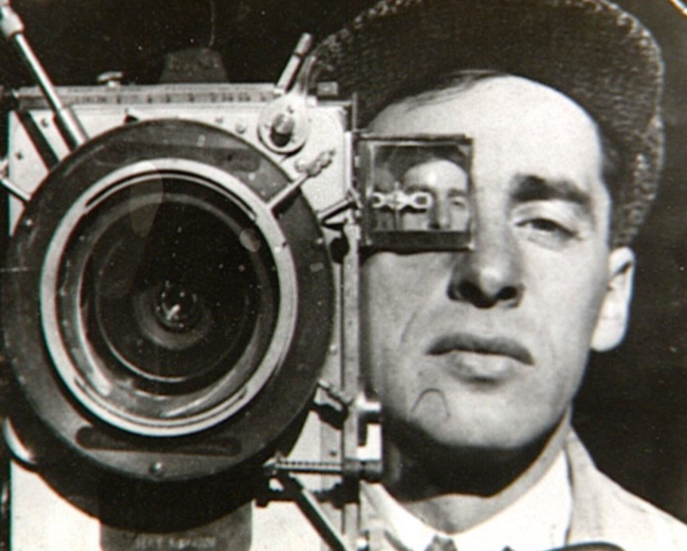
Dziga Vertov
Born in Poland in 1896, Vertov became an editor of newsreels in 1918 for the Cinema Committee.
Kino-Glaz (Cinema-Eye) during the 1920s, Vertov and the group of young filmmaker he worked with believed in the absolute ability of the cinema apparatus to reproduce reality as it actually appears, and the necessity of editing to arrange this reality into an expressive and persuasive whole.

Slide 50
Dziga Vertov
Born in Poland in 1896, Vertov became an editor of newsreels in 1918 for the Cinema Committee.
Kino-Glaz (Cinema-Eye) during the 1920s, Vertov and the group of young filmmaker he worked with believed in the absolute ability of the cinema apparatus to reproduce reality as it actually appears, and the necessity of editing to arrange this reality into an expressive and persuasive whole.

Slide 51
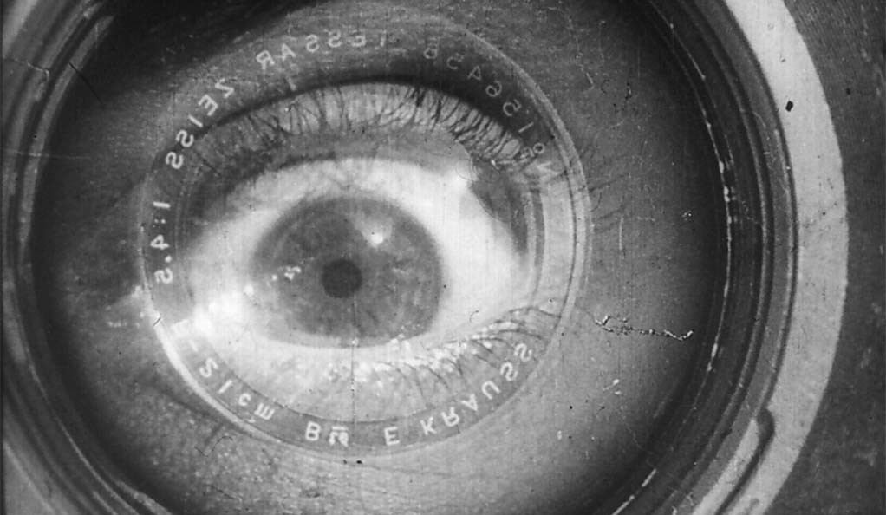
Man with a Movie Camera (1929)
Dir. Dziga Vertov

Slide 52
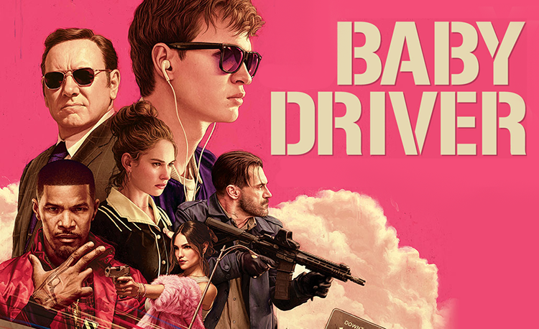
Baby Driver (2017)
Dir. Edgar Wright

Slide 53
Comparative Analysis:
Watch and compare two sequences from Baby Driver and Man with a Movie Camera. Do you see any influence of the Soviet Montage filmic language on contemporary Hollywood cinema?
Given the oppositional stance of Soviet Montage to Hollywood filmic language of continuity editing, and the influence of Marxism on the filmic language of Montage, what are the implications (formal, ideological, etc.) when this filmic language appears in Hollywood films?

Slide 54
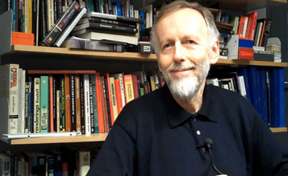
Ian Christie
Ian Christie is a British film scholar. He is Professor of Film and Media
History at Birkbeck, University of London
In addition to writing about film history, Christie is also a curator, broadcaster, and consultant.
He writes about early cinema, Russian cinema, as well as filmmakers including Scorsese and Gilliam.

Slide 55
He has also worked on exhibitions ranging from Film as Film (1979), Eisenstein: His Life and Art (1988), Spellbound: Art and Film (1996) and Modernism: Designing a New World (2006).

Slide 56
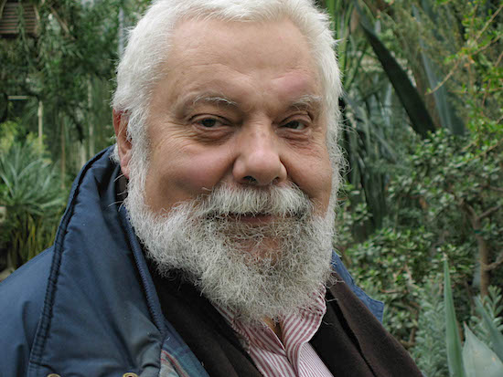
Chuck Kleinhans
Kleinhans was an associate professor of film studies at Northwestern University for 32 years.
In 1974, he co-founded the influential media studies journal Jump Cut with Julia Lesage and John Hess, which he co-edited until his death in 2017.

Slide 57
In 2007, the Society for Cinema and Media Studies (SCMS) awarded him its Outstanding Pedagogical Achievement Award.

Slide 58
Formalism, Marxism, and Film
During and after the Russian Revolution, formalist literary critics including Viktor Shklovsky and Yuri Tynyanov were not only theorizing new forms of Soviet cinema, they were also working as scriptwriters and consultants on films
Eisenstein and Vertov were both filmmakers as well as theorists.

Slide 59
“The Formalists argue that poetic and prosaic language are not confined to the literary genres of poetry and prose could also be applied to cinema…”
“Formalists were able to argue that the use of ‘factual’ documentary material by Dziga Vertov did not in itself make his films factual.” (OGFS, P. 60)

Slide 60
Dangerous slippage between aesthetic and political disagreement during the purges of 1930s
1960s – renewed interest in Russian cinema and its theories (Neo-Formalism) This contributed to the question of innovative forms matching a revolutionary content.
1970s – deeper explanation and more complex patterns (e.g. semiotics, psychoanalysis)
The “politicization of form”

Slide 61
“…increasingly theory turned to examining the meaning of a film as produced by an interaction between a text and a spectator who was understood not as an ahistorical ‘subject’ but as a historical person with social attributes of gender, race, class, age, nationality, and so on—all of which shaped the interpretive context.” (OGFS, P. 111)

Slide 62
“…increasingly theory turned to examining the meaning of a film as produced by an interaction between a text and a spectator who was understood not as an ahistorical ‘subject’ but as a historical person with social attributes of gender, race, class, age, nationality, and so on—all of which shaped the interpretive context.” (OGFS, P. 111)

Slide 63
“Marxist analysis is an essential part of much contemporary gender, race-ethnicity, and post-colonial thinking in film studies.” (OGFS, P. 106)

Slide 64
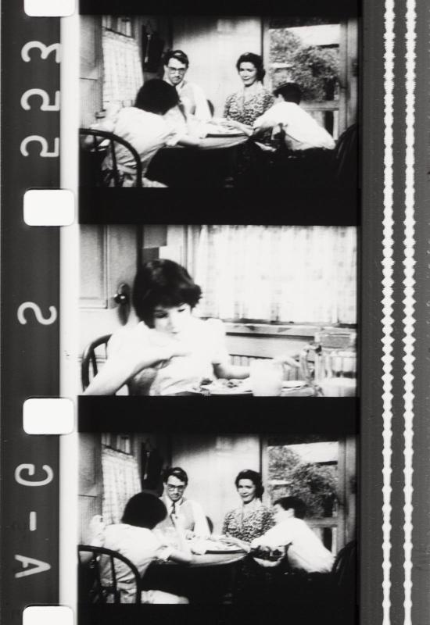
A Different Kind of Montage?
Watch Passage à l'acte (1993, Dir. Martin Arnold)
Think about its relationship to Hollywood cinema (which film is the scene scene it deconstructs from?) as well as Soviet Montage.

Slide 65
Instead of creating an oppositional filmic language to Hollywood continuity editing, Austrian filmmaker Martin Arnold chose to work directly on a Hollywood studio film (To Kill a Mockingbird, 1962, Dir. Robert Mulligan) to deconstruct its narrative and continuity. Yes – he worked directly on the celluloid film strip itself.
How does Arnold’s critique of Hollywood cinema – and do you think it is a critique? – compare to the critique by Soviet filmmakers like Eisenstein and Vertov?

