Slide 1
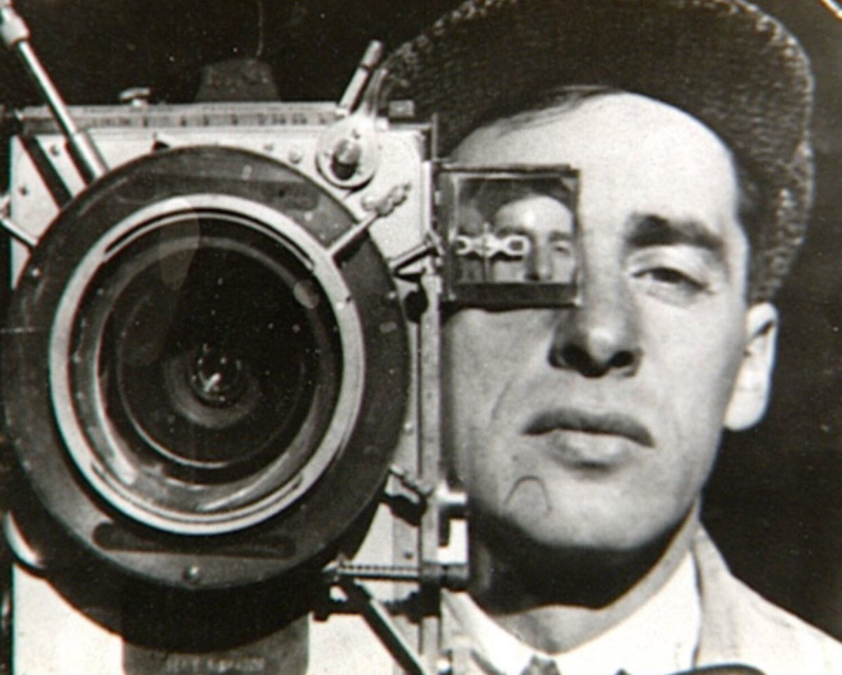
Dziga Vertov
Kino-Glaz (Cinema-Eye) during the 1920s, Vertov and the group of young filmmaker he worked with believed in the absolute ability of the cinema apparatus to reproduce reality as it actually appears, and the necessity of editing to arrange this reality into an expressive and persuasive whole.
Born in Poland in 1896, Vertov became an editor of newsreels in 1918 for the Cinema Committee.

Slide 2
Dziga Vertov
Born in Poland in 1896, Vertov became an editor of newsreels in 1918 for the Cinema Committee.
Kino-Glaz (Cinema-Eye) during the 1920s, Vertov and the group of young filmmaker he worked with believed in the absolute ability of the cinema apparatus to reproduce reality as it actually appears, and the necessity of editing to arrange this reality into an expressive and persuasive whole.

Slide 3
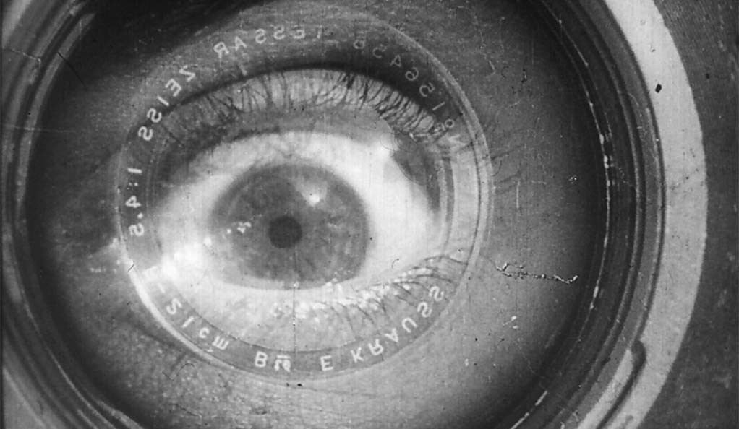
Man with a Movie Camera (1929)
Dir. Dziga Vertov

Slide 4
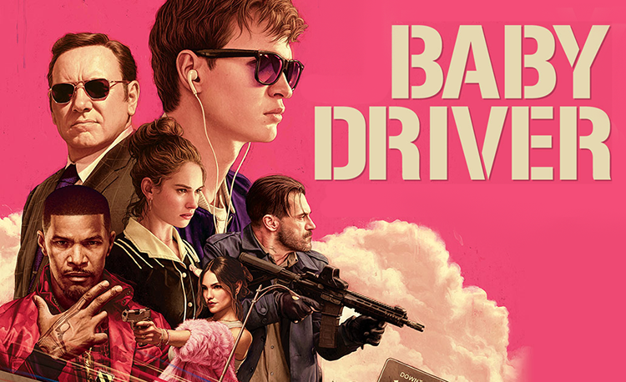
Baby Driver (2017)
Dir. Edgar Wright

Slide 5
Comparative Analysis:
Watch and compare two sequences from Baby Driver and Man with a Movie Camera. Do you see any influence of the Soviet Montage filmic language on contemporary Hollywood cinema?
Given the oppositional stance of Soviet Montage to Hollywood filmic language of continuity editing, and the influence of Marxism on the filmic language of Montage, what are the implications (formal, ideological, etc.) when this filmic language appears in Hollywood films?

Slide 6
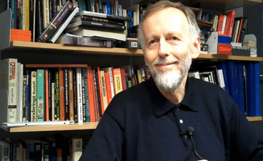
Ian Christie
Ian Christie is a British film scholar. He is Professor of Film and Media
History at Birkbeck, University of London
In addition to writing about film history, Christie is also a curator, broadcaster, and consultant.
He writes about early cinema, Russian cinema, as well as filmmakers including Scorsese and Gilliam.

Slide 7
He has also worked on exhibitions ranging from Film as Film (1979), Eisenstein: His Life and Art (1988), Spellbound: Art and Film (1996) and Modernism: Designing a New World (2006).

Slide 8
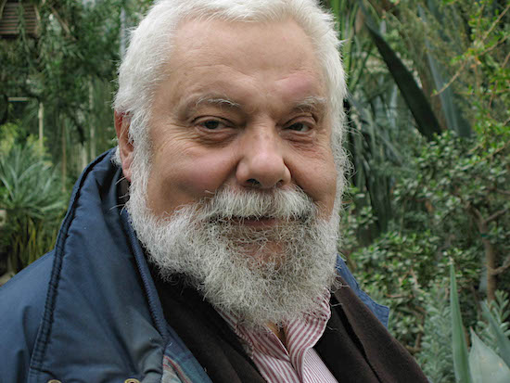
Chuck Kleinhans
Kleinhans was an associate professor of film studies at Northwestern University for 32 years.
In 1974, he co-founded the influential media studies journal Jump Cut with Julia Lesage and John Hess, which he co-edited until his death in 2017.

Slide 9
In 2007, the Society for Cinema and Media Studies (SCMS) awarded him its Outstanding Pedagogical Achievement Award.

Slide 10
Formalism, Marxism, and Film
During and after the Russian Revolution, formalist literary critics including Viktor Shklovsky and Yuri Tynyanov were not only theorizing new forms of Soviet cinema, they were also working as scriptwriters and consultants on films
Eisenstein and Vertov were both filmmakers as well as theorists.

Slide 11
“The Formalists argue that poetic and prosaic language are not confined to the literary genres of poetry and prose could also be applied to cinema…”
“Formalists were able to argue that the use of ‘factual’ documentary material by Dziga Vertov did not in itself make his films factual.” (OGFS, P. 60)

Slide 12
Dangerous slippage between aesthetic and political disagreement during the purges of 1930s
1960s – renewed interest in Russian cinema and its theories (Neo-Formalism) This contributed to the question of innovative forms matching a revolutionary content.
1970s – deeper explanation and more complex patterns (e.g. semiotics, psychoanalysis)
The “politicization of form”

Slide 13
“…increasingly theory turned to examining the meaning of a film as produced by an interaction between a text and a spectator who was understood not as an ahistorical ‘subject’ but as a historical person with social attributes of gender, race, class, age, nationality, and so on—all of which shaped the interpretive context.” (OGFS, P. 111)

Slide 14
“…increasingly theory turned to examining the meaning of a film as produced by an interaction between a text and a spectator who was understood not as an ahistorical ‘subject’ but as a historical person with social attributes of gender, race, class, age, nationality, and so on—all of which shaped the interpretive context.” (OGFS, P. 111)

Slide 15
“Marxist analysis is an essential part of much contemporary gender, race-ethnicity, and post-colonial thinking in film studies.” (OGFS, P. 106)

Slide 16
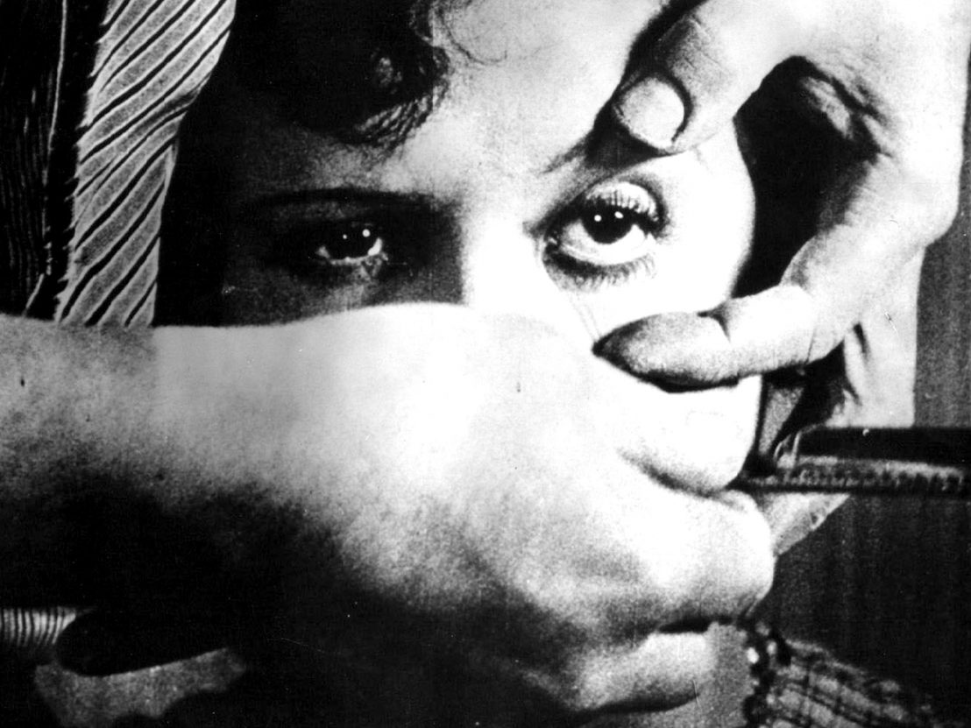
Avant-Garde Cinema Group 1:
Un Chien Andalou (1929)
Dir. Luis Buñuel & Salvador Dali

Slide 17
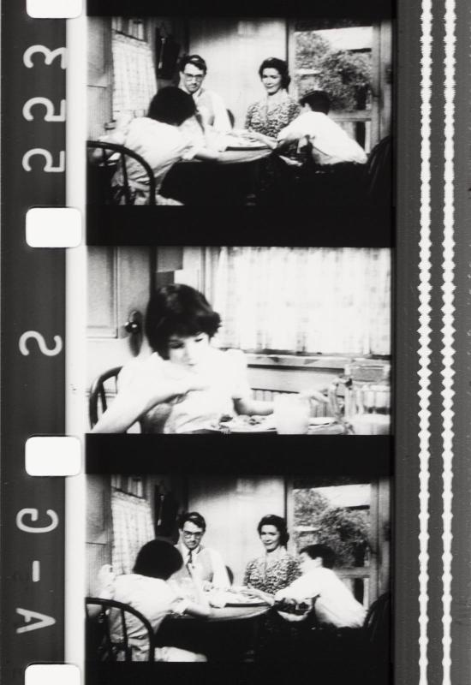
A Different Kind of Montage?
Watch Passage à l'acte (1993, Dir. Martin Arnold)
Think about its relationship to Hollywood cinema (which film is the scene scene it deconstructs from?) as well as Soviet Montage.

Slide 18
Instead of creating an oppositional filmic language to Hollywood continuity editing, Austrian filmmaker Martin Arnold chose to work directly on a Hollywood studio film (To Kill a Mockingbird, 1962, Dir. Robert Mulligan) to deconstruct its narrative and continuity. Yes – he worked directly on the celluloid film strip itself.
How does Arnold’s critique of Hollywood cinema – and do you think it is a critique? – compare to the critique by Soviet filmmakers like Eisenstein and Vertov as well as Surrealists like Buñuel and Dali?

Slide 19
INTRODUCTION TO FILM
Sound Film and the Studio System

Slide 20
Sound can actively shape how we perceive and interpret the image:

Slide 21
Sound can actively shape how we perceive and interpret the image:
Loudness (volume, distance, space, emotion)

Slide 22
Sound can actively shape how we perceive and interpret the image:
Loudness (volume, distance, space, emotion)
Pitch (highness or lowness of the sound, voice)

Slide 23
Sound can actively shape how we perceive and interpret the image:
Loudness (volume, distance, space, emotion)
Pitch (highness or lowness of the sound, voice)
Timbre (color and tone)

Slide 24
Sound can actively shape how we perceive and interpret the image:
Loudness (volume, distance, space, emotion)
Pitch (highness or lowness of the sound, voice)
Timbre (color and tone)
Silence (true silence is very rare in film)

Slide 25
Sound can actively shape how we perceive and interpret the image:
Loudness (volume, distance, space, emotion)
Pitch (highness or lowness of the sound, voice)
Timbre (color and tone)
Silence (true silence is very rare in film)
Rhythm (editing, speech, music)

Slide 26
Sound can actively shape how we perceive and interpret the image:
Loudness (volume, distance, space, emotion)
Pitch (highness or lowness of the sound, voice)
Timbre (color and tone)
Silence (true silence is very rare in film)
Rhythm (editing, speech, music)
Fidelity (realism, expressive quality, “fidelity has nothing to do with what originally made the sound in production.” Film Art, p. 365)

Slide 27
Sound can actively shape how we perceive and interpret the image:
Loudness (volume, distance, space, emotion)
Pitch (highness or lowness of the sound, voice)
Timbre (color and tone)
Silence (true silence is very rare in film)
Rhythm (editing, speech, music)
Fidelity (realism, expressive quality, “fidelity has nothing to do with what originally made the sound in production.” Film Art, p. 365)

Slide 28
Sound space

Slide 29
Sound space
Time and duration

Slide 30
Sound space
Time and duration
(Film Art, p. 395) Good questions to ask when analyzing sound in film.

Slide 31
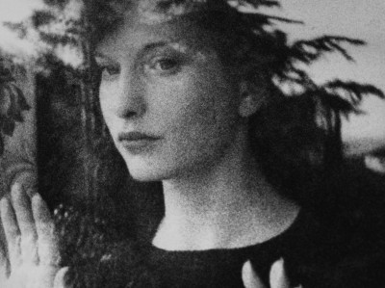
Avant-Garde Cinema Group 2:
Meshes of the Afternoon (1935)
Dir. Maya Deren

Slide 32
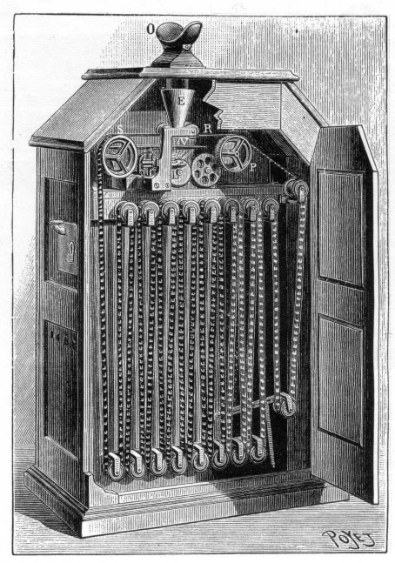
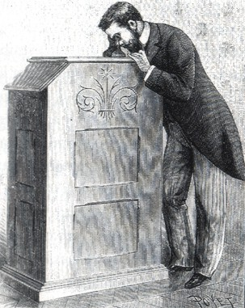
Sound in Early Cinema

Slide 33
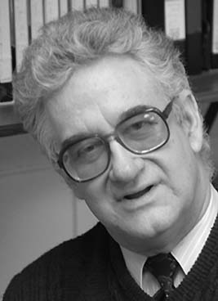
Rick Altman
Professor in Cinema and Comparative literature at University of Iowa
Also written books on the musical film genre, and edited a book on sound theory and practice that we will read from later this semester.

Slide 34
Sound in Early Cinema
What sounds were heard in relationship to early films?

Slide 35
Sound in Early Cinema
What sounds were heard in relationship to early films?
Music (live or recorded, orchestral to popular)

Slide 36
Sound in Early Cinema
What sounds were heard in relationship to early films?
Music (live or recorded, orchestral to popular)
Human voice (lecturers, actors, audience)

Slide 37
Sound in Early Cinema
What sounds were heard in relationship to early films?
Music (live or recorded, orchestral to popular)
Human voice (lecturers, actors, audience)
Sound effects (performative)

Slide 38
Sound in Early Cinema
What sounds were heard in relationship to early films?
Music (live or recorded, orchestral to popular)
Human voice (lecturers, actors, audience)
Sound effects (performative)
Silence

Slide 39
Sound in Early Cinema
What sounds were heard in relationship to early films?
Music (live or recorded, orchestral to popular)
Human voice (lecturers, actors, audience)
Sound effects (performative)
Silence
Machines (vitascope vs. cinematographe)

Slide 40
Sound in Early Cinema
What sounds were heard in relationship to early films?
Music (live or recorded, orchestral to popular)
Human voice (lecturers, actors, audience)
Sound effects (performative)
Silence
Machines (vitascope vs. cinematographe)
Other forms of entertainment

Slide 41
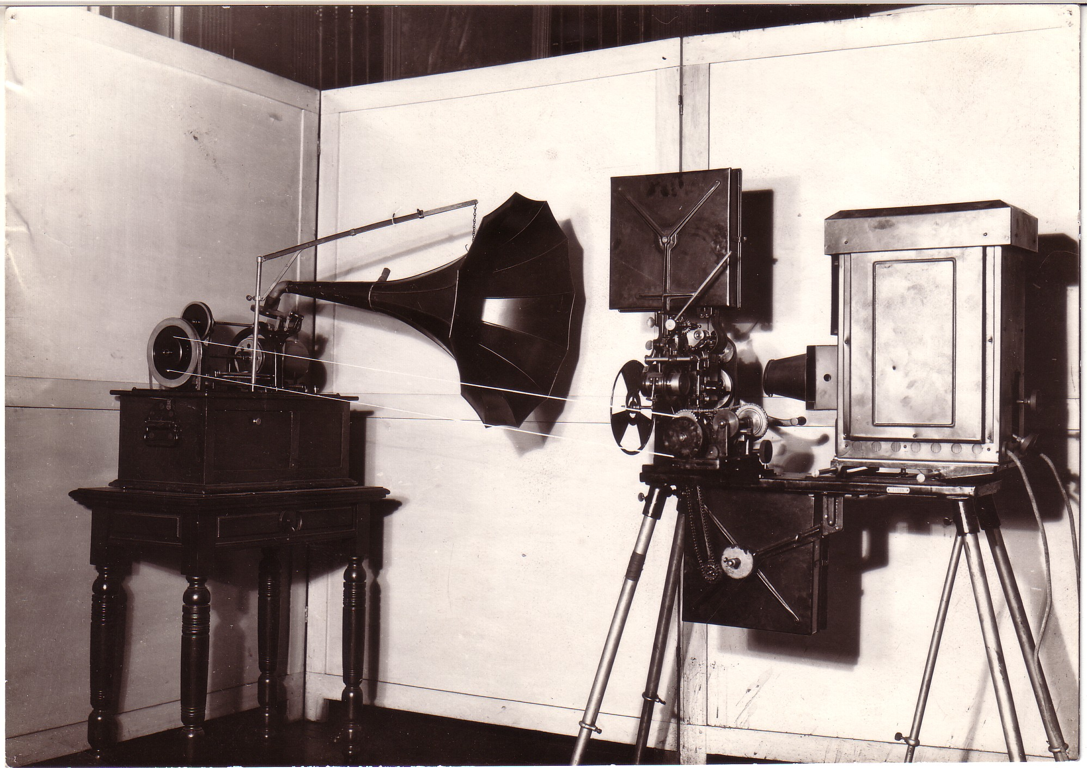
Edison Kinetophone

Slide 42
The Kinetophone – combining Kinetoscope with phonogram

Slide 43
The Kinetophone – combining Kinetoscope with phonogram
Semi-synchronization

Slide 44
The Kinetophone – combining Kinetoscope with phonogram
Semi-synchronization
Cue-sound aesthetic: “instead of people making sounds, dance and band films portray people keeping time to sounds.” (Altman, p. 81)

Slide 45
The Kinetophone – combining Kinetoscope with phonogram
Semi-synchronization
Cue-sound aesthetic: “instead of people making sounds, dance and band films portray people keeping time to sounds.” (Altman, p. 81)

Slide 46
Silent Film Music
Film programs before 1912 - several short films, illustrated songs, and vaudeville acts
Early teens (“golden era” of silent film music) – explosion of theater construction; picture palaces; blockbuster films of 1915-16 season
1914-20: expected number of musicians went from 16 to over 70 concert-level musicians

Slide 47
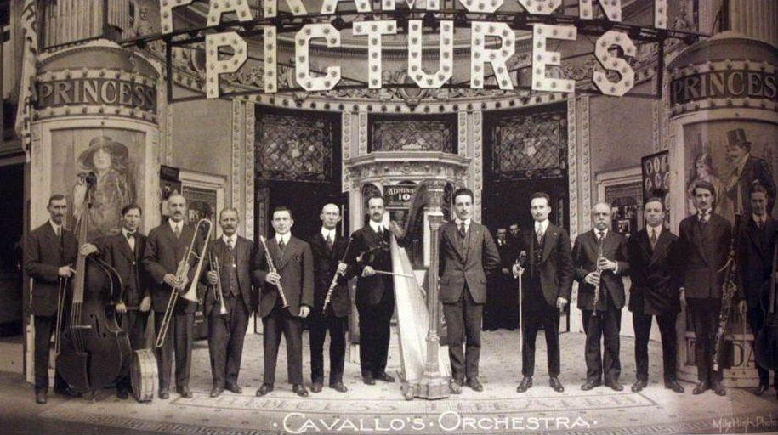
By 1922: 500 theater orchestras of 30+ musicians out of about 15,000 theaters in the U.S. 30-50% of theaters employ an orchestra, most commonly 5-10 musicians

Slide 48
Film Music for The Birth of A Nation
The Clune orchestra featured 40 instrumentalists, several vocalists, and a chorus of 12. The Liberty orchestra featured 50 instrumentalist.
Score by Carli Elinor, with compositions by Mozart, Rossini, Bizet, and Beethoven. New score by Joseph Carl Breil, incorporating Romantic compositions (e.g.Wagner), folk favorites (e.g.“Auld Lang Syne”) marches and patriotic numbers (e.g.“Dixie”) as well as popular tunes (e.g.“Zip Coon”)

Slide 49
Breil’s original composition – love theme for Elsie Stoneman and Ben Cameron – marketed as “The Perfect Song” (sheet music)
“The Birth of A Nation proved that motion pictures could serve as prestige vehicles. In order to fulfill this promise, however, a film had to be accompanied by an orchestra of unprecedented size.” (Altman, p. 294)

Slide 50
Multi-Perspectival Analysis of The Birth of A Nation
Its visual language and narrative structure
Race, gender, stereotypes, ideology
Its musical score as representative of the “golden era of silent film music”

Slide 51
1. Visual Language and Narrative Structure

Slide 52
1. Visual Language and Narrative Structure
What do you see when you watch the film?

Slide 53
1. Visual Language and Narrative Structure
What do you see when you watch the film?
What kind of shots?

Slide 54
1. Visual Language and Narrative Structure
What do you see when you watch the film?
What kind of shots?
How are the different shots connected through editing?

Slide 55
1. Visual Language and Narrative Structure
What do you see when you watch the film?
What kind of shots?
How are the different shots connected through editing?
Do you see anything else?

Slide 56
1. Visual Language and Narrative Structure
What do you see when you watch the film?
What kind of shots?
How are the different shots connected through editing?
Do you see anything else?
How does its filmic language support or determine its narrative structure?

Slide 57
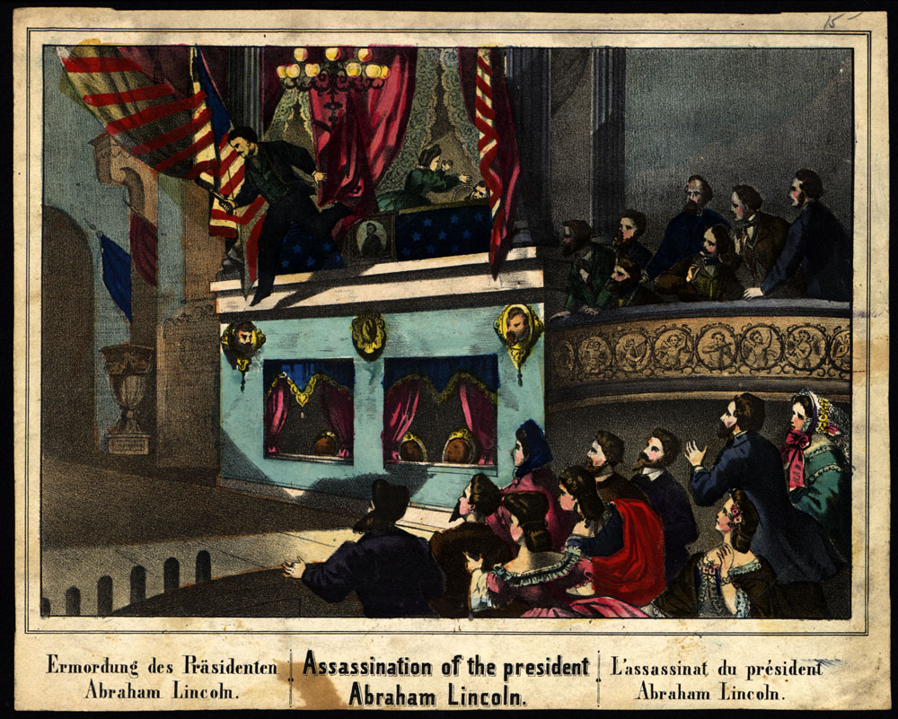
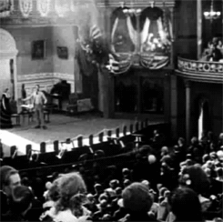
Griffith’s use of historical “facsimile”
Press image
Film image

Slide 58
2. Stereotypes and Ideology

Slide 59
2. Stereotypes and Ideology
What are stereotypes? Do you see any in the film?

Slide 60
2. Stereotypes and Ideology
What are stereotypes? Do you see any in the film?
How do stereotypes contribute to the film’s narrative structure, its ideology?

Slide 61
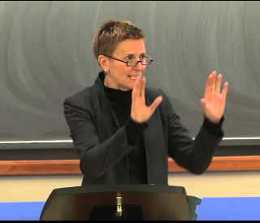
Robyn Wiegman
Wiegman is Professor of Literature and Women's Studies and formerly the Margaret Taylor Smith Director of Women's Studies at Duke, from 2001-2007.
Her research interests include feminist theory, queer theory, American Studies, critical race theory, and film and media studies.

Slide 62
Wiegman’s publications include Object Lessons (2012) and American Anatomies: Theorizing Race and Gender (1995)

Slide 63
2. Stereotypes and Ideology
Racial stereotypes show us the pervasiveness of racism as an institutionalized element in Hollywood film, which have been present since its beginning

Slide 64
2. Stereotypes and Ideology
Racial stereotypes show us the pervasiveness of racism as an institutionalized element in Hollywood film, which have been present since its beginning

Slide 65
“In filmic structure and forms of visual pleasure (narrative, setting, cosmetology, and camera technique) as well as industry labor practices and ‘morality’ codes, we witness the full arsenal of the stereotype’s production.” (OGFS, p. 164)

Slide 66
“In filmic structure and forms of visual pleasure (narrative, setting, cosmetology, and camera technique) as well as industry labor practices and ‘morality’ codes, we witness the full arsenal of the stereotype’s production.” (OGFS, p. 164)

Slide 67
2. Stereotypes and Ideology
According to Wiegman, what are some of the problems with stereotype analysis?

Slide 68
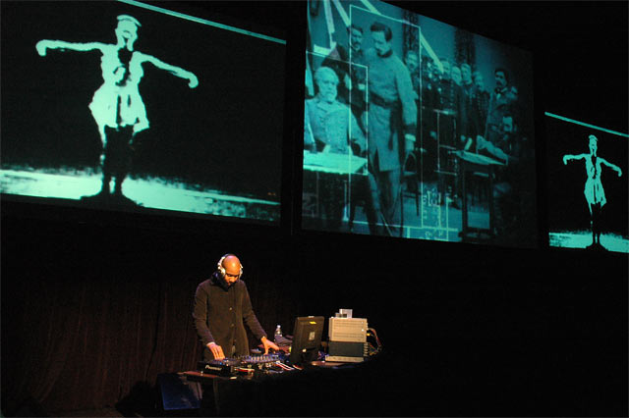
DJ Spooky performing Rebirth of a Nation (2005-8) at Chicago Museum of Contemporary Art November 2004

Slide 69
Further Analysis:
How does DJ Spooky’s re-scoring of the music in The Birth of A Nation alter and/or affirm the meaning of the images, narrative, and other elements in the film?
Do you think the live performances (do a search for images and clips on the web) of Rebirth of A Nation is the same as the single-channel version (which you can watch on Sakai)? What about the album (on Spotify and other platforms)?

Slide 70
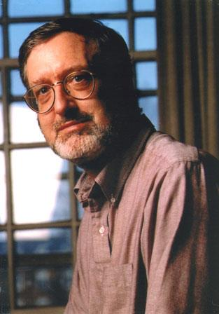
Douglas Gomery
Douglas Gomery is Resident Scholar at the Broadcasting Archives at the University of Maryland and Professor Emeritus at the Philip Merrill College of Journalism at the University of Maryland in College Park.
His publications include The Coming of Sound: A History (1975), The Hollywood Studio System (1986), and A History of Broadcasting in the United States (2008).

Slide 71
Gomery has written for the Village Voice, Modern Maturity, The Wilson Quarterly, The Baltimore Sun and other newspapers.
He is a former senior researcher for the Woodrow Wilson International Center for Scholars Media Studies project.

Slide 72
The Coming of Sound and the Hollywood Studio System
1925-1934: The Jazz Singer (1927), Society of Sound Engineers formed in 1934
A period of experimentation driven by the smaller companies of Warner Brothers and Fox, adapting telephone (AT&T) and radio (RCA) research for use in film.
Warner Bros Pictures Inc. formed Vitaphone in 1926

Slide 73
The Coming of Sound and the Hollywood Studio System
1925-1934: The Jazz Singer (1927), Society of Sound Engineers formed in 1934
A period of experimentation driven by the smaller companies of Warner Brothers and Fox, adapting telephone (AT&T) and radio (RCA) research for use in film.
Warner Bros Pictures Inc. formed Vitaphone in 1926

Slide 74
Gomery identifies 3 distinct phases: invention, innovation, diffusion
Focused on singing and musical films, and newsreels (Fox Movietone News)

Slide 75
Gomery identifies 3 distinct phases: invention, innovation, diffusion
Focused on singing and musical films, and newsreels (Fox Movietone News)

Slide 76
Critical Voices:
“The period of the transition to sound film offers a splendid example of historical overdetermination.” (Williams, p. 126)
“Sound is a two-edged invention, and it is most probable that its use will proceed along the line of least resistance, i.e. along the line of satisfying simple curiosity.” (Soviet Constructivists, p. 83)

Slide 77
Critical Voices:
“The period of the transition to sound film offers a splendid example of historical overdetermination.” (Williams, p. 126)
“Sound is a two-edged invention, and it is most probable that its use will proceed along the line of least resistance, i.e. along the line of satisfying simple curiosity.” (Soviet Constructivists, p. 83)
Did synch-sound technology lead to the dominance of classical Hollywood film style?

Slide 78
Key Terms:
The “Coming of Sound” – a term commonly used to refer to the period in which the U.S. film industry (i.e. Hollywood) adopted the cinematic form and production model of films with synchronous sound, especially dialogue. This period can be roughly defined as late 1920s to mid ‘30s (1925-1934) for the U.S. The rate and period of adoption varies between countries and film industries

Slide 79
Synchronous sound – sound that is matched with the image to create a sense of realism. For example, when the dialogue corresponds to the lip movements of an actor. The standards of image-sound synchronization can vary depending on the conditions of production.
Asynchronous sound - sound that is not matched temporally with the movements occurring in the images. For example, when dialogue does not match the lip movements of the actor.
Diegetic sound – any sound (voice, music, location, sound effect) presented as a part of the diegesis (the world that the film constructs).

Slide 80
Non-diegetic sound – sound originating from a source outside the film’s world, such as music or voice commentary not from a character in the film.
Internal diegetic sound – sound originating from inside the mind of a character, sometimes this includes amplified bodily sounds such as breathing, moans and groans.
External diegetic sound – diegetic sound occurring outside the mind or body of a character.
Sound bridge – sound that comes in earlier or stay later than the image, used to create smooth transitions between visual edits.

Slide 81
Off-screen sound – diegetic sound from a source that is not visible onscreen.
Off-screen space – areas not visible onscreen but still part of the space of the scene. For example, off each side, above, and below the frame, behind the set, behind the camera.

Slide 82
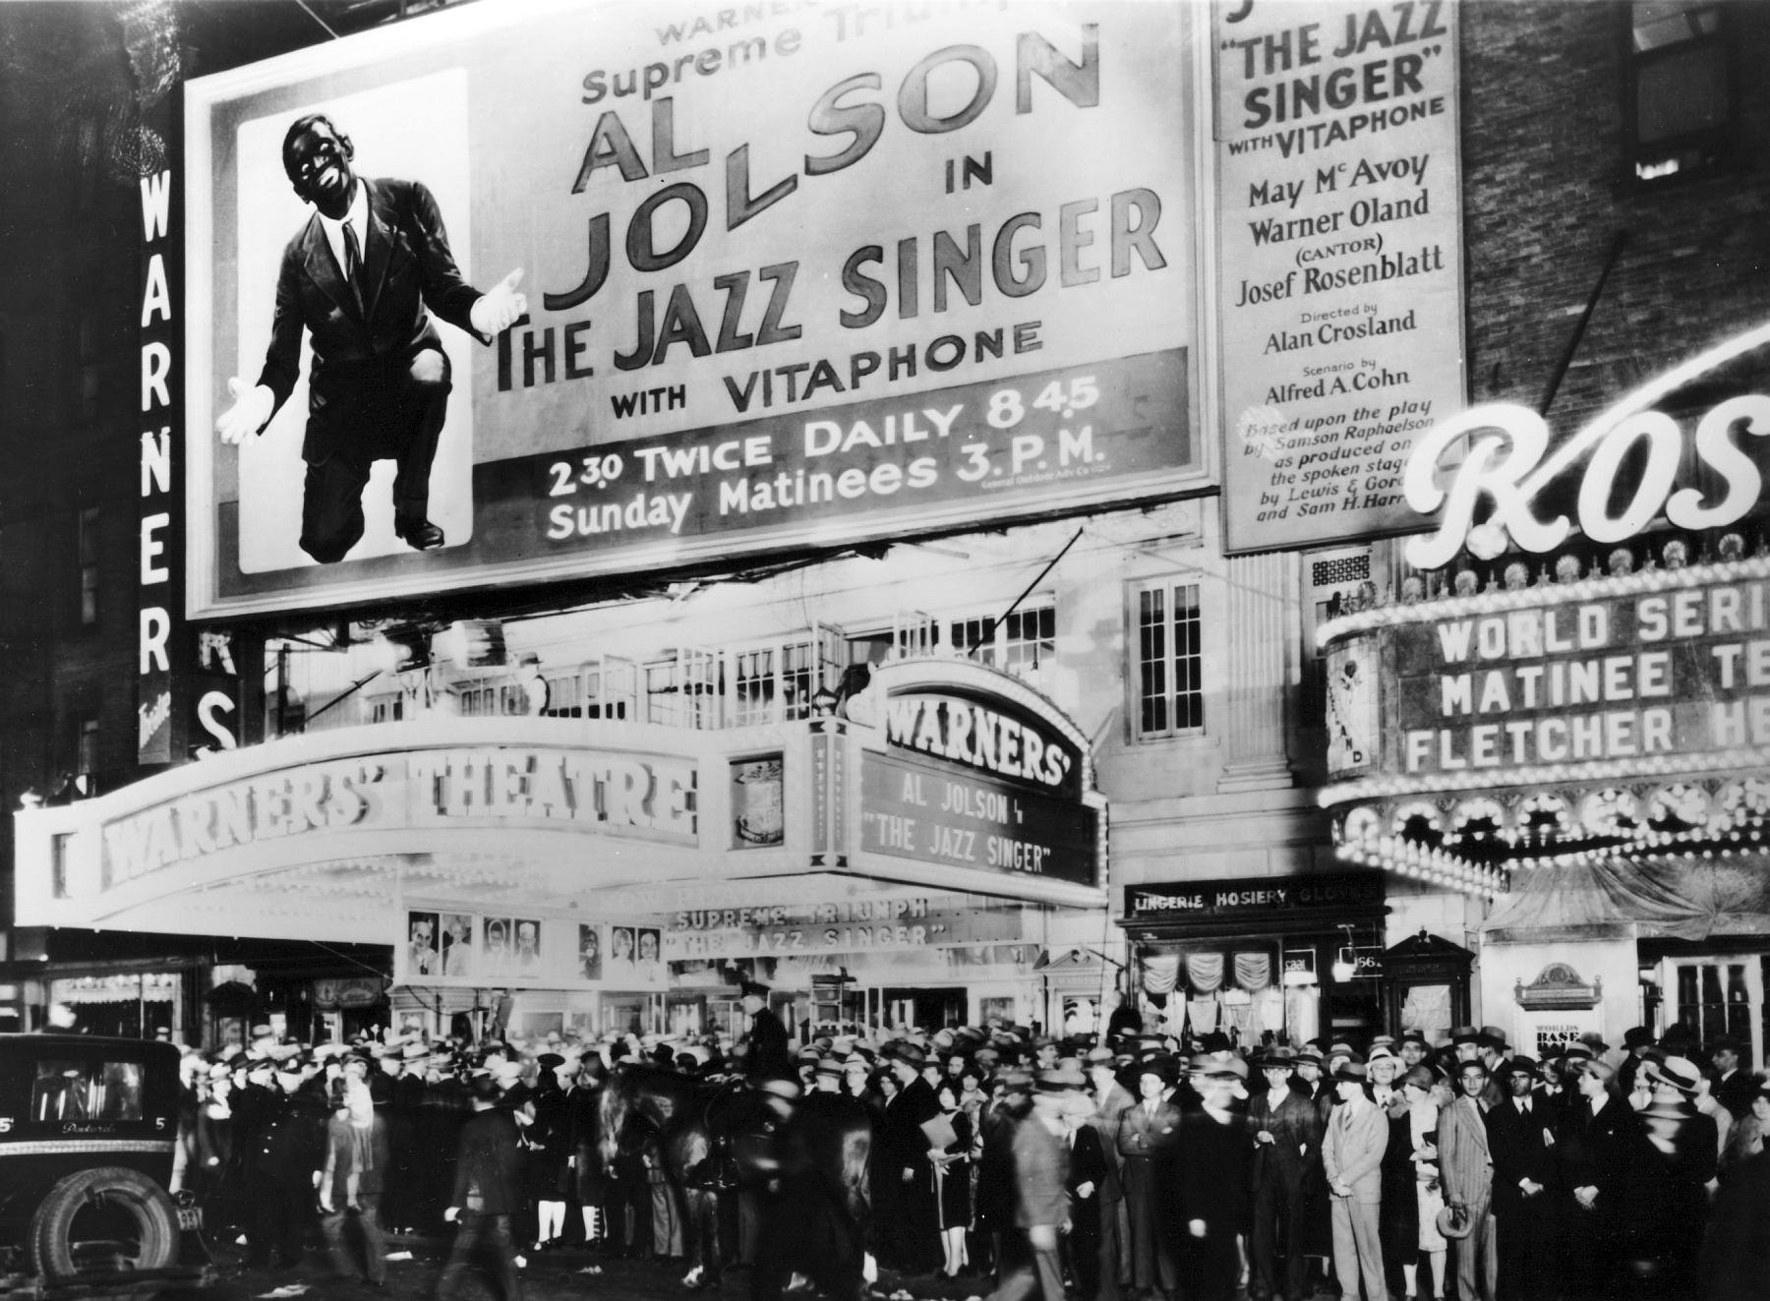
Opening night of The Jazz Singer at the Warner Theater, New York, on October 6, 1927.

Slide 83
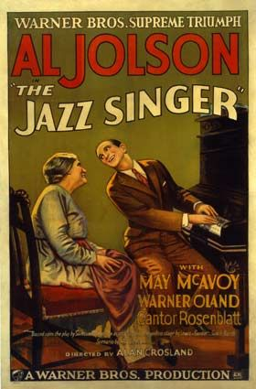
Based on Samson Raphealson’s short story “The Day of Atonement”; published in 1922, then adapted into a stage play with the title “The Jazz Singer”.
Filmic structure and use of synchronized sound

Slide 84
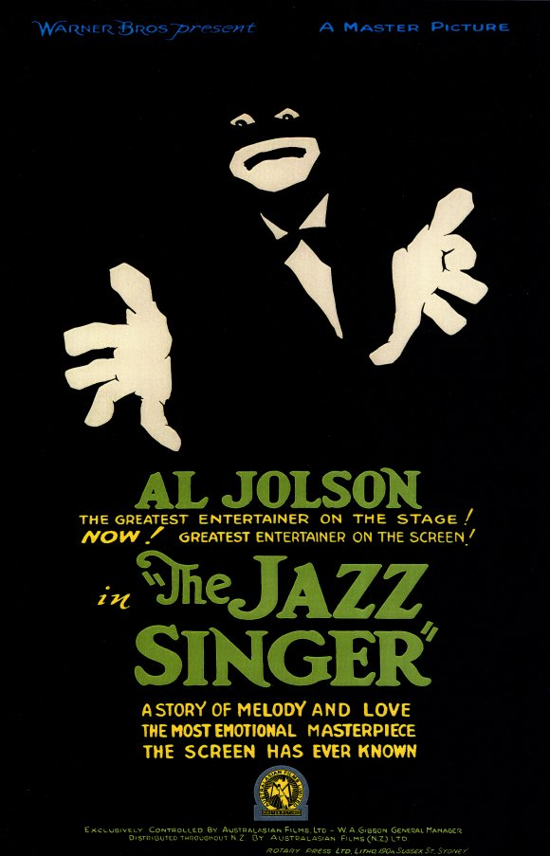
Race and ethnicity – blackface, minstrelsy, Jewish humor, assimilation.
Reflexivity – musical about the making of a musical. Williams argues that the film both looks forward (to the studio musicals of the 1930s) and bids farewell (to the genre of family melodrama, pre-talkies)

Slide 85
Fallacies In Film Sound Theory:
(Altman, Film Sound, pp. 35-45)

Slide 86
Fallacies In Film Sound Theory:
(Altman, Film Sound, pp. 35-45)
Historical

Slide 87
Fallacies In Film Sound Theory:
(Altman, Film Sound, pp. 35-45)
Historical
Ontological

Slide 88
Fallacies In Film Sound Theory:
(Altman, Film Sound, pp. 35-45)
Historical
Ontological
Reproduction

Slide 89
Fallacies In Film Sound Theory:
(Altman, Film Sound, pp. 35-45)
Historical
Ontological
Reproduction
Nominalism

Slide 90
Fallacies In Film Sound Theory:
(Altman, Film Sound, pp. 35-45)
Historical
Ontological
Reproduction
Nominalism
Cinema as index

Slide 91
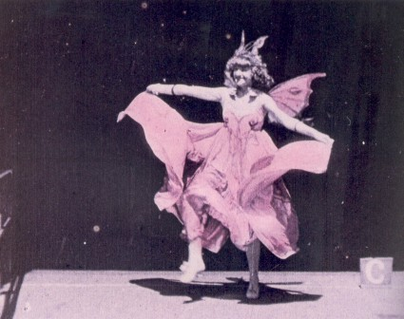
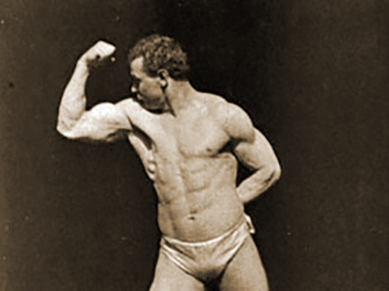
Cue Sound Aesthetics
Take one of the Edison films on the Sakai Film Playlist, and experiment with playing different music as accompaniment – as diverse and as unexpected genres as possible!
Annabelle Butterfly Dance (1894)
Sandow (1894)

Slide 92
Cue Sound Aesthetics
Consider Altman’s theory of “cue-sound aesthetic”. Do you find that these early films: “portray people keeping time to sounds.”
What does your experiment tell you about audio-visual relationships in early U.S. cinema?
Annabelle Butterfly Dance (1894)
Sandow (1894)

