Slide 1
INTRODUCTION TO FILM
Continuity Editing &
The Studio System

Slide 2
Key Terms:
The “Coming of Sound” – a term commonly used to refer to the period in which the U.S. film industry (i.e. Hollywood) adopted the cinematic form and production model of films with synchronous sound, especially dialogue. This period can be roughly defined as late 1920s to mid ‘30s (1925-1934) for the U.S. The rate and period of adoption varies between countries and film industries

Slide 3
Synchronous sound – sound that is matched with the image to create a sense of realism. For example, when the dialogue corresponds to the lip movements of an actor. The standards of image-sound synchronization can vary depending on the conditions of production.
Asynchronous sound - sound that is not matched temporally with the movements occurring in the images. For example, when dialogue does not match the lip movements of the actor.
Diegetic sound – any sound (voice, music, location, sound effect) presented as a part of the diegesis (the world that the film constructs).

Slide 4
Non-diegetic sound – sound originating from a source outside the film’s world, such as music or voice commentary not from a character in the film.
Internal diegetic sound – sound originating from inside the mind of a character, sometimes this includes amplified bodily sounds such as breathing, moans and groans.
External diegetic sound – diegetic sound occurring outside the mind or body of a character.
Sound bridge – sound that comes in earlier or stay later than the image, used to create smooth transitions between visual edits.

Slide 5
Off-screen sound – diegetic sound from a source that is not visible onscreen.
Off-screen space – areas not visible onscreen but still part of the space of the scene. For example, off each side, above, and below the frame, behind the set, behind the camera.

Slide 6
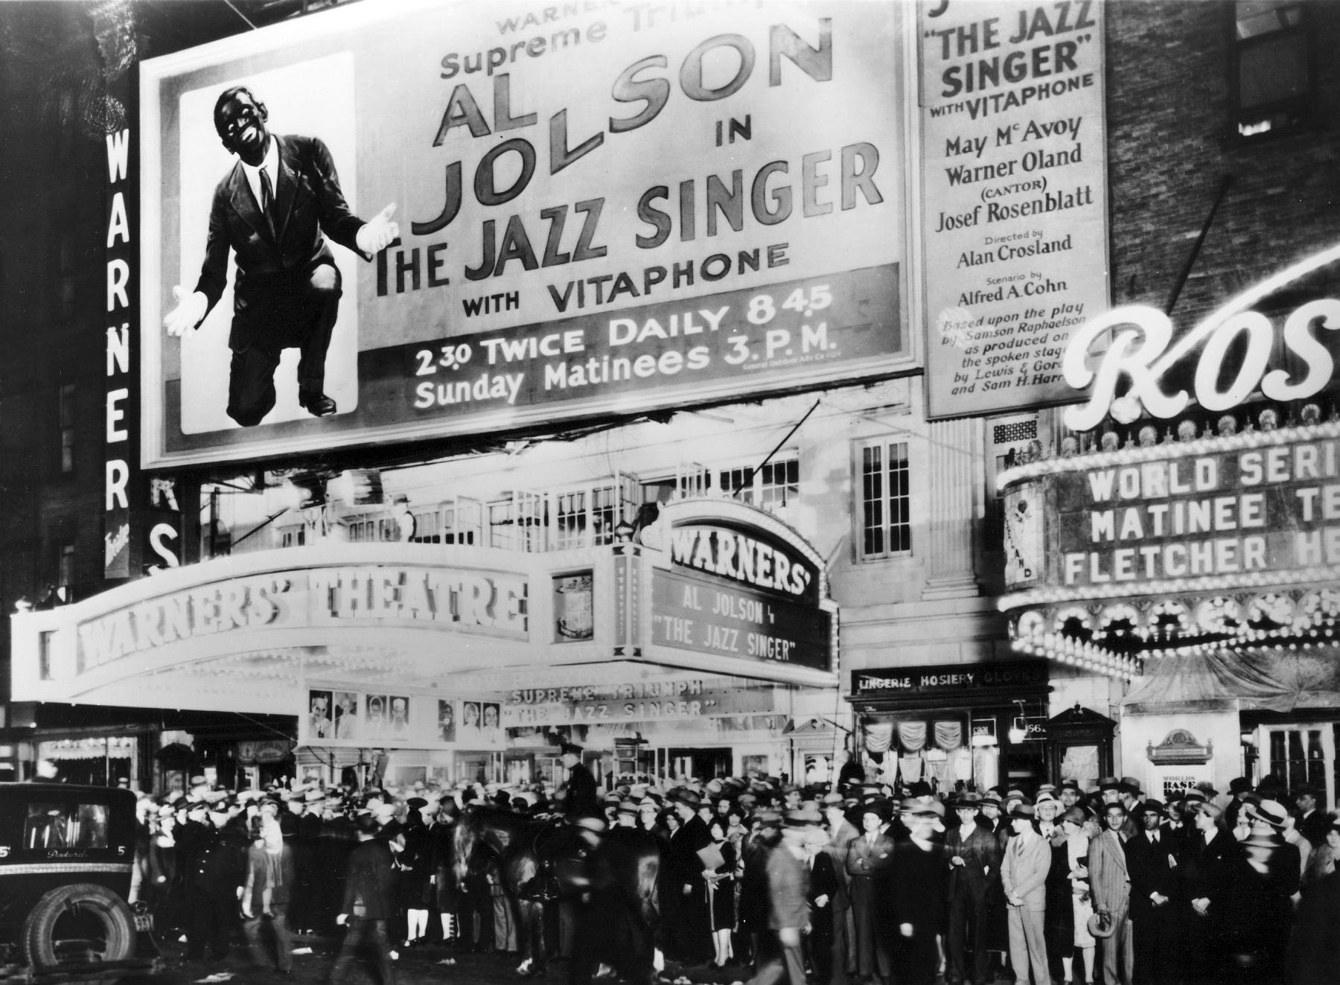
Opening night of The Jazz Singer at the Warner Theater, New York, on October 6, 1927.

Slide 7
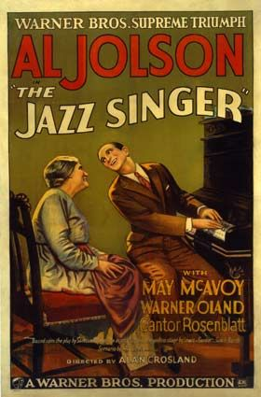
Based on Samson Raphealson’s short story “The Day of Atonement”; published in 1922, then adapted into a stage play with the title “The Jazz Singer”.
Filmic structure and use of synchronized sound

Slide 8
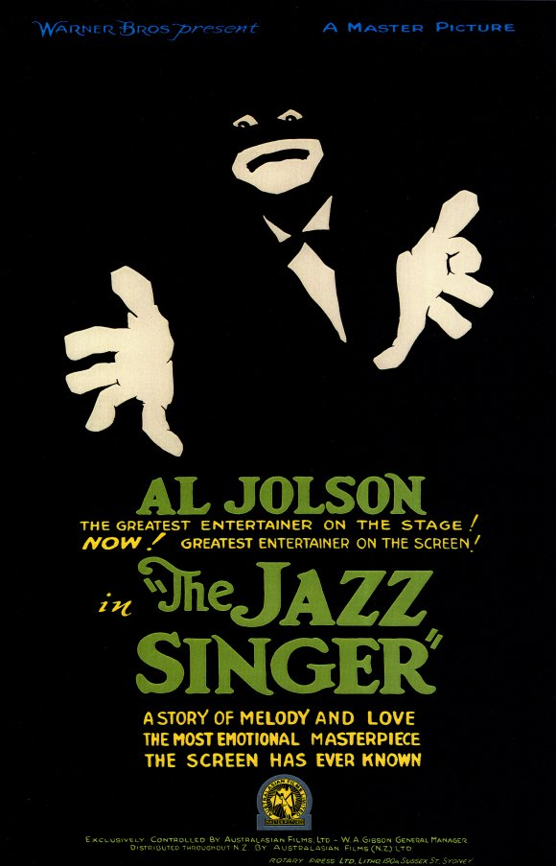
Race and ethnicity – blackface, minstrelsy, Jewish humor, assimilation.
Reflexivity – musical about the making of a musical. Williams argues that the film both looks forward (to the studio musicals of the 1930s) and bids farewell (to the genre of family melodrama, pre-talkies)

Slide 9
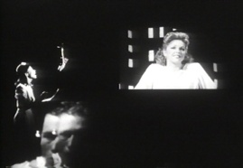
“Musicals” Group 1: Illusions (1982)
Dir. Julie Dash

Slide 10
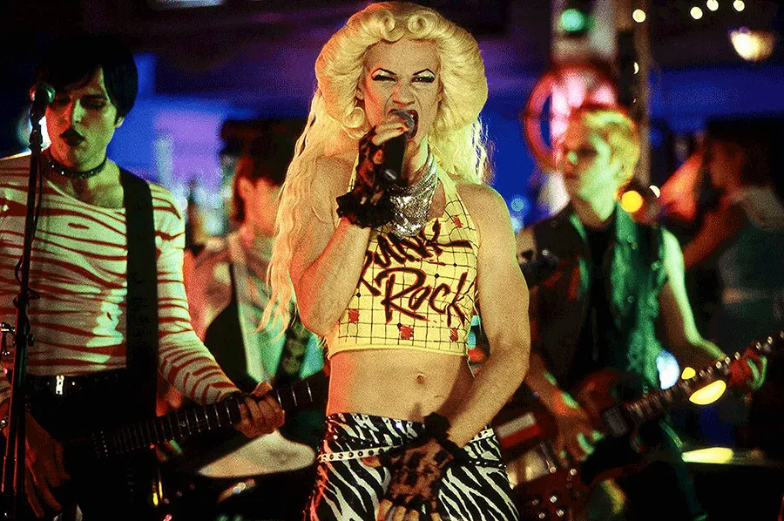
“Musicals” Group 2:
Hedwig & The Angry Inch
(2001) Dir. John Cameron Mitchell

Slide 11
Fallacies In Film Sound Theory:
(Altman, Film Sound, pp. 35-45)

Slide 12
Fallacies In Film Sound Theory:
(Altman, Film Sound, pp. 35-45)
Historical

Slide 13
Fallacies In Film Sound Theory:
(Altman, Film Sound, pp. 35-45)
Historical
Ontological

Slide 14
Fallacies In Film Sound Theory:
(Altman, Film Sound, pp. 35-45)
Historical
Ontological
Reproduction

Slide 15
Fallacies In Film Sound Theory:
(Altman, Film Sound, pp. 35-45)
Historical
Ontological
Reproduction
Nominalism

Slide 16
Fallacies In Film Sound Theory:
(Altman, Film Sound, pp. 35-45)
Historical
Ontological
Reproduction
Nominalism
Cinema as index

Slide 17
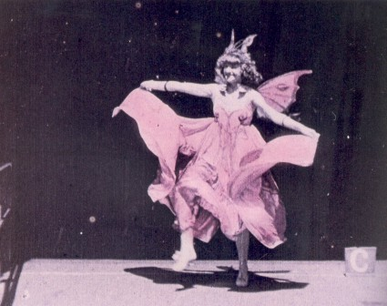
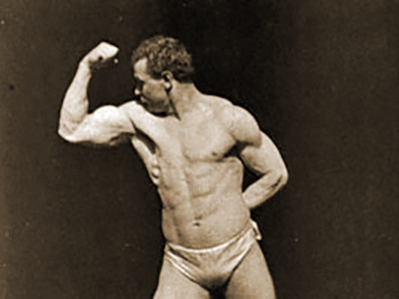
Cue Sound Aesthetics
Take one of the Edison films on the Sakai Film Playlist, and experiment with playing different music as accompaniment – as diverse and as unexpected genres as possible!
Annabelle Butterfly Dance (1894)
Sandow (1894)

Slide 18
Cue Sound Aesthetics
Consider Altman’s theory of “cue-sound aesthetic”. Do you find that these early films: “portray people keeping time to sounds.”
What does your experiment tell you about audio-visual relationships in early U.S. cinema?
Annabelle Butterfly Dance (1894)
Sandow (1894)

Slide 19
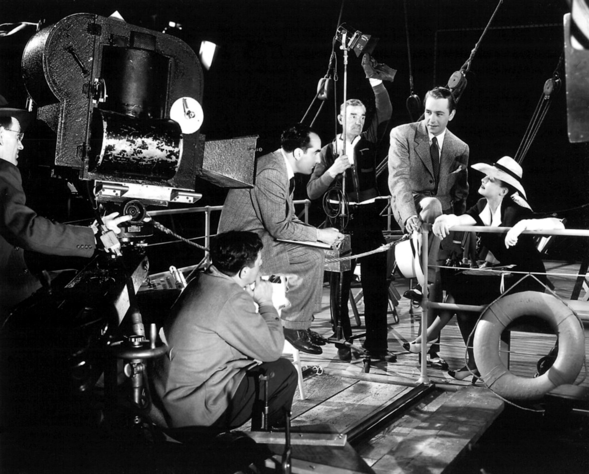
The Studio Era in Hollywood
1930s-40s
The rise of the U.S. film industry from the late 19th
Production of Now, Voyager (1942) Dir. Irving Rapper, Warner Bros.
century to the 1930s, marked by trade associations MPAA and MPA (Motion Picture Association) founded in 1922 and still exist today.

Slide 20
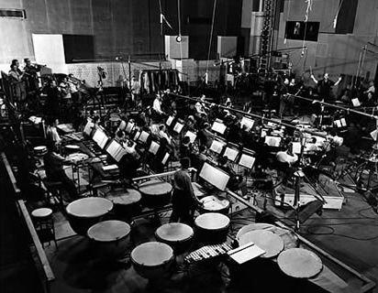
The Big Five: Paramount, Loew’s/MGM, Fox Films, Warner Brothers, RKO
All had their own pre and post-production,
MGM Studio Orchestra, 1951
distribution, and exhibition venues. (Vertical integration)
The Little Three: Universal Pictures, Columbia Pictures, and United Artists

Slide 21
The Big Five: Paramount, Loew’s/MGM, Fox Films, Warner Brothers, RKO
All had their own pre and post-production,
MGM Studio Orchestra, 1951
distribution, and exhibition venues. (Vertical integration)
The Little Three: Universal Pictures, Columbia Pictures, and United Artists

Slide 22
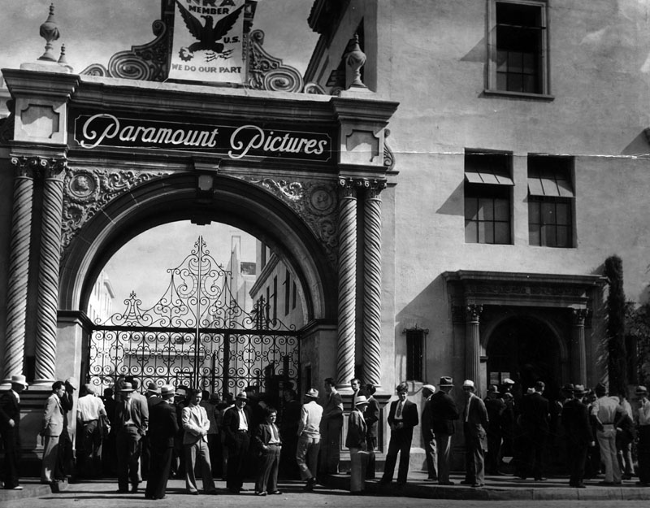
“Poverty Row”: companies including Monogram and Republic Pictures produce “B-movies” in a double feature
Influence of the
Production Code (Hays Code): self-censorship
Genres of the studio era: musicals, gangster, newspaper picture, biopic, screwball comedies, mystery/horror/noir (later in the ‘40s)
Paramount Studio, 1933

Slide 23
“Poverty Row”: companies including Monogram and Republic Pictures produce “B-movies” in a double feature
Influence of the
Production Code (Hays Code): self-censorship
Genres of the studio era: musicals, gangster, newspaper picture, biopic, screwball comedies, mystery/horror/noir (later in the ‘40s)
Paramount Studio, 1933

Slide 24
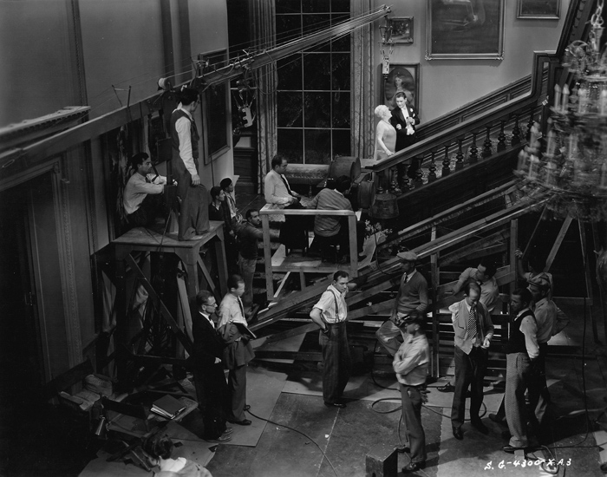
Decline of the studio era: Paramount antitrust decrees (1948), rise of independent productions in the 1950s, emergence of TV, suburbanization
The 1970s: New Hollywood
Production of Raffles (1930) Dir. George Fitzmaurice
Samuel Goldwyn Company
Today - multi-national media conglomerates (News Corps, Time Warner, Walt Disney Co., Comcast)

Slide 25
Decline of the studio era: Paramount antitrust decrees (1948), rise of independent productions in the 1950s, emergence of TV, suburbanization
The 1970s: New Hollywood
Production of Raffles (1930) Dir. George Fitzmaurice
Samuel Goldwyn Company
Today - multi-national media conglomerates (News Corps, Time Warner, Walt Disney Co., Comcast)

Slide 26
Analyses of Classical Hollywood Cinema:

Slide 27
Analyses of Classical Hollywood Cinema:
Acting and performance

Slide 28
Analyses of Classical Hollywood Cinema:
Acting and performance
Film music

Slide 29
Analyses of Classical Hollywood Cinema:
Acting and performance
Film music
Textual analysis (“reading a film”) linguistics, semiotics, Marxism, psychoanalysis

Slide 30
Analyses of Classical Hollywood Cinema:
Acting and performance
Film music
Textual analysis (“reading a film”) linguistics, semiotics, Marxism, psychoanalysis
Reception studies

Slide 31
Analyses of Classical Hollywood Cinema:
Acting and performance
Film music
Textual analysis (“reading a film”) linguistics, semiotics, Marxism, psychoanalysis
Reception studies
Feminist film theory (psychoanalysis, spectatorship)

Slide 32
Analyses of Classical Hollywood Cinema:
Acting and performance
Film music
Textual analysis (“reading a film”) linguistics, semiotics, Marxism, psychoanalysis
Reception studies
Feminist film theory (psychoanalysis, spectatorship)
Queering

Slide 33
Key Terms:
Continuity editing – smooth seamless editing used to create narrative continuity. Shots are linked so that the cuts appear invisible to viewers. The style of Classical Hollywood cinema, and dominant language for narrative film.
180-degree rule – a system of filming action that ensured continuity in the spatial relations between objects on screen. The camera must stay on one side of an imaginary 180-degree line, or axis of action, that runs through the center of the set, from one side of the frame to the other. i.e. the camera does not cross the imaginary line, usually located behind the actors in the scene.

Slide 35
Establishing shot – a shot that establishes the whole space of a scene, commonly shown at the beginning of a scene. The establishing shot presents a more-or-less complete view of the scene, and is usually a long shot.
Shot / reverse shot – the alternating shots of two characters in conversation, in conformity to the 180-degree rule. In continuity editing, characters in one shot usually look left, in the other shot, right.
Over-the-shoulder two shot – a shot containing two people viewed over the shoulder of one of them. A major component of Classical Hollywood style.

Slide 36
Match on action – a continuity cut that splices two shots of the same action together at the same moment of the movement, making the action appear to be continuous.
Eyeline match – the alternation of a shot showing a character looking off screen with a shot of what they are looking at.
Sequence - a unit of film structure made up of one or more scenes or shots that combine to form a larger unit. Shot / Scene / Sequence

Slide 37
Some questions to consider in classical film analysis:

Slide 38
Some questions to consider in classical film analysis:
1. What is the smoothness, unobtrusiveness, invisibility/inaudibility of continuity style hiding in Classical Hollywood films?

Slide 39
Some questions to consider in classical film analysis:
2. How are particular films put together? And what effects and functions particular films have?

Slide 40
Some questions to consider in classical film analysis:
3. What will count as an “appropriate” reading of a given film and to what extent will the contingencies of the extra-textual determine the form of interpretative processing to which a particular film is subject?

Slide 41
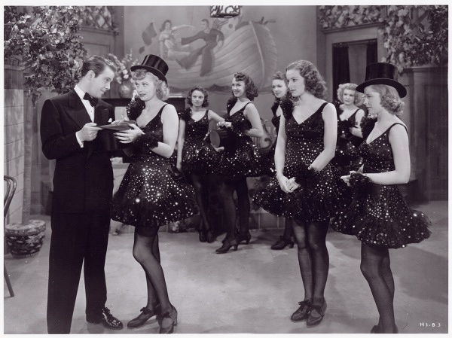
Dance, Girl, Dance
(1940) Dir. Dorothy Arzner

Slide 42
Analysis:

Slide 43
Analysis:
Formal Language: what kinds of shots, editing, structure

Slide 44
Analysis:
Formal Language: what kinds of shots, editing, structure
Meaning: how does the filmic language construct the narrative? Who are the (main) characters and what happens to them in this scene? (Referential and explicit meanings)

Slide 45
Analysis:
Formal Language: what kinds of shots, editing, structure
Meaning: how does the filmic language construct the narrative? Who are the (main) characters and what happens to them in this scene? (Referential and explicit meanings)
Identify other meanings: implicit, symptomatic

Slide 46
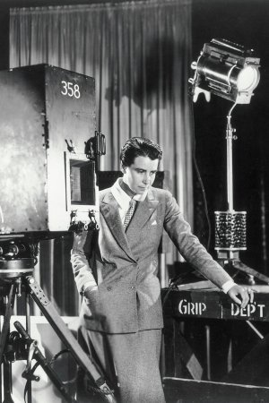
Dorothy Arzner
1897-1979
From 1927 till her retirement in 1943, Arzner was the only female director working in the Hollywood studio system.
Starting as a film editor, she made 20 films during her career.

Slide 47
Analysis:
How does this film exemplify Classical Hollywood style? What does it tell us about this style?

Slide 48
Other Conventions and Characteristics of Hollywood Studio Films:
90-degree rule: scenes are typically photographed off the 90-degree angle to create the illusion of depth. Straight-on 90 degree shots are unusual.
Suturing effect – a process in which the viewer’s gaze is stitched into the narrative. “We become part of the telling of the story as well as the one to whom the story is told.” (Kolker, Film, Form, and Culture, p. 88)

Slide 49
Conventions as “established common traits.” (Film Art, p.52) They are ideological.
Continuity editing - economically driven, industry standard for Classical Hollywood style for both production and reception
Gender and coding: conventions are learnt, consciously or subconsciously, and can be played with, challenged, shifted.

Slide 50
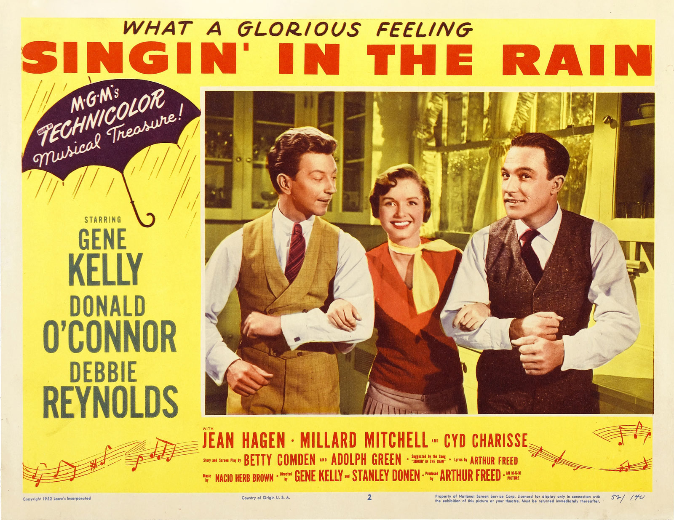
Singin’ in the Rain (1952)
Dir. Stanley Donen, Gene Kelly

Slide 51
Continuity editing is the dominant style, but not the only style:

Slide 52
Continuity editing is the dominant style, but not the only style:
Ellipsis and montage (editing) used to condense and expand time

Slide 53
Continuity editing is the dominant style, but not the only style:
Ellipsis and montage (editing) used to condense and expand time
Jump cuts: disruption (e.g. Jean-Luc Goddard, Andy Warhol)

Slide 54
Continuity editing is the dominant style, but not the only style:
Ellipsis and montage (editing) used to condense and expand time
Jump cuts: disruption (e.g. Jean-Luc Goddard, Andy Warhol)
360-degree space (used be Jacques Tati, Yasujiru Ozu, and others outside of Hollywood)

Slide 55
Continuity editing is the dominant style, but not the only style:
Ellipsis and montage (editing) used to condense and expand time
Jump cuts: disruption (e.g. Jean-Luc Goddard, Andy Warhol)
360-degree space (used be Jacques Tati, Yasujiru Ozu, and others outside of Hollywood)
Non-diegetic inserts – symbolic or metaphorical images outside of the diegesis.

Slide 56
Continuity editing is the dominant style, but not the only style:
Ellipsis and montage (editing) used to condense and expand time
Jump cuts: disruption (e.g. Jean-Luc Goddard, Andy Warhol)
360-degree space (used be Jacques Tati, Yasujiru Ozu, and others outside of Hollywood)
Non-diegetic inserts – symbolic or metaphorical images outside of the diegesis.
Resistance to synchronized sound (e.g. Rene Clair and Soviet filmmakers)

Slide 57
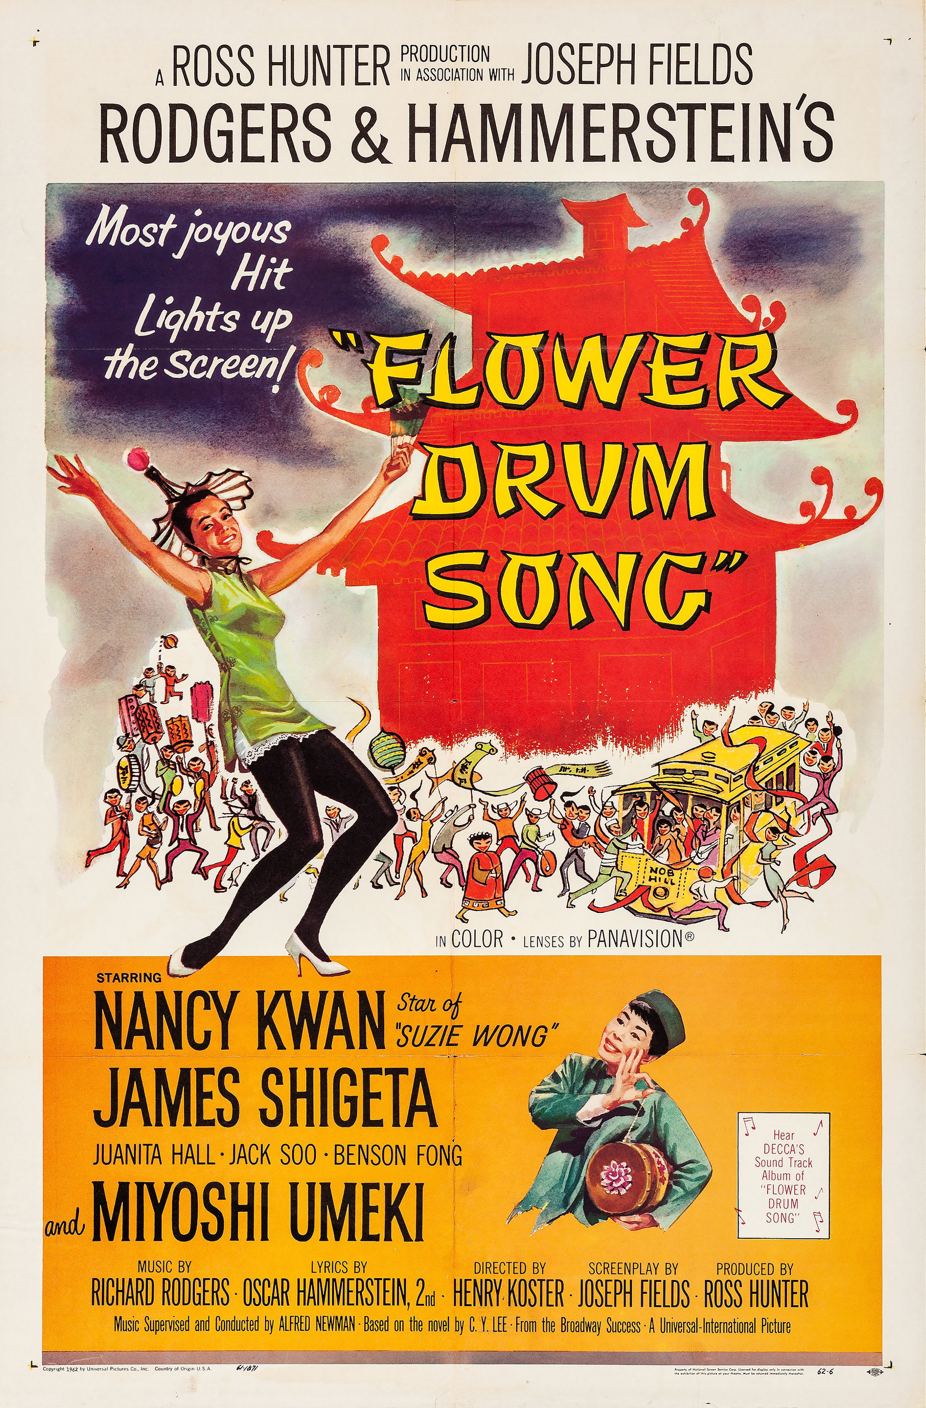
Comparative Analysis:
Watch two musical numbers, one from Singin’ in the Rain (“Beautiful Girl” number 35:30-38:45) and the other from Flower Drum Song (“Sunday” number 1:43:50-1:51:15)

Slide 58
Comparative Analysis:
Compare the formal (filmic language) in these two scenes: how are they filmed, edited, etc. How does sound work with image?

Slide 59
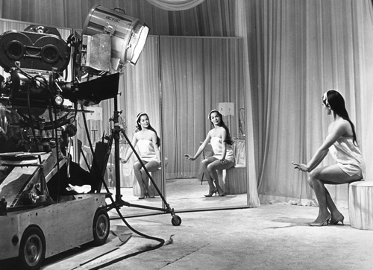
Connect your observation of the filmic language to the different levels of meaning in these scenes
How does conventions and ideology work in these scenes (there maybe more than one at work here…)? How do these films fit into or challenge what you know about Classic Hollywood cinema?

