Slide 1
INTRODUCTION TO FILM
Expressionist Mise-en-Scène

Slide 2
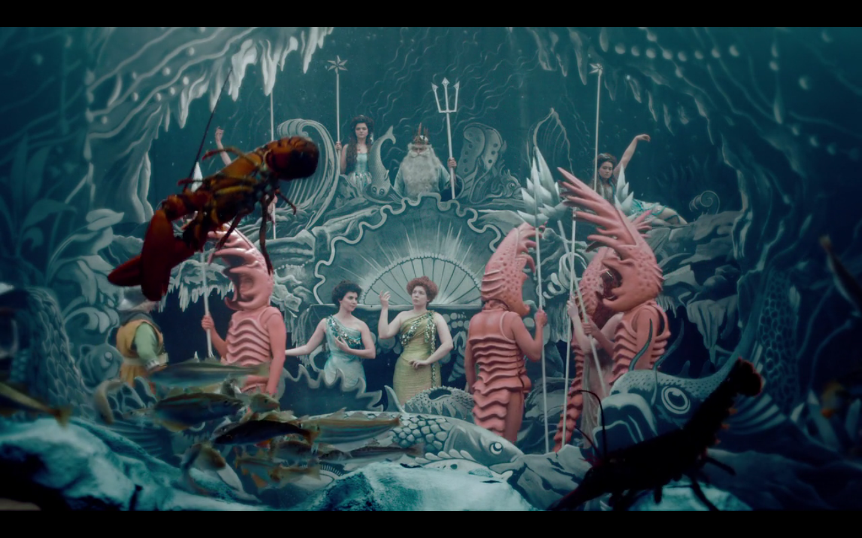
Mise-en-Scène
Representation of the shooting of Le Royaume des fées (Fairyland) by Georges Méliès, 1903 in Hugo (2011) Dir. Martin Scorsese

Slide 3
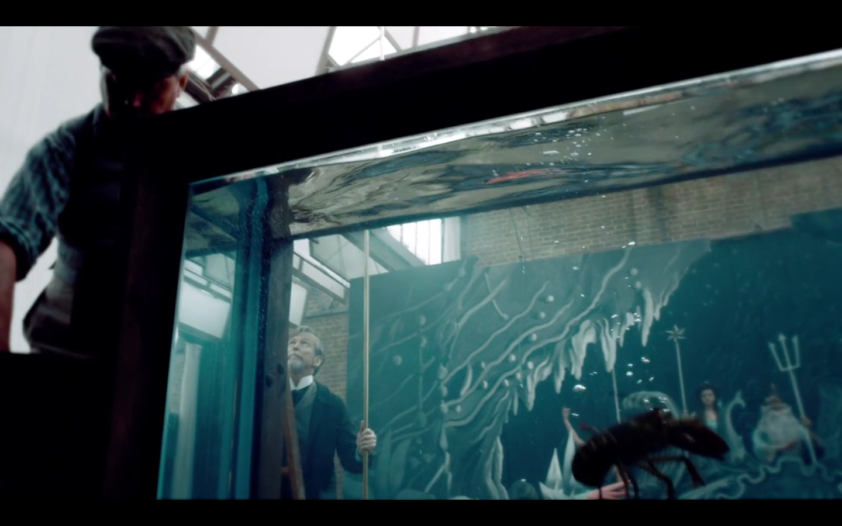
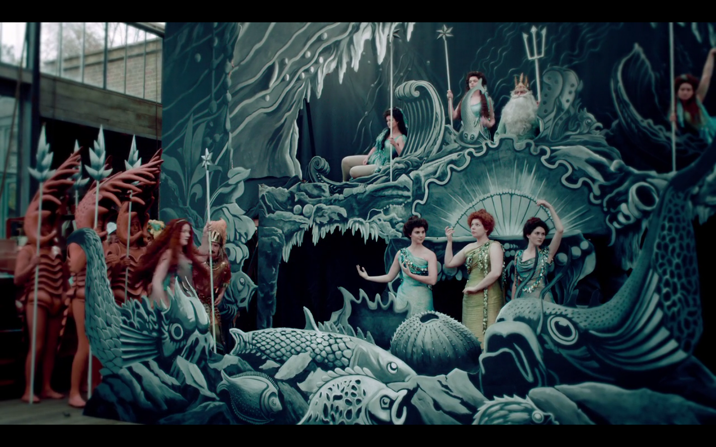
Mise-en-Scène literally means “putting in the scene” in French.

Slide 4
Mise-en-Scène literally means “putting in the scene” in French.

Slide 5
Mise-en-Scène is “everything that happens in the frame”
(Kolker, Film, Form & Culture, p. 64)

Slide 6
Mise-en-Scène is “everything that happens in the frame”
(Kolker, Film, Form & Culture, p. 64)

Slide 7
Mise-en-Scène is often judge on the values of realism - how realistic is the scene? - but realism is a notion that changes across cultures and over time.

Slide 8
Mise-en-Scène is often judge on the values of realism - how realistic is the scene? - but realism is a notion that changes across cultures and over time.

Slide 9
Examples of films and genres featuring the expressive use of mise-en-scène: musicals, Universal horror films, film noir, films by Alfred Hitchcock, Josef von Sternberg, and others.

Slide 10
Aspects of Mise-en-Scène:
Setting
Costume and make-up
Lighting
Staging
Space
Time

Slide 11
Aspects of Mise-en-Scène:
Setting: location, built set, props
Costume and make-up
Lighting: quality, direction, source, color
Staging: movement, acting
Space: movement, color differences, balance of distinct components, variations in size
Shallow-space
Deep-space
Time

Slide 12
Key Terms:
Mise-en-Scène – literally “put in the scene”, the way space is organized and composed in a film, including the way the figure and background are composed, lighting, movement, costume, set, even the choice of film stock – everything that happens within a frame, including the frame itself, as opposed to effects generated by cutting. Some critics consider camera movement and framing aspects of mise-en-scène, which is disputed by other critics in favor of a narrower definition.

Slide 13
Expressionism – a term originally referring to a style in painting, theater and film developed in post WWI Germany, where the mise-en-scène evokes of the exaggerated, neurotic, psychological state of a character or characters.
Tone – the degree of lightness of a hue.
Saturation – the degree of purity of a hue.
Warm colors – colors to the left of the visible spectrum: red, orange, yellow.
Cool colors - colors to the right of the visible spectrum: blues, indigo, violet.

Slide 14
Chiaroscuro – the arrangement of light and shadow in a composition (of a shot). A term borrowed from painting.
Three point lighting – an arrangement of key, fill, and backlighting which serves to model the figure while maintaining an even illumination in the shot.
Key lighting – the main source of lighting in a scene
Fill light – lighting used to soften the keylighting in a scene

Slide 15
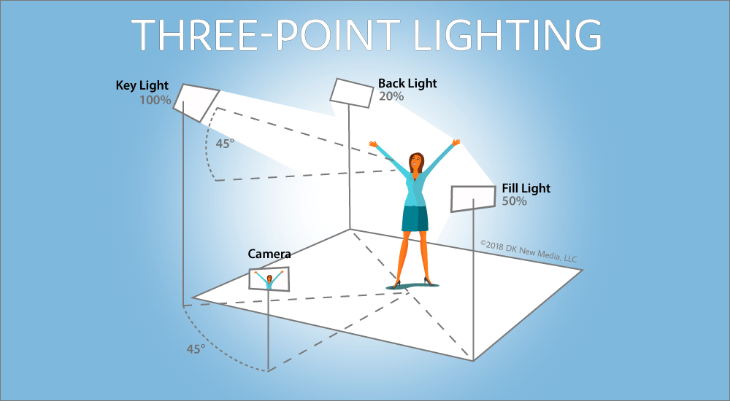
Back lighting – lighting cast from behind a figure or figures to highlight their outline in the image. Also called rim lighting or edge lighting.

Slide 17
High contrast lighting (low-key lighting) – lighting that creates a sharp difference between the lighted and shadowed areas of a scene.
Low contrast lighting (high-key lighting) – lighting that diffuses the boundaries between light and shadow.
Film noir – “dark film” in French, a term applied by French critics to a type of American film, developed in the 1940s, usually in the detective or thriller genres, with low-key/high contrast lighting and a somber mood.

Slide 18
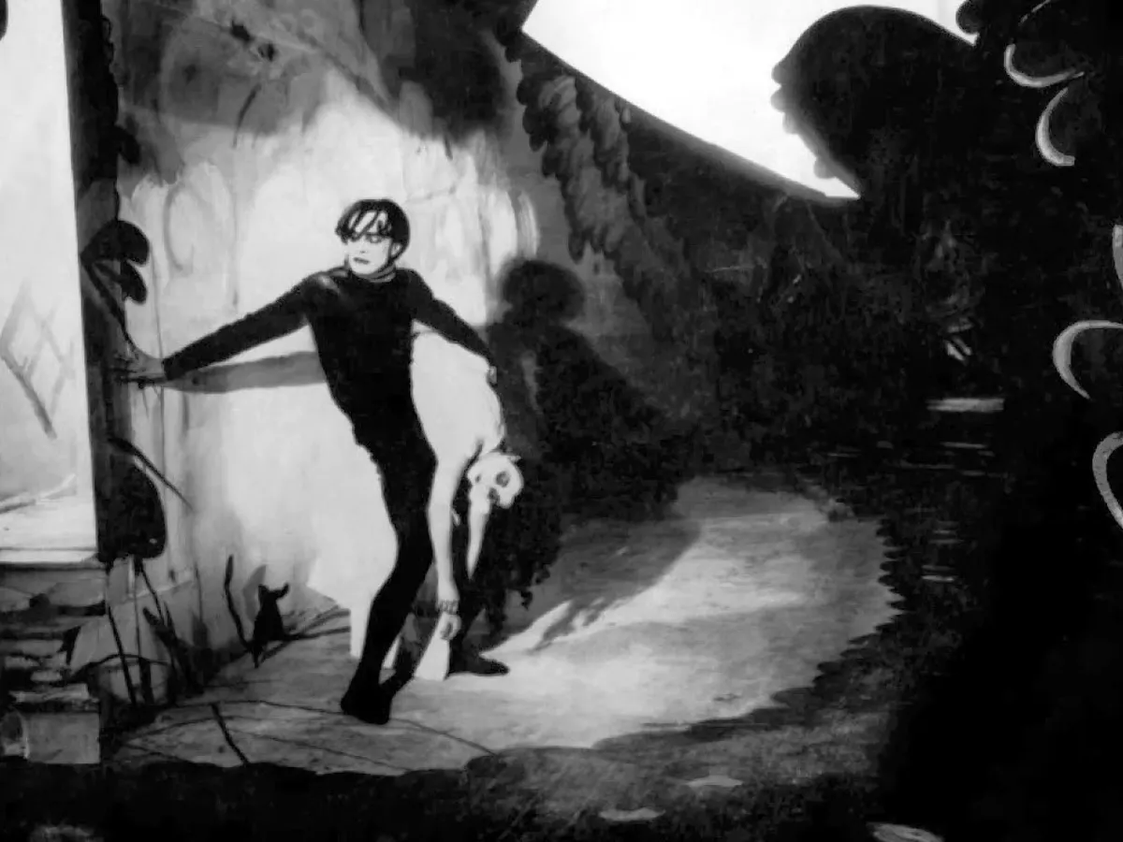
The Cabinet of Dr. Caligari
(1920) Dir. Robert Wiene

Slide 19
German Expressionism
A modernist movement that began in poetry and painting, originating in German at the beginning of the 20th century.
Expressionist artists were more interested in expressing emotional experience rather than physical reality.
From poetry and painting, the style developed into architecture, literature, theater, dance, music, and film.

Slide 20
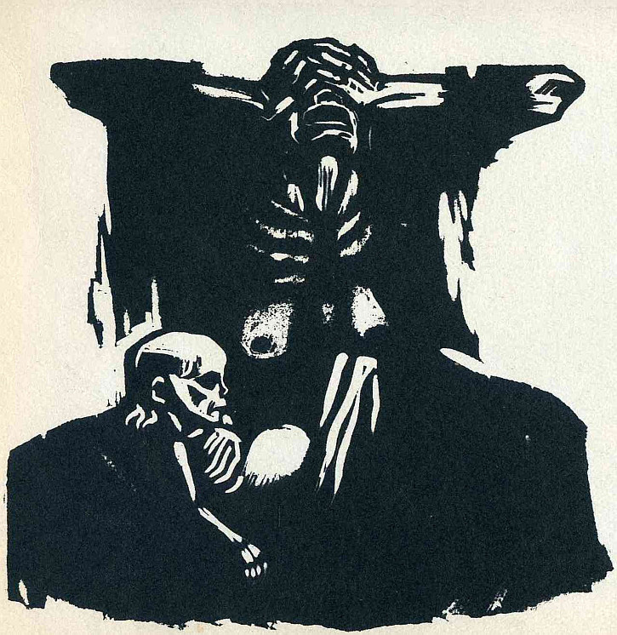
German Expressionist Art
Hunger, 1924, Käthe Kollwitz

Slide 21
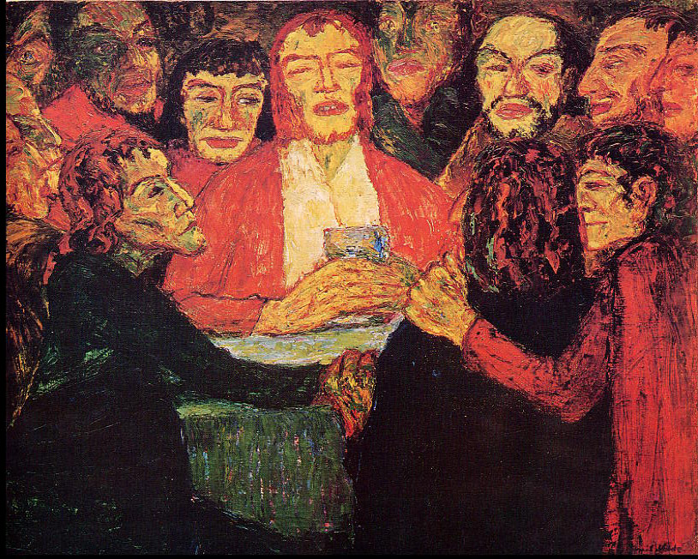
German Expressionist Art
The Last Supper, 1909, Emil Nolde

Slide 22
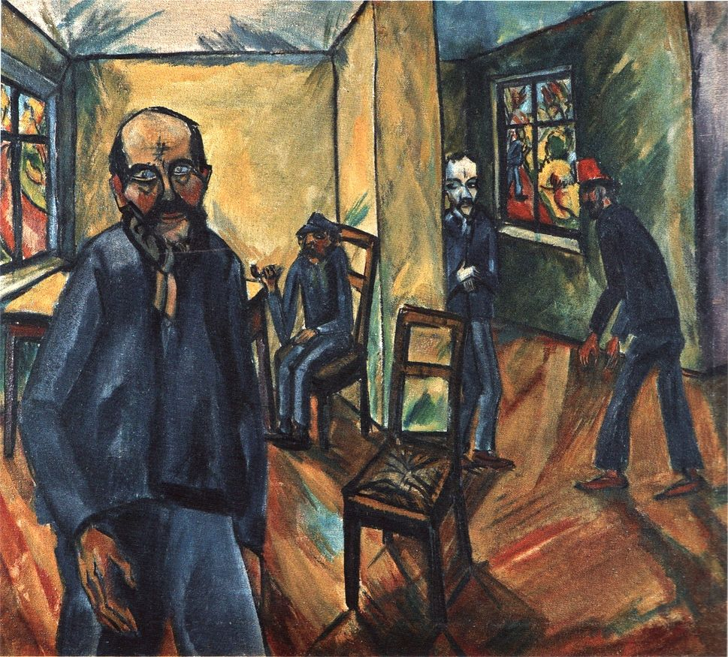
German Expressionist Art
The Madhouse, 1914, Erich Heckel

Slide 23
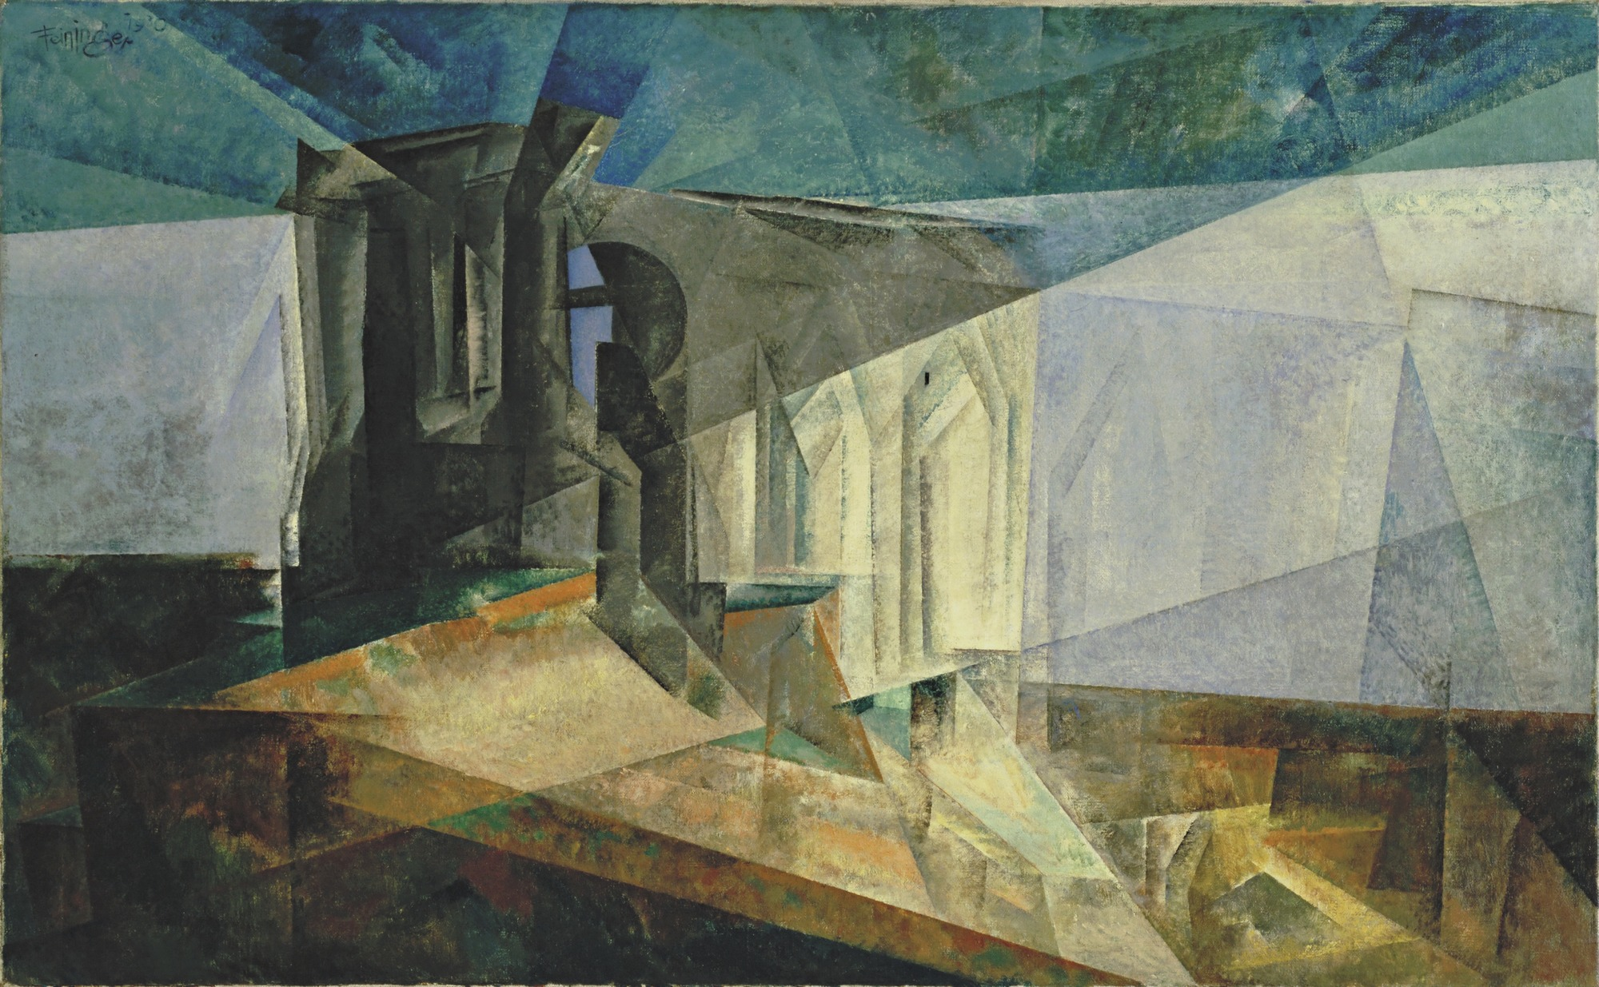
German Expressionist Art
Ruin by the Sea, 1930, Lyonel Feininger

Slide 24
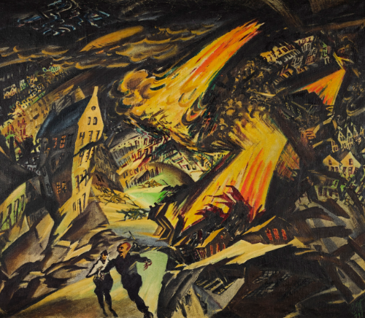
German Expressionist Art
Apocalyptic Landscape, 1912, Ludwig Meidner

Slide 25
Expressionist Cinema
After WWI, from 1911-1917, a small state-subsidized film industry began to develop in Germany.
UFA (Universum Film Aktiengesellschft) was first formed by the German government in 1917.
UFA built the best-equipped studios in Europe, attracted foreign filmmakers to make films in Germany.

Slide 26
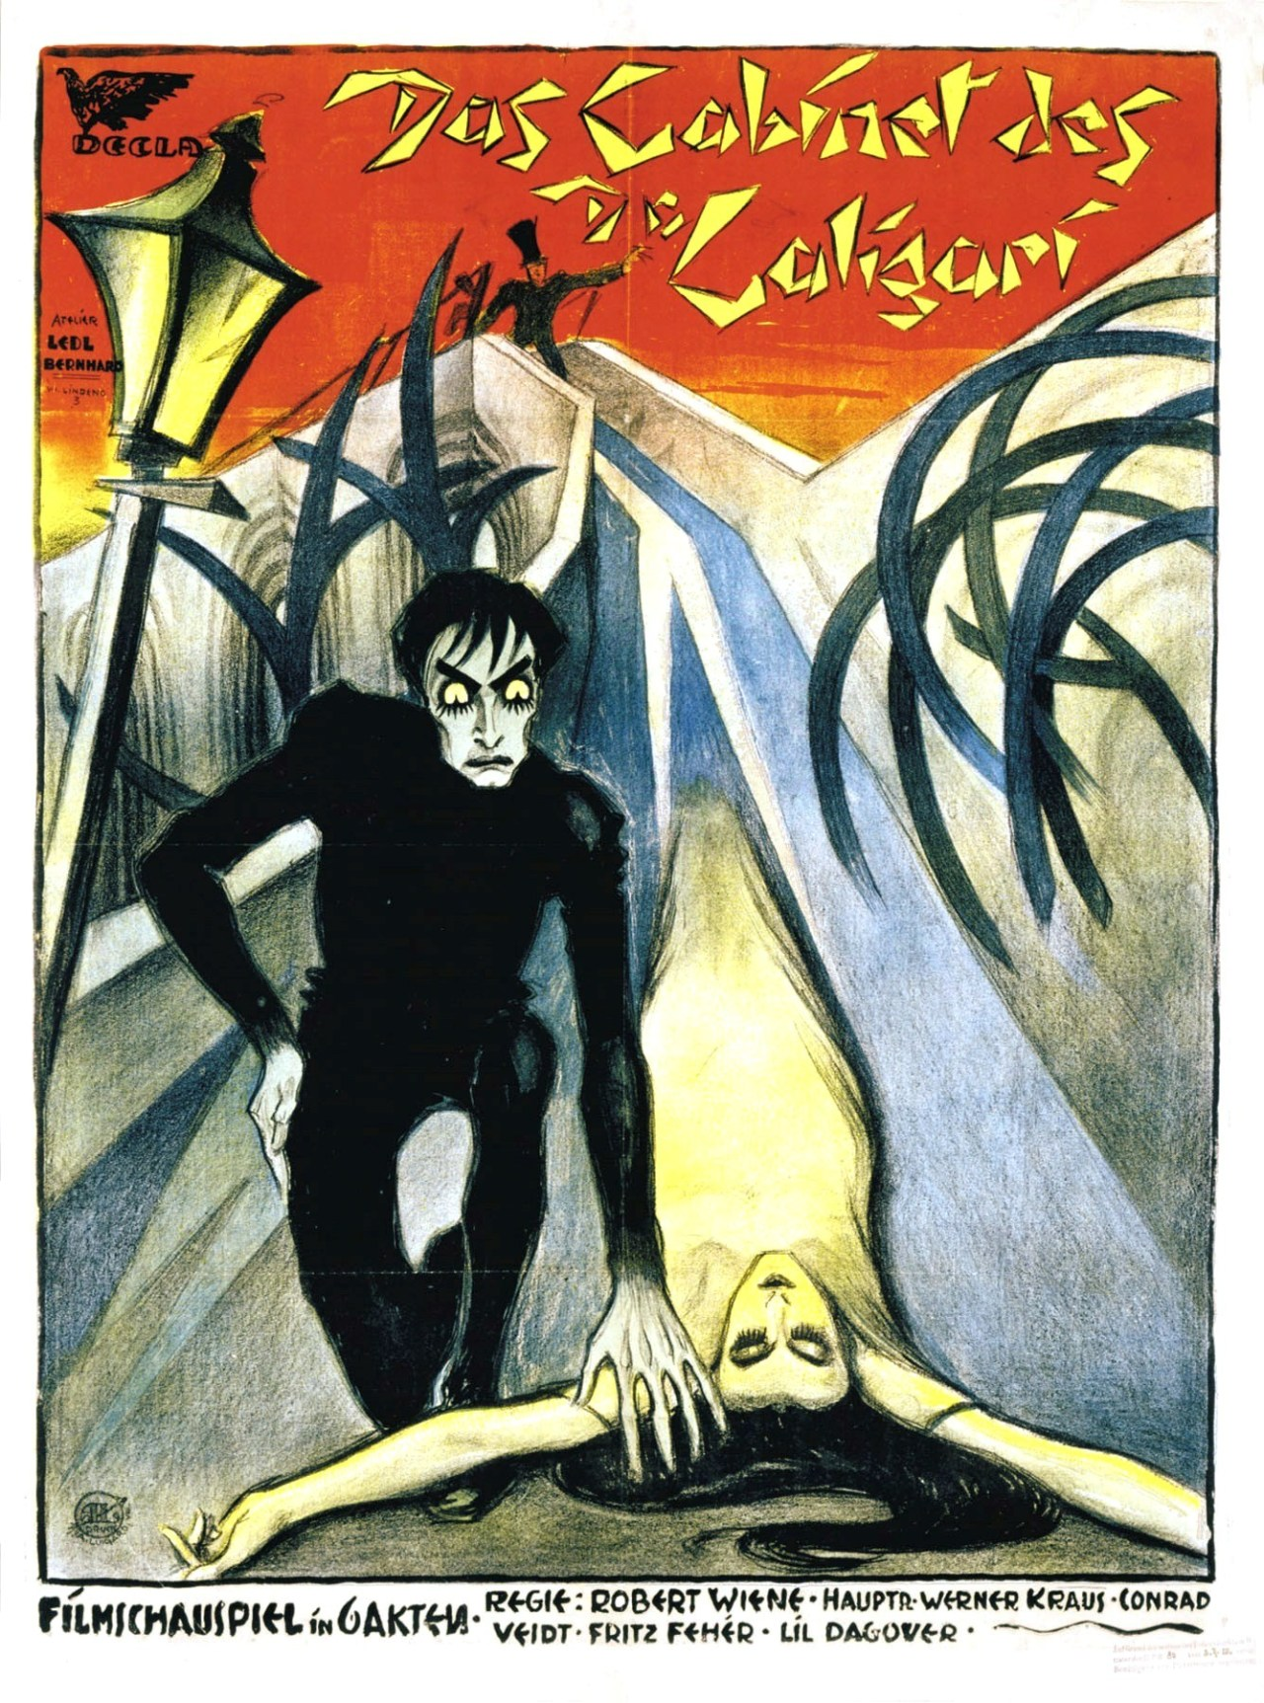
The Cabinet of Dr. Caligari
In 1919, Erich Pommer’s Decla produced the film from a script written by Carl Mayer and Hans Janowitz directed by Robert Wiene, along with three art directors: Herman Warm, Walter Reimann, Walter Röhrig.

Slide 27
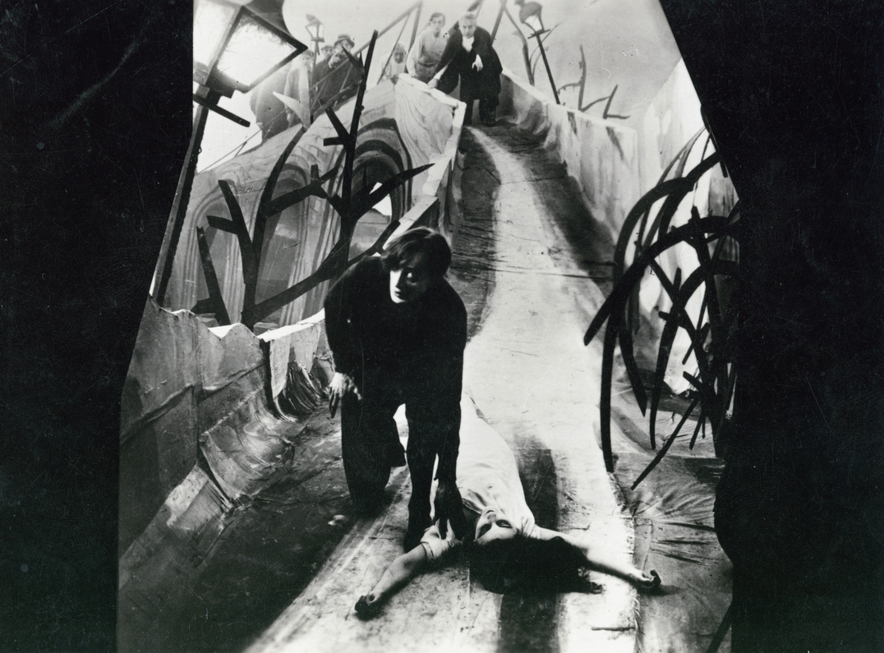
The art directors suggested that the film be done in an Expressionist style.
Herman Warm: “the film image must become graphic art.”
The film became a sensation in Berlin and in the US when it opened in 1920, and began a movement that lasted several years.

Slide 28
The Cabinet of Dr. Caligari
(1920) Dir. Robert Wiene

Slide 29
Analysis:
How is The Cabinet of Dr. Caligari similar to or different from other films we studied from this period (e.g. The Birth of A Nation was released in 1915)
Discuss the film’s formal language. Focus on the elements of mise-en-scène (e.g. set design, costume, lighting, acting style, etc.)
Compare the use of mise-en-scène to other films from this period

Slide 30
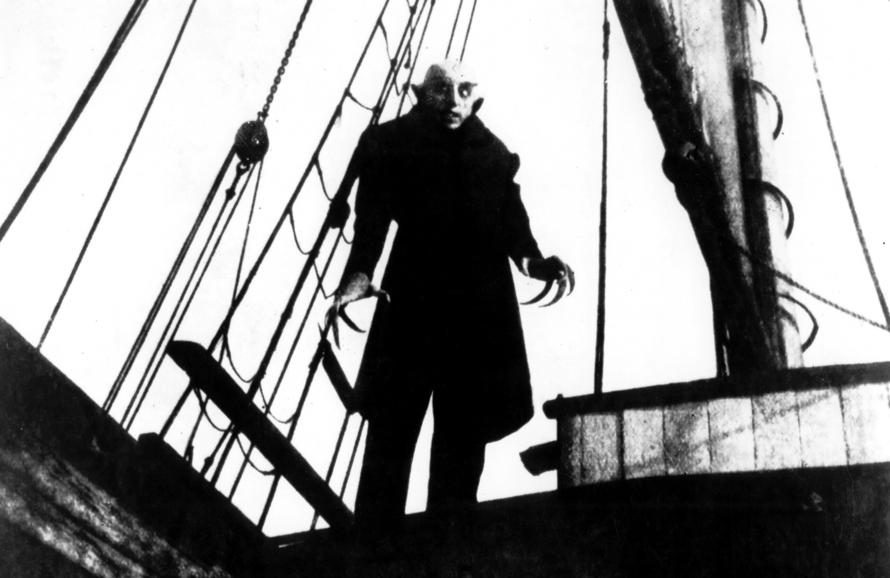
Nosferatu
(1922) Dir. F.W. Murnau

Slide 31
Comparative Analysis on scenes from The Cabinet of Dr. Caligari and Nosferatu :
Compare the visual language of these films.
How are the elements of mise-en-scène utilized in them?
Do you see any influence from these early film on contemporary horror or thriller films?

Slide 32
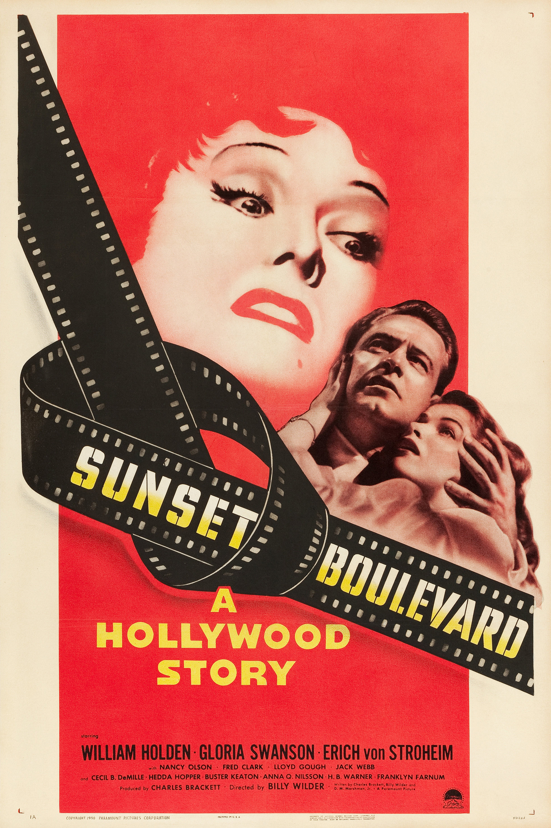
Sunset Boulevard (1950) Dir. Billy Wilder

Slide 33
Sunset Boulevard (1950) Dir. Billy Wilder
Starring William Holden (as Joe Gillis) and Gloria Swanson (as Norma Desmond)
Director and co-writer Billy Wilder began his film career as a screenwriter in Germany in the late 1920s, and came to Hollywood in 1933.

Slide 34
Sunset Boulevard (1950) Dir. Billy Wilder
Both a self-reflexive film about early Hollywood and a film noir.
Swanson and Erich Von Stroheim, who played Max, both worked in silent films

Slide 35
Sunset Boulevard (1950) Dir. Billy Wilder
Cecil B. DeMille and Hedda Hopper both had cameos as themselves
Set designer Hans Dreier began his career in Germany at UFA.

Slide 36
Sunset Boulevard (1950) Dir. Billy Wilder
Cinematographer John F. Seitz also shot other film noir including Double Indemnity (1944, also directed by Wilder)
The film was shot in black and white although it had to option to be shot in color.

Slide 37
Sunset Boulevard (1950) Dir. Billy Wilder
Divide into 3 groups, view and discuss the final scene in this film.
Analyzing this scene, discuss how the mise-en-scene contributed to its different levels of meaning (explicit, referential, etc.)

Slide 38
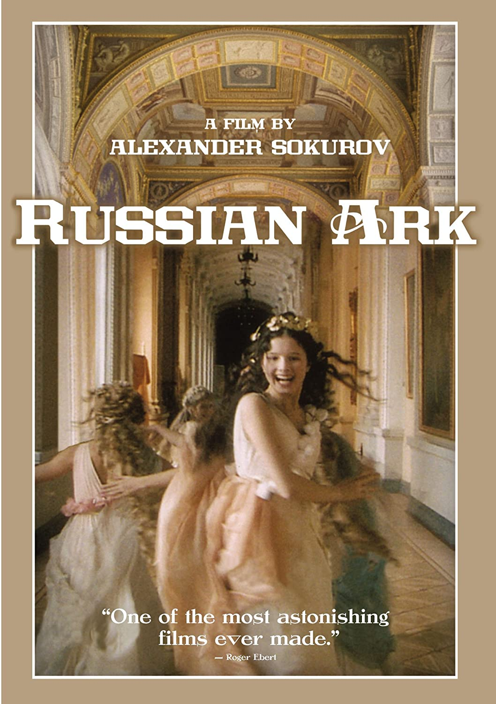
Russian Ark (2002)
Dir. Alexander Sokurov
Since this is a one-shot film, (i.e. no editing) how do you think its use of mise-en-scene contributed to its narrative and filmic language?
Compare to other films that emphasize mise-en-scene in their film form.

