Slide 1
“There is no soundtrack”
- Michel Chion

Slide 2
“There is no soundtrack” (?)
- Michel Chion

Slide 3
INTRODUCTION TO FILM
Audiovisual Analysis

Slide 4
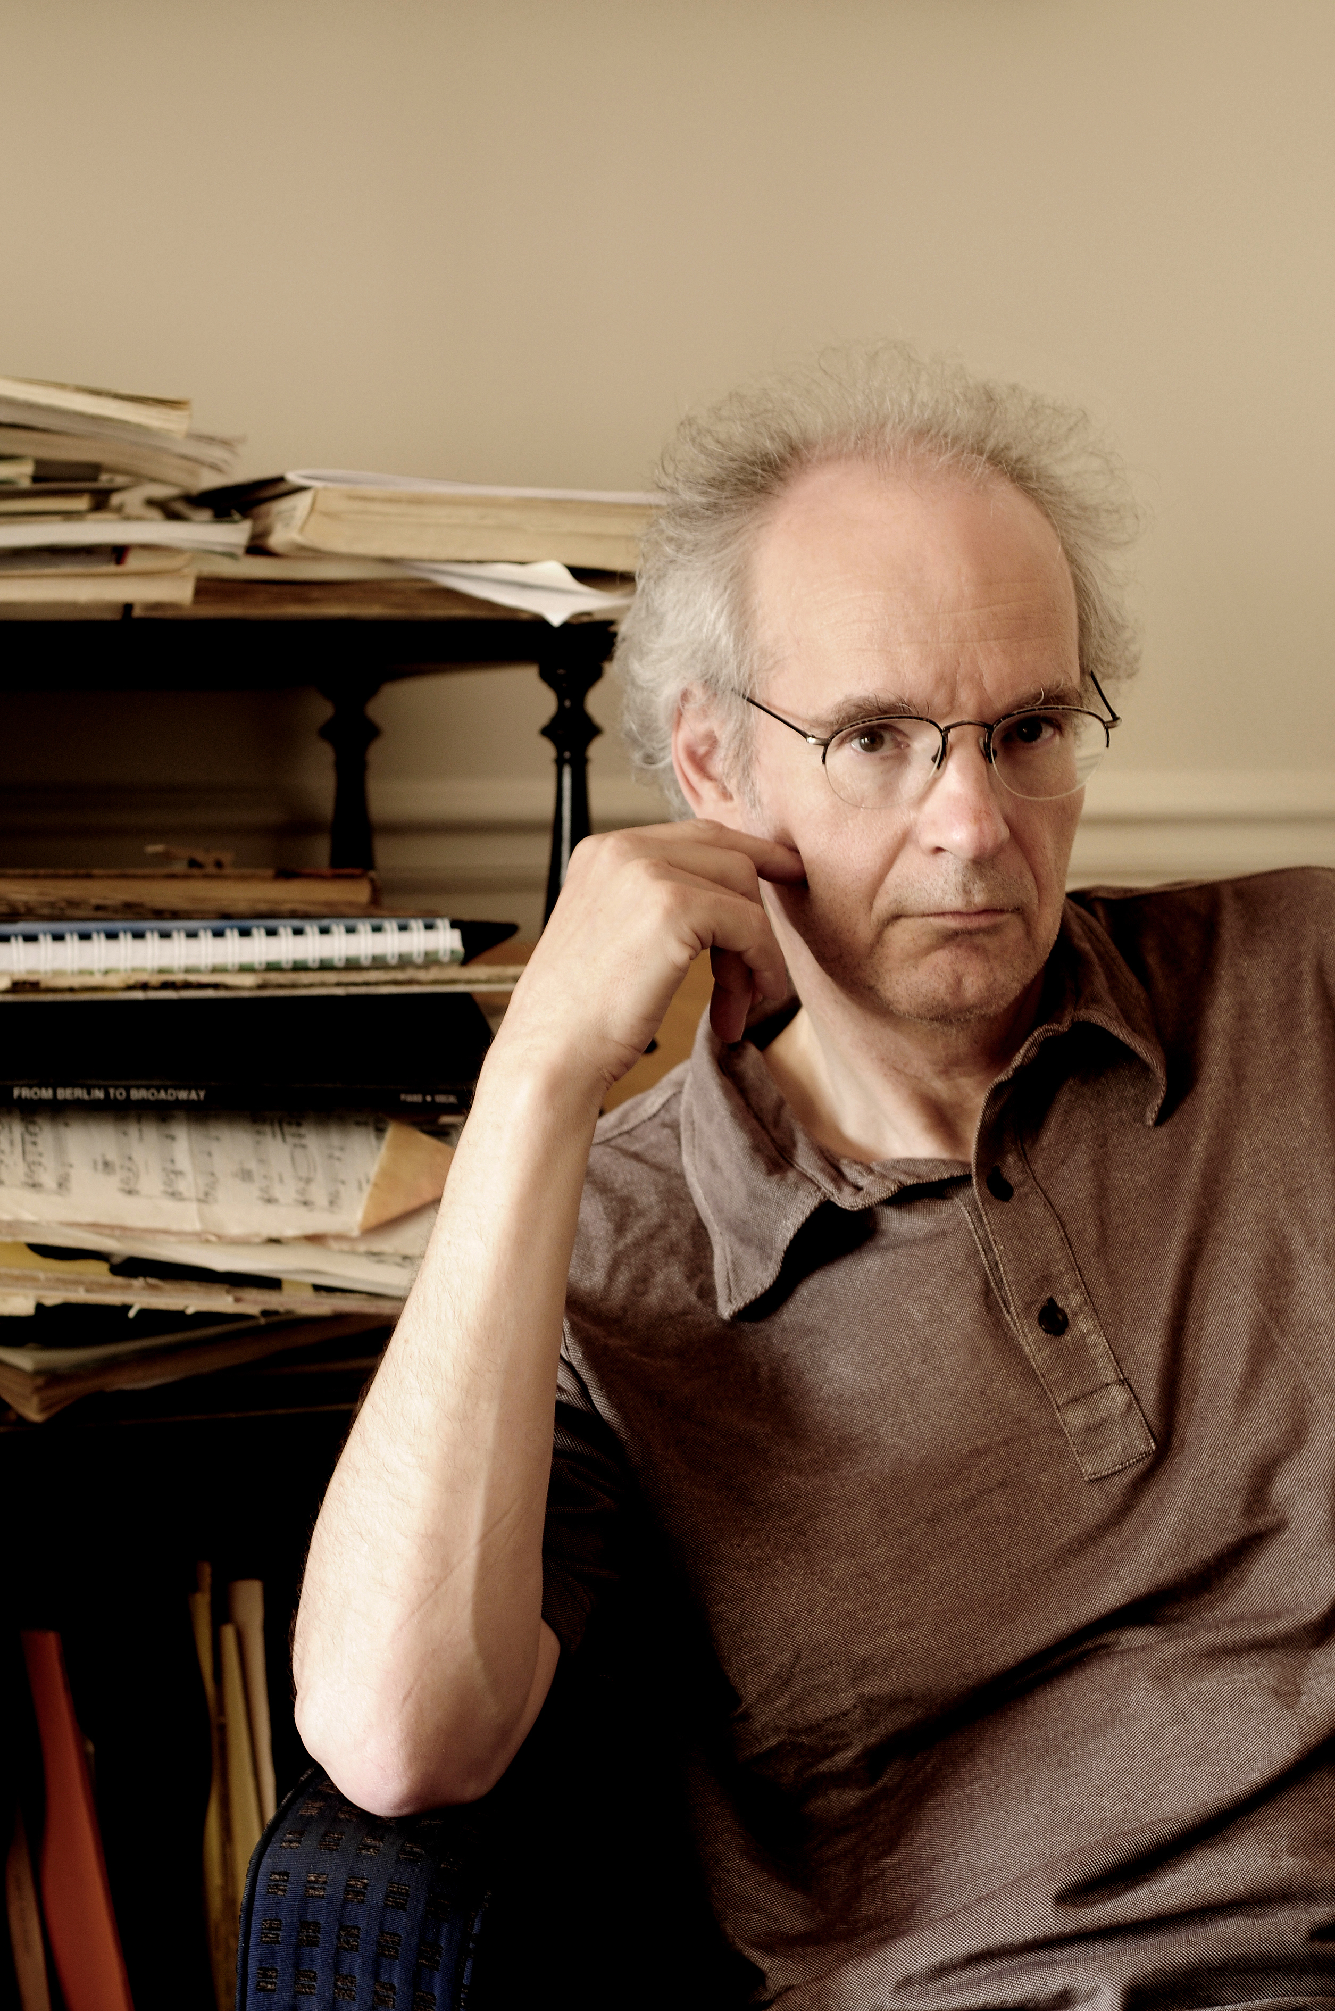
Michel Chion
French theorist of film sound who trained as a composer under Pierre Schaeffer and Pierre Henry
Associate Professor at the University of Paris III: Sorbonne Nouvelle, where he is a theoretician and teacher of audio-visual relationships
He wrote almost twenty books on film sound and monographs on filmmakers including Stanley Kubrick, Jacques Tati and David Lynch, and on films including Eyes Wide Shut and The Thin Red Line

Slide 5
Key Terms:
Added value - the expressive and informative value with which a sound enriches a given image so as to create the impression that this comes naturally from what is seen.
Synchresis - the forging of an immediate and necessary relationship between something one hears (sound) and something one sees (image). Synchronization + synthesis = synchresis.
Vococentrism - privileging of the human voice in film. Verbocentrism - privileging of the human voice as a medium of verbal expression in film.

Slide 6
Music (Empathetic / Anempathetic Effects) – music directly expressing its participation in the feeling of a scene (empathetic), or exhibiting conspicuous indifference to the scene (anempathetic).
Points of synchronization – where visible synchronization can be observed in film. For example, synch-sound dialogue, choreography in a musical number, or “mickey-mousing” in an animation.
Spotting – rapid visual movement accompanied by rapid auditory punctuation. (e.g. fight scene)

Slide 7
Audiovisual contract: The audiovisual relationship is not natural but rather a symbolic pact to which the audio-spectator agrees when she or he considers the elements of sound and image to be participating in one and the same entity or world.

Slide 8
Chion’s Methodology of Audio-Visual Analysis:

Slide 9
Chion’s Methodology of Audio-Visual Analysis:
1. Forced marriage

Slide 10
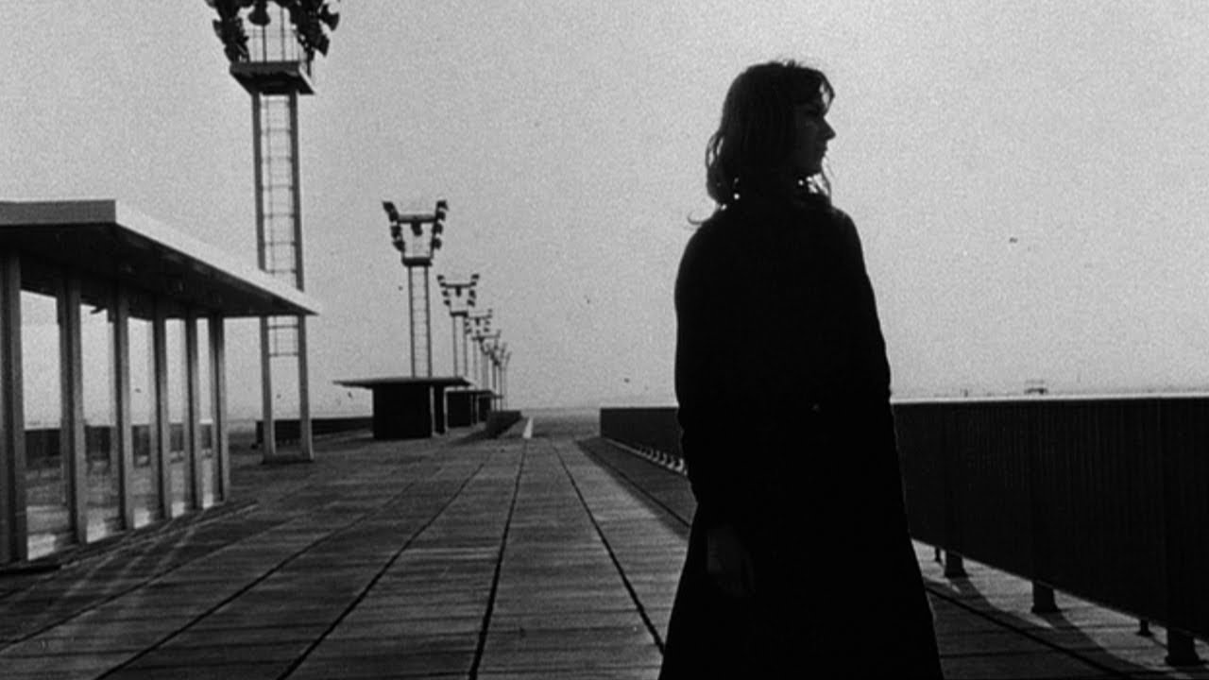
La Jetée (The Pier) Dir. Chris Marker (1962)

Slide 11
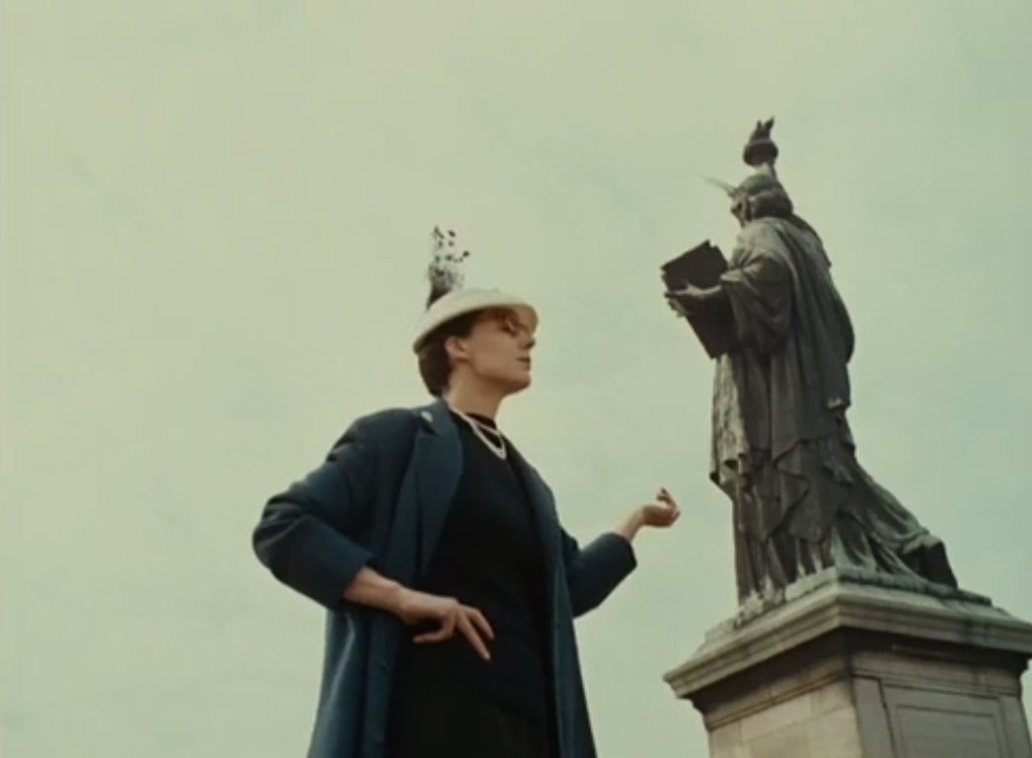
Lettre de Sibérie (Letter from Siberia) Dir. Chris Marker (1957)

Slide 12
Three Mode of Listening:

Slide 13
Three Mode of Listening:
Causal

Slide 14
Three Mode of Listening:
Causal
Semantic

Slide 15
Three Mode of Listening:
Causal
Semantic
Reduced

Slide 16
Chion’s Methodology of Audio-Visual Analysis:
2. Masking

Slide 17
Psycho (1960) Dir. Alfred Hitchcock

Slide 18
Temporalization
The influence of sound on the perception of time in the image
Sound temporalizes images in 3 ways:

Slide 19
Temporalization
The influence of sound on the perception of time in the image
Sound temporalizes images in 3 ways:
temporal animation of the image

Slide 20
Temporalization
The influence of sound on the perception of time in the image
Sound temporalizes images in 3 ways:
temporal animation of the image
endows shots with temporal linearization

Slide 21
Temporalization
The influence of sound on the perception of time in the image
Sound temporalizes images in 3 ways:
temporal animation of the image
endows shots with temporal linearization
vectorizes or dramatizes shots

Slide 22
Conditions necessary for sound to temporalize an image:
Static shot – image has no temporal linearization or vectorization in itself
Sound’s temporality combines with temporality already present in the image.

Slide 23
Factors governing temporalization:

Slide 24
Factors governing temporalization:
How sound is sustained

Slide 25
Factors governing temporalization:
How sound is sustained
The predictability of the sound

Slide 26
Factors governing temporalization:
How sound is sustained
The predictability of the sound
Tempo

Slide 27
Factors governing temporalization:
How sound is sustained
The predictability of the sound
Tempo
Sound definition

Slide 28
Sound cinema is chronography
Sound cinema is written in time as well as in movement
The result of the standardization and normalization of film projection speed

Slide 29
Film Analysis Assignment 3: Audiovisual Analysis
View a film of your choice.
In a short paper, analyze its use of sound using the key terms from the Chion reading.
Due two weeks from today. Your paper topic and film must be approved by me, please come and see me once you have chosen your film and method of analysis (I suggest you meet with me sooner rather than later)

Slide 30
Film Analysis Assignment 3: Audiovisual Analysis
How does the sound function in this film?
What are the audiovisual relationships?
Does what you hear correspond to what you see?

Slide 31
Film Analysis Assignment 3: Audiovisual Analysis
Given the short length of the assignment, I suggest you focus your analysis on a key scene, contextualized with the rest of the film, and 1-3 of Chion’s concepts (do not try to cover all of his ideas).

Slide 32
Your document should be in a MS Word format (.doc or .docx) only (i.e. no PDFs please)
Your essay should be about 500-1,000 words long: about 3-5 pages, typed and double-spaced. It should contain about 4-5 paragraphs including introduction and conclusion.
Please write your name, our class, and date in your document
Edit, spell-check, proof-read in addition to make sure factual information (e.g. film title, character names, etc.) are correct, as well as your usage of the key terms and other terminology
Please upload your assignment by 5PM PST of the due date to your Sakai Drop Box.

Slide 33
How to list film titles in your academic writing:
The first time you mention a title, list the title, year of release, and name of director:
Citizen Kane (1968, dir. Orson Welles)
Citizen Kane (1968) directed by Orson Welles
After that, under or italic the title:
Citizen Kane or Citizen Kane

Slide 34
Citation formats to use for academic writing:

Slide 35
Citation formats to use for academic writing:
1. MLA (Modern Language Association) style:
Use footnotes or endnotes in your text
Citation format: Chion, Michel. Audio-Vision: Sound on Screen. Trans. Claudia Gorbman. New York: Columbia University Press, 1994, p. 1.
No need to include bibliography

Slide 36
Citation formats to use for academic writing:
2. Chicago (Author-Date) style:
In text (Chion 1994, 1)
Bibliography: Chion, Michel. 1994. Audio-Vision: Sound on Screen. Trans. Claudia Gorbman. New York: Columbia University Press.

Slide 37
Citation formats to use for academic writing:
3. Please do not cite film scenes or dialogue (instead, use quotation marks to demarcate specific dialogue, and explain the context—who said it and when—in your writing) or class lectures.

