Slide 1
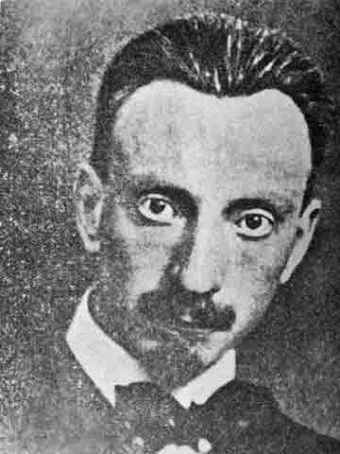
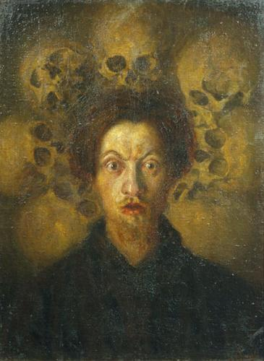
Luigi Russolo

Slide 2
The Art of Noises A Futurist Manifesto
Luigi Russolo (1833-1947)
Futurism in Italy
Art of Noises as a manifesto
Machine vs. Nature
Music vs. Noise

Slide 3
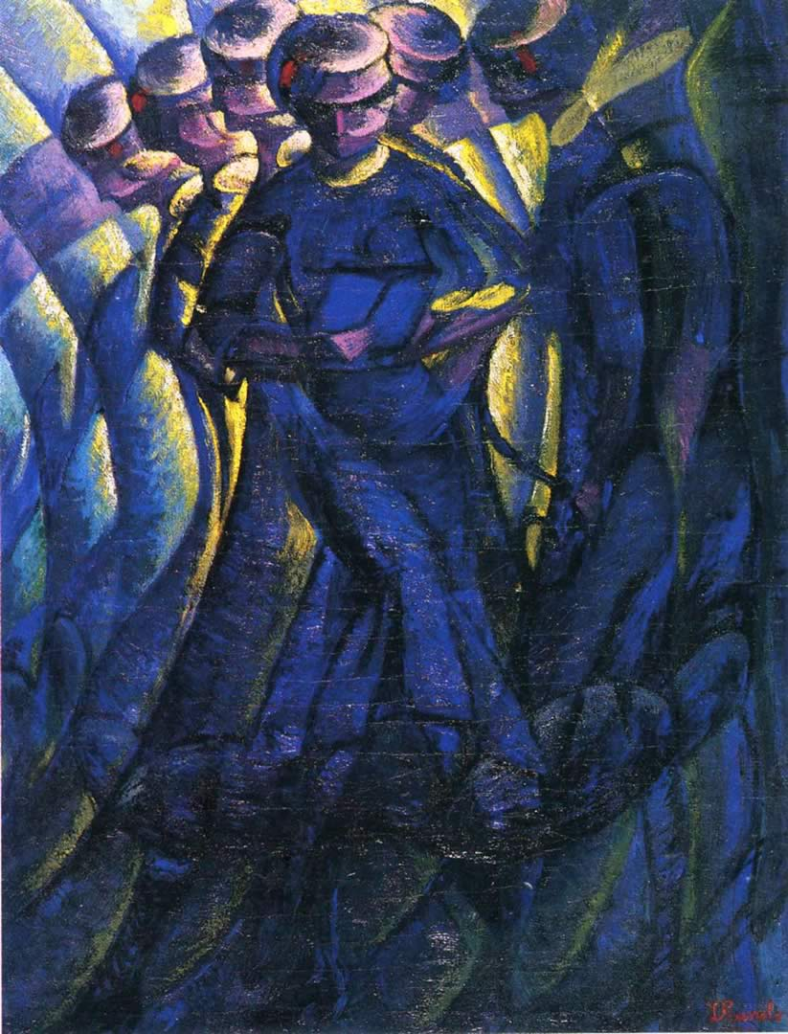
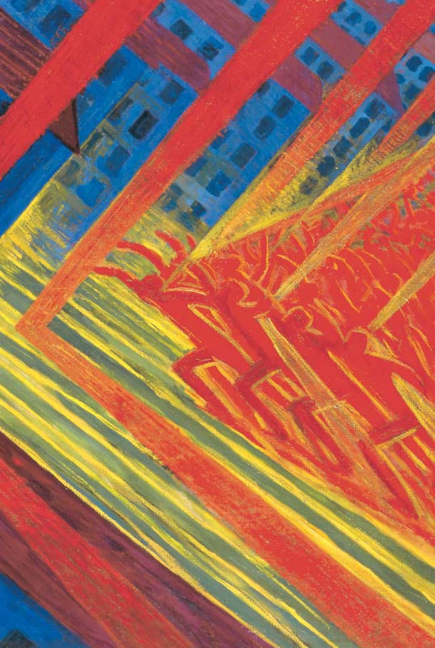
Futurist Paintings by Luigi Russolo

Slide 4
“The evolution of music is comparable to the multiplication of machines” (p. 11)
“We must break out of this limited circle of sounds and conquer the infinite varieties of noise-sounds.” (p. 11)
“We want to give pitches to these diverse noises, regulating them harmonically and rhythmically.” (p. 12)

Slide 5
Six families of noises of the futurist orchestra (p. 13):
Roars, Thundering, Explosions, Hissing roars, Bangs, Booms;
Whistling, Hissing, Puffing;
Whispers, Murmurs, Mumblings, Mutterings, Gurgling;
Screeching, Creaking, Rustling, Humming, Crackling, Rubbing;
Noises obtained by beating on metals, woods, skins, stones, pottery, etc.
Voices of animals and people, Shouts, Screams, Shrieks, Wails, Hoots, Howls, Death rattles, Sobs

Slide 6
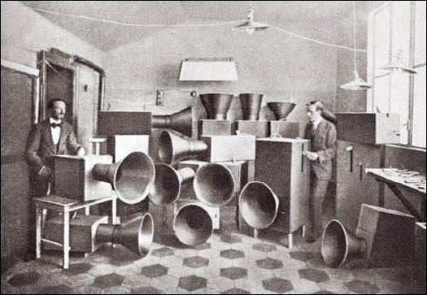
Intonarumori

Slide 7
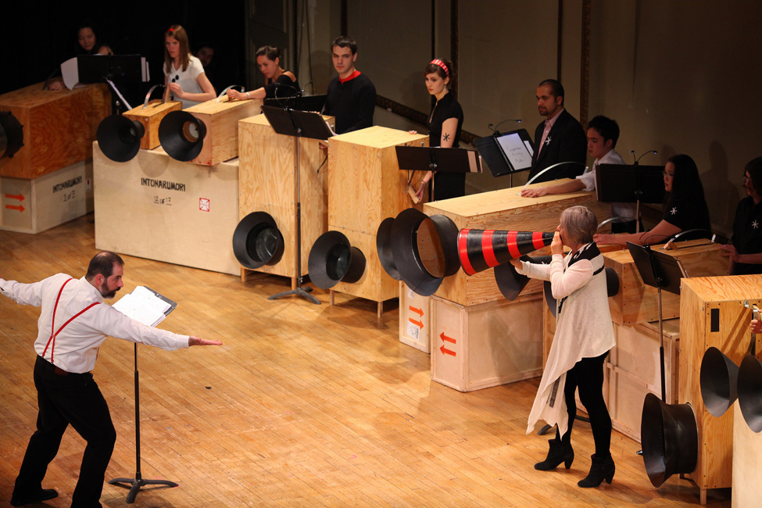
Intonarumori Today

Slide 8
Sound Theories
2. Noise

Slide 9
2 + 1 Theoretical Models / Case Studies:
Noise as political economy (Attali)
Noise as industrial pollution (Bijsterveld)
Noise as music and art (Kahn – time permitting)

Slide 10
1. Noise: The Political Economy of Music (Attali)
“Our science has always desired to monitor, measure, abstract, and castrate meaning, forgetting that life is full of noise and that death alone is silent: work noise, noise of man, and noise of beast. Noise bought, sold, or prohibited. Nothing essential happens in the absence of noise.” (p. 29)

Slide 11
“Now we must learn to judge a society more by its sound, by its art, and by its festivals, than by its statistics.” (p. 29)
According to Attali, what is music’s role in our society?

Slide 12
Music =

Slide 13
Music =
Noise

Slide 14
Music =
Noise
Simulacrum (of ritual and sacrifice)

Slide 15
Music =
Noise
Simulacrum (of ritual and sacrifice)
Mirror of society

Slide 16
Music =
Noise
Simulacrum (of ritual and sacrifice)
Mirror of society
A way of perceiving the world

Slide 17
Music =
Noise
Simulacrum (of ritual and sacrifice)
Mirror of society
A way of perceiving the world
Commodity

Slide 18
Music =
Noise
Simulacrum (of ritual and sacrifice)
Mirror of society
A way of perceiving the world
Commodity
Fetishized

Slide 19
Music =
Noise
Simulacrum (of ritual and sacrifice)
Mirror of society
A way of perceiving the world
Commodity
Fetishized
Spectacle

Slide 20
Music =
Noise
Simulacrum (of ritual and sacrifice)
Mirror of society
A way of perceiving the world
Commodity
Fetishized
Spectacle
Herald (“for it is prophetic” p. 29)

Slide 21
Subversion

Slide 22
Subversion
“Metaphor of the real” (p. 31)

Slide 23
Subversion
“Metaphor of the real” (p. 31)
“A tool for the creation
or consolidation of a community” (p. 32)

Slide 24
Subversion
“Metaphor of the real” (p. 31)
“A tool for the creation
or consolidation of a community” (p. 32)
A mode of immaterial production, a collective memory

Slide 25
Music =
Noise
Simulacrum (of ritual and sacrifice)
Mirror of society
A way of perceiving the world
Commodity
Fetishized
Spectacle
Herald (“for it is prophetic” p. 29)

Slide 26
Subversion
“Metaphor of the real” (p. 31)
“A tool for the creation
or consolidation of a community” (p. 32)
A mode of immaterial production, a collective memory

Slide 27
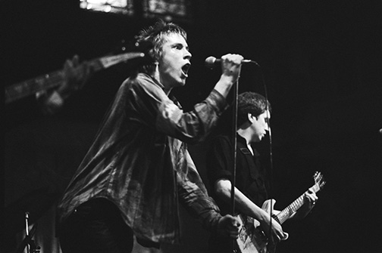
“Our music foretells our future. Let us lend it an ear.” (p. 36)

Slide 28
2. Industrial Noise (Bijsterveld)
“… to demonstrate the role of the cultural meaning of sound in the clash between the dramatization of industrial noise problem by experts, notably physicians, and the response to this dramatization by shop-floor laborers.” (p. 153)
Focusing on pro-earplug campaigns in the Netherlands and Germany – within the wider context of Western history of industrial noise and noise abatement.

Slide 29
Sound in science - the role of sound in generating scientific knowledge
Science of sound – e.g. acoustics, and their coevolution with the public problems of noise
Symbolism of sound / cultural meaning of sound

Slide 30
Cultural meanings of industrial noise:
Chaotic and lacking a univocal rhythm
Street noise worse than industrial noise (bourgeois view)
Music in factories “…rhythmic sounds was the thing to strive for.” (p. 154) believed to lead to productivity and efficiency
Potential to inflict damage to the ear

Slide 31
Quieting the machines VS. personal protective devices for workers
Efforts to educate workers VS. worker’s refusal to wear earplugs
Noise as reassurance
Worker’s indigenous knowledge
Is there a gender dynamic?

Slide 32
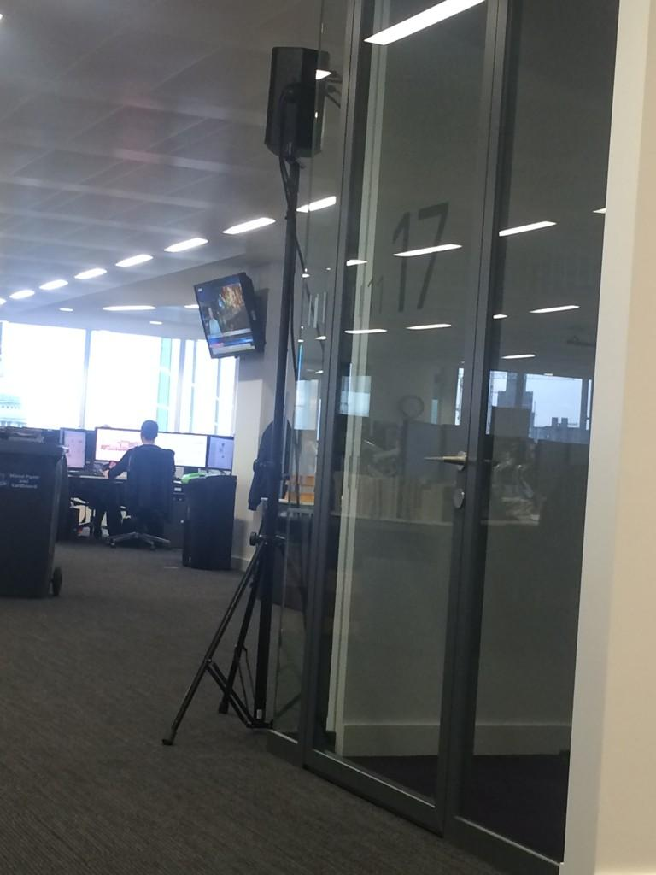
Is this “epistemologically relevant”?

Slide 33
Is this “epistemologically relevant”?
See Sound Studies Reader, p. 161 and post on MS52 blog

Slide 35
3. Avant-Garde Noise (Kahn)

Slide 36
Who is the avant-garde?

Slide 37
Who is the avant-garde?
Cabaret Voltaire of Zurich Dada (Richard Huelsenbeck, Hugo Ball, Tristan Tzara)

Slide 38
Who is the avant-garde?
Cabaret Voltaire of Zurich Dada (Richard Huelsenbeck, Hugo Ball, Tristan Tzara)
Italian Futurists (Russolo, F.T. Marinetti, Balilla Pratella)

Slide 39
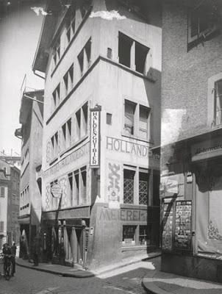
Cabaret Voltaire, Zurich, 1935

Slide 40
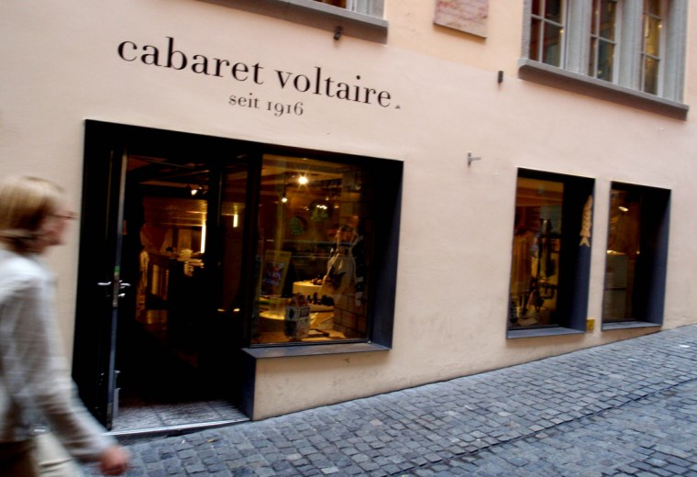
Cabaret Voltaire today

Slide 41
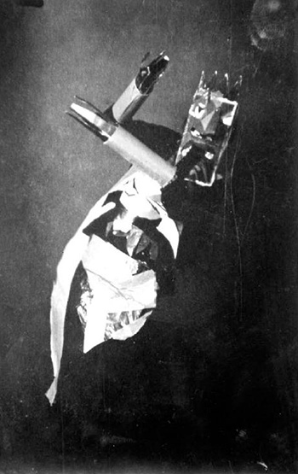
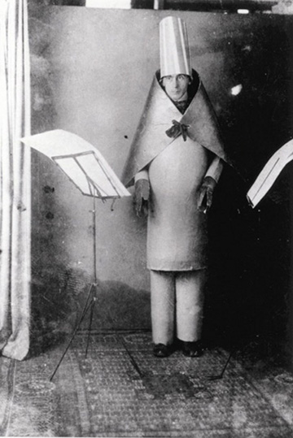
Sophie Taeuber
Hugo Ball

Slide 42
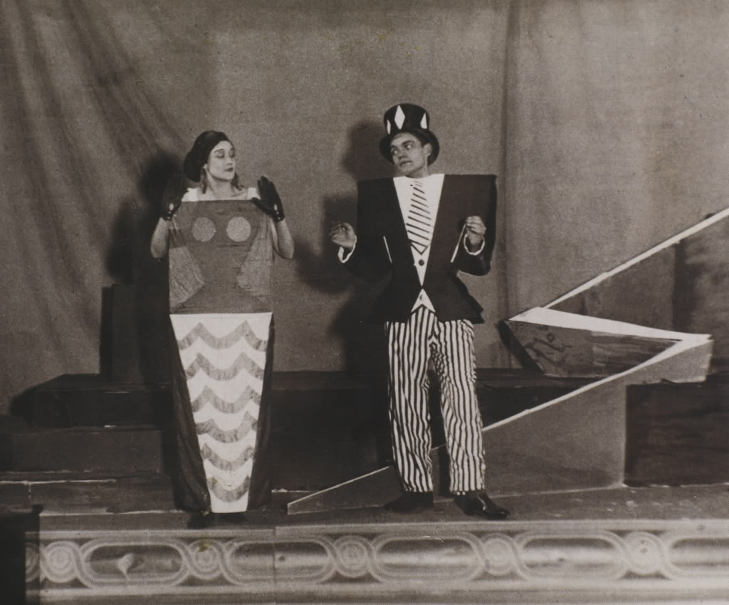
Tristan Tzara performance

Slide 43
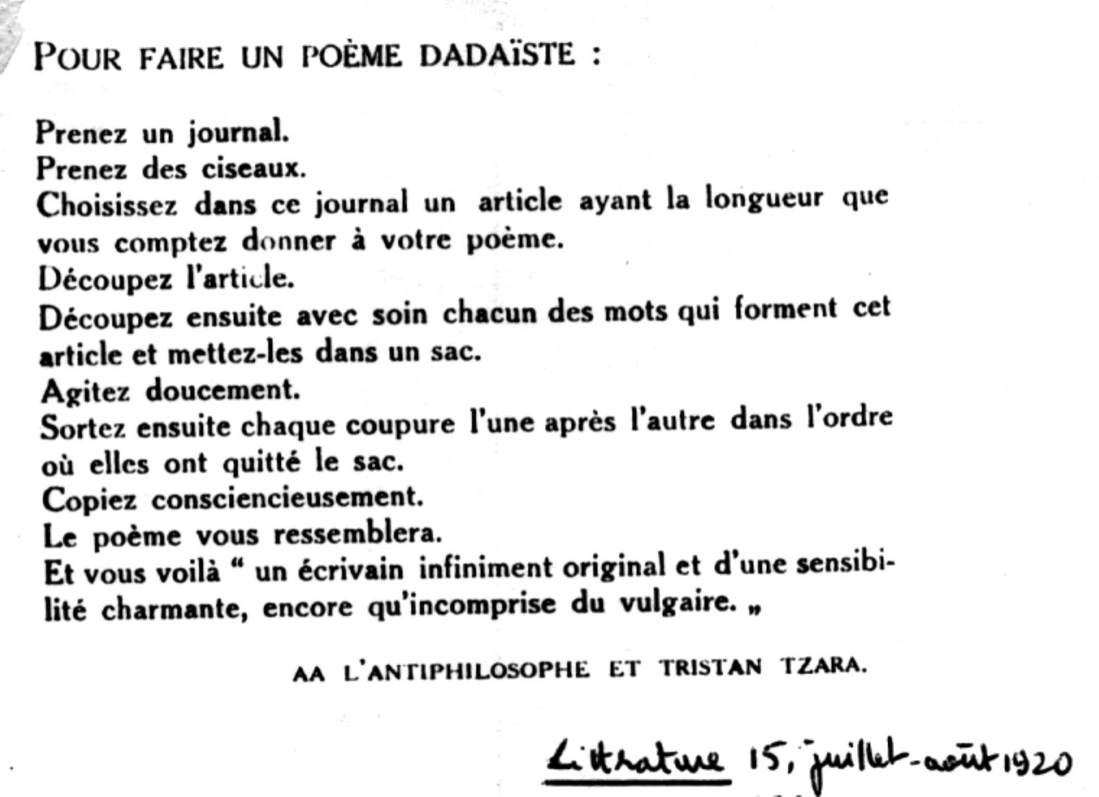
Tristan Tzara, How to Make a Dadaist Poem

Slide 44
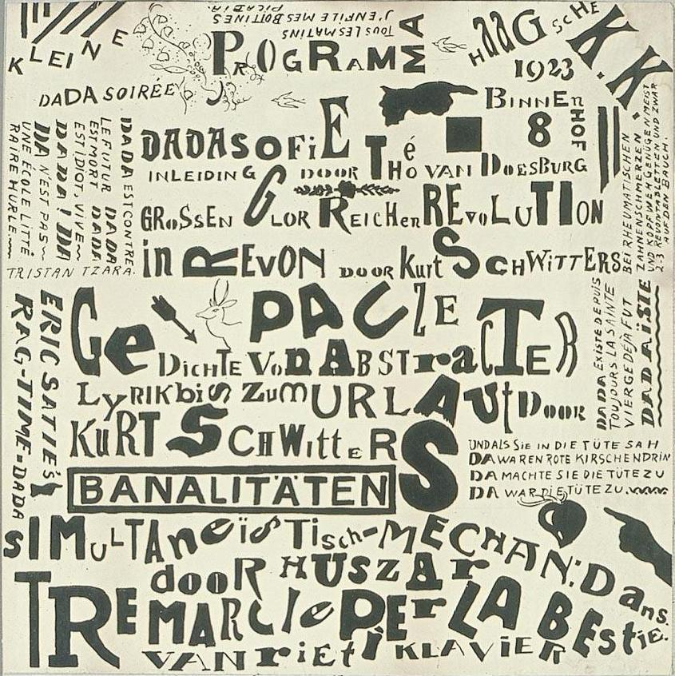
Theo van Doesburg, poster for a Dada soirée,
ca.1923

Slide 45
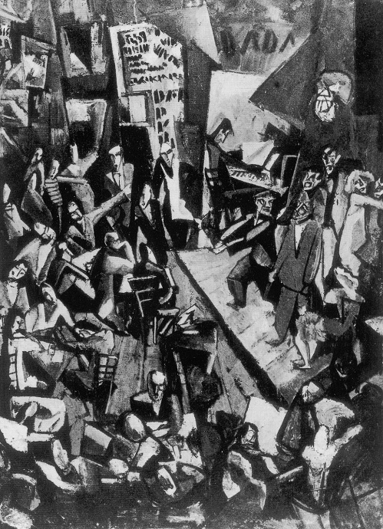
Marcel Janco
Cabaret Voltaire
(1916)

Slide 46
Avant-Garde Noise
All of Dada “beats a drum, wails, sneers and lashes out.” (Richard Huelsenbeck quoted on p. 427)
“This noise was made significant in part by making others—primarily women and non-Europeans—insignificant in a context of war and religion.” (p. 427)

Slide 47
Dada:
Bruitism
Futurism
Primitivism
Christian?
Polygot
Simultaneism

Slide 48
Avant-garde noise, in other words, both marshals and mutes the noise of the other: power is attacked at the expense of the less powerful, and society itself is both attacked and reinforced.” (p. 429)
What does Kahn mean by this?

Slide 49
Artists and composers influenced by Russolo’s “The Art of Noises” (p. 436):
Ravel, Debussy, Prokofiev, Stravinsky, Antheil, Satie, Milhaud, Honegger, Varèse, Cowell
Cocteau and Diaghilev’s production of Parade, scored by Satie
The poetry of Mayakovsky and the films of Vertov.
Vorticism in the UK (Ezra Pound)
Moholy-Nagy and Mondrian

Slide 51
4’33” (1952) by John Cage

Slide 52
“Wherever we are, what we hear is mostly noise. When we ignore it, it disturbs us. When we listen to it, we find it fascinating .” (John Cage, Audio Culture, p. 25)

Slide 53
Silence is
Negative space (“The stuff between the notes,” Audio Culture, p. 40)
Threatened and endangered
Unattainable (“There is no aural equivalent for the eyelid,” Audio Culture, p. 41)
“Requisite for contemplation, or more quaintly, the forming of a self.” (Audio Culture, p. 42)

Slide 54
Vacuum, void, death
An auditory veil
The end and the beginning
Censorship and propaganda
“…the enemy of art, it is also its motivation and medium.” (Audio Culture, p. 44)
Anti-Capitalist
“… is the only Voice of our God.” (Melville quoted on Audio Culture, p. 44)
A commodity

