Slide 1
II. Histories of Sound
2. Histories of Sound and Technology

Slide 2
Listening tech(nique)ology in 19th century medicine (Nicolson)
The Soundscape of Modernity (Thompson)

Slide 3
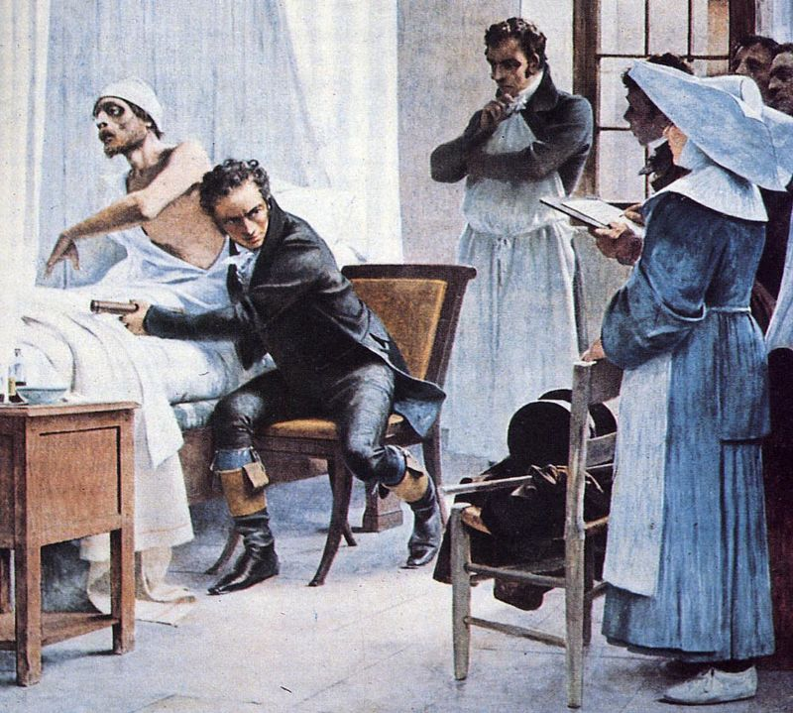
1. Having the Doctor’s Ear in 19th Century Edinburgh

Slide 4
Auscultation (based on the Latin verb auscultare "to listen") is the term for listening to the internal sounds of the body, usually using a stethoscope.
Auscultation is performed for the purposes of examining the circulatory system and respiratory system (heart sounds and breath sounds), as well as the gastrointestinal system (bowel sounds).

Slide 5
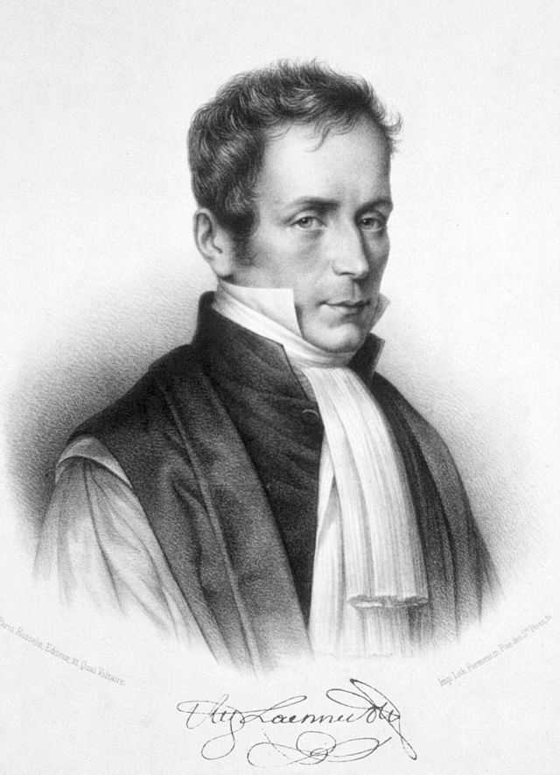
René-Théophile-Hyacinthe Laennec

Slide 6
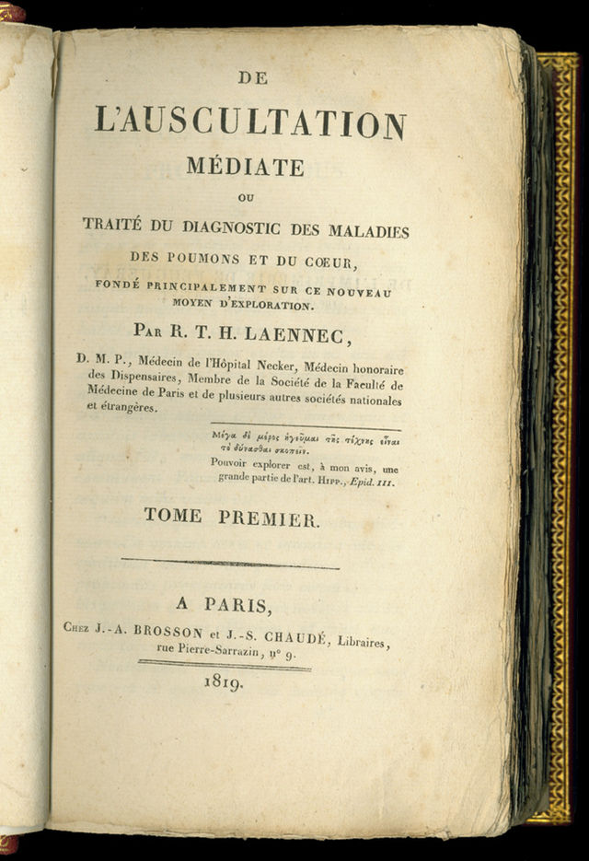
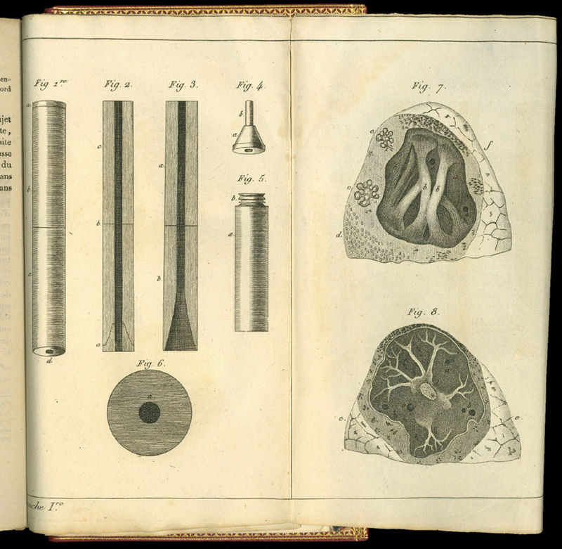
Pages from De l’auscultation mediate (published in 1819) showing Laennec’s stethoscope design

Slide 7
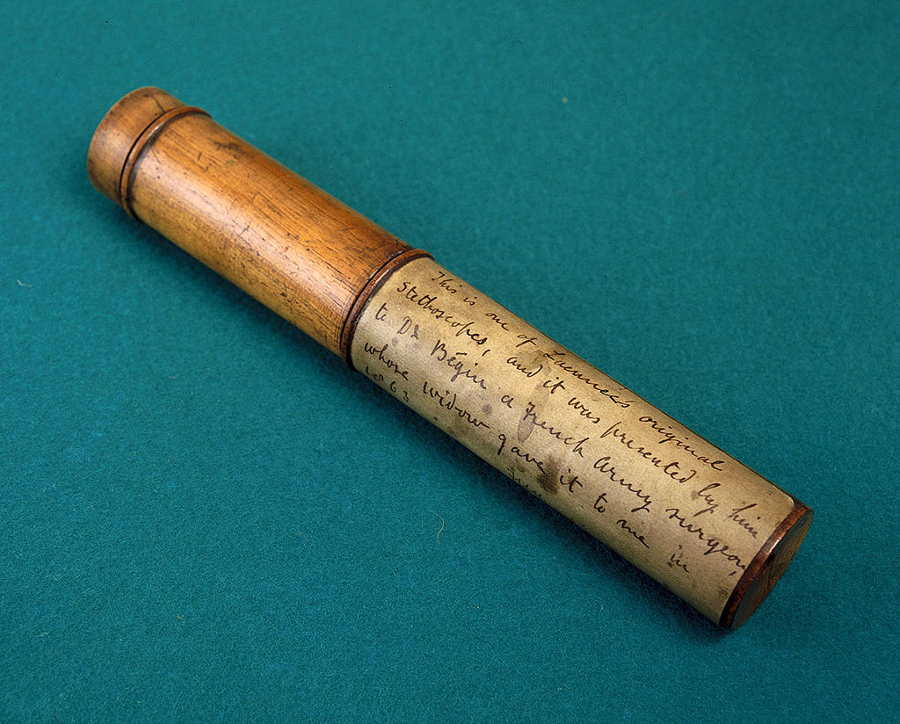
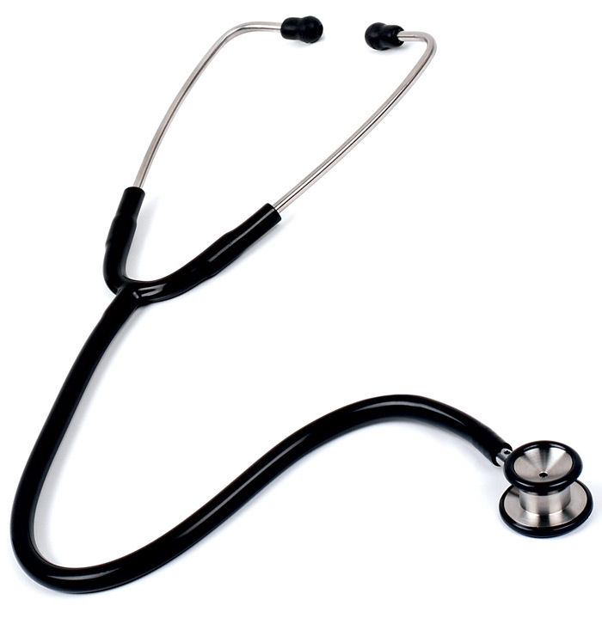
Laennec’s stethoscope (lf.) compared to a contemporary design (rt.) – see discussion of N.P. Comins’s development of a flexible model (p. 160-161)

Slide 8
Was the introduction of auscultation in Britain a contested process?

Slide 9
Paris: Laënnec’s invention of the stethoscope in 1816, and published De l’auscultation mediate in 1819
Edinburgh: Andrew Duncan and other’s review of De l’auscultation mediate:
More a text on pathological anatomy than one on diagnostics;
Difference between academic and practical knowledge of the techniques of physical examination

Slide 10
Impact of trained stethoscopists like Andrew Cullen and John Crauford Gregory
From 1825 onwards, new theories developed independent of the French source by James Hope, John William Turner and others (p. 159)
Improvements on the instrument: N.P. Comins
By 1828-9 stethoscope use was taught in medical textbooks

Slide 11
By 1831: innovation of stethoscopy transferred from Paris to Edinburgh
Why Edinburgh?

Slide 12
“… one of the major advantages of mediate auscultation over other techniques of physical diagnosis was that it offered physicians a means to undertake examinations without compromising their professional dignity. The fact that stethoscopy did not involve direct bodily contact was considered to be very helpful, both when one’s clientele were the unwashed poor of the hospital or dispensary and when one was consulted by modest ladies in one’s private practice. In other words, the stethoscope respected the social niceties of the practice of elite physic.” (p. 164)

Slide 13
“… one of the major advantages of mediate auscultation over other techniques of physical diagnosis was that it offered physicians a means to undertake examinations without compromising their professional dignity. The fact that stethoscopy did not involve direct bodily contact was considered to be very helpful, both when one’s clientele were the unwashed poor of the hospital or dispensary and when one was consulted by modest ladies in one’s private practice. In other words, the stethoscope respected the social niceties of the practice of elite physic.” (p. 164)

Slide 14
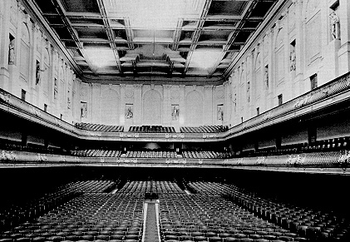
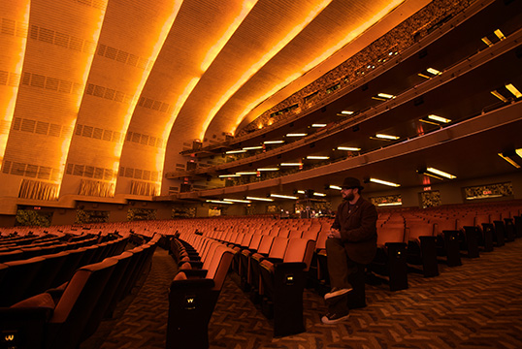
2. The Soundscape of Modernity

Slide 15
Thompson’s definition of soundscape:
“I define the soundscape as an auditory or aural landscape. Like a landscape, a soundscape is simultaneously a physical environment and a way of perceiving the environment; it is both a world and a culture constructed to make sense of the world. The physical aspect of a soundscape consists not only of the sounds themselves, the waves of acoustical energy permeating the atmosphere in which people live, but also the material objects that create, and sometimes destroy, those sounds."
(p. 116)

Slide 16
Thompson’s definition of soundscape:
“I define the soundscape as an auditory or aural landscape. Like a landscape, a soundscape is simultaneously a physical environment and a way of perceiving the environment; it is both a world and a culture constructed to make sense of the world. The physical aspect of a soundscape consists not only of the sounds themselves, the waves of acoustical energy permeating the atmosphere in which people live, but also the material objects that create, and sometimes destroy, those sounds."
(p. 116)

Slide 17
The Soundscape of Modernity:
The American soundscape underwent a particularly dramatic transformation in the years between 1900-1933
Sounds became signals - a new criterion by which the evaluate them - located in the new electrical technologies
The opening of Symphony Hall in Boston (1900) and the opening of Radio City Music Hall in New York (1932) frames the period covered by the book

Slide 18
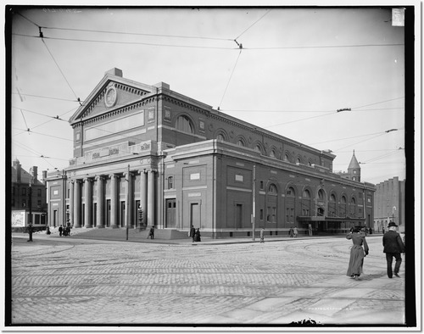
The Symphony Hall in Boston,1904

Slide 19
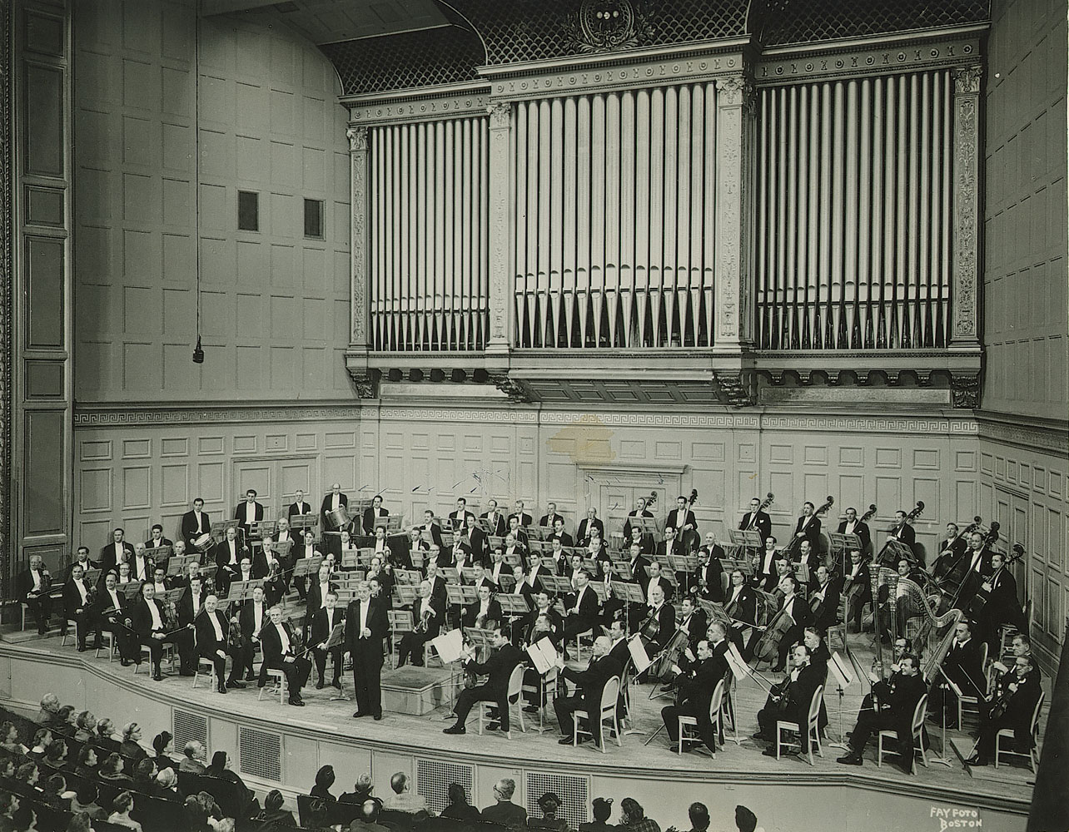

Slide 20
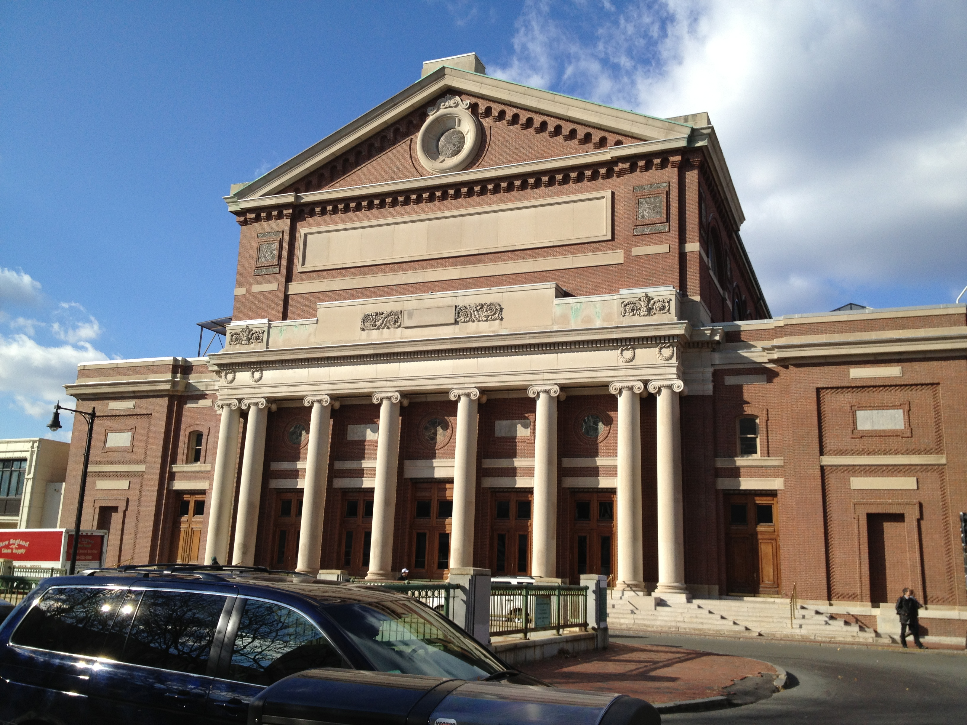
The Symphony Hall today

Slide 21
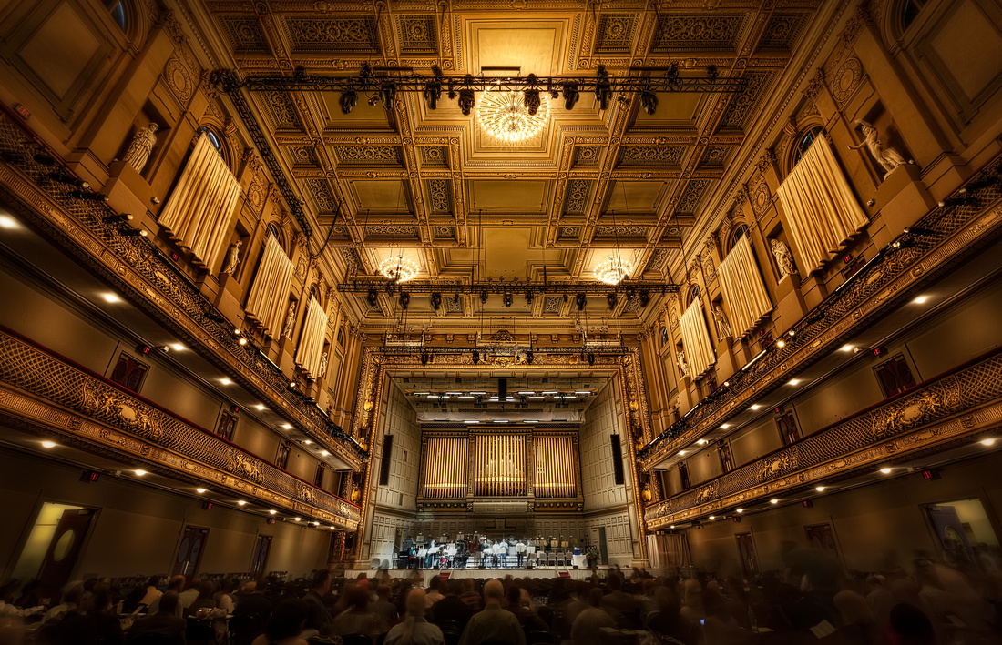

Slide 22
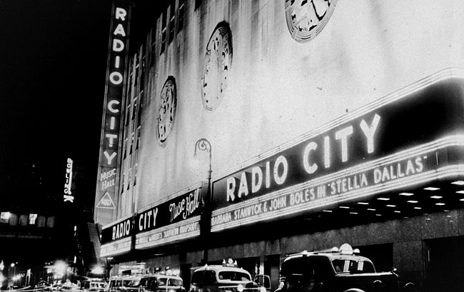
The Radio City Music Hall in New York,1937

Slide 23
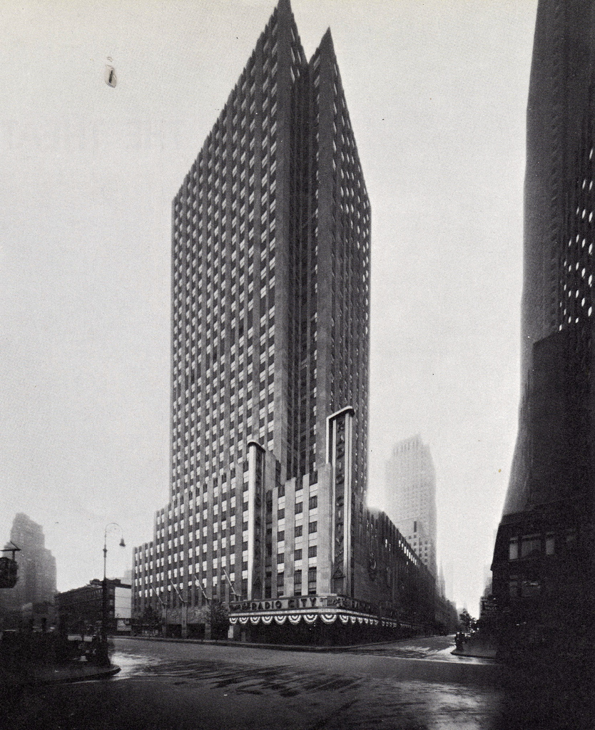

Slide 24
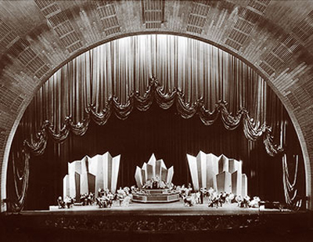

Slide 25
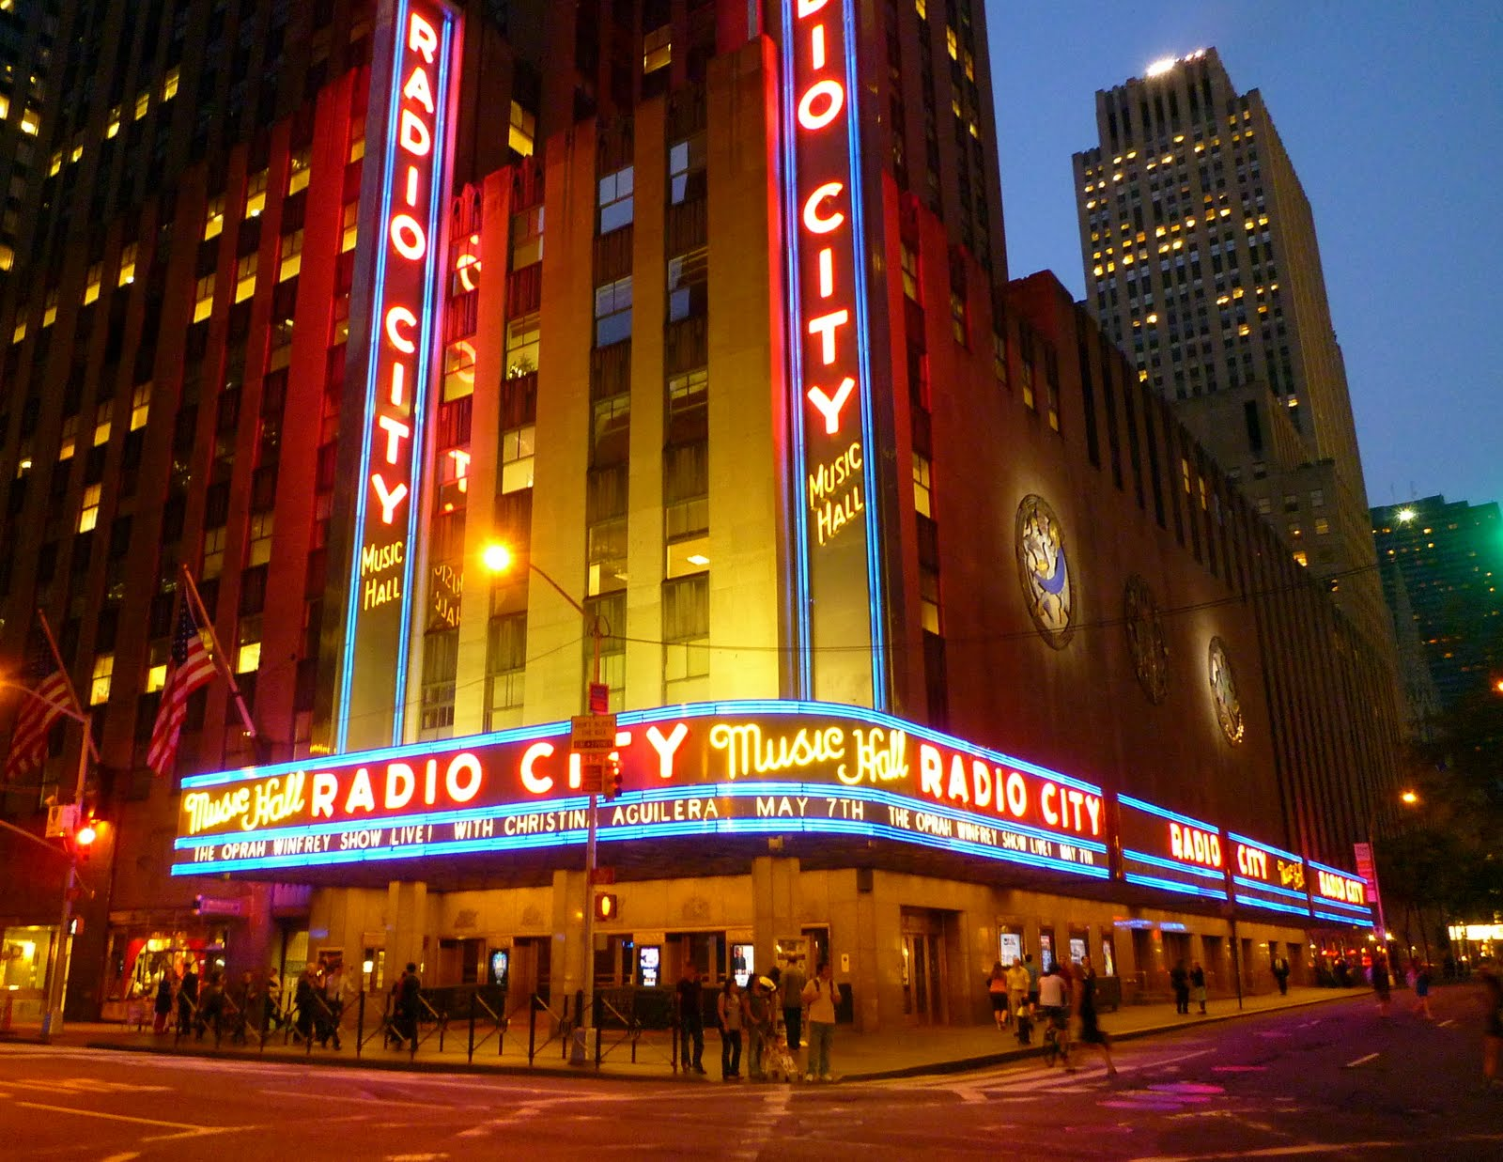
Radio City Music Hall today

Slide 26
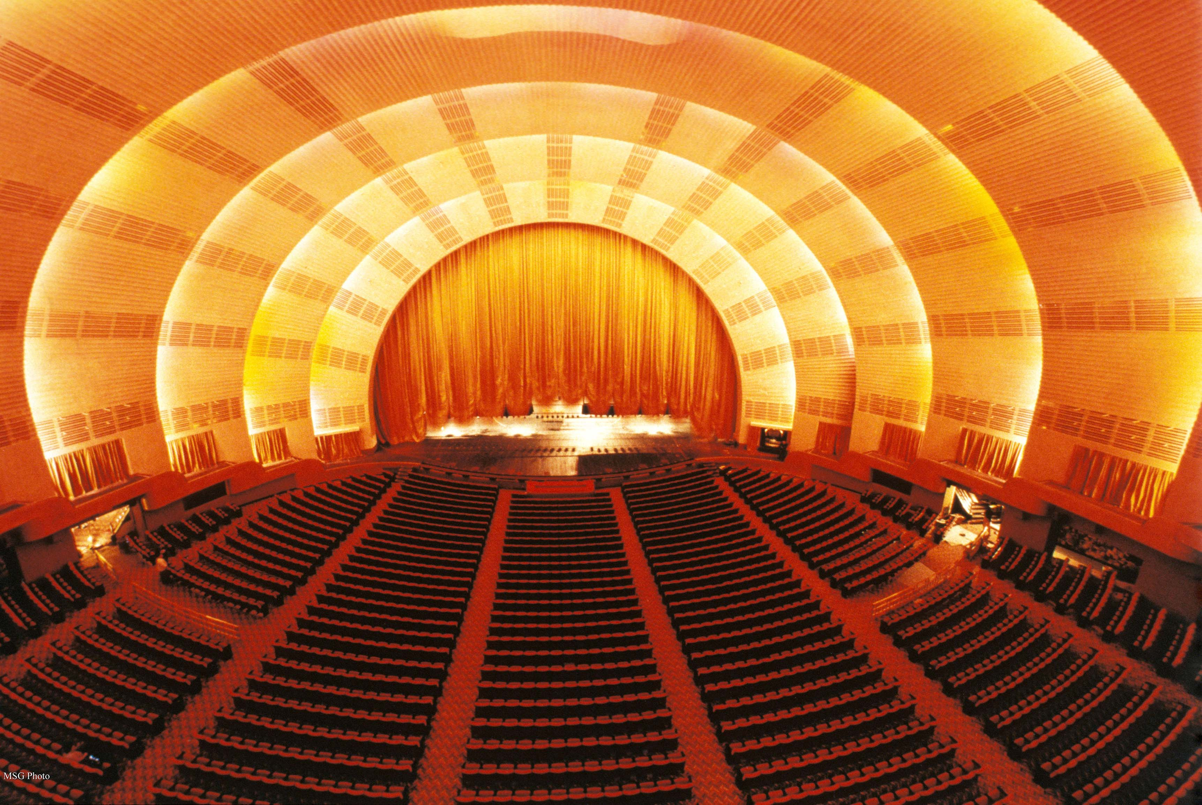

Slide 27
Thompson describes the emergence of a new, modernist sound. Define it:

Slide 28
Thompson describes the emergence of a new, modernist sound. Define it:
An object of scientific scrutiny

Slide 29
Thompson describes the emergence of a new, modernist sound. Define it:
An object of scientific scrutiny
Controlled (a "good sound”)

Slide 30
Thompson describes the emergence of a new, modernist sound. Define it:
An object of scientific scrutiny
Controlled (a "good sound”)
Non-reverberant

Slide 31
Thompson describes the emergence of a new, modernist sound. Define it:
An object of scientific scrutiny
Controlled (a "good sound”)
Non-reverberant
Many different places begin to sound alike

Slide 32
Thompson describes the emergence of a new, modernist sound. Define it:
An object of scientific scrutiny
Controlled (a "good sound”)
Non-reverberant
Many different places begin to sound alike
Easy to understand

Slide 33
Thompson describes the emergence of a new, modernist sound. Define it:
An object of scientific scrutiny
Controlled (a "good sound”)
Non-reverberant
Many different places begin to sound alike
Easy to understand
Efficient

Slide 34
Thompson describes the emergence of a new, modernist sound. Define it:
An object of scientific scrutiny
Controlled (a "good sound”)
Non-reverberant
Many different places begin to sound alike
Easy to understand
Efficient
Had little to say about the places in which it was produced and consumed

Slide 35
"...if most of sounds of the past are gone for good, they have nonetheless left behind a rich record of their existence in the artifacts, the people, and the cultures that once brought them forth.

Slide 36
"...if most of sounds of the past are gone for good, they have nonetheless left behind a rich record of their existence in the artifacts, the people, and the cultures that once brought them forth. By starting here, with the solidity of technological objects and material practices of those who designed, built, and used them, we can begin to recover the sounds that have long since melted into air.

Slide 37
"...if most of sounds of the past are gone for good, they have nonetheless left behind a rich record of their existence in the artifacts, the people, and the cultures that once brought them forth. By starting here, with the solidity of technological objects and material practices of those who designed, built, and used them, we can begin to recover the sounds that have long since melted into air. Along with those sounds, we can recover more fully our past." (p. 125-126)

Slide 38
For Thursday: Choose a sound technology and do research on the historical developments and factors that shaped its present form, then compare that history to one that we studied this week. Use this comparative analysis to frame your discussion question.

