Slide 1
III. Sound As Media

Slide 2
Media Networks and Communities
Film Sound

Slide 3
Key words for this section:

Slide 4
Key words for this section:
Transduction

Slide 5
Key words for this section:
Transduction
Reproducibility

Slide 6
Key words for this section:
Transduction
Reproducibility
Acousmatic sound (Schaeffer)

Slide 7
Key words for this section:
Transduction
Reproducibility
Acousmatic sound (Schaeffer)
Schizophonia (Schafer)

Slide 8
Key words for this section:
Transduction
Reproducibility
Acousmatic sound (Schaeffer)
Schizophonia (Schafer)
Recording

Slide 9
Key words for this section:
Transduction
Reproducibility
Acousmatic sound (Schaeffer)
Schizophonia (Schafer)
Recording
Fidelity and intelligibility

Slide 10
Key words for this section:
Transduction
Reproducibility
Acousmatic sound (Schaeffer)
Schizophonia (Schafer)
Recording
Fidelity and intelligibility
Agency and communication

Slide 11
Media Networks & Communities:
Radio (Hilmes)
Online Music Sites (Pinch & Athanasiades)
Phonograph / Gramophone (Kittler)
Telephone (Martin & Martel)

Slide 12
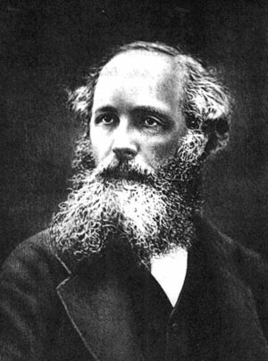
James Clerk Maxwell showed in theoretical and mathematical form in 1864 that electromagnetic waves could propagate through free space.

Slide 13
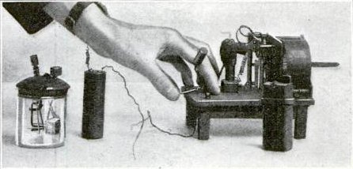
In 1879, David Edward Hughes performed an experiment in which a signal was transmitted by means of electromagnetic waves. (Image: Hughes wireless apparatus used in his experiments)

Slide 14
In 1888 Heinrich Rudolf Hertz was able to conclusively prove transmitted airborne electromagnetic waves in an experiment confirming Maxwell's theory of electromagnetism. (Image: Hertz’s first radio transmitter)

Slide 15
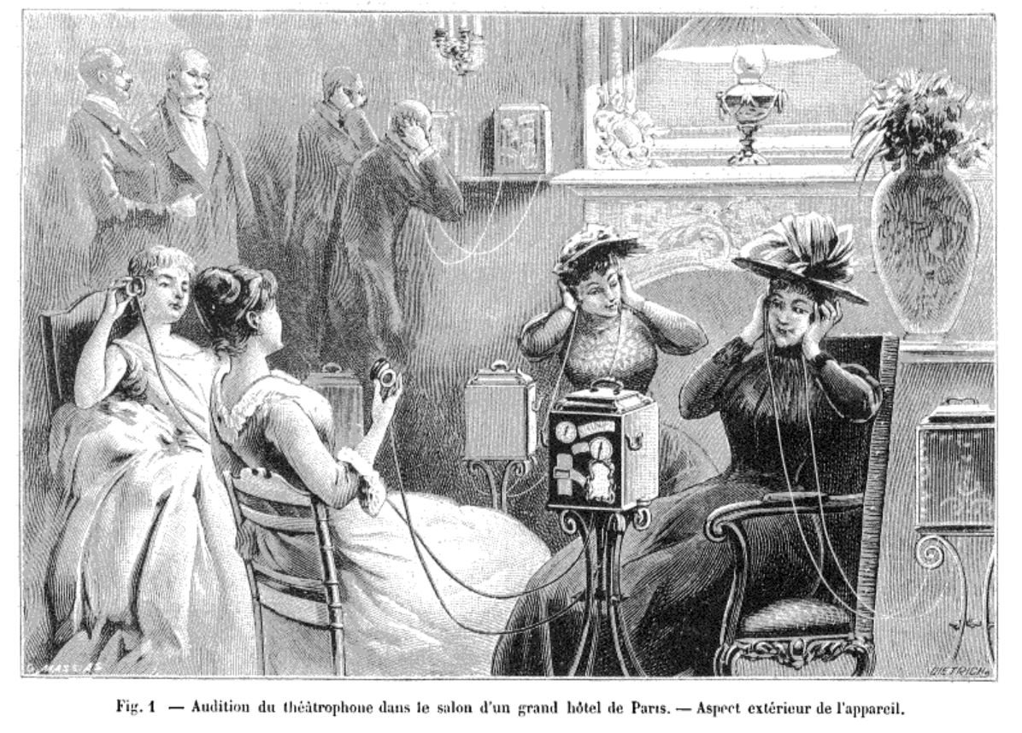
From as early as 1890, there was a system whereby news, music, live theatre, music hall, fiction readings, religious broadcasts, were transmitted to private homes.

Slide 16
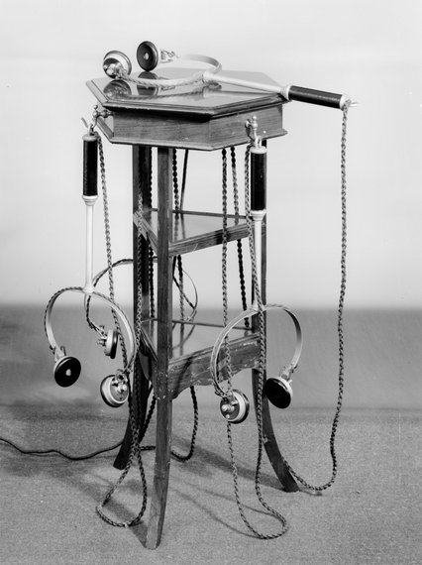
In Britain this system was known as Electrophone, and was available as early as 1895 or 1899 and up until 1926. In Hungary, it was called Telefon Hírmondó (1893-1920s), and in France, Théâtrophone
(1890-1932).

Slide 17
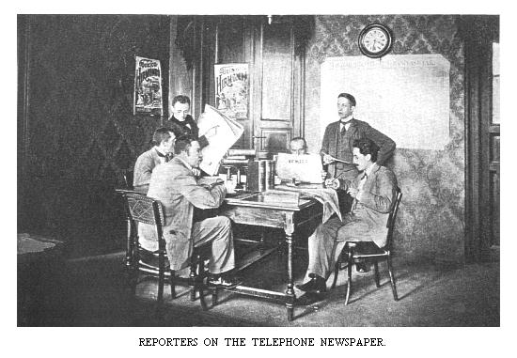

Slide 18
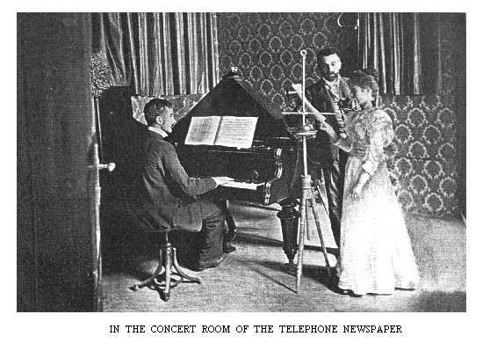

Slide 19
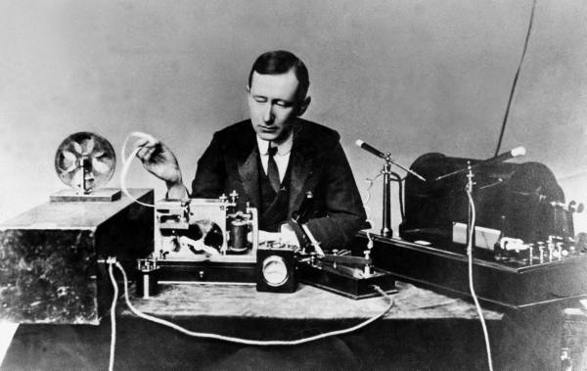
The first broadcasting of a radio transmission (in Morse code) was made by Guglielmo Marconi in 1895.
This followed on from other pioneering work in the field by Alessandro Volta, André-Marie Ampère, and Georg Ohm.

Slide 20
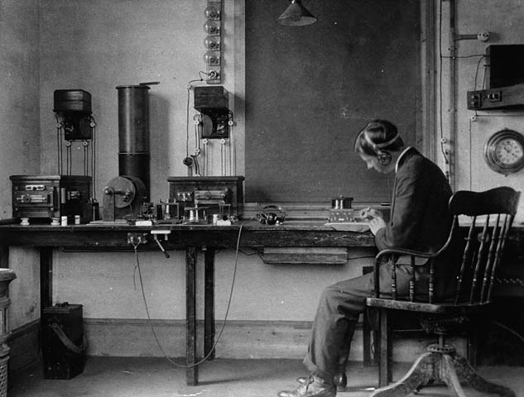
The Marconi Company was founded in England in 1897.
The broadcasting of music and talk via radio started experimentally around 1905-1906,
and commercially around 1920 to 1923. VHF (very high frequency) stations started 30 to 35 years later.

Slide 21
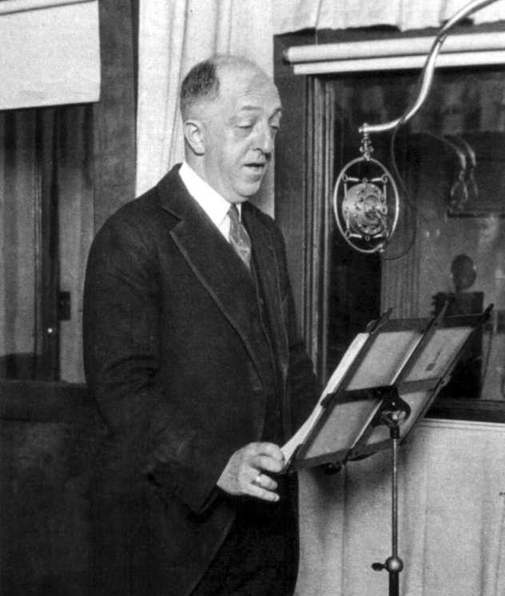
The beginning of regular, commercially licensed radio broadcasting in the United States in 1920. By 1928, the United States had three national radio networks: two owned by NBC (the National Broadcasting Company), and one by CBS (the Columbia Broadcasting System).

Slide 22
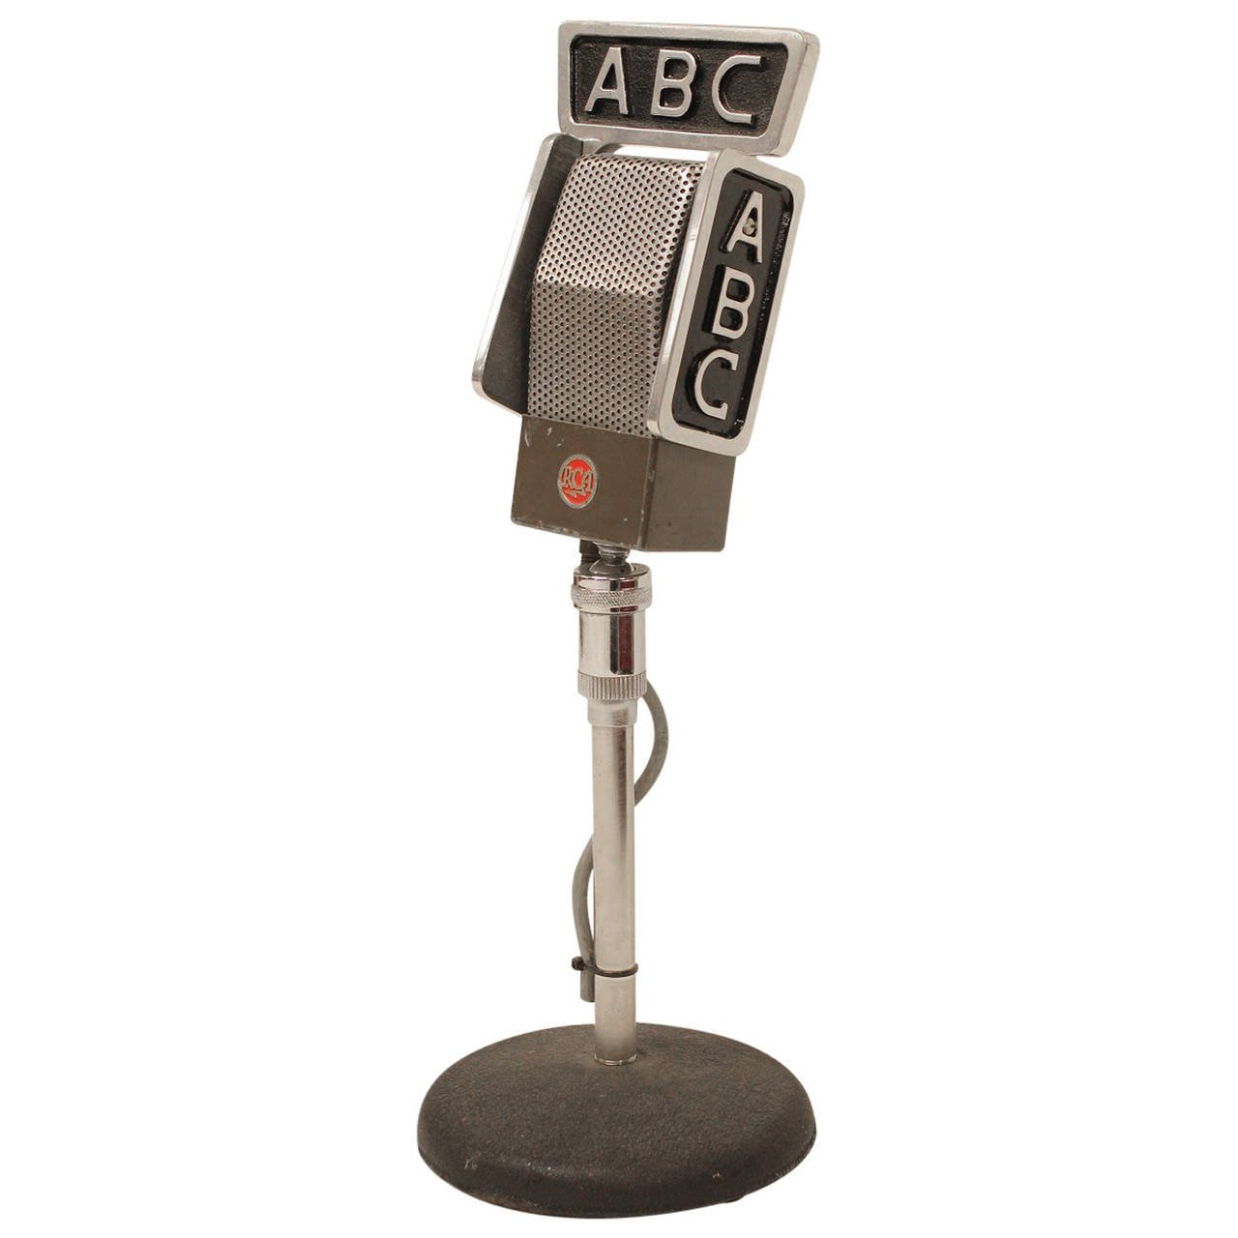
Until 1943, there were four major national radio networks: two owned by NBC, one owned by CBS and one owned by Mutual Broadcasting System. NBC's second network became ABC, the American Broadcasting Company.

Slide 23
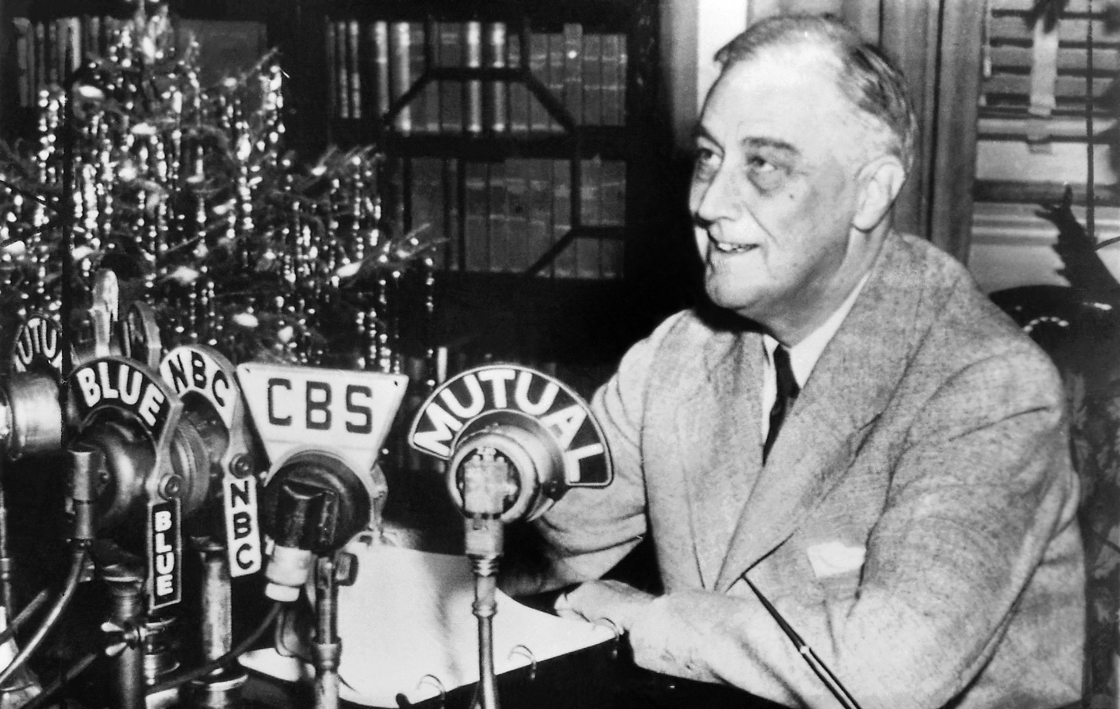
President Franklin D. Roosevelt delivering one of his nationwide radio 'Fireside chats’ in 1943.

Slide 24
Radio as imagined community:
Benedict Anderson’s description of the modern print-influenced citizen // radio listener
“Unity, connection, and communication in its purest sense.” (p. 352)
Simultaneity of experience – without direct contact

Slide 25
Exposure to the public – in the privacy of one’s home
“Radio’s ‘immateriality’ allowed it to cross these boundaries: allowed ‘race’ music to invade the white middle-class home, vaudeville to compete with opera in the living room, risqué city humor to raise rural eyebrows, salesmen and entertainers to find a place in the family circle.” (p. 355)

Slide 26
Radio’s power to unify the nation culturally – what national culture?
Commercialism
Utopian discourse of uplift and education
Dystopian fear of the popular
Vast audiences of women
Linguistic unity
Enforcement of cultural norms

Slide 27
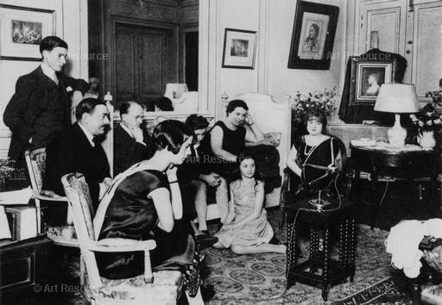
Listening to the radio in the 1920s

Slide 28
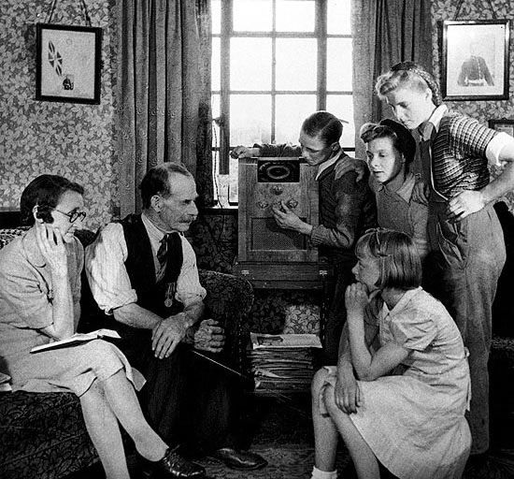
Listening to the radio in the 1950s

Slide 29
Online Music Sites
(sonic technosocial communities):
An ethnographic study of ACIDplanet.com
ACID turns the computer into a recording studio and enables users to make music, post/share, and review each other’s music
Review system (comments and star-rating; a “translation mode”) and contests (remixes and mash-ups)

Slide 30
Users: provide most of the content, form a devoted community; more organic than regular file-sharing systems
Public interaction – visible to all users
Special sociotechnical instruments / scopic focusing technologies: allow users to focus on certain selected pieces of content
Double sociality – economies of reputation

Slide 31
Transduction
New and old identities and systems - possibilities, problems, and contradictions

Slide 32
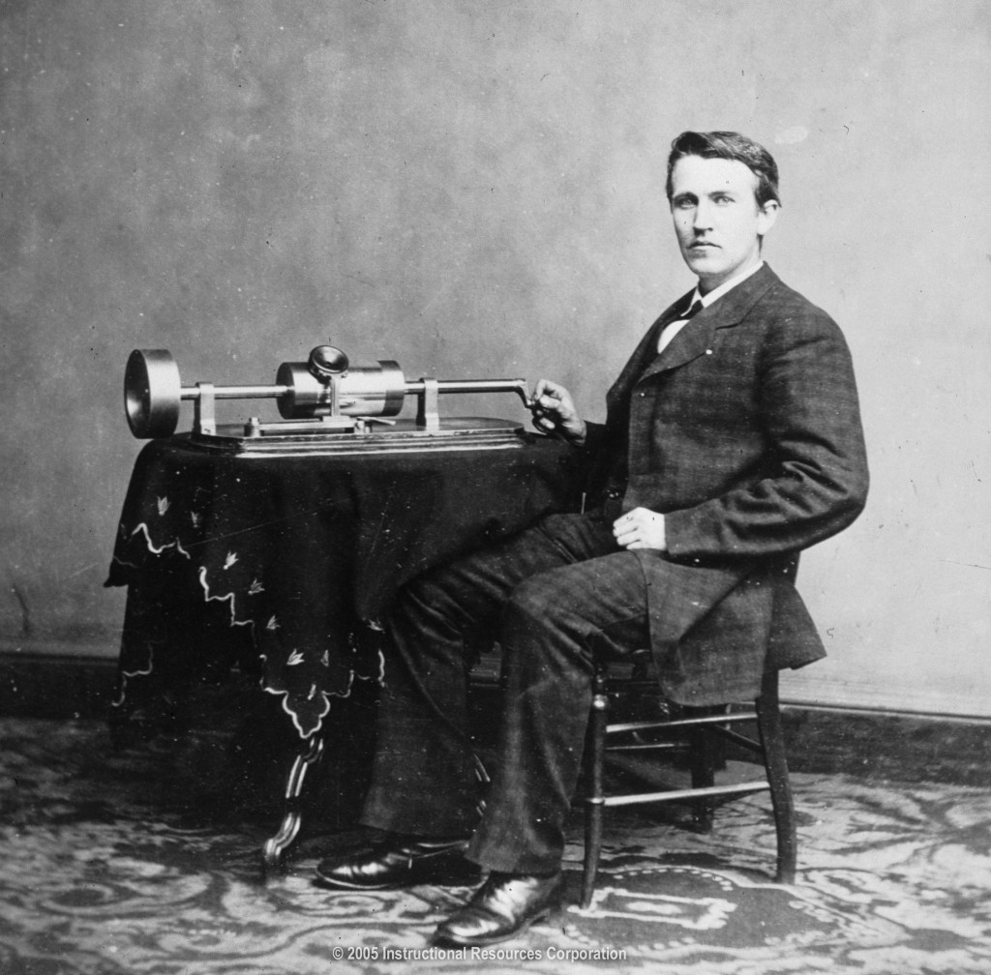
The phonograph was invented by Thomas Edison in 1877. This photograph was taken in 1878.

Slide 33
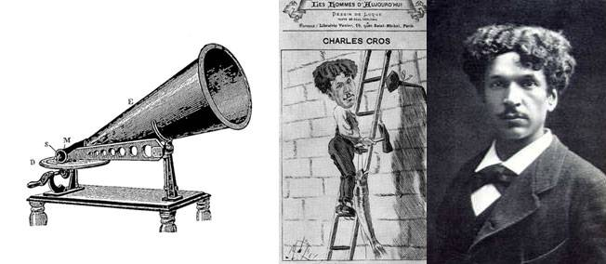
Charles Cros, a French poet and inventor, actually conceived of a phonograph-like device before Edison. On April 30, 1877, he submitted a letter to the Academy of Sciences in Paris describing a method of reproducing sound using a diaphragm.

Slide 34
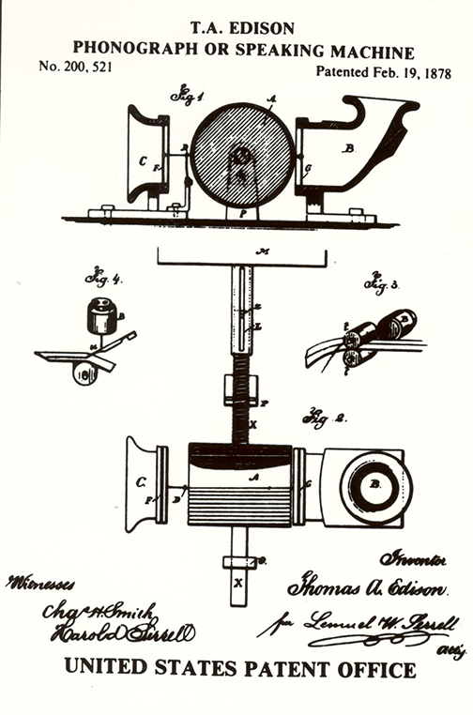
Edison announced his invention on November 21, 1877, and demonstrated the device for the first-time on Nov. 29. The Edison Phonograph was patented on February 19, 1878.

Slide 35
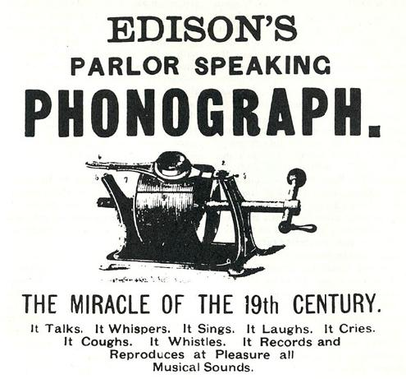
The Edison Speaking Phonograph Company was formed in April, 1878.

Slide 36
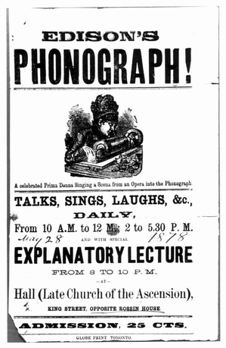
One of the first requests to for the phonograph, made by the American Philological Society, was “to preserve the accents of the Onondagas and Tuscaroras, who are dying out.” (p. 288) The company organized a series of lectures to demonstrate and promote Edison’s new invention.

Slide 37
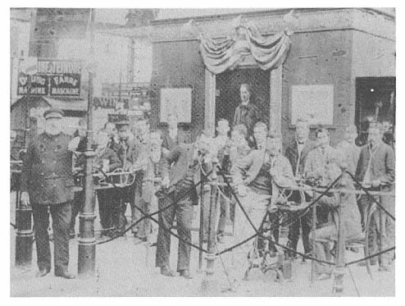
Edison phonograph display at the 1889 Paris International Exposition

Slide 38
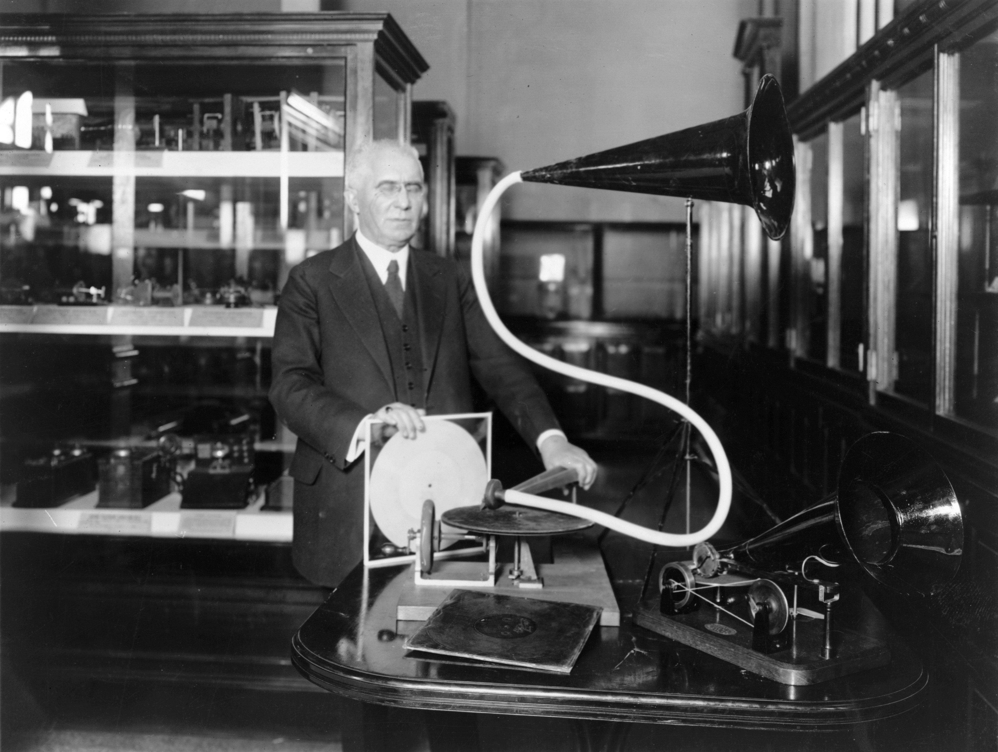
Emile Berliner, a German inventor, was granted a patent for what he called the Gramophone in 1887.

Slide 39
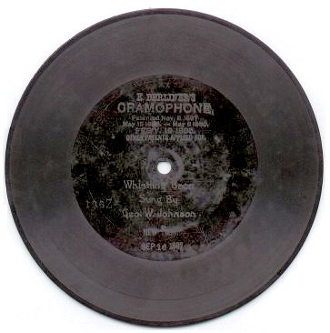
In 1888, Berlin’s recording method was to use a stylus to trace a line through a thin coating of wax on a zinc disc, which was then etched in acid to form playable grooves. He formed the US Berliner Gramophone Company in 1895
1897 Berliner Gramophone Record

Slide 40
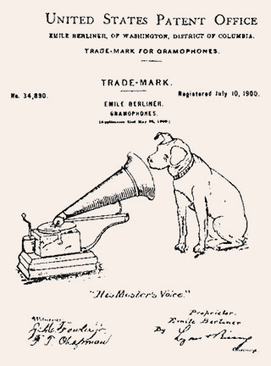

Slide 41
What is the significance of the Gramophone for Kittler?
Technological media a priori
Gramophone / phonograph “records acoustic events as such” (p. 235)
All concepts of trace are based on Edison’s idea.
A writing machine (relationship to deafness and education) within a continuum with other technologies, such as computers using silicon memory chips

Slide 42
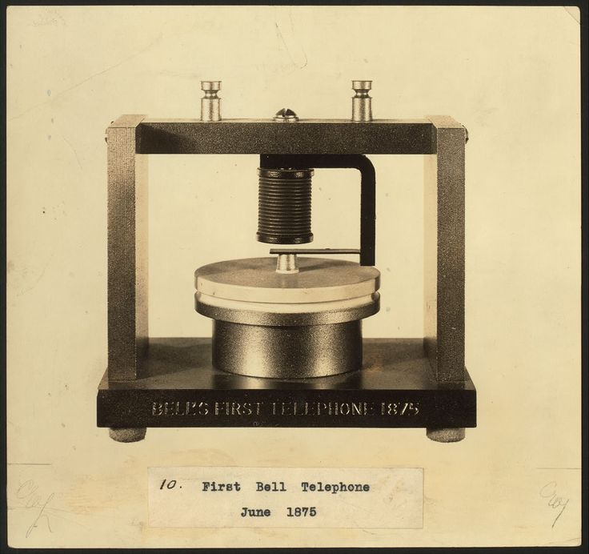
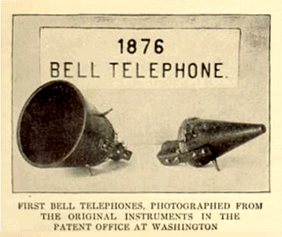
In March, 1876, Alexander Graham Bell was able to use his “acoustic telegraph” to work. He said the words: “Mr. Watson—Come here—I want to see you.” into a liquid transmitter, and Thomas Watson, listening in an adjoining room, heard his words on the receiver.

Slide 43
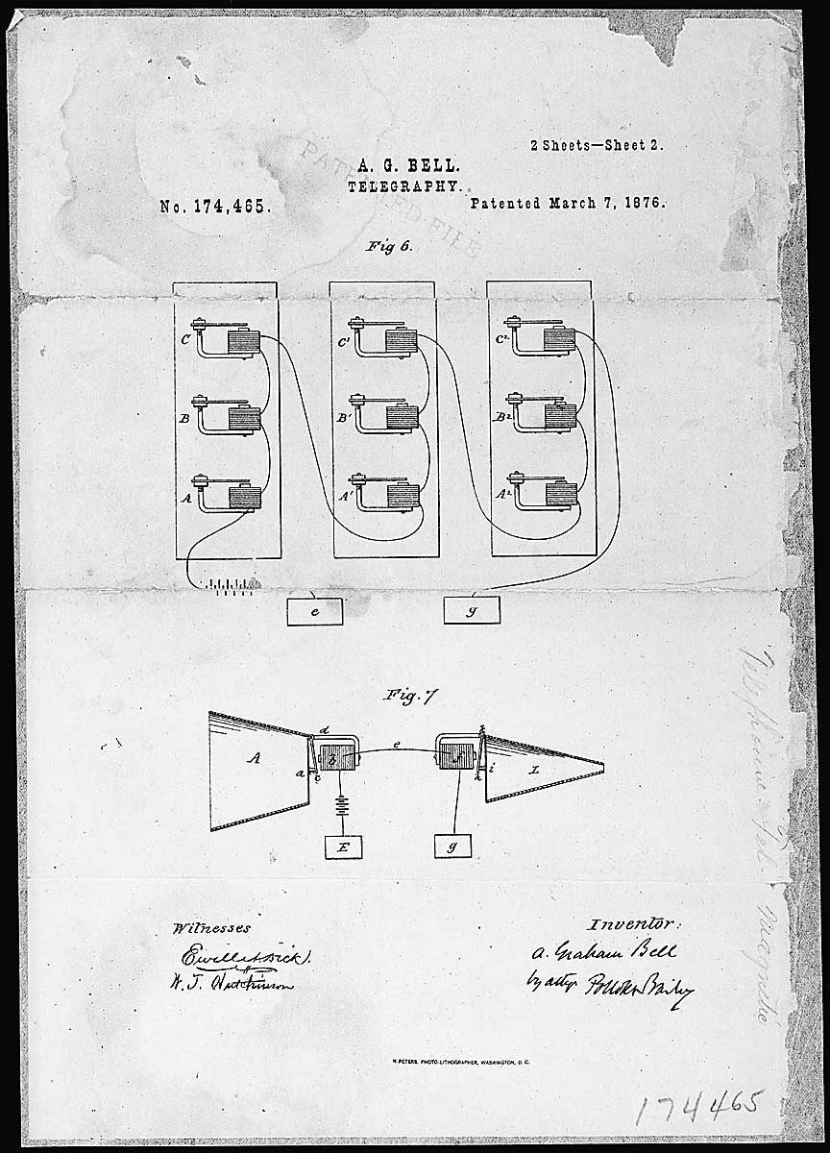
Bell’s telephone patent drawing, issue on March 7, 1876. He was in a race with Elisha Gray – both were experimenting on similar concepts - and there was a controversy on who invented the device first.

Slide 44
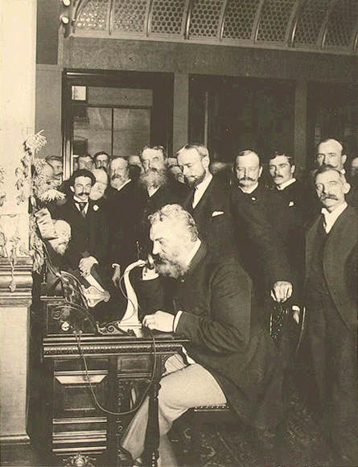
Bell began to conduct a series of public lectures and demonstrations on early telephone prototypes. The Bell Telephone Company was formed in 1877. By 1886, more than 150,000 people in the U.S. owned telephones.
Bell at the opening of the NY-Chicago long-distance line in 1892

Slide 45
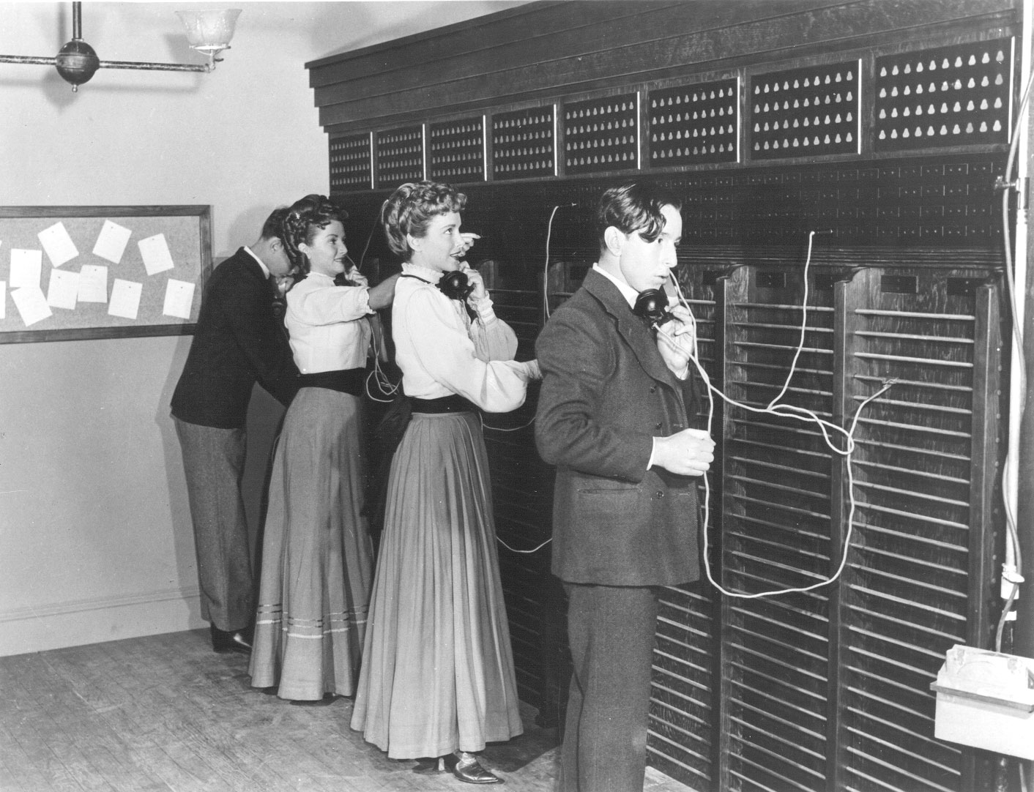
Up to the 1880s there were no phone numbers, human operators used the name of subscribers to track the slots on the switchboard. Emma and Stella Nutt became the first female operators in 1878.

Slide 46
