Slide 1
IV. Sound Space
2. Acoustemology & Representation

Slide 3
Some Useful Theoretical Terms and Concepts:
Profound listening

Slide 4
Some Useful Theoretical Terms and Concepts:
Profound listening
Broadband sound

Slide 5
Anthropology of sound (Feld & Helmreich)
Representing soundscape, Soundscape as representation (Sound art projects by Lopez, Fontana, & Aitken)

Slide 6
A. Anthropology of sound
(Feld & Helmreich)

Slide 7
What role does anthropological inquiry have in shaping the discourse of acoustic ecology and soundscape studies?

Slide 8
What role does anthropological inquiry have in shaping the discourse of acoustic ecology and soundscape studies?
And how does acoustic phenomena and technological mediation shape and influence these inquiries?

Slide 9
What role does anthropological inquiry have in shaping the discourse of acoustic ecology and soundscape studies?
And how does acoustic phenomena and technological mediation shape and influence these inquiries?
How might anthropology/ethnography help us imagine auditory culture(s) as historical formations of distinct sensibilities, as sonic geographies of difference?

Slide 10
Feld: “Deep down the hope is that by giving marginalized voices places to speak and shout and sing from, anthropology can in some measure counter the long-standing arrogance of colonial and imperial authority, of history written in one language, in one voice, as one narrative.” (p. 223)

Slide 11
Feld: “Deep down the hope is that by giving marginalized voices places to speak and shout and sing from, anthropology can in some measure counter the long-standing arrogance of colonial and imperial authority, of history written in one language, in one voice, as one narrative.” (p. 223)

Slide 12
Feld: “Deep down the hope is that by giving marginalized voices places to speak and shout and sing from, anthropology can in some measure counter the long-standing arrogance of colonial and imperial authority, of history written in one language, in one voice, as one narrative.” (p. 223)

Slide 13
Helmreich: “...inquiry motivated not by the visual rhetoric of self-examination and self-correcting perspectivalism but by auditorily inspired, lateral attention to the modulating relations that produce insides and outsides, subjects and objects, sensation and sense data...” (p. 169)

Slide 14
Helmreich: “...inquiry motivated not by the visual rhetoric of self-examination and self-correcting perspectivalism but by auditorily inspired, lateral attention to the modulating relations that produce insides and outsides, subjects and objects, sensation and sense data...” (p. 169)

Slide 15
Helmreich: “...inquiry motivated not by the visual rhetoric of self-examination and self-correcting perspectivalism but by auditorily inspired, lateral attention to the modulating relations that produce insides and outsides, subjects and objects, sensation and sense data...” (p. 169)

Slide 16
“Rather than seeing from a point of view, I suggest tuning in to surroundings and to circumstances that allow resonance, reverberation, echo—senses of presence and distance, at scales ranging from individual to collective.”

Slide 17
“Rather than seeing from a point of view, I suggest tuning in to surroundings and to circumstances that allow resonance, reverberation, echo—senses of presence and distance, at scales ranging from individual to collective.”

Slide 18
“Rather than seeing from a point of view, I suggest tuning in to surroundings and to circumstances that allow resonance, reverberation, echo—senses of presence and distance, at scales ranging from individual to collective.”
“a model of anthropologists as transducers in circuits of social relations.”(all p. 169-170)

Slide 19
“Rather than seeing from a point of view, I suggest tuning in to surroundings and to circumstances that allow resonance, reverberation, echo—senses of presence and distance, at scales ranging from individual to collective.”
“a model of anthropologists as transducers in circuits of social relations.”(all p. 169-170)

Slide 20
Some Useful Theoretical Terms and Concepts:

Slide 21
Some Useful Theoretical Terms and Concepts:
Acoustemology

Slide 22
Some Useful Theoretical Terms and Concepts:
Acoustemology
Poetic cartography:
Lift-up-over-sounding” (dulugu ganalan)
“flowing” (a:ba:lan)

Slide 23
Some Useful Theoretical Terms and Concepts:
Acoustemology
Poetic cartography:
Lift-up-over-sounding” (dulugu ganalan)
“flowing” (a:ba:lan)
Sound worlds as embodied histories (histories lived musically)

Slide 24
Some Useful Theoretical Terms and Concepts:
Transductive ethnography

Slide 25
Some Useful Theoretical Terms and Concepts:
Transductive ethnography
Immersion

Slide 26
Comparative Analysis Between the Sound World of the Kaluli and Alvin

Slide 27
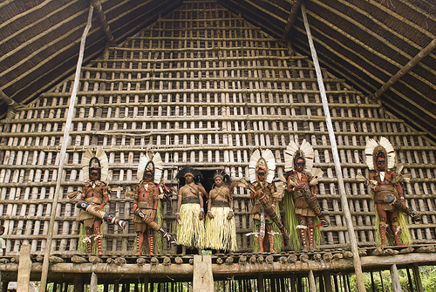
Visual World of the Kaluli, Papua New Guinea

Slide 28
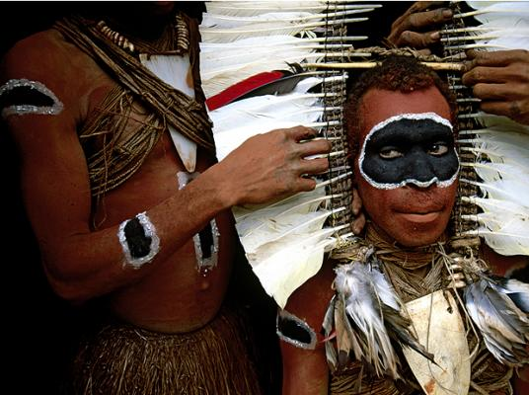

Slide 32
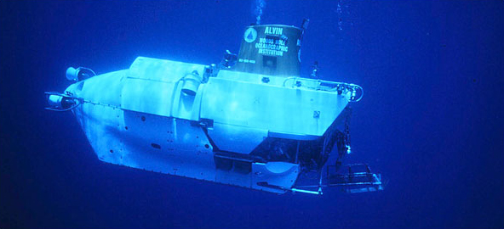
Visual World of Alvin (DVS-2)

Slide 33
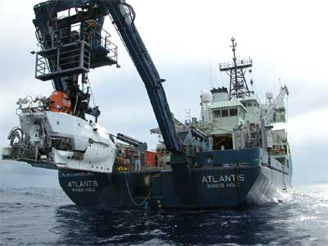
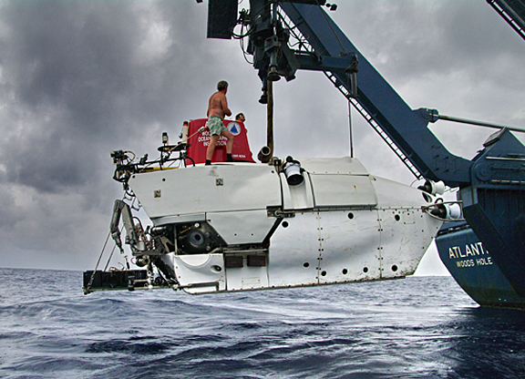

Slide 34
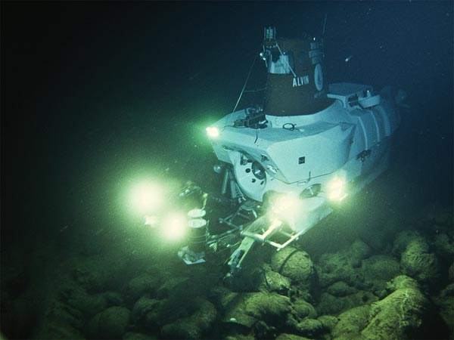

Slide 35
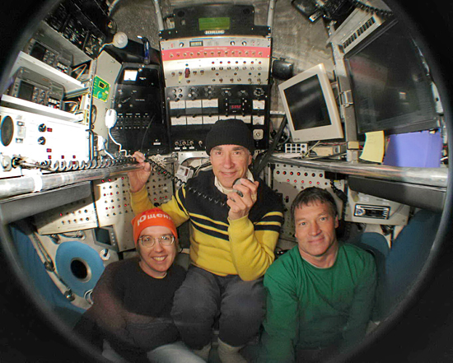

Slide 36
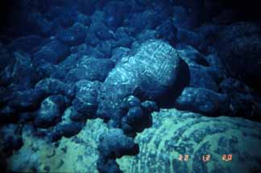
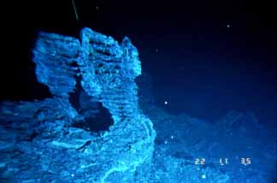

Slide 37
How are the soundscapes of the Kaluli and deep sea environments similar and different from ours?

Slide 38
How are the soundscapes of the Kaluli and deep sea environments similar and different from ours?
How are these soundscapes similar and different from each other?

