Slide 1
IV. Sound Space

Slide 2
Soundscape
Ethnography, Field Recordings, Site Specificity

Slide 3
Key concepts for this section:
“Space is the grain of sound.” (John Mowitt)
Space is the register where sound can happen and have meaning
Sound space = social space
Space is in constant formation, dissolution, reformation
Power relationships – a politics of space

Slide 4
Areas of study:
Soundscape
Acoustic ecology
Anthropology of sound
Aural architecture
Urban space and mobile
technologies
History
Noise

Slide 5
The Soundscape (Schafer)
Mobile technology (Bull)
Space & sound art (LaBelle)

Slide 6
The Soundscape
What is the relationship between man and the sounds of his environment and what happens when those sounds change?
The soundscape of the world is changing (p. 95)
Industrialization = noise
Noise abatement (negative) vs. acoustic design (positive)
Ear cleaning
The world as a “macrocosmic composition”

Slide 7
What is acoustic design?

Slide 8
What is acoustic design?
What are the sonic features of the landscape?

Slide 9
What is acoustic design?
What are the sonic features of the landscape?
What does Schafer say about hearing and the senses in different cultures?

Slide 10
B. Mobile technology
Urban experience becomes synonymous with technological experience (consumerism)
iPod – most totalizing of these mobile individualizing technologies
The use of an iPod enables users to create a satisfying aestheticized reality for themselves as they move through daily life. (p. 198)
Aesthetic colonization
An auditory attentiveness
A solipsistic viewer
Non-interactive fantasies

Slide 11
iPod users and flâneurism
Kracauer – urban colonization
The world becomes a mimetic fantasy in which the “otherness” of the world in its various guises is negated

Slide 12
“Sound both colonizes the listener and actively recreates and reconfigures the spaces of experience. Through the power of a privatized sound world the world becomes intimate, known and possessed. Imagination is the mediated by the sounds of the iPod becoming an essential component in the ability of users to imagine at all. Users are often unable to aestheticize experience without the existence of their own individual soundtrack acting as a spur to the imagination.” (p. 205)

Slide 13
“Sound both colonizes the listener and actively recreates and reconfigures the spaces of experience. Through the power of a privatized sound world the world becomes intimate, known and possessed. Imagination is the mediated by the sounds of the iPod becoming an essential component in the ability of users to imagine at all. Users are often unable to aestheticize experience without the existence of their own individual soundtrack acting as a spur to the imagination.” (p. 205)

Slide 14
D. Space & Sound Art
“It is my view that sound’s relational condition can be traced through modes of spatiality, for sound and space in particular have a dynamic relationship. This no doubt stands at the core of the very practice of sound art.” (p. 469)
Perspectives of sound art:
Sound is always in more than one space
Sound occur among bodies
Sound is never a private affair

Slide 15
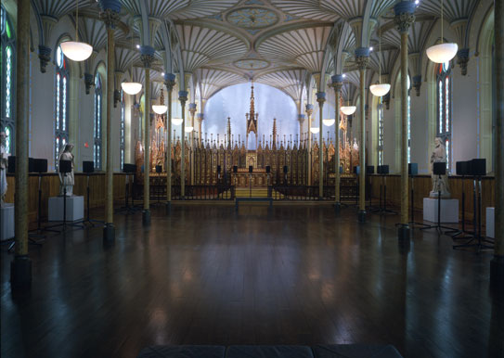
The Forty Part Motet (2001) by Janet Cardiff Installation in the Rideau Chapel, National Gallery of Canada

Slide 16
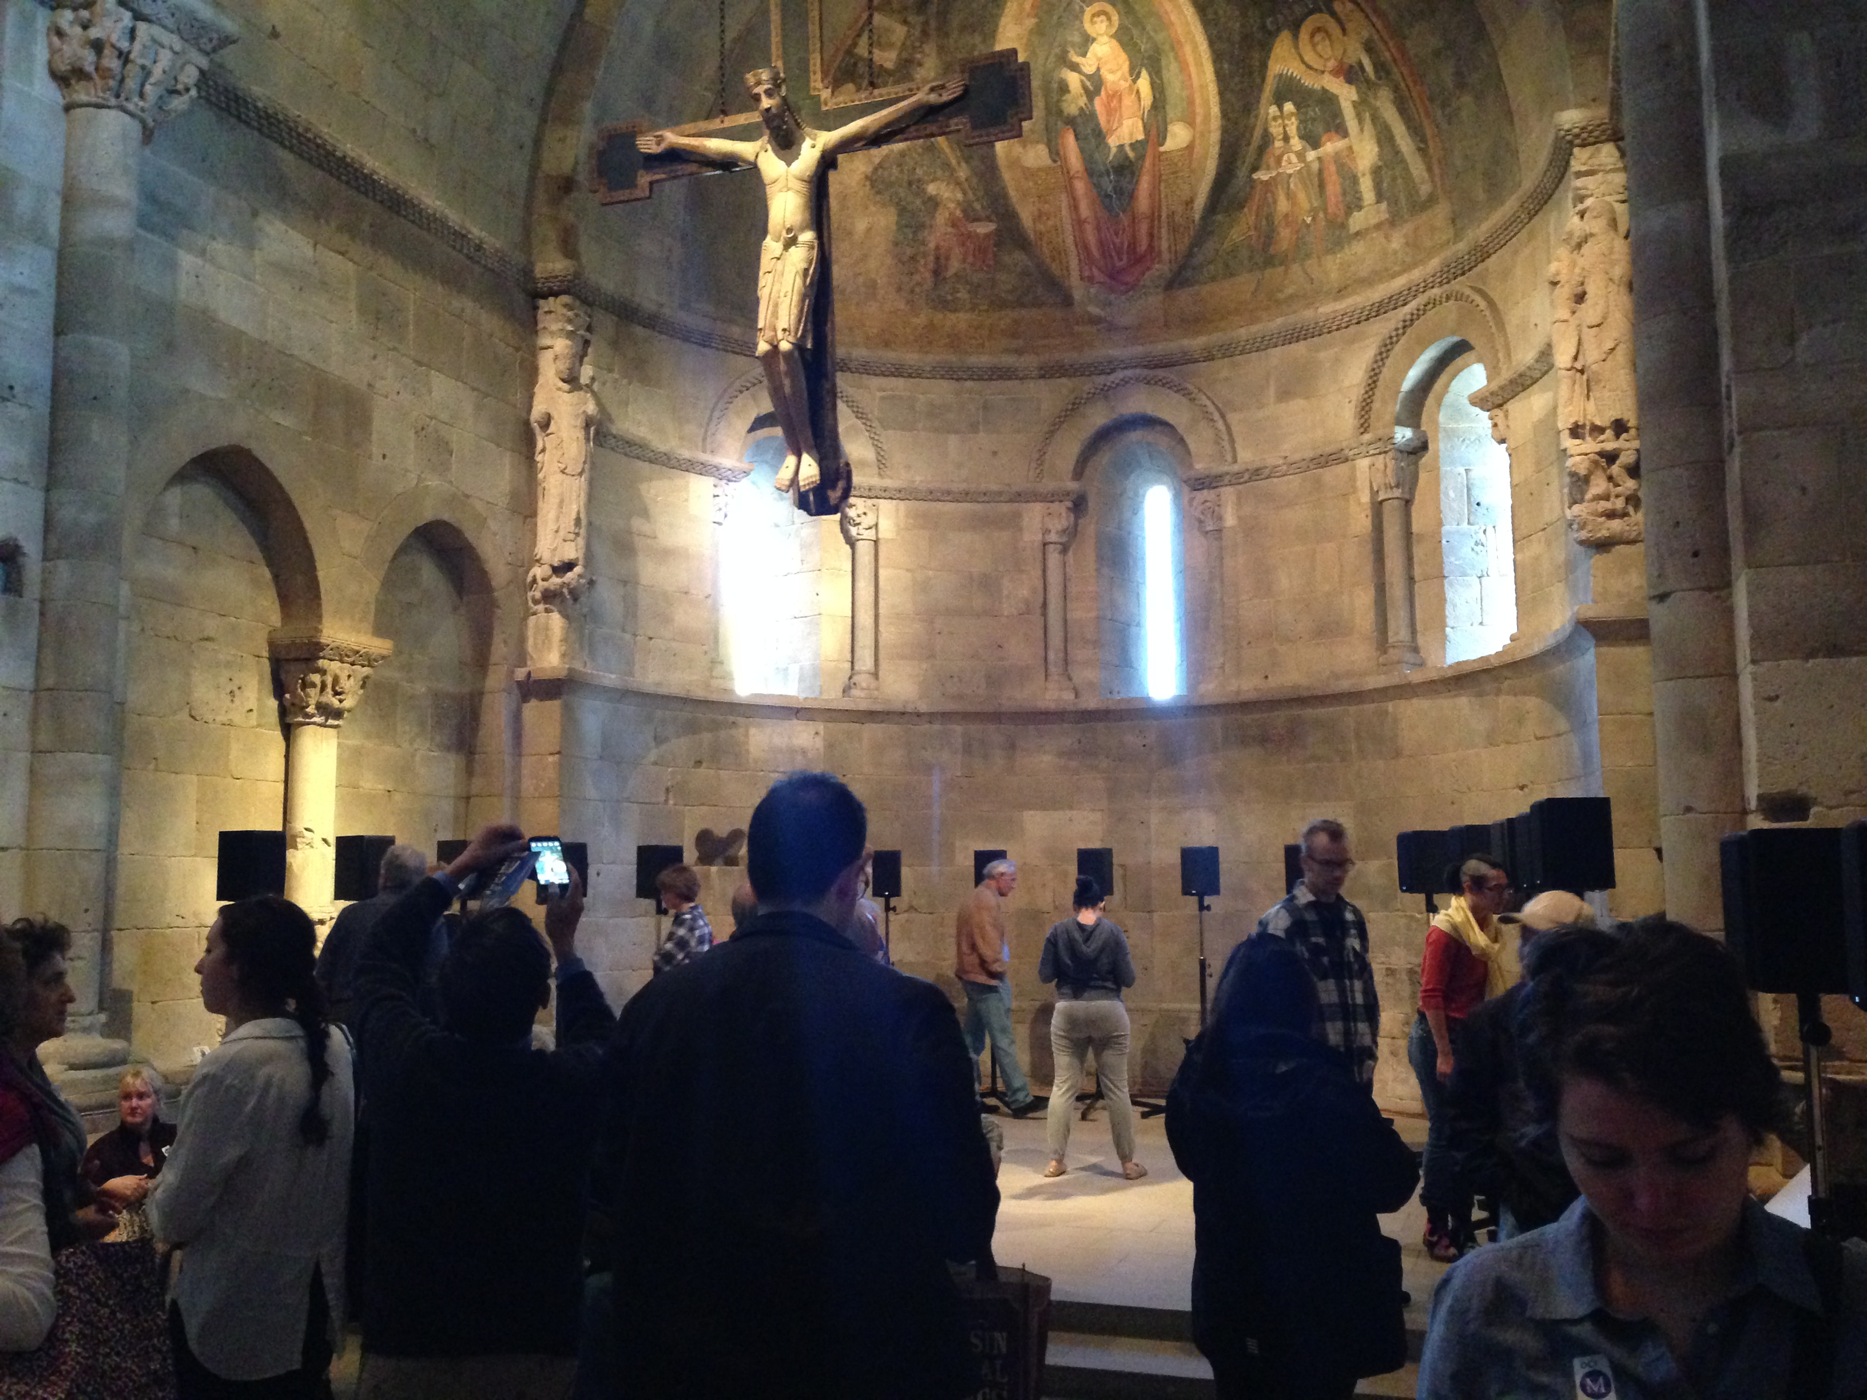
Installation in the Fuentidueña Chapel, The Cloisters, New York

Slide 17
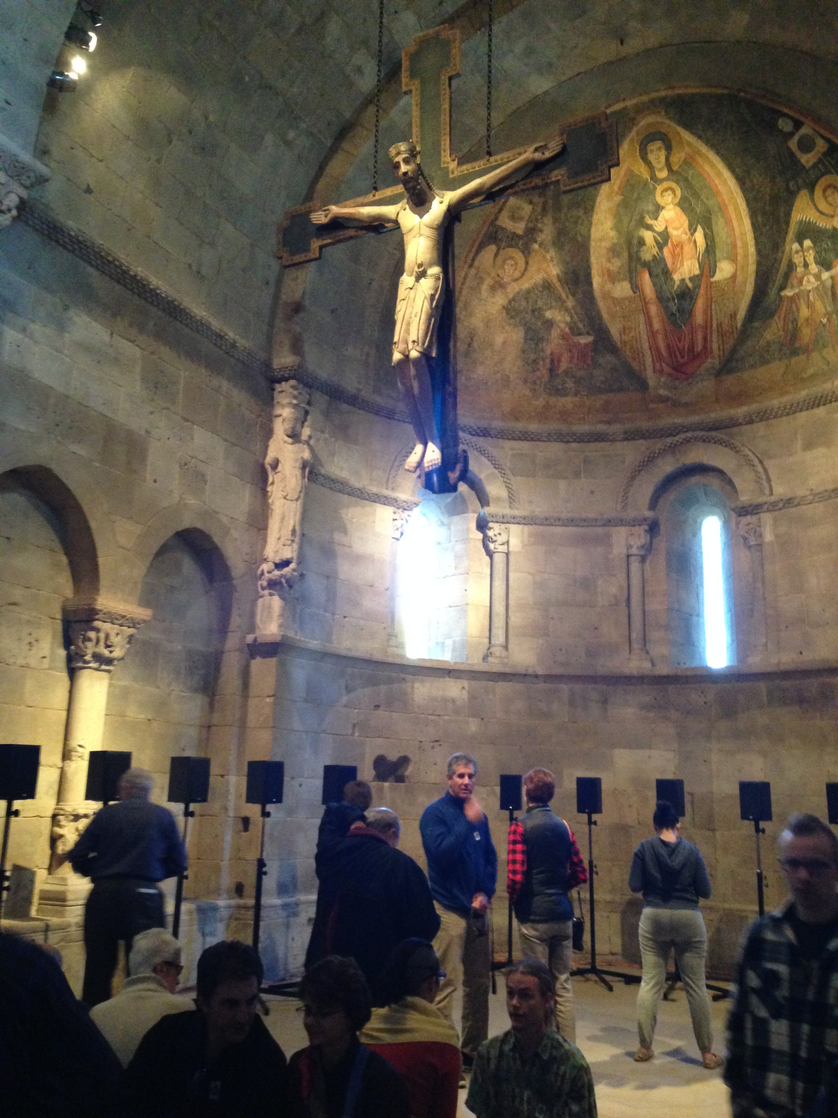

Slide 18
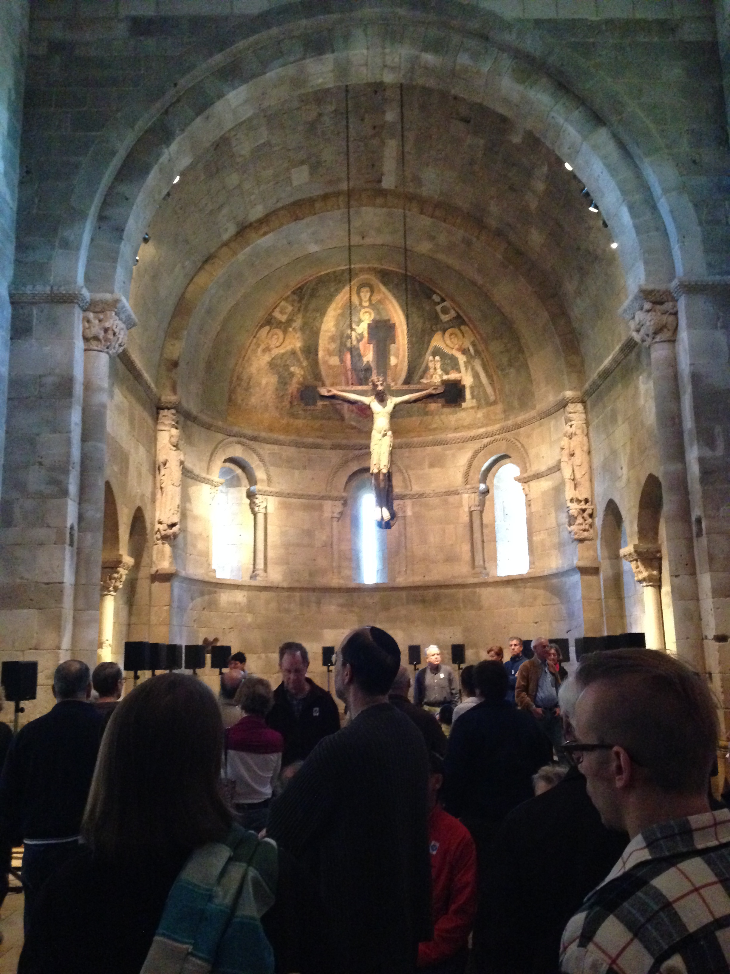

Slide 19
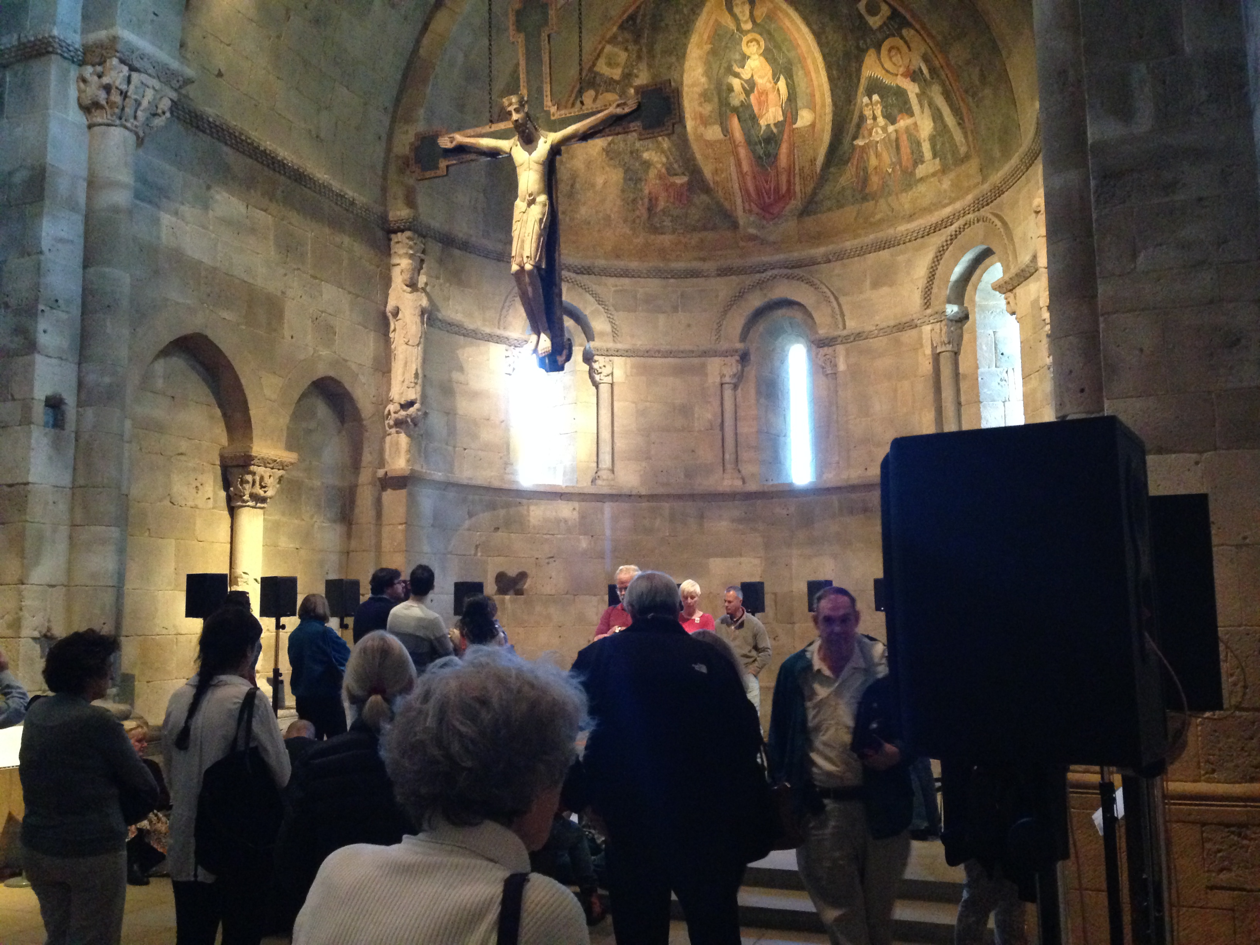

Slide 22
B. Architectural acoustics
“Acoustical spaces reflected the beliefs underlying social order as well as vocal and instrumental sounds.” (Rath, p. 131)
Religious or ceremonial architecture – ancient, prehistoric, Christian
Church acoustics
Chesapeake churches and chapels
Quaker meeting houses
Earcon
Reverberation

