Slide 1
VIDEO & DIVERSITY
Week 10:
AIDS Activism, Identity Politics

Slide 2
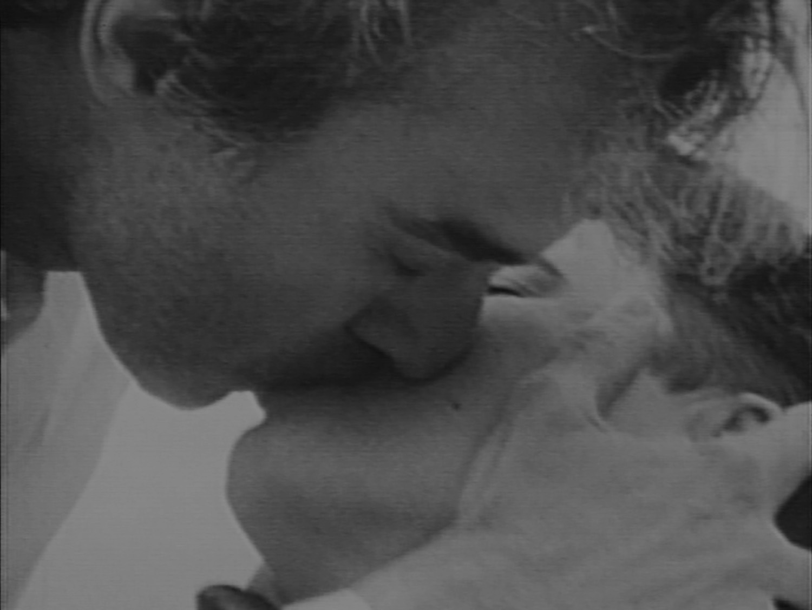
They are lost to vision altogether
(1989) Dir. Tom Kalin

Slide 3
Discussion
Saalfield writes: “Here protest is the process, communication is our means of resistance, and everyone has a say” (p.27) How is this statement relevant to the production, distribution, and study of AIDS activist videos?
How much did developments in video technology during the 1980s and early ‘90s influenced AIDS activist videos?

Slide 4
ACTUP Oral History Project
www.actuporalhistory.org/

Slide 5
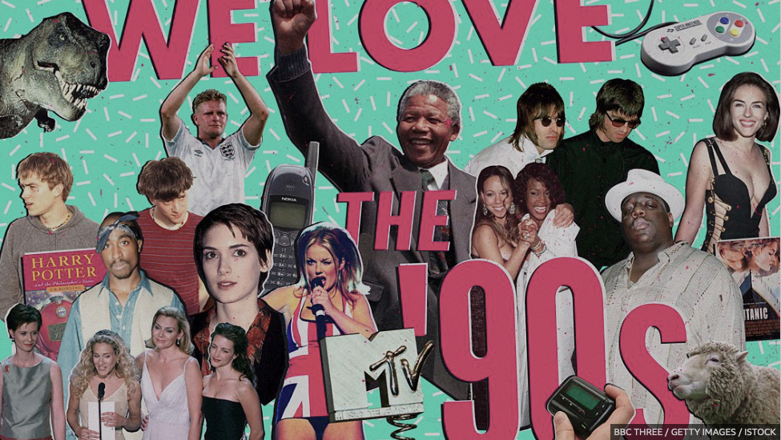
1990s Historical Perspective

Slide 6
Identity & Politics:

Slide 7
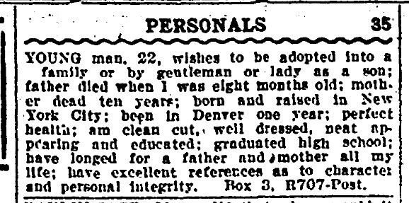
Identity & Politics:
Why did you choose these specific words or phrase to identify yourself with?

Slide 8
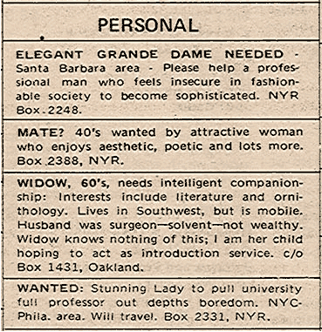
Identity & Politics:
Why did you choose these specific words or phrase to identify yourself with?
Do you think they describe you adequately?

Slide 9
Identity & Politics:
Do you think they are lacking? If so, how would you choose to describe yourself?

Slide 10
Identity & Politics:
Do you think they are lacking? If so, how would you choose to describe yourself?
Do you think these identities/labels are merely descriptive? Or is there power and ideology attached to them?

Slide 11
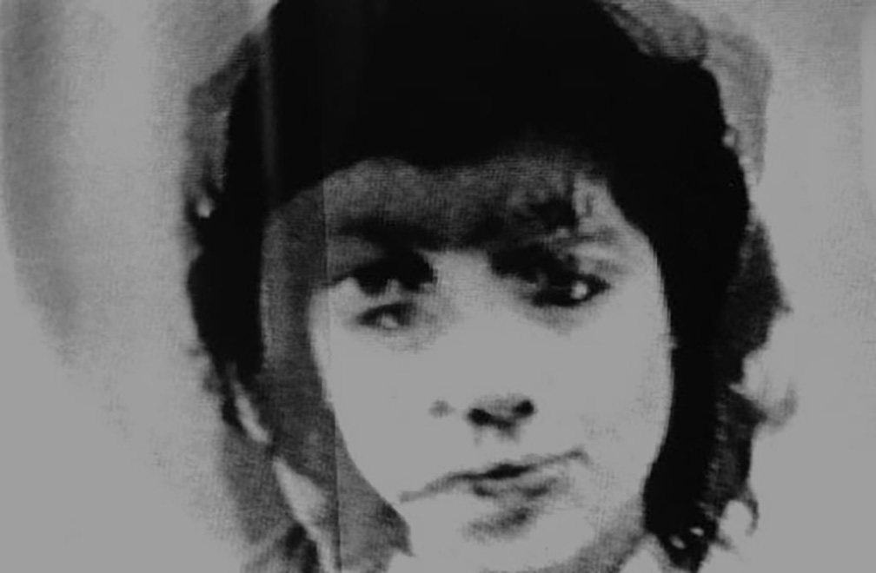
ALL ORIENTALS LOOK THE SAME
(1986) Dir. Valerie Soe

Slide 12
“…I knew as a Chinese American that images of Asian Americans that I saw on television and in mainstream films were nothing like the people I knew in my family and my community. They were really stereotyped. So [my video] was a way for me to bring a little truth of representation into what was being shown.”
- Valerie Soe (p.252)

Slide 13
“I’m trying to present a more realistic view, not necessarily a ‘positive image.’ I’m not interested in heroic figures. With them you’re just substituting one stereotype for another, right?”
- Valerie Soe (p.252)

Slide 14
Animaquiladora (1997)
Dir. Alex Rivera & Lalo Lopez

Slide 15
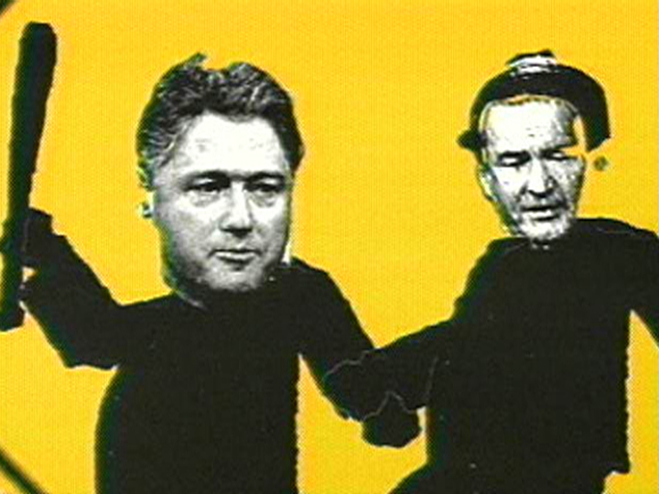
Connect one of the segments in the video to an idea discussed in the Fusco reading

Slide 16
“Understanding marginality as position and place of resistance is crucial for oppressed, exploited, colonized people.”
- bell hooks (p. 342)

