Slide 1
VIDEO & DIVERSITY
Week 2: What is Video?

Slide 2
Some common terms:

Slide 3
Some common terms:
Video

Slide 4
Some common terms:
Video
Film

Slide 5
Some common terms:
Video
Film
Movie

Slide 6
Some common terms:
Video
Film
Movie
Motion pictures or moving pictures (old timey!)

Slide 7
Some common terms:
Video
Film
Movie
Motion pictures or moving pictures (old timey!)
Animation or cartoon

Slide 8
Some common terms:
Video
Film
Movie
Motion pictures or moving pictures (old timey!)
Animation or cartoon
Photography

Slide 9
Some common terms:
Video
Film
Movie
Motion pictures or moving pictures (old timey!)
Animation or cartoon
Photography
Analog / digital

Slide 10
Video Vs. Film
What are some of the differences and similarities between video and film?

Slide 11
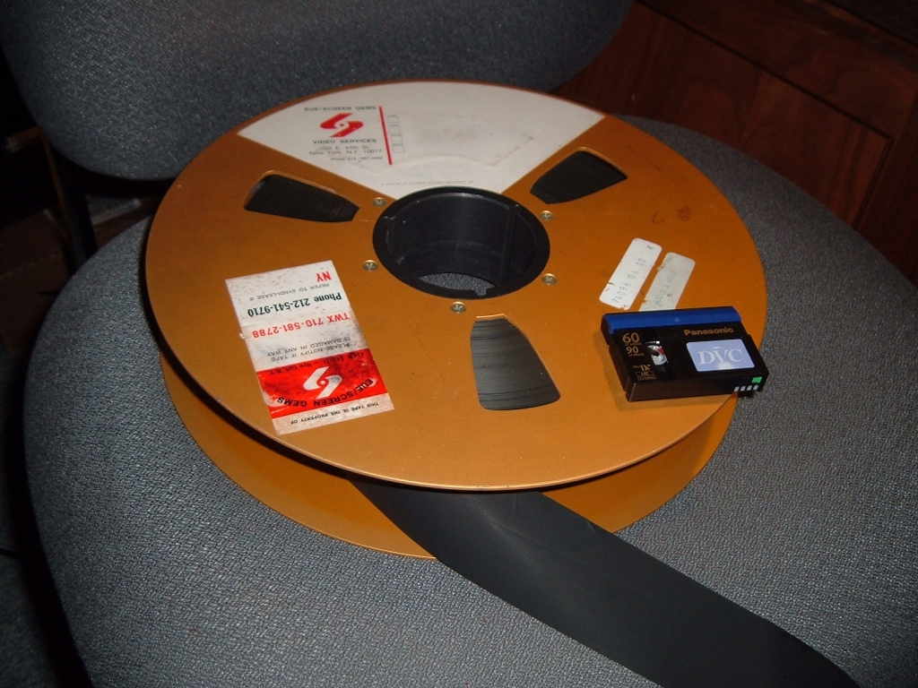
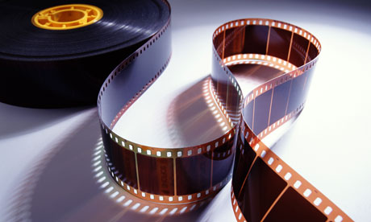
Video Vs. Film

Slide 12
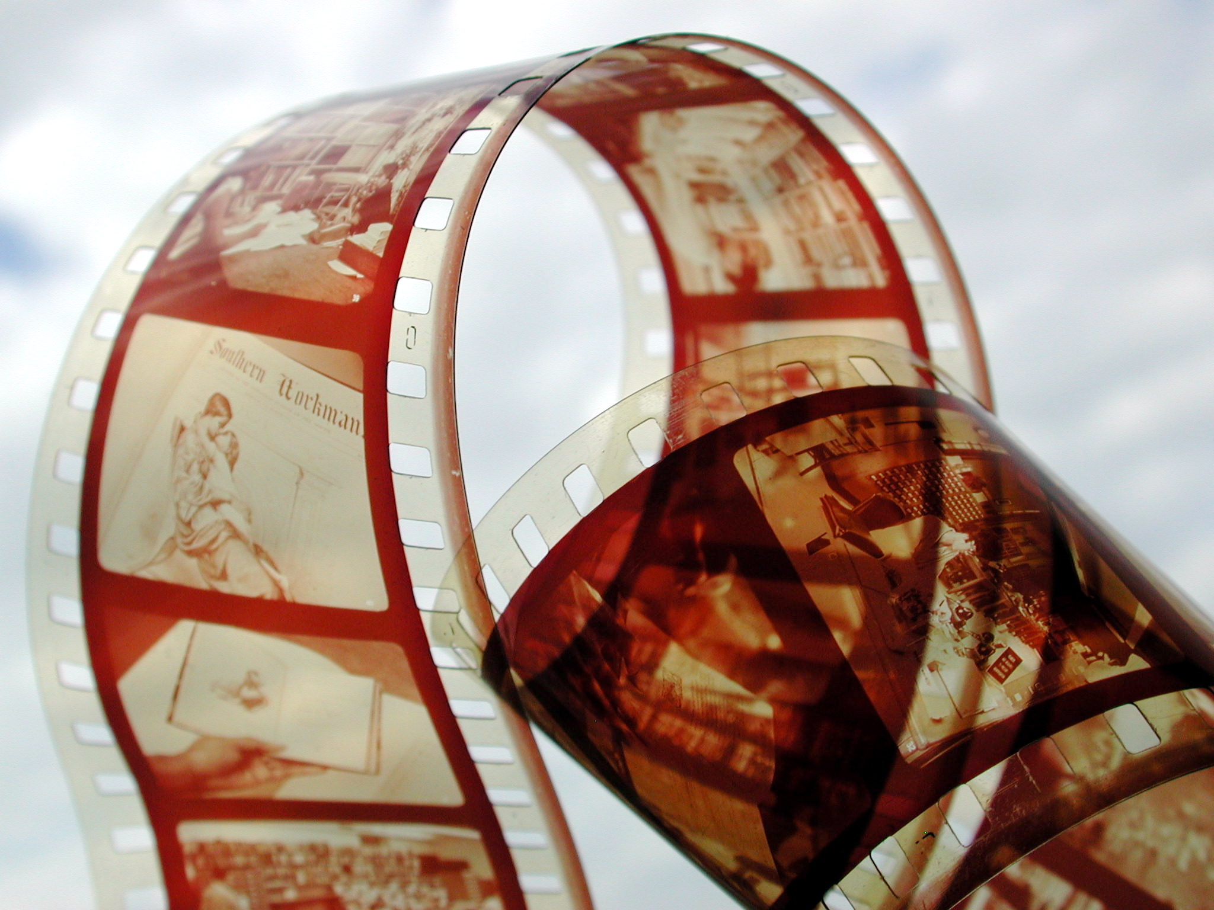
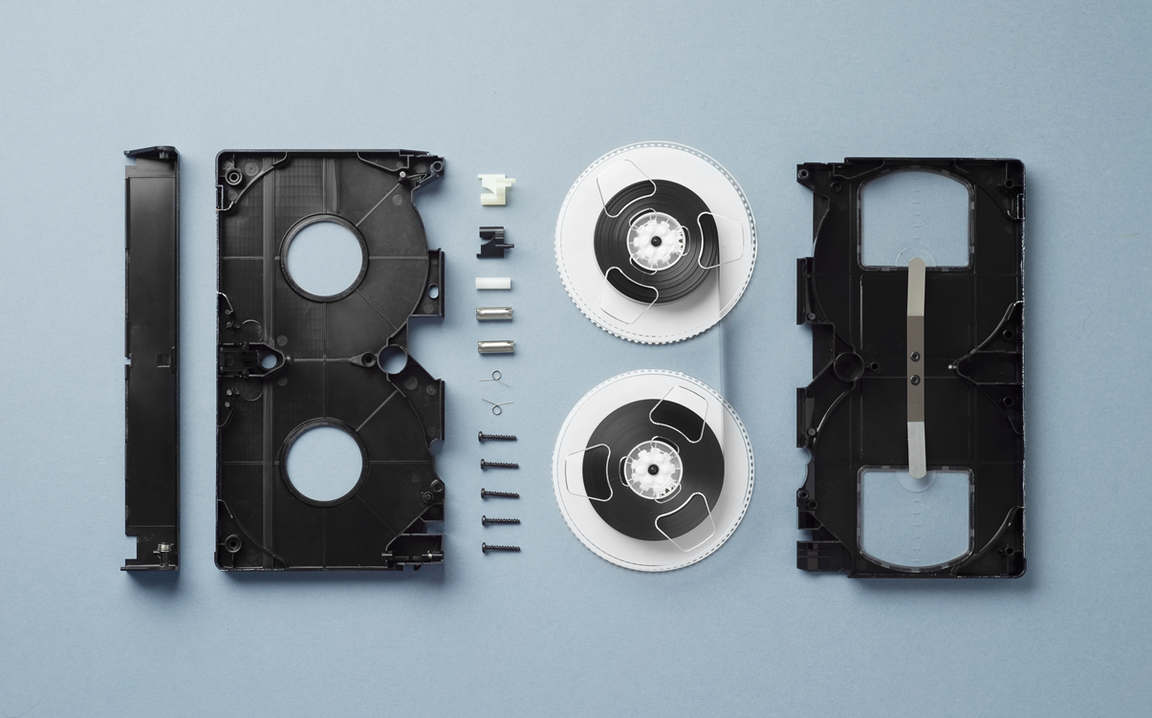
Video Vs. Film

Slide 13
Video Vs. Film
PROPERTIES | VIDEO | FILM
Material | - Plastic, glue, magnetic emulsion | -Celluloid
Appearance | - Resolution (scan lines for analog and pixels for digital video) | - Grain
Color | Additive color mixing: Red + green + blue = white Green + red = yellow Green + blue = cyan Red + blue = magenta | Subtractive color system: - yellow = blue - cyan = red - magenta = green All 3 = black No dye = white
Processing | - Instant replay | - Requires developing

Slide 14
Video Vs. Film
PROPERTIES | VIDEO | FILM
Nature | - Electromagnetic, electronic, or digital medium | - Chemical, light-reflective medium
Sound | - Usually recorded with image | - Usually recorded separate from image
Editing & Post-Production | - Manipulation of video signal (editing system with decks, controllers, synthesizers, and computer) or digital information (computer-based non-linear editing software) | - Cutting and hand manipulation of film strips possible, requires making work prints, physical process

Slide 15
Video Vs. Film
PROPERTIES | VIDEO | FILM
Exhibition | - Monitors, electronic projection, or broadcast of signal. Sound integrated. | - Projection requires light source. Sound usually separate.
Cost | - Comparatively more accessible (i.e. cheaper!) | - More expensive (film needs to be developed, work prints, etc.)
 | - Videomaker often involved in all stages of production and post-production | - Filmmaker usually not involved in developing film (done at labs) or cutting the negative
 | - Original (source tape) remains | - Original film negative is cut

Slide 16
Class Activity (5 mins.)
Open your Sakai playlist and watch the first minute from Fuses (1964-67) by Carolee Schneemann and Vertical Roll (1972) by Joan Jonas
While watching, make notes describing what you are seeing and hearing - focus more on what it looks and sounds like than what it is that you are perceiving – post these notes on Zoom chat

Slide 17
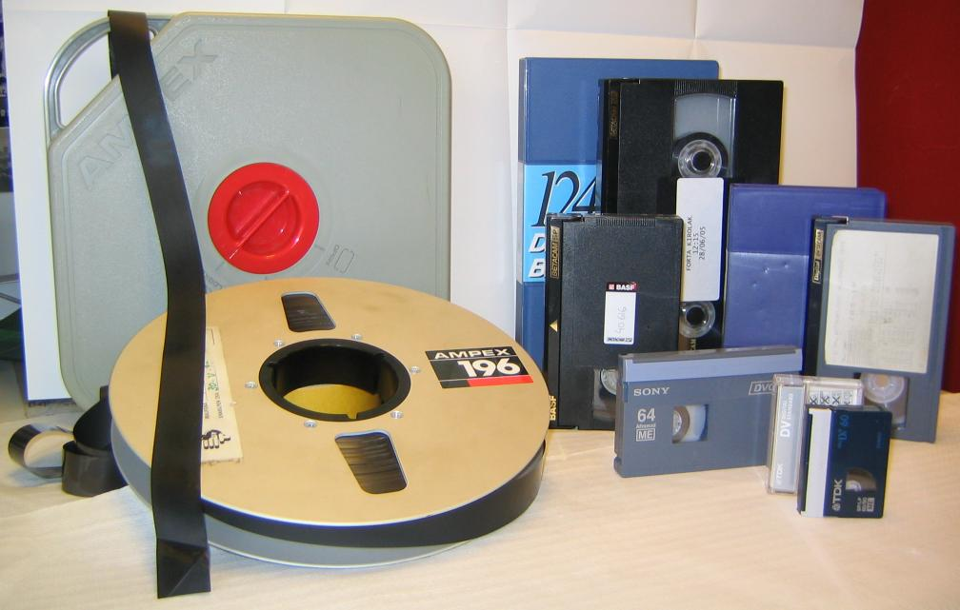
Video Formats:
1” or 2” reel-to-reel, ¾”, ½” (VHS), Betacam SP (broadcast quality), Video 8, Hi-8, Mini DV, DVD, (last 2 are digital formats)

Slide 18
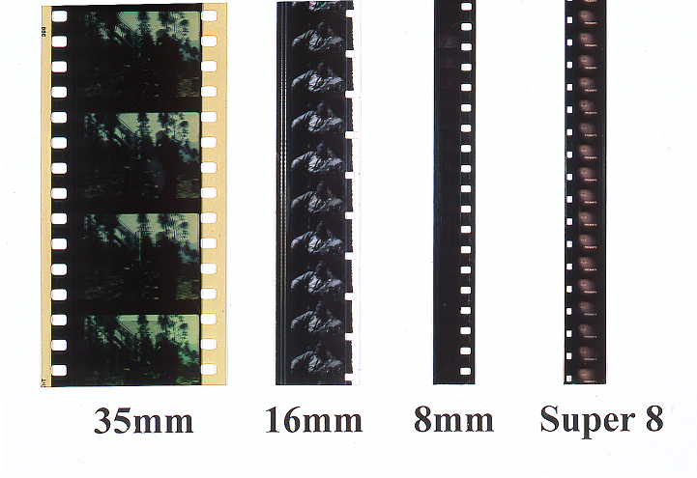
Film Formats

Slide 19
Media Production:
After watching Television Delivers People (1973) by Richard Serra and Carlotta Fay Schoolman and Boomerang (1974) by Serra, what do you think these works say about media production?

Slide 20
Media Production:
Is a construction

Slide 21
Media Production:
Is a construction
”Process not product.” (Armes, p.196)

Slide 22
Media Production:
Is a construction
”Process not product.” (Armes, p.196)
Who is in control of the message?

Slide 23
Media Production:
Is a construction
”Process not product.” (Armes, p.196)
Who is in control of the message?
Who has access to production and distribution?

Slide 24
Media Production:
Is a construction
”Process not product.” (Armes, p.196)
Who is in control of the message?
Who has access to production and distribution?
Who is the audience?

Slide 25
Media Production:
Is a construction
”Process not product.” (Armes, p.196)
Who is in control of the message?
Who has access to production and distribution?
Who is the audience?
What is the purpose (education, entertainment, propaganda, activism, and more)?

Slide 26
“Video as an idea, as a working method, rather than a specific medium, a particular piece—something to keep in the back if my mind while I’m doing something else” (Vito Acconci)

