Slide 1
VIDEO & DIVERSITY
Week 3: Post-WWII Mediascape

Slide 2
Media Production Process:
After watching Television Delivers People (1973) by Richard Serra and Carlotta Fay Schoolman and Boomerang (1974) by Serra, what do you think these works tell us about media production processes?

Slide 3
Media Production Process:
After watching Television Delivers People (1973) by Richard Serra and Carlotta Fay Schoolman and Boomerang (1974) by Serra, what do you think these works tell us about media production processes?
And how do they tell us?

Slide 4
Media Production:
Is a construction

Slide 5
Media Production:
Is a construction
”Process not product.” (Armes, p.196)

Slide 6
Media Production:
Is a construction
”Process not product.” (Armes, p.196)
Who is in control of the message?

Slide 7
Media Production:
Is a construction
”Process not product.” (Armes, p.196)
Who is in control of the message?
Who has access to production and distribution?

Slide 8
Media Production:
Is a construction
”Process not product.” (Armes, p.196)
Who is in control of the message?
Who has access to production and distribution?
Who is the audience?

Slide 9
Media Production:
Is a construction
”Process not product.” (Armes, p.196)
Who is in control of the message?
Who has access to production and distribution?
Who is the audience?
What is the purpose (education, entertainment, propaganda, activism, and more)?

Slide 10
“Video as an idea, as a working method, rather than a specific medium, a particular piece—something to keep in the back if my mind while I’m doing something else” (Vito Acconci)

Slide 11
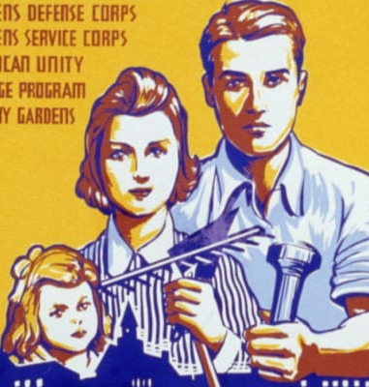
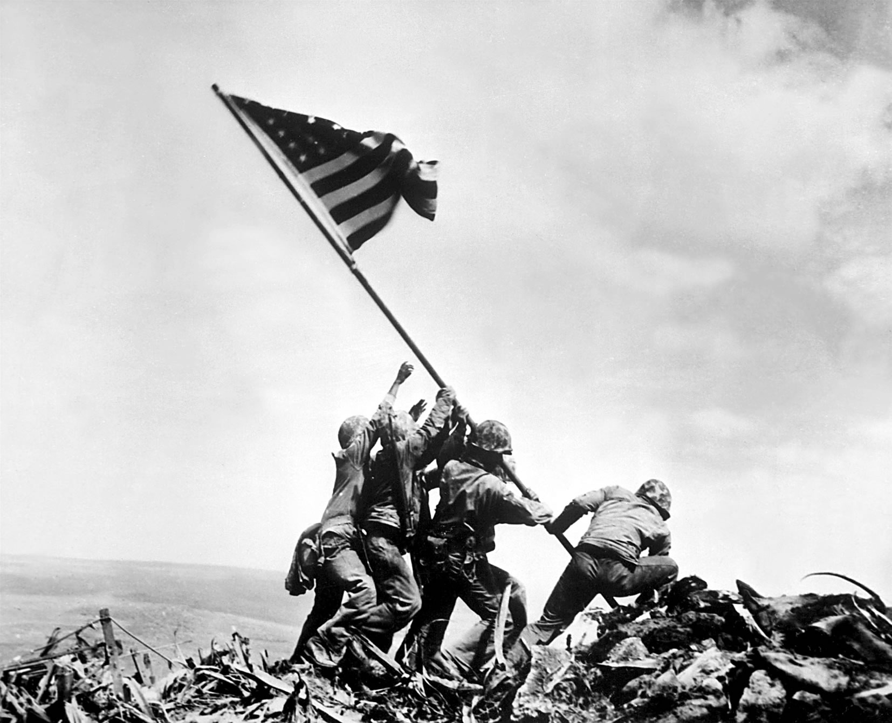
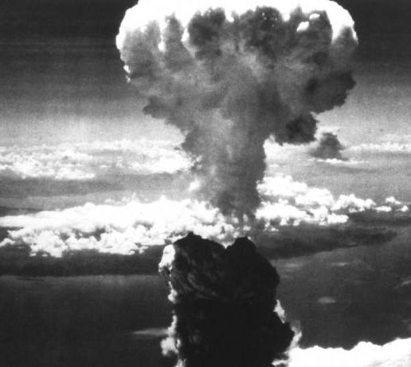
The 1940s - World War II
1941 – Japan attacks Pearl Harbor, US enters the war
1942 – Executive Order 9066, Japanese American internment
Nazism and the Holocaust
Women in the workplace (e.g. Rosie the Riveter)
Racial segregation in the arm forces
Atom bomb dropped on Hiroshima and Nagasaki; Japan surrendered in 1945
US becomes a “superpower”.

Slide 12
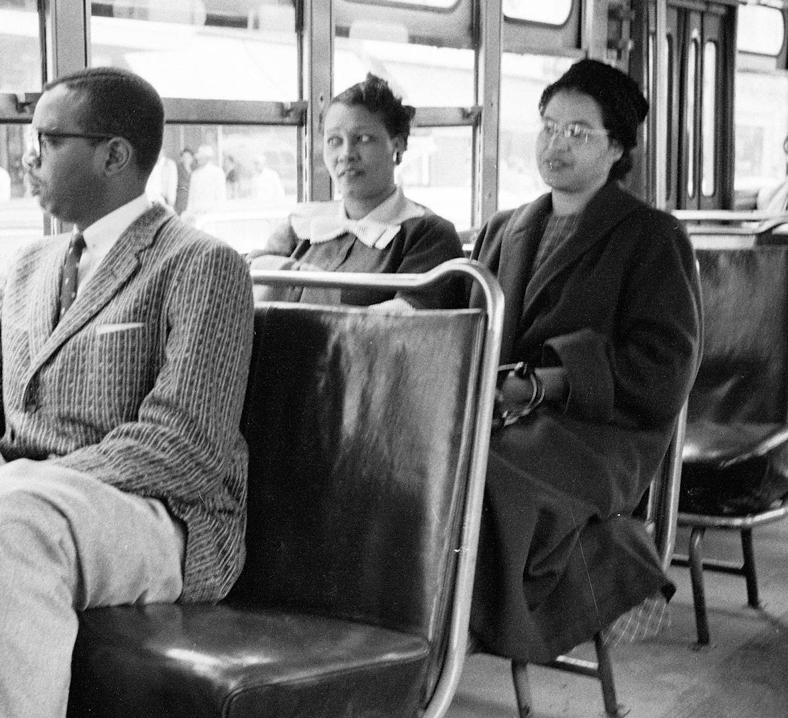
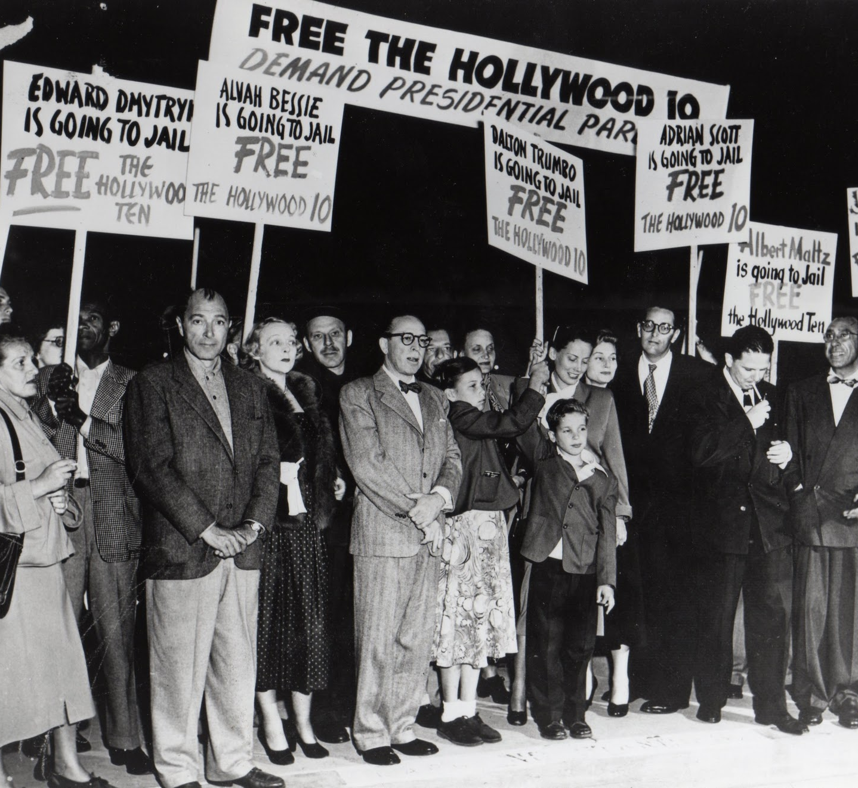
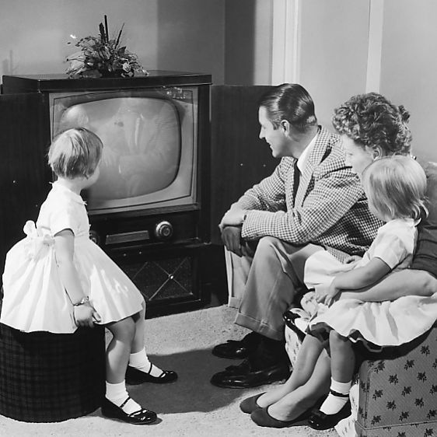
The 1950s –
The Cold War
Nuclear arms race
Korean War
Red scare / HUAC
Hollywood 10
1951-53 Julius & Ethel Rosenberg trial
Civil Rights – Rosa Parks, Emmett Till
Post-WWII baby boom & rise of consumerist culture
Television became the dominant media

Slide 13
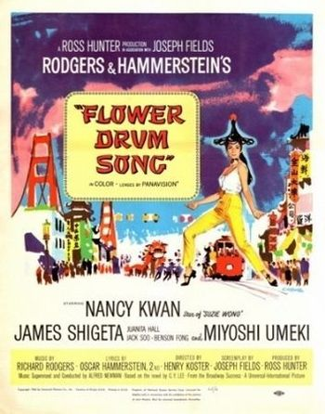
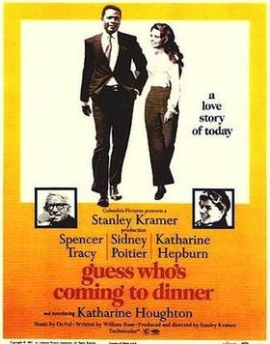
Comparative Analysis:
Flower Drum Song (1961)
Dir. Henry Koster
Guess Who’s Coming to Dinner (1967) Dir. Stanley Kramer

