Slide 1
VIDEO & DIVERSITY
Week 7: Feminist Video Art

Slide 2
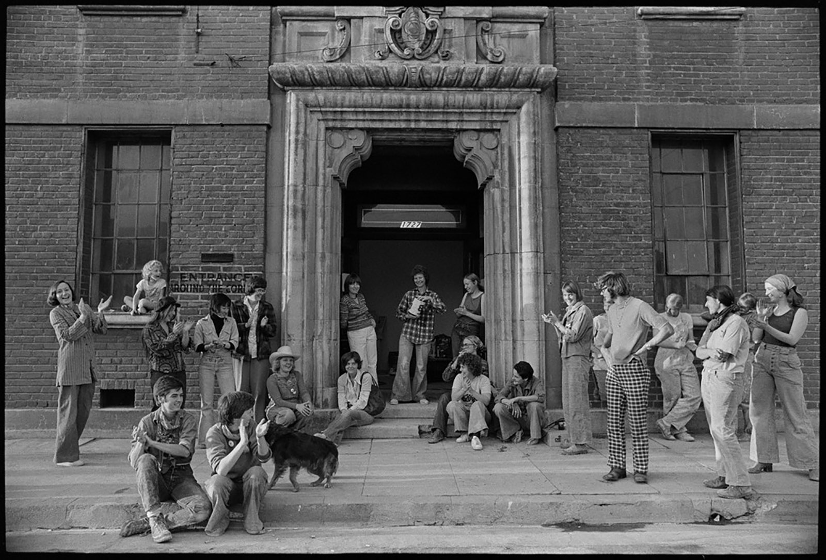
Feminist Video Art
in the 1970s
Women’s Building, Los Angeles, 1975

Slide 3
Feminist Video Art
in the 1970s
Vertical Roll (1972) by Joan Jonas
Always Love Your Man by Carla DeVito (1975)
Take Off by Susan Mogul (1974)
Vital Statistics of A Citizen, Simply Obtained by Martha Rosler (1977)

Slide 4
Feminist Video Art
in the 1970s
Working together, each group will create an introductory paragraph, with a clearly identifiable thesis statement, and summaries of 2-3 supporting arguments (i.e. the introduction for your second essay)

Slide 5
Feminist Video Art
in the 1970s
Your thesis and supporting arguments should reference at least one of the class readings for this week and its thesis, and use the two videos you all watched to construct your thesis as well as supporting arguments.

Slide 6
Feminist Video Art
in the 1970s
Additionally, your paragraph should incorporate, in a meaningful way, at least two of the following keywords and phrases: collective, consciousness-raising, giving voice to, oral history (or herstory), performance, self-reflexivity, social construction, the personal is political

Slide 7
Feminist Video Art
in the 1970s
Your paragraph will be read and discussed in class.

Slide 8
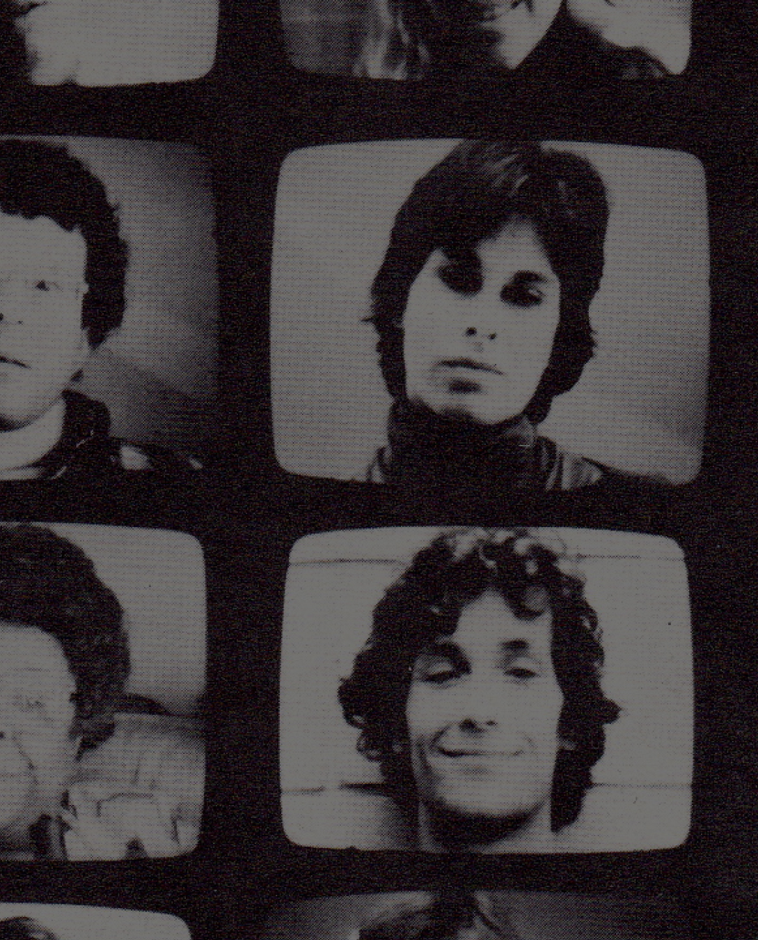
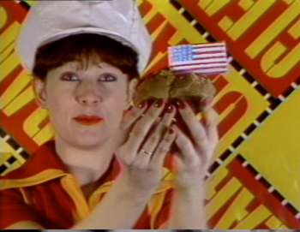
Comparative Analysis
Love Tapes (1971-2001)
Dir. Wendy Clarke
Made for TV (1984) Dir. Tom Rubinitz & Ann Magnuson

Slide 9
Comparative Analysis
Christine Tamblyn writes: “Video’s lack of an established tradition undoubtedly promotes experimentation, and its multichannel sound and image transcription predisposes artists to produce layered work.” (p. 405)
How do these two videos demonstrate or challenge her observation?

Slide 10
Comparative Analysis
Martha Gever argues: “Many women artists recognize that the project of counteracting descriptions of ‘reality’ that routinely objectify women would not be effective if the concept of ‘reality’ itself was not overhauled. That meant initiating a thorough and specific examination of the ways in which ‘real’ events and people were represented.” (p. 230)

Slide 11
Comparative Analysis
Do Clarke or Rubinitz and Magnuson’s videotapes support Gever’s argument? If so, in what ways?
How about the lived experiences and media practices of Kate Horsfield and Susan Mogul, both of whom participated in the Feminist video art movement?

Slide 12
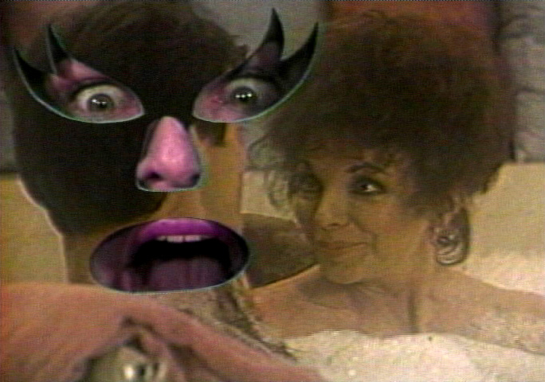
Comparative Analysis
Joan Does Dynasty (1986) Dir. Joan Braderman

Slide 13
Comparative Analysis
How do the videos, criticism and discourse, as well as lived experiences of U.S. feminist video art and artists support or challenge bell hooks’s definition of feminism?
What about other ideas (e.g. “the personal is political”, social construction, consciousness raising, performance, parody and humor) from this week’s reading on feminism?

