Slide 1
EXPERIMENTAL MEDIA STUDIO
Topic One: Body

Slide 2
Key Concepts & Genres
Body Art
Performance Art
Subjectivity, identity, embodiment
Exchange and engagement
Performativity
Live (implies an audience, presence, theatrical setting)
Mediated (Body art can take place in the privacy of the artists studio and experienced through photography, film, video, and/or text – an extension of portraiture.)

Slide 3
Artists and Movements
Feminist Art Movement, Fluxus, Viennese Actionism, Gutai
Carolee Schneemann, Yayoi Kusama, Ana Mendieta, Vito Acconci, Hannah Wilke, Orlan, Bob Flanagan/Sheree Rose, Yoko Ono, Ulay/Abramovic, Matthew Barney, Pipilotti Rist, Bruce Nauman, Mona Hatoum, Chris Burden, Regina Jose Galindo, Ron Athey, Skip Arnold, Kalup Linzy, Ryan Trecartin, Artur Zmijewski, Maria Diaz, Alex Villar, VALIE EXPORT, MaLiuming, He Chengyao, Yang Zhichao, Zhang Huan, Christian Marclay

Slide 4
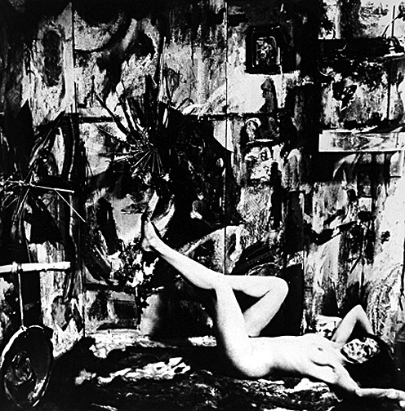
Carolee Schneemann, Eye Body, 1963

Slide 5
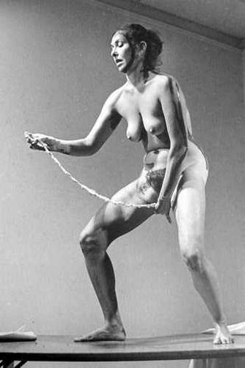
Carolee Schneemann, Interior Scroll, 1975

Slide 6
Yayoi Kusama in her studio at St. Mark’s Place, NY, 1970

Slide 7
Yayoi Kusama, Sex Obsession Food Obsession Macaroni Infinity Nets & Kusama, 1962

Slide 8
Yayoi Kusama, Peep Show, 1966

Slide 9
Yayoi Kusama, Naked Happening Orgy & Flag Burning, 1968

Slide 10
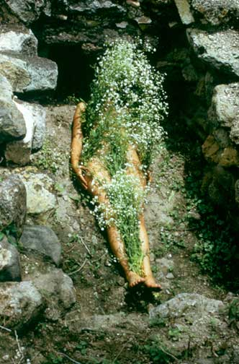
Ana Mendieta, Silueta Series, 1970s, various locations

Slide 16
Mary Kelly, Post-Partum Document,1973-79

Slide 17
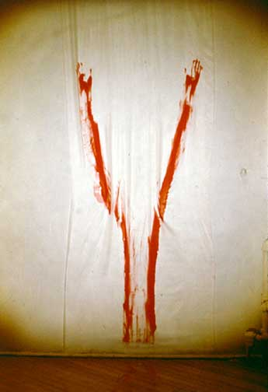
Ana Mendieta, Untitled (Body Tracks), 1973

Slide 18
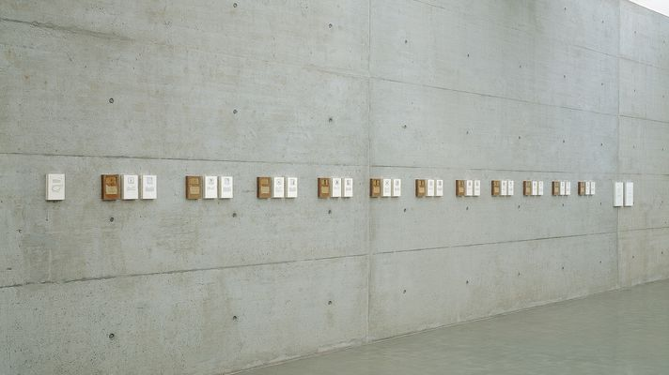
Mary Kelly, Post-Partum Document, Installation view

Slide 19
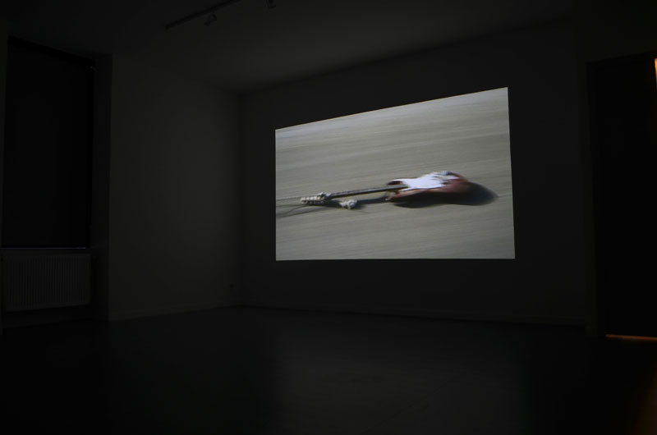
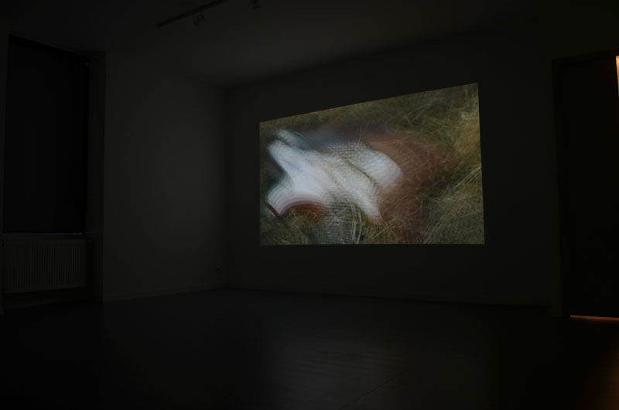
Guitar Drag (2000)
Video installation by Christian Marclay

Slide 20
Christian Marclay’s video installation Guitar Drag (2000) is a single-channel video documenting an action Marclay performed on November 18, 1999, while he was artist-in-residence at ArtPace Foundation for Contemporary Art in San Antonio, Texas.
The action involves tying a Fender Stratocaster guitar to the back of a pick-up truck and dragging it on the road. During the action, the guitar is connected to an amplifier, and the sounds it makes becomes the soundtrack of the work.
Marclay prefers to show Guitar Drag as an installation, with the fourteen-minute video projected in an enclosed space and the sound played through speakers, but the work also circulates in other formats and through other channels, to a lesser degree.

Slide 23
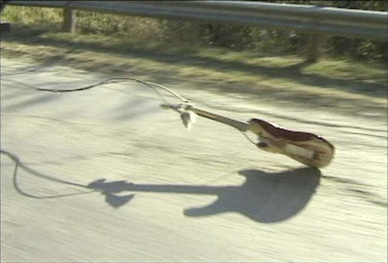

Slide 25
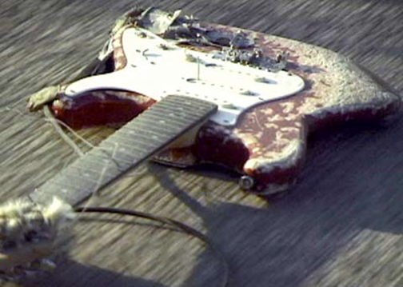

Slide 26
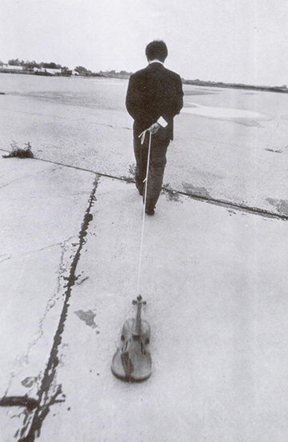
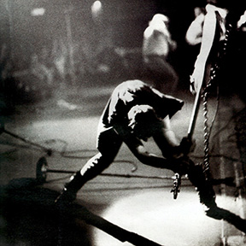
Above: Paul Simonon of The Clash smashing his bass guitar at the Palladium, New York, 1979.
Left: Nam June Paik, Violin with String, performance at the 12th Annual New York Avant-Garde Festival in 1975

