Slide 1
EXPERIMENTAL MEDIA STUDIO
Topic Two: Time

Slide 2
Some Common Time Standards in Media:
Feature films (narrative and documentary): 60 – 120 mins., most are 90 mins.
TV programs: 40-50 mins. (hour-long), 21-22 mins. (half an hour-long)
Commercials/ads: 15 secs. – 1 min., most are 30 secs.
Movie trailers: 40 secs. – 3 mins. 30 secs., most are 2 mins. 30 sec.
Theatre and live performances: 1-5 hrs., most are between 1 hr. 30 mins.-2 hrs. 30 mins.
Average length a viewer at a museum or gallery spend in front of an artwork: 6 secs.

Slide 3
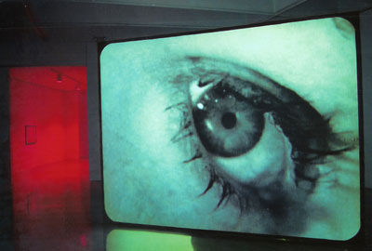
Douglas Gordon, 24-Hour Psycho, 1993

Slide 4
Douglas Gordon, 24 hour psycho back and forth and to and fro, 2008

Slide 5
Andy Warhol, Empire, 1964 TRT 8 hours 5 minutes

Slide 6
Key Concepts & Genres
Time-based media – film/video, performance, installation, interactive work
Time as duration – real time, edited time (“sculpting in time”)
Time as history, memory, forgetting – human memory / digital memory (ephemerality / permanence)
Linear and non-linear time
Past / present: saba, recollection objects, sense memory
Chronophobia
Durational aesthetics
Ethics of slowness

Slide 7
Artists and Movements
John Cage, Andrey Tarkovsky, Douglas Gordon, Tehching Hsieh, Linda Montano, Shauna Beharry, Mona Hatoum, Ulay and Abramovic, Lin Hixson, Goat Island, Forced Entertainment, Franko B, La Ribot, Andy Warhol, Jim Campbell, On Kawara, Hanna Darboven, Vito Acconci, Joseph Beuys, Roman Opalka, Rea Tajiri, Walid Ra’ad, Julie Dash

Slide 8
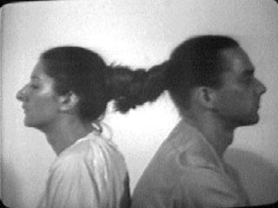
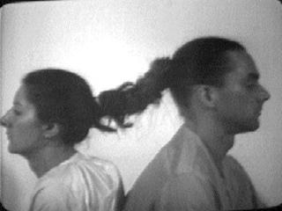
Ulay / Abramovic, Relation in Time, 1977

Slide 9
Ulay / Abramovic, The Lovers – Great Wall Walk, 1988

Slide 11
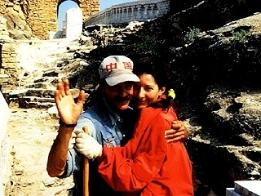

Slide 12
Tehching Hsieh, One Year Performance (Cage Piece), 1978-1979

Slide 17
Tehching Hsieh, One Year Performance (Time Clock Piece), 1980-1981

Slide 19
Tehching Hsieh, One Year Performance, 1981-1982

Slide 21
Tehching Hsieh and Linda Montano, Art/Life One Year Performance, 1983-1984

Slide 22
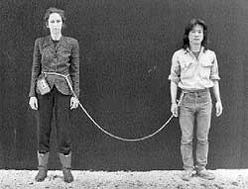

Slide 23
Shauna Beharry, Ashes to Flowers: The Breathing, 1993, undocumented performance

Slide 24
John Cage, 4’33”, 1952

