Slide 1
EXPERIMENTAL MEDIA STUDIO
Topic Four: Action

Slide 2
Key Concepts & Genres
Action and intervention
Praxis = theory + practice
Situationism (see p. 45 of reading)
Detournement
Dérive
Media performance – media event and public information campaign
Propaganda vs. agit prop
Culture jamming – memes and metamemes

Slide 3
Artists and Movements
The Situationist International, Suzanne Lacy, Leslie Labowitz, Gran Fury, Adbuster Media Foundation, RTMark, The Yes Men, Wafaa Bilal, Fallen Fruit, Elana Mann, Yoko Ono

Slide 4
Situationist International
Founders of the Situationist International at Cosio d'Arroscia, Italy, April 1957. From left to right: Guiseppe Pinot Gallizio, Piero Simondo, Elena Verrone, Michele Bernstein, Guy Debord, Asger Jorn, and Walter Olmo.

Slide 5
Situationists coming out from the British Sailors Society during the 4th Conference of the Situationist International, which took place on Sept. 24, 1960 in London, UK. Participants were Debord, Jacqueline de Jong, Jorn, Kotányi, Katja Lindell, Jörgen Nash, Prem, Sturm, Maurice Wyckaert and H.P. Zimmer.

Slide 6
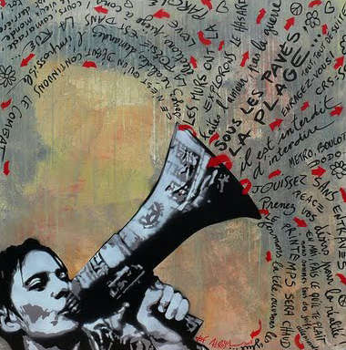
Paris, May 1968

Slide 7
Still from In Girum Imus Nocte et Consumimur Igni, 1978, by Guy Debord

Slide 8
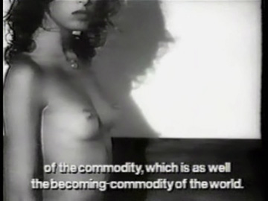
Stills from The Society of the Spectacle, 1973, by Guy Debord

Slide 10
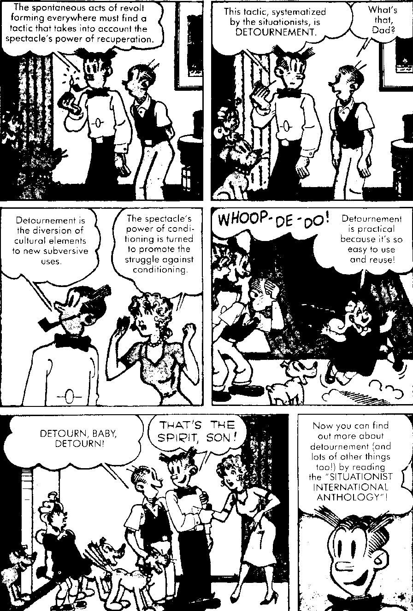
Leaflet publicizing the Situationist International Anthology, December, 1981, by Ken Knabb, Bureau of Public Secrets

Slide 11
Psychogeographical Map of Paris, 1955(?), by Guy Debord

Slide 12
Woman’s Building, 1973, Los Angeles

Slide 13
Leslie Labowitz, Record Companies Drag Their Feet, 1977, with Women Against Violence Against Women(WAVAW) and National Organization for Women (NOW)

Slide 14
Suzanne Lacy & Leslie Labowitz, In Mourning and In Rage, 1977

Slide 15
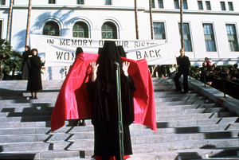

Slide 16
Gran Fury, Kissing Doesn’t Kill Campaign, 1989

Slide 19
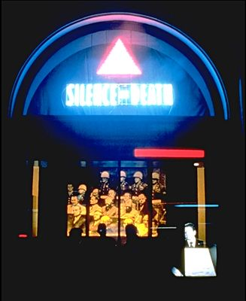
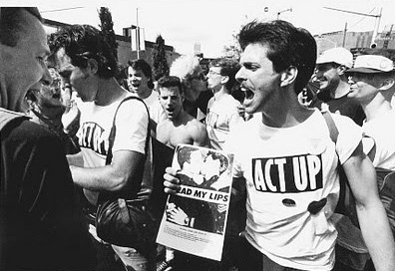

Slide 22
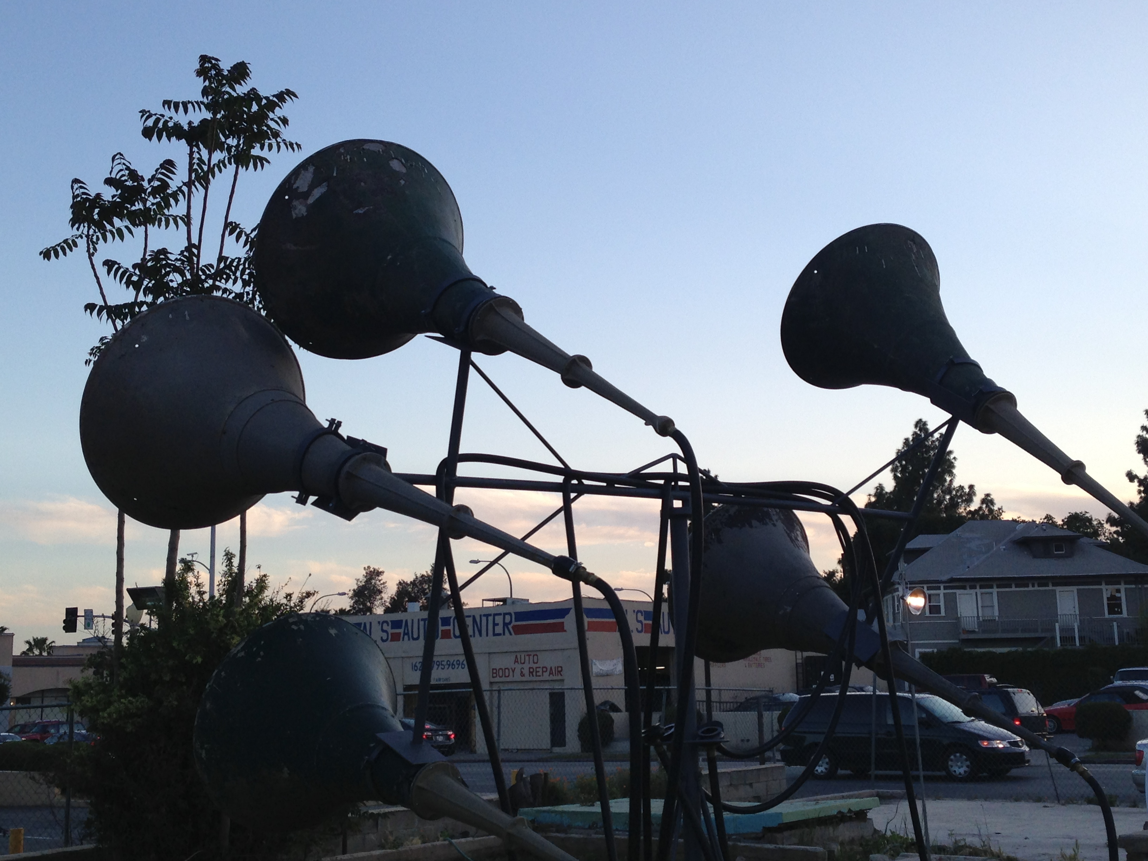
Elana Mann, Listening as (a) movement, 2013

Slide 23
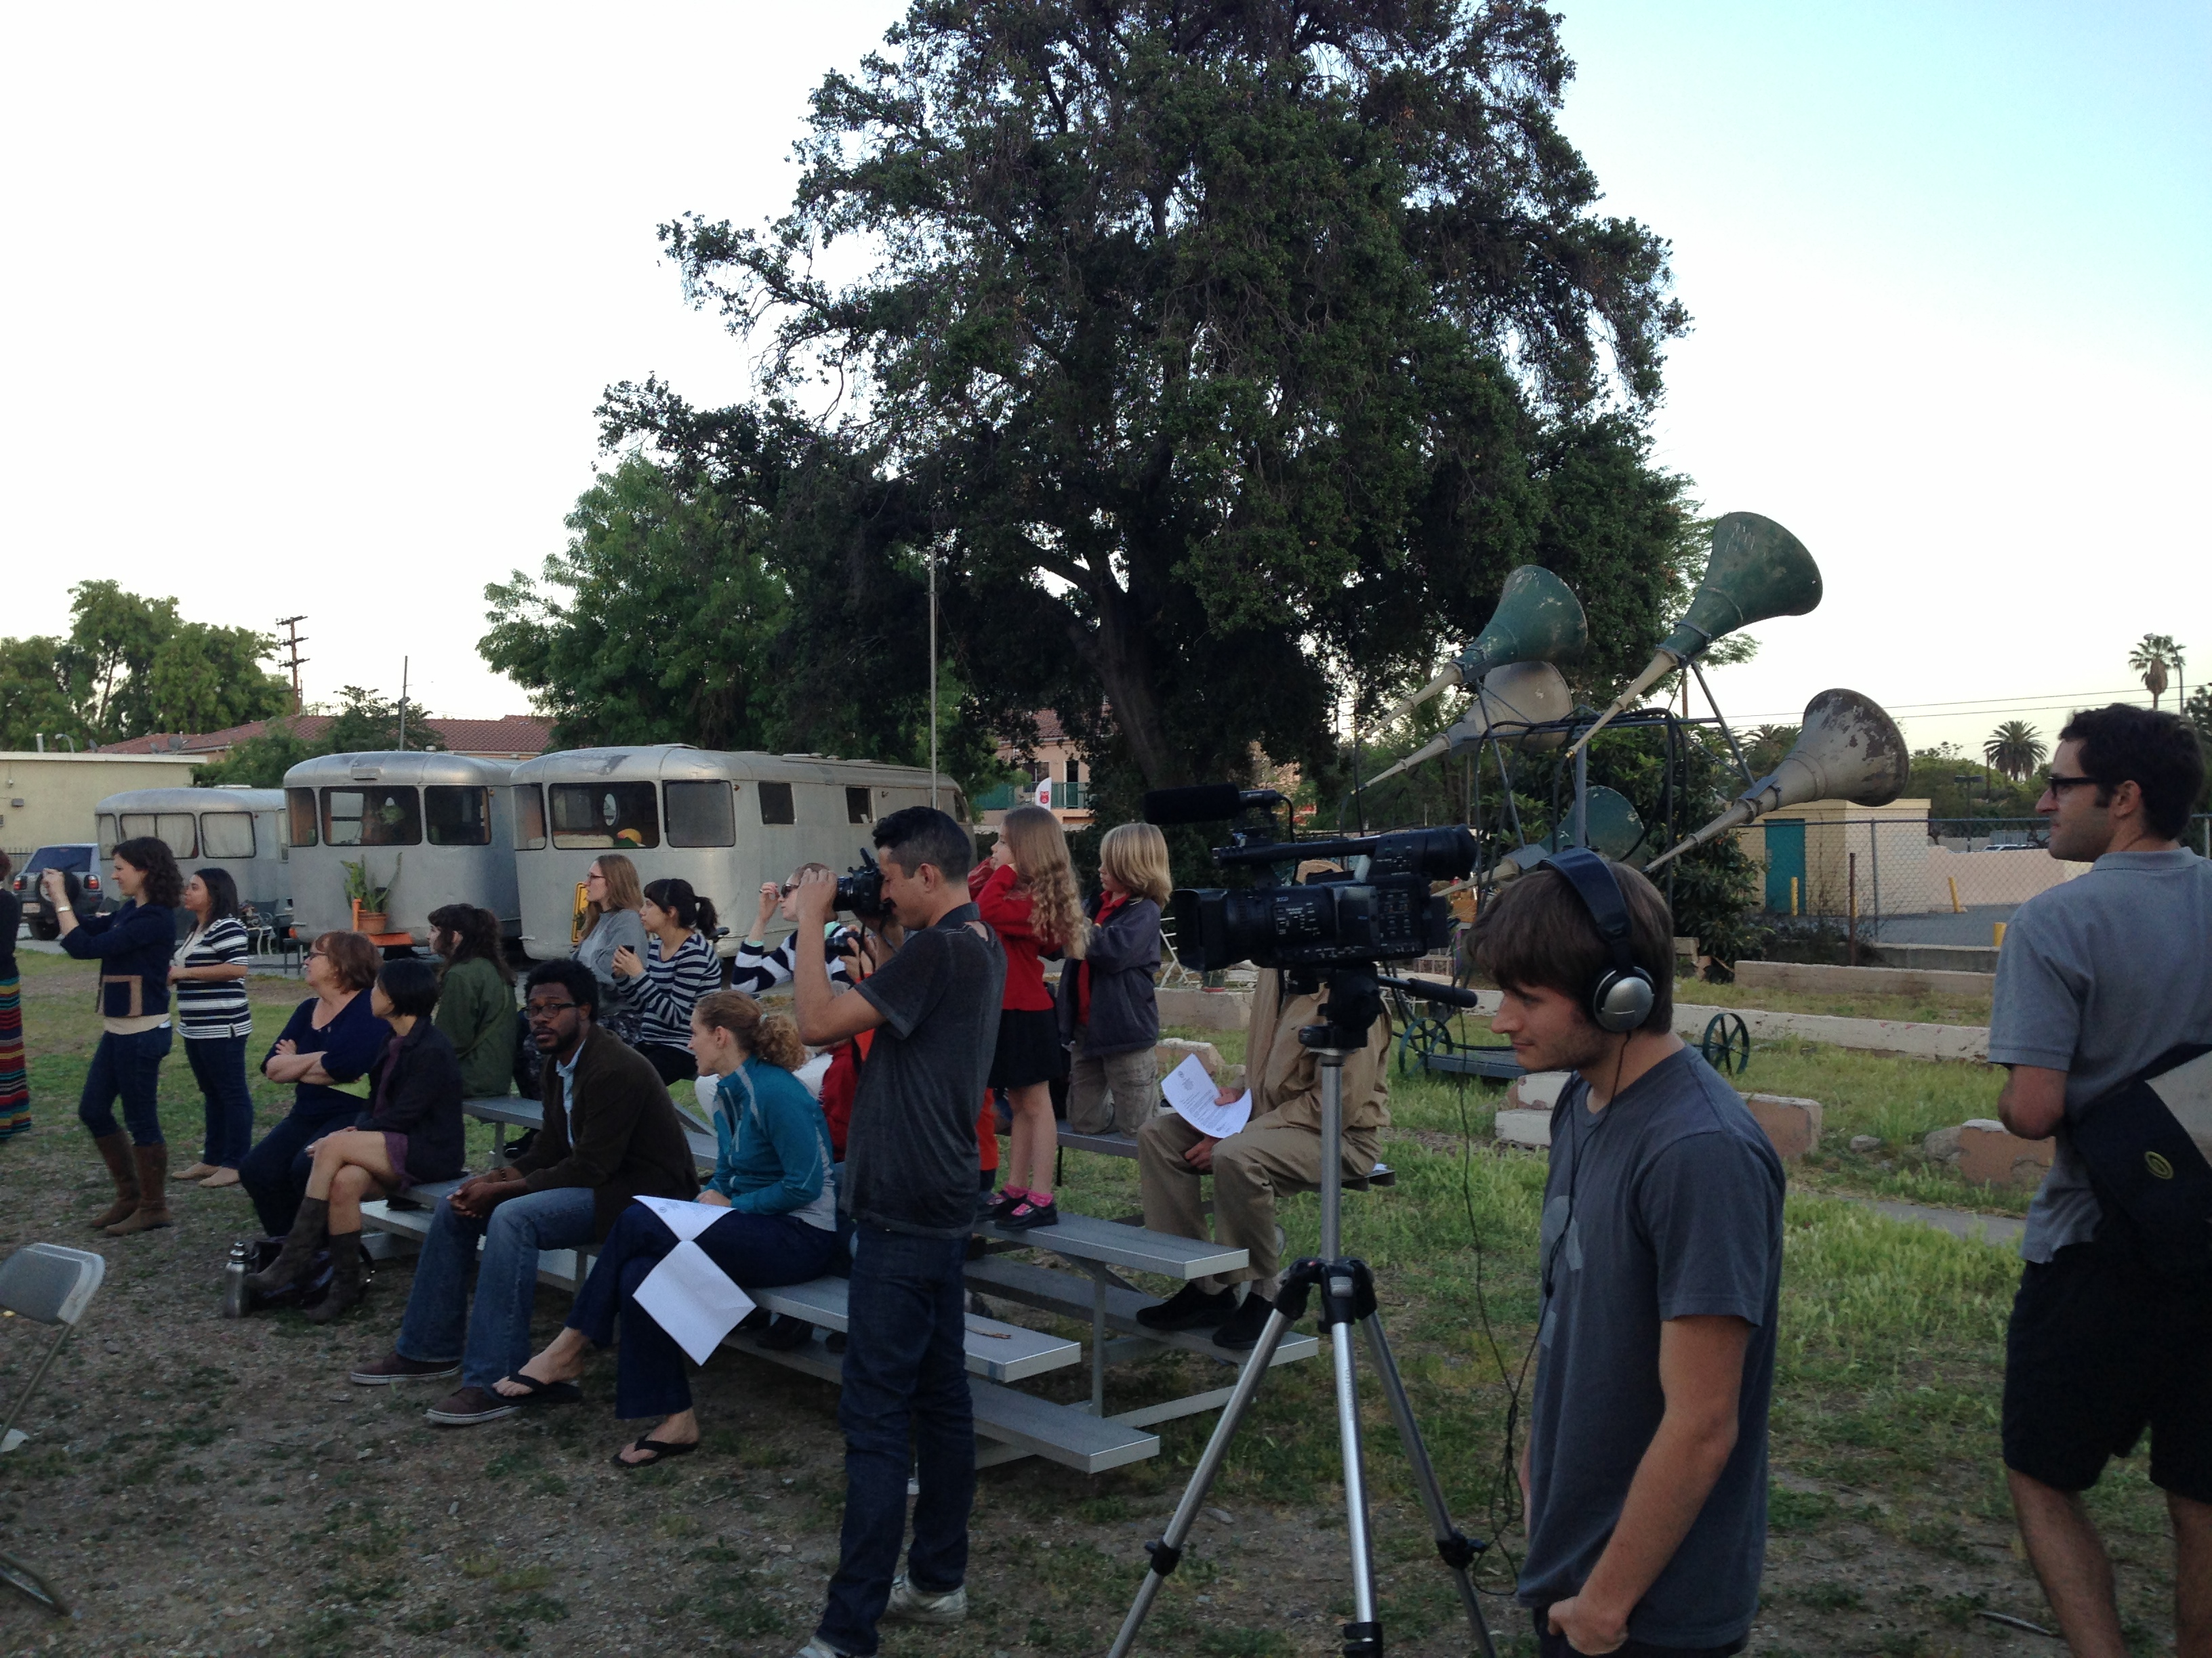

Slide 24
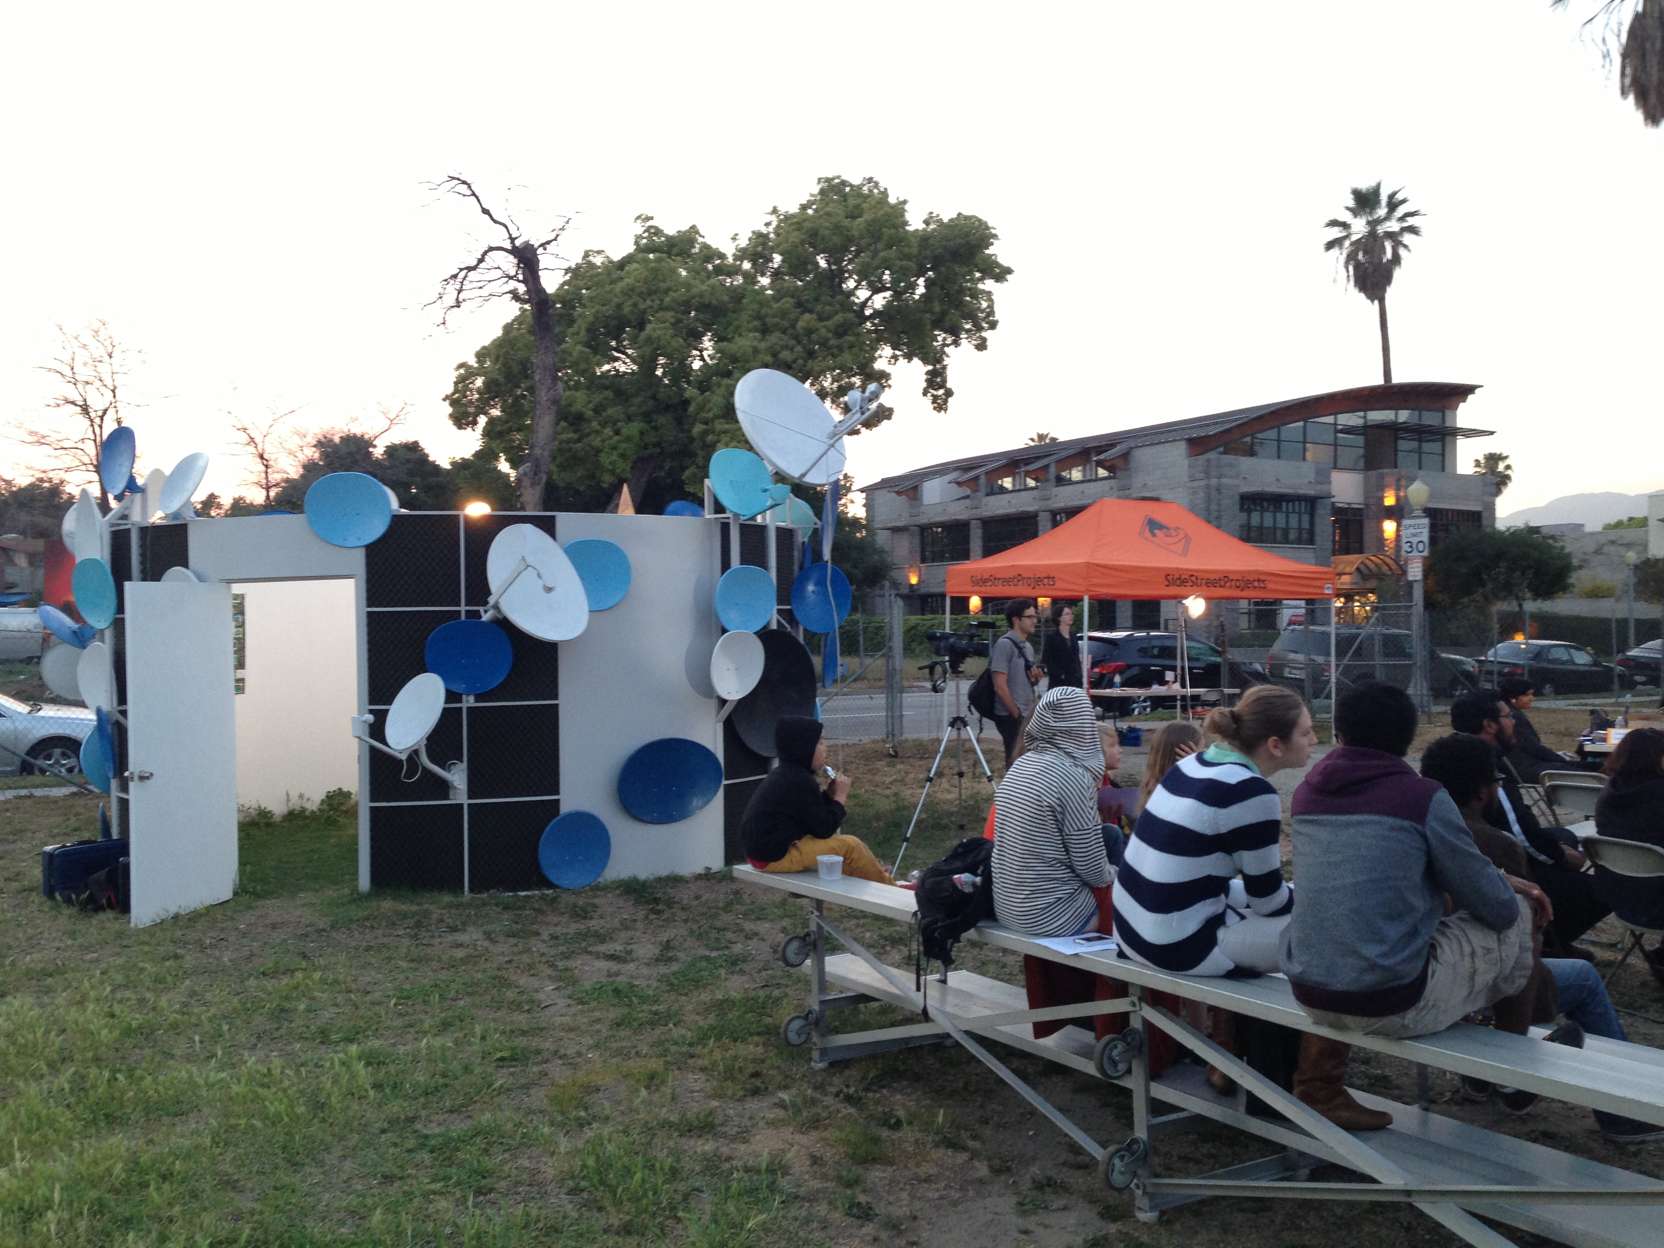

Slide 25
What are the different kinds of listening that one can do at this project and site?

Slide 26
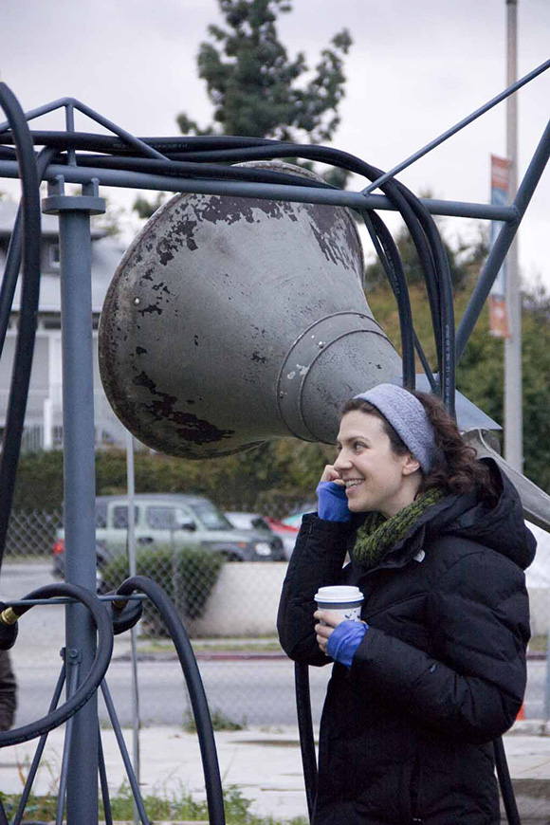
Physical listening

Slide 27
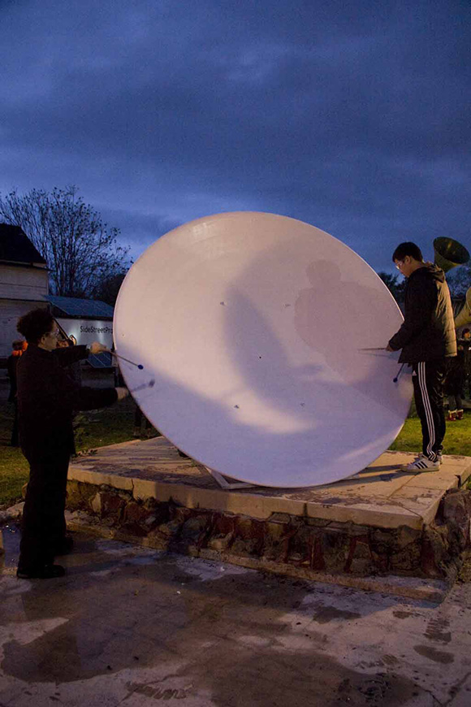
Playful listening, as performance (music performance by Allison Johnson at Opening night)

Slide 28
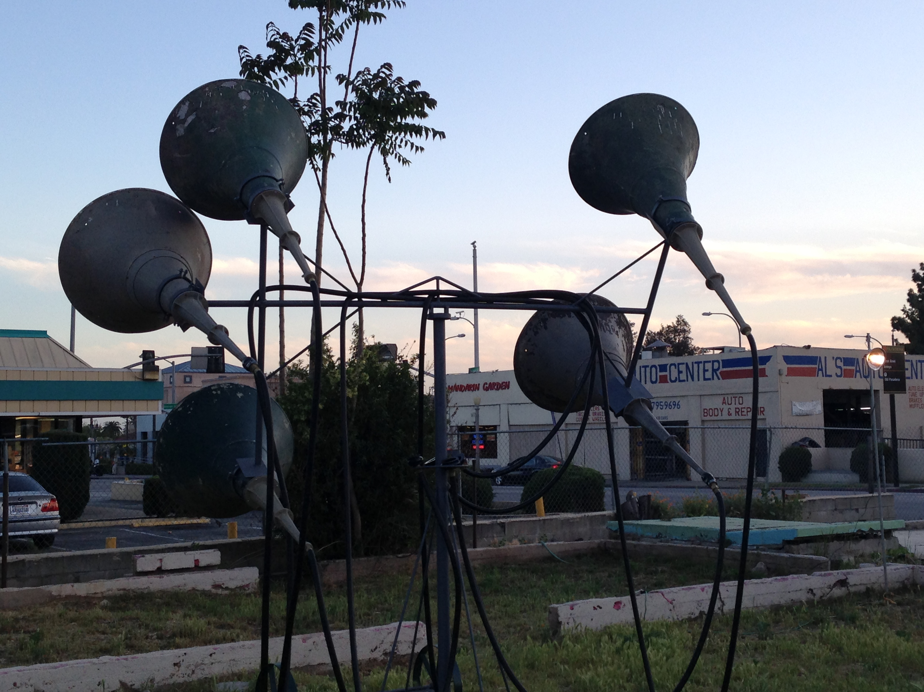
Listening as surveillance, information gathering, mapping, ethnography

Slide 29
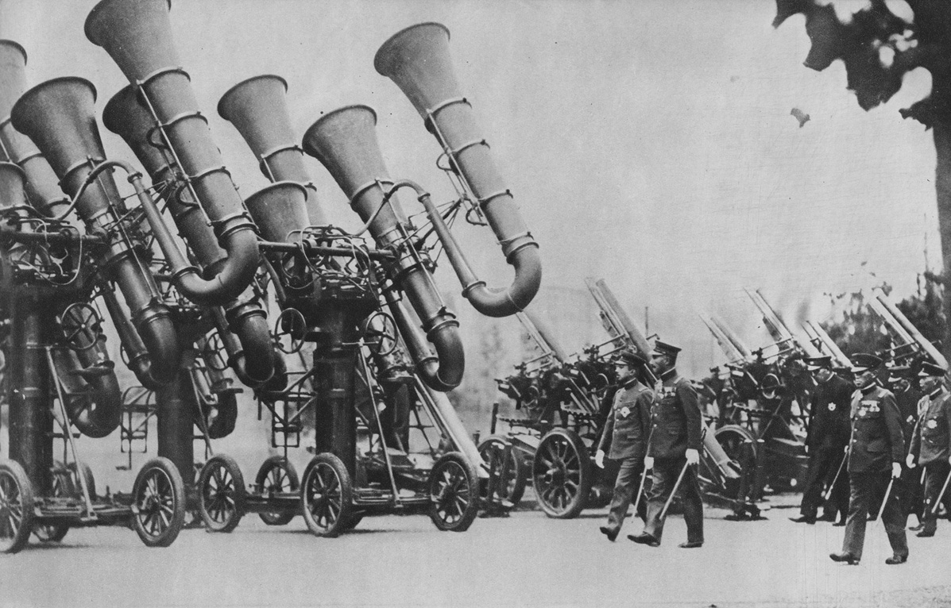
Japanese “War Tubas” (1930s)

Slide 30
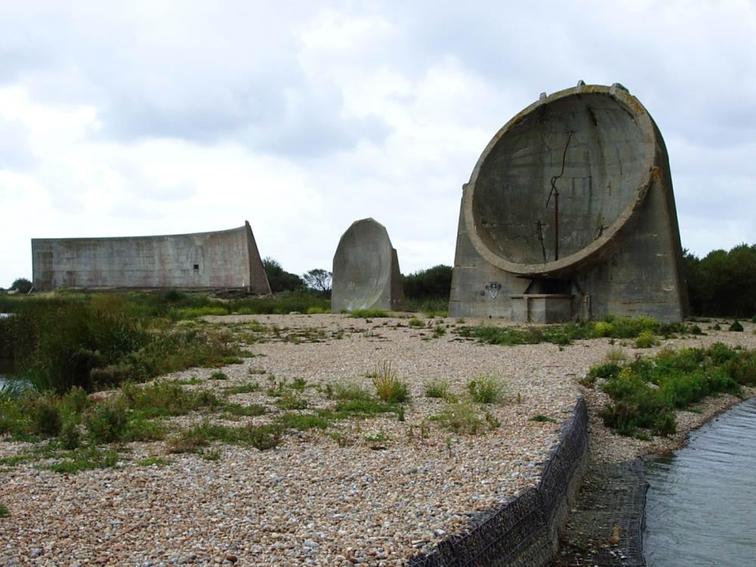
Denge sound mirrors, Dungeness, UK Built in 1920s and ’30s – between WWI & II

Slide 31
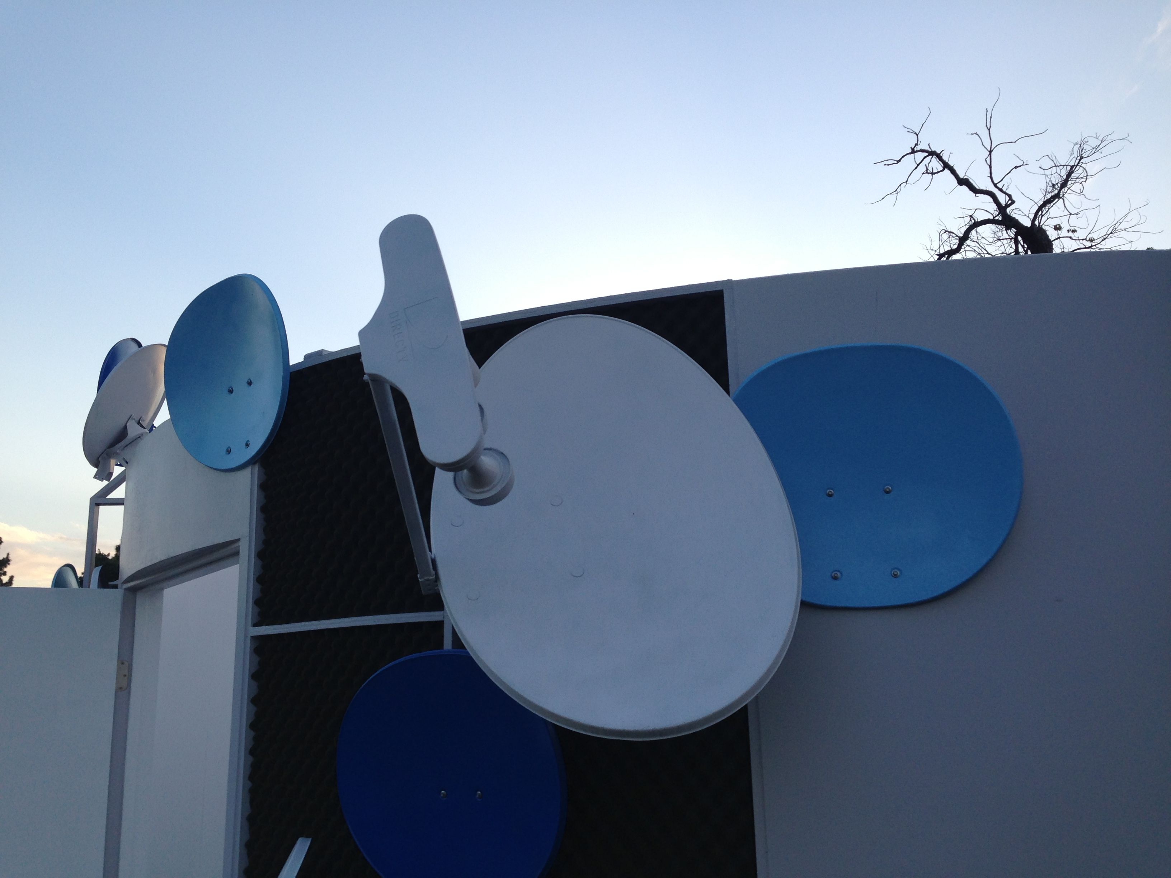

Slide 32
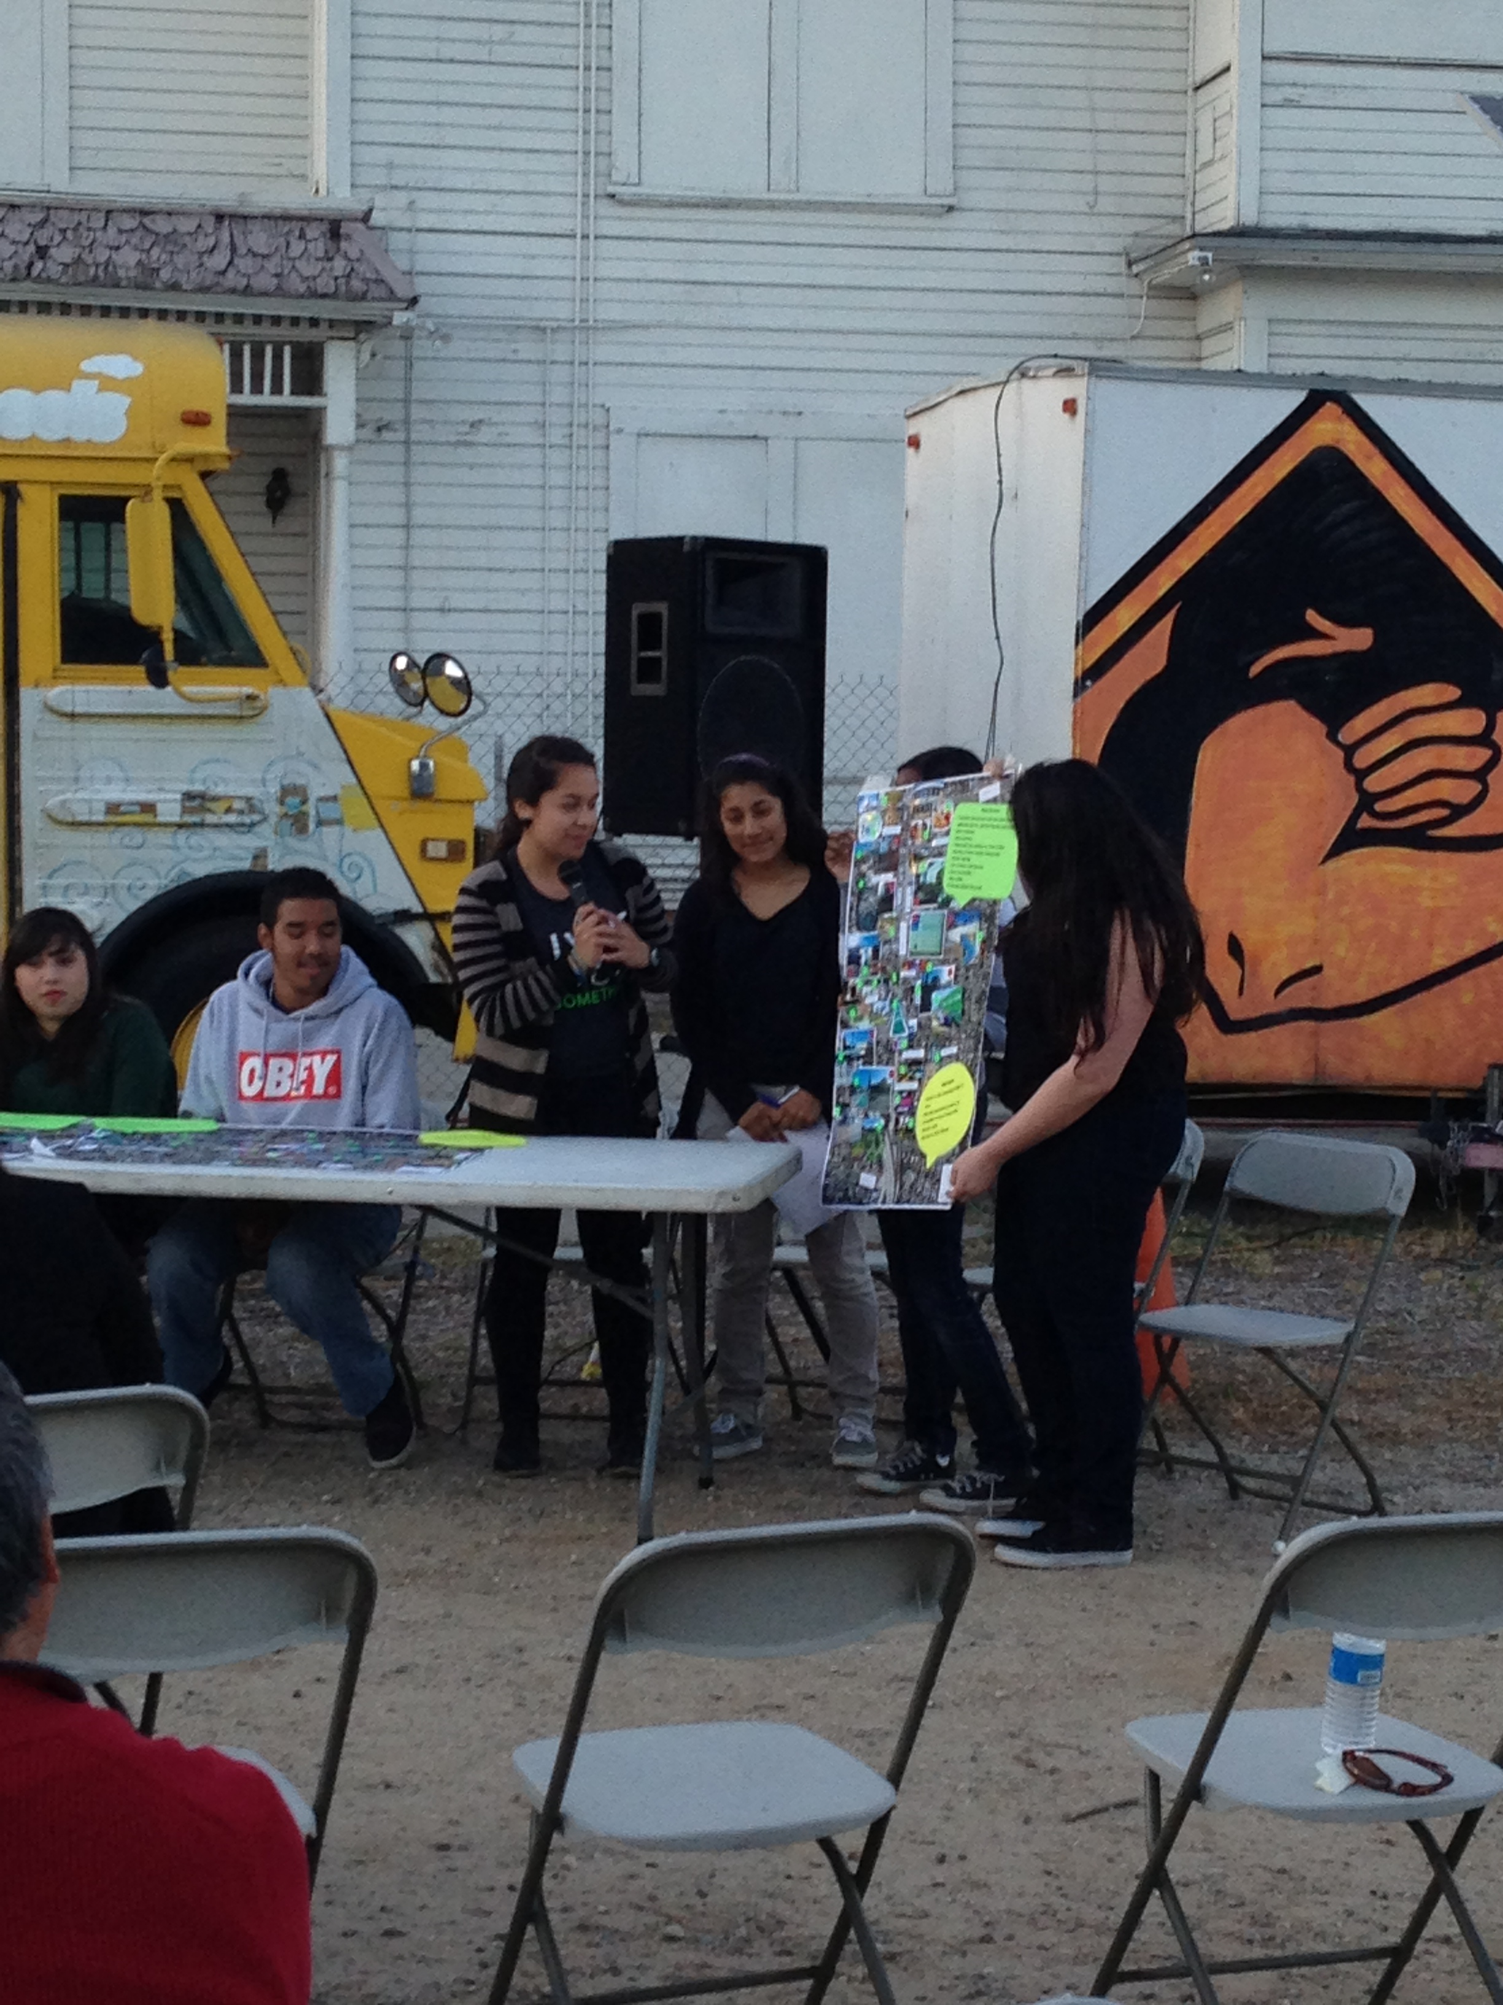
Listening as a part of mapping and understanding communities, as democratic process

Slide 33
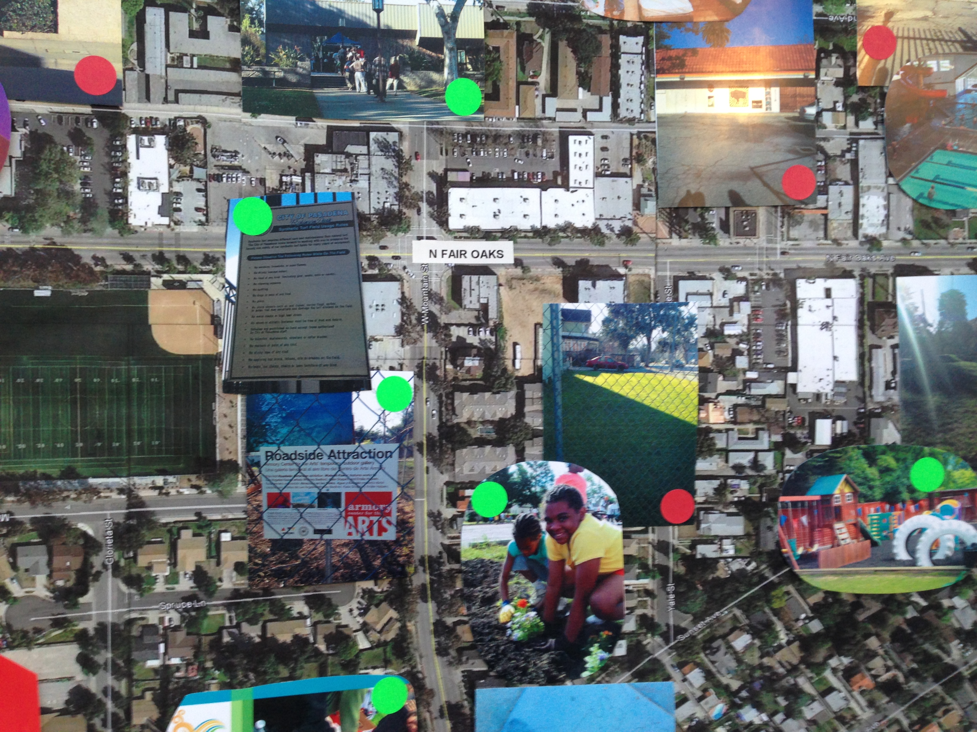

Slide 34
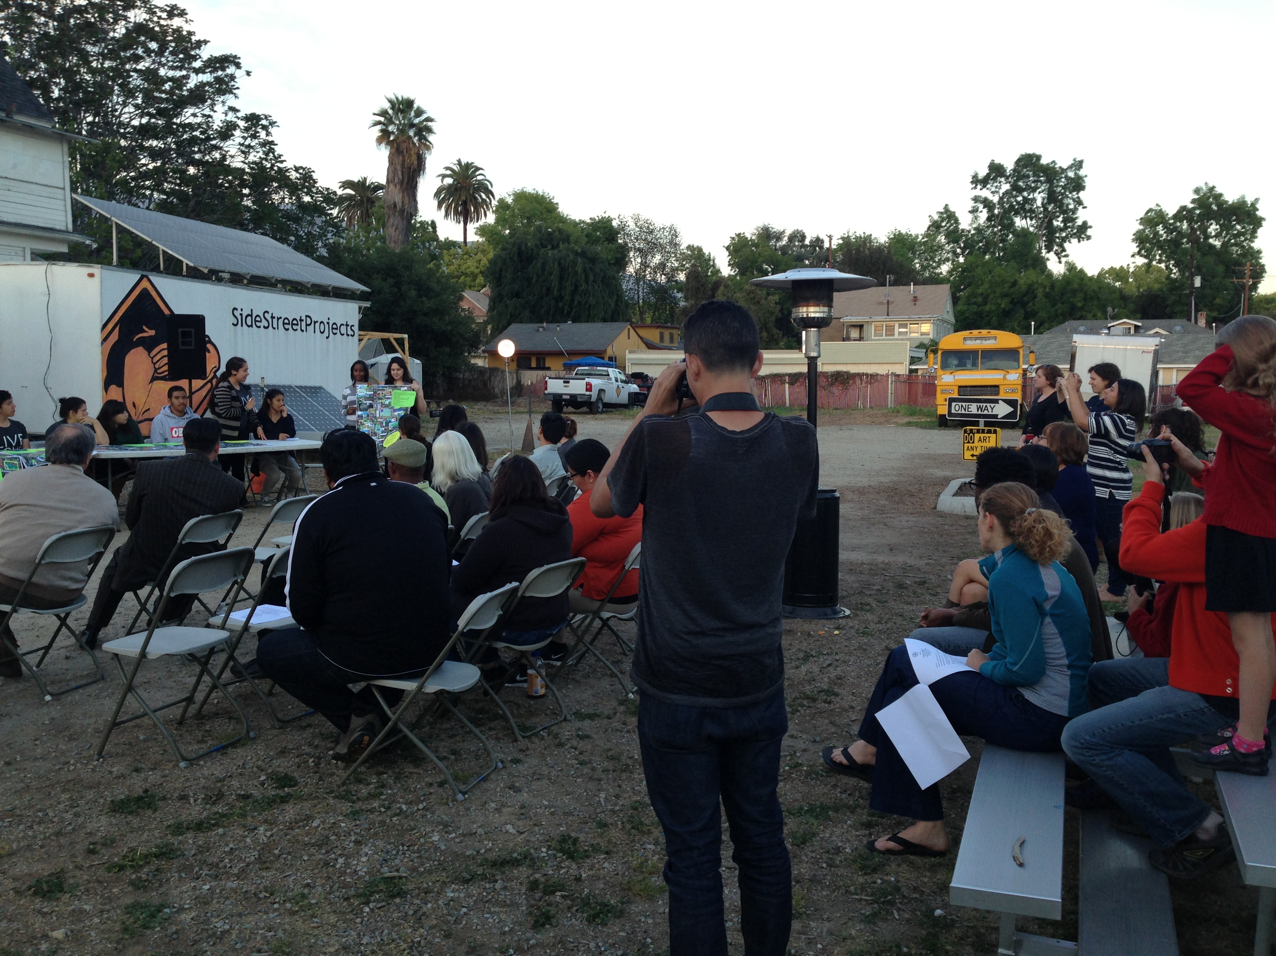

Slide 35
Different kinds of listening (physical and metaphorical)
Technology: old and new (WWI-II devices to drones)
Listening as a way of understanding a community, (surveillance / community organizing) public and private
Sound ethnography - an ethics of listening; feedback / talking back (to whom?)

Slide 37
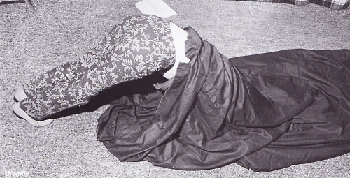
Yoko Ono, Bag Piece, 1966

Slide 38
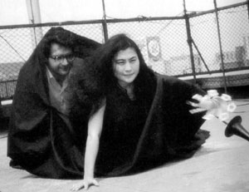

Slide 39
Ming-Yuen S Ma, Bag Piece (Reproduced), 2006

