Slide 2
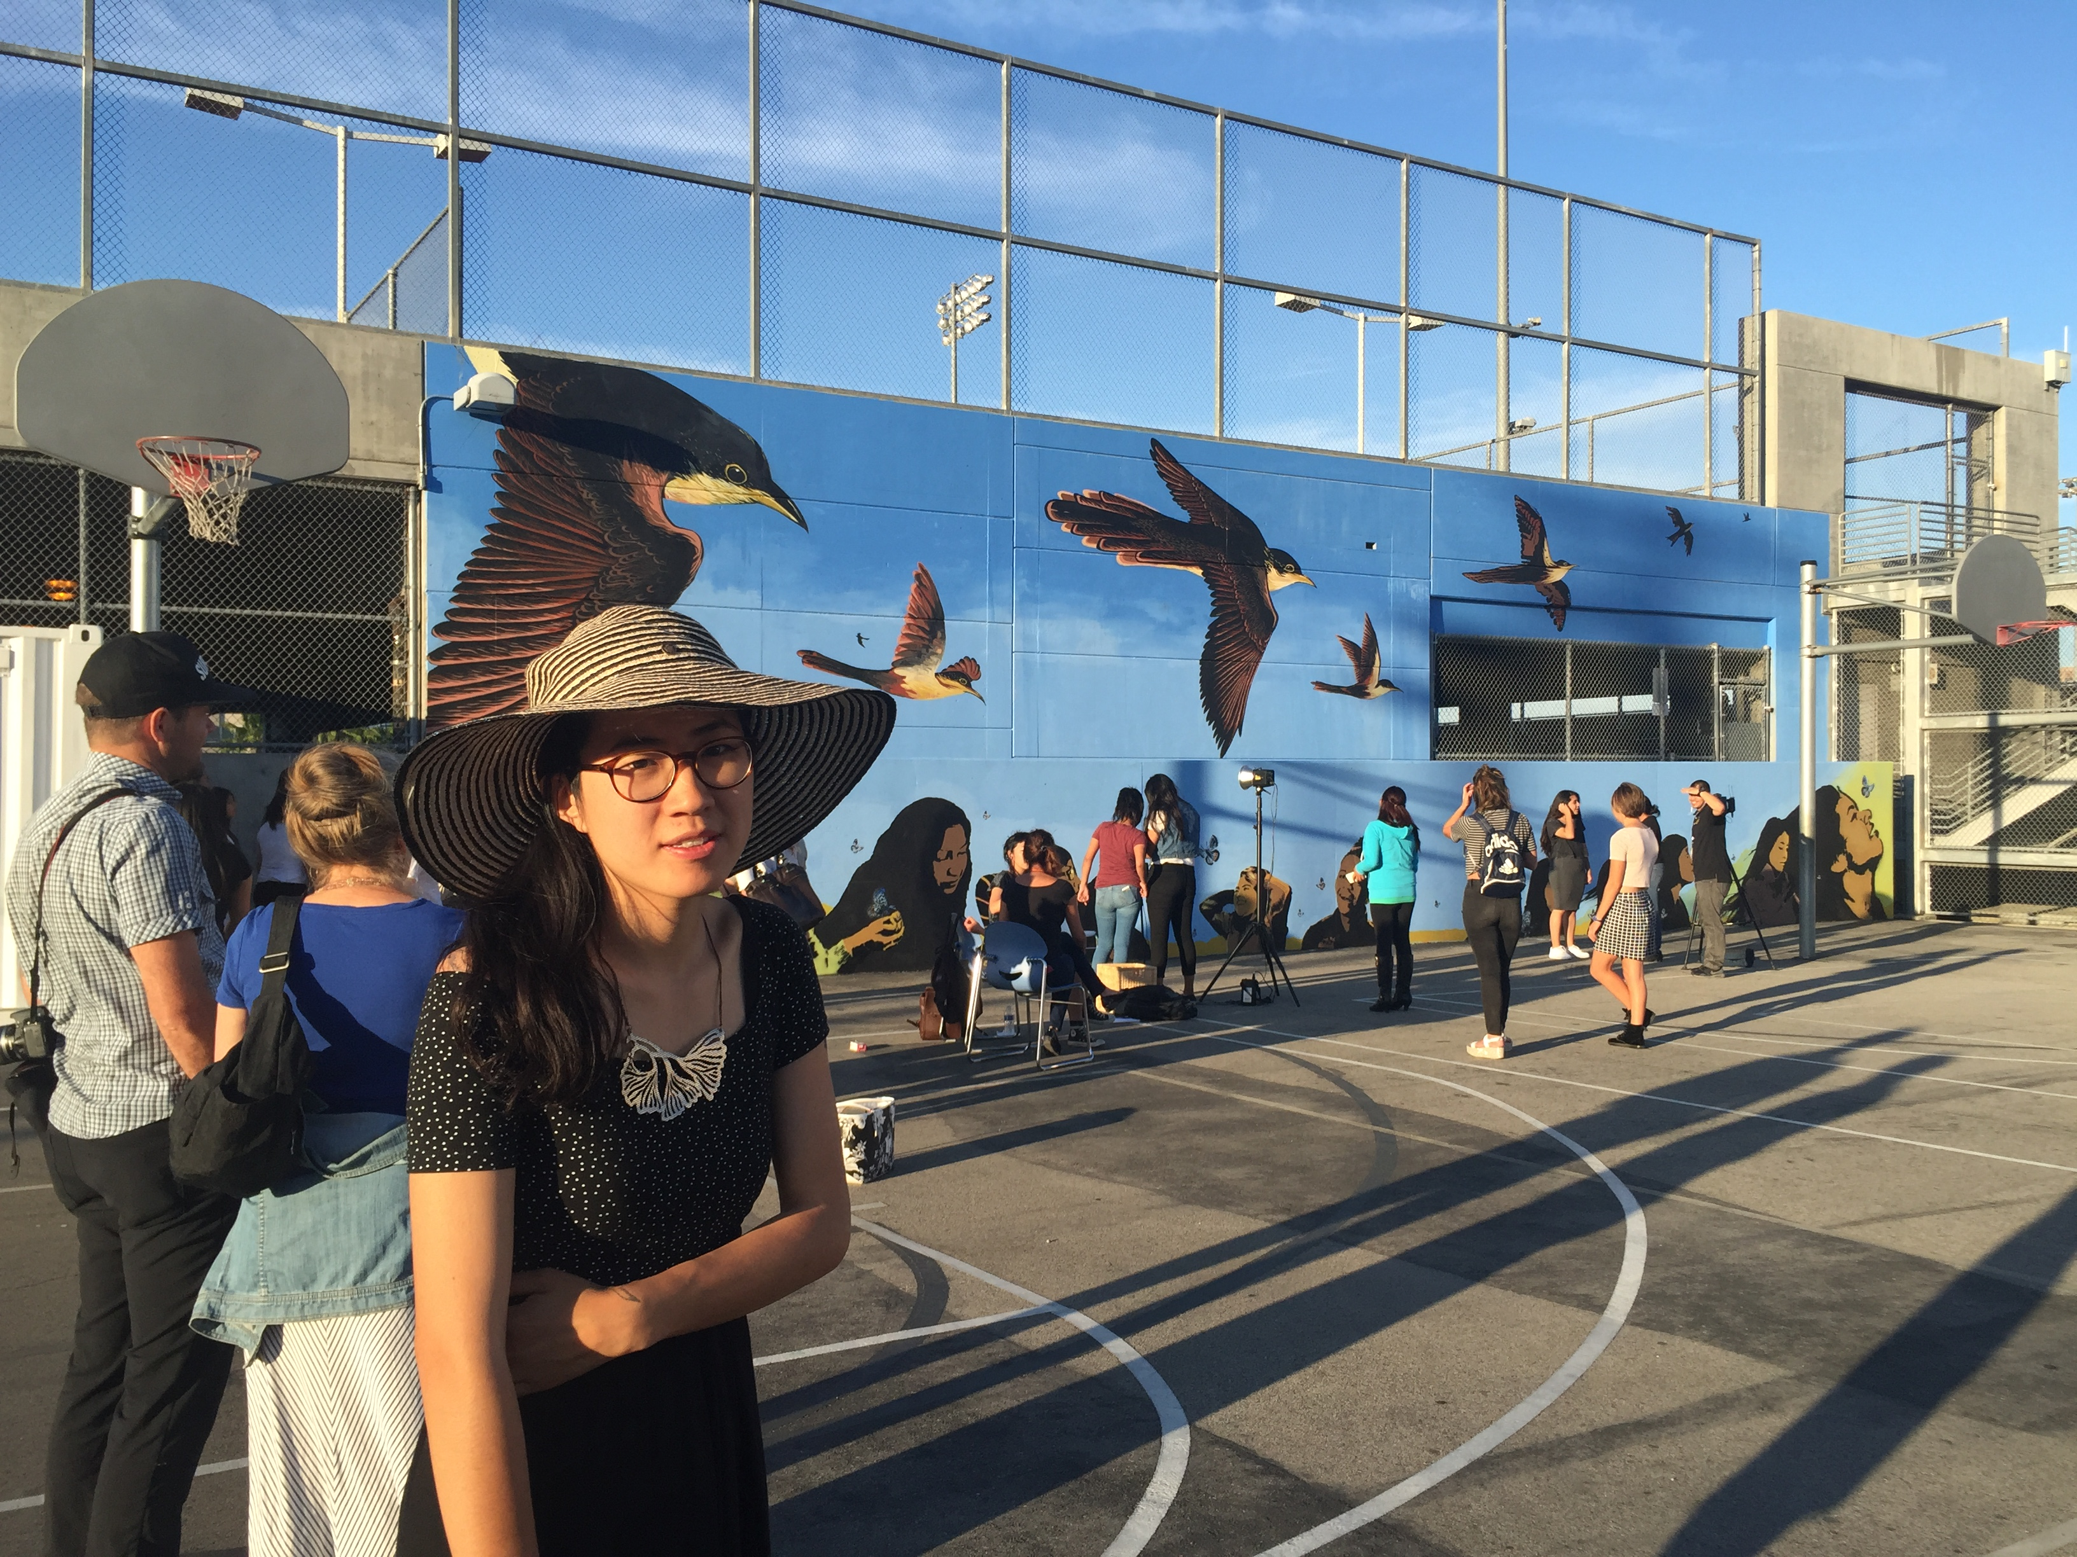

Slide 3
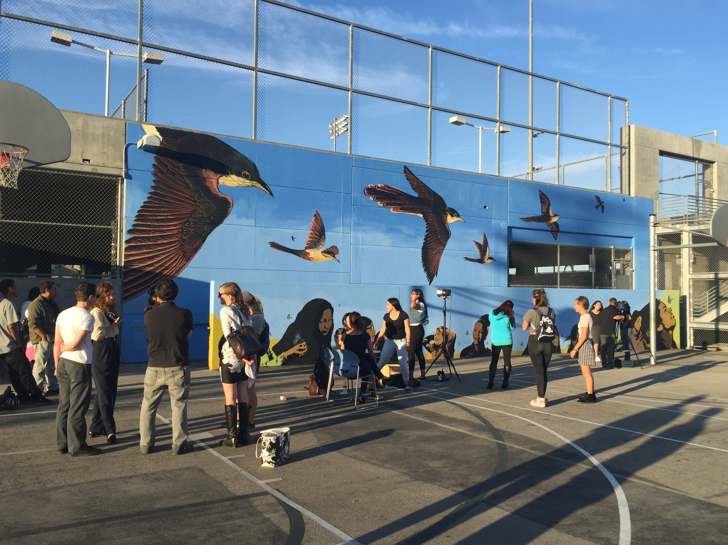

Slide 4
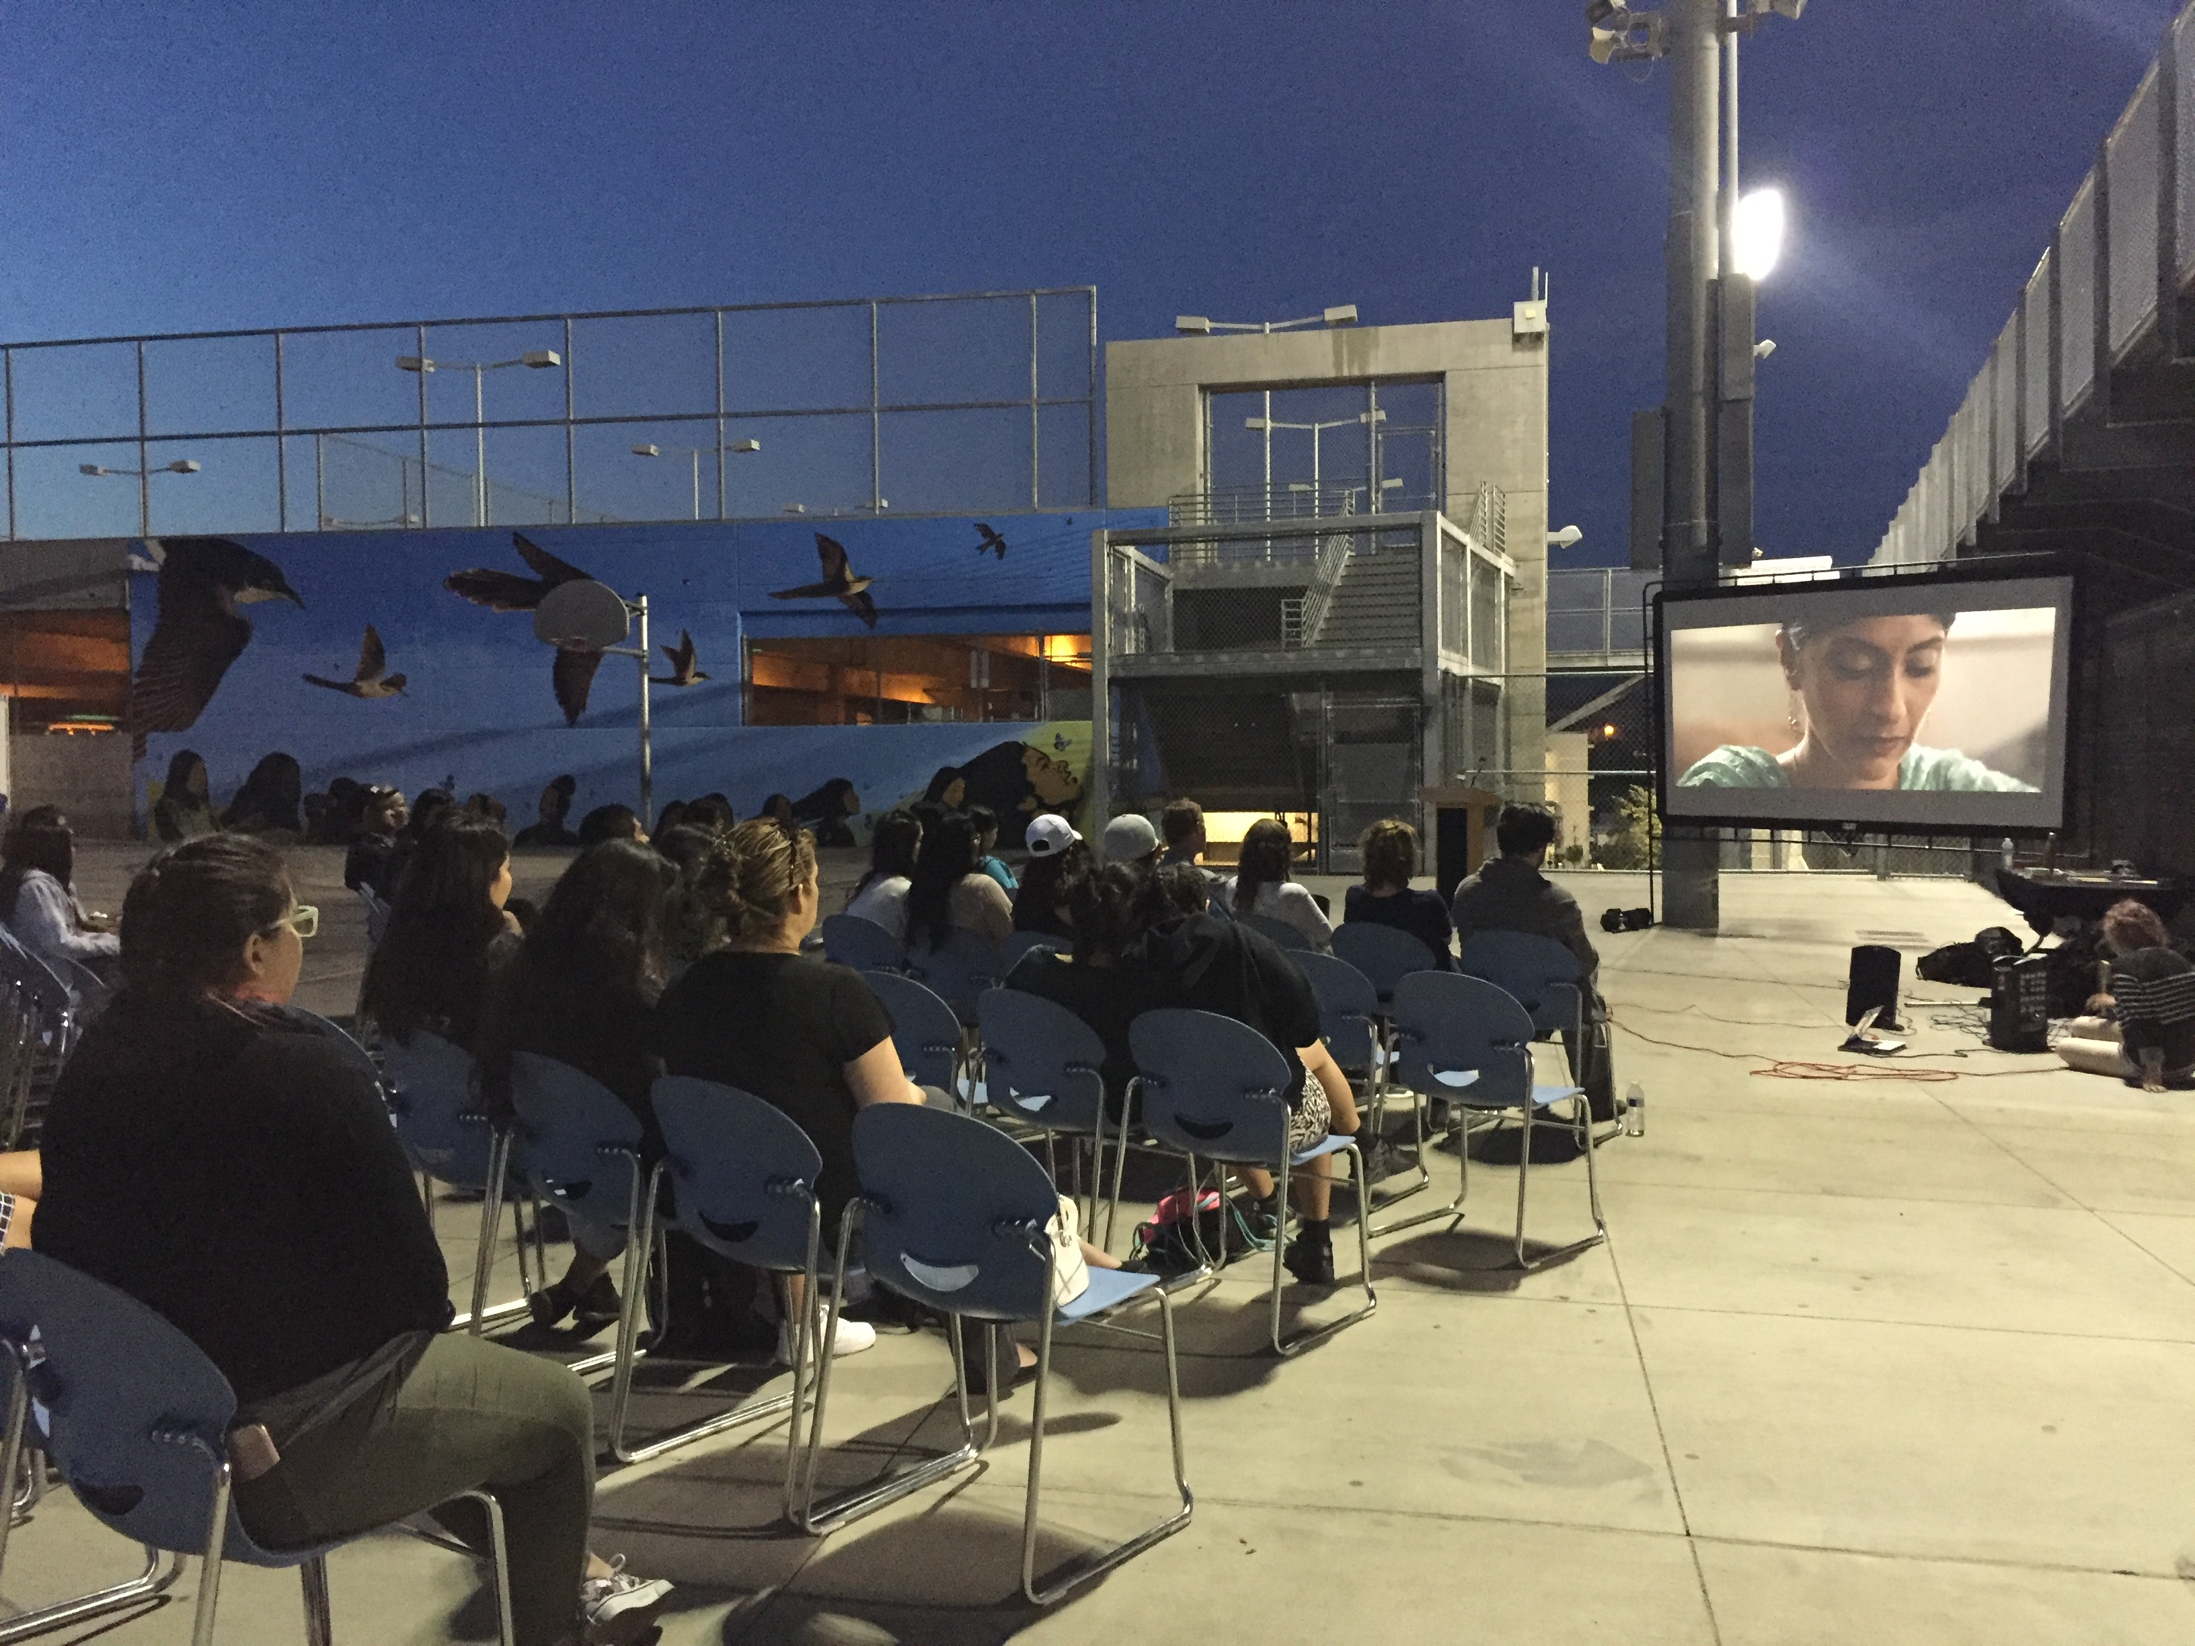

Slide 5
ASIAN AMERICAN MEDIA IN COMMUNITIES
Week 1: Asian American Media Arts Centers

Slide 6
Topics:
Asian American Movement / Third World Strike / Ethnic Studies
Counter culture
Independent media
Asian American media arts center

Slide 7
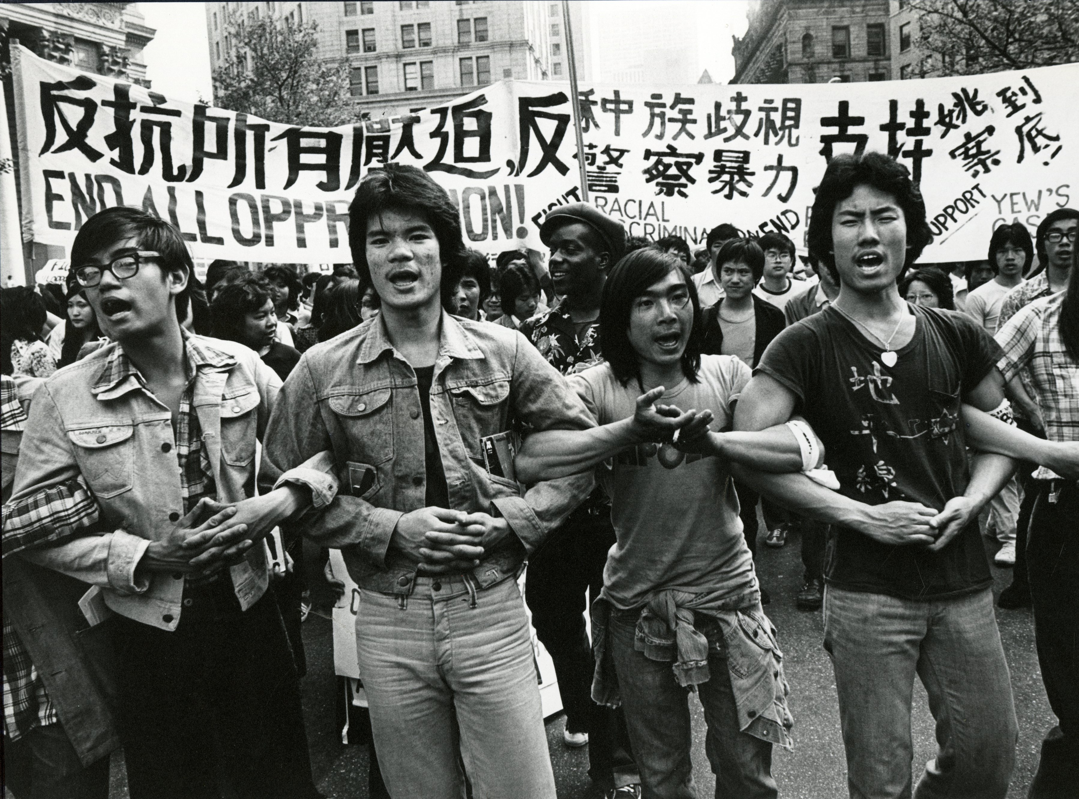
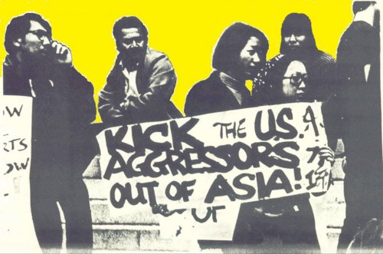
Asian American Movement in the 1970s

Slide 8
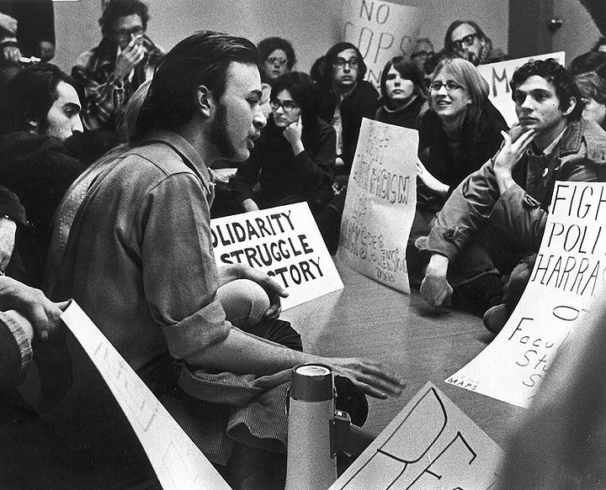
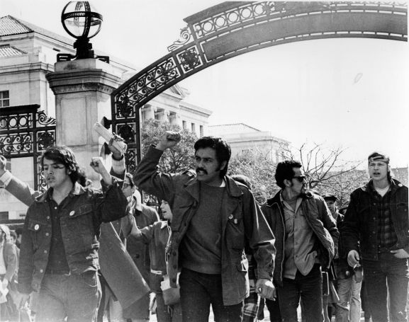
Influenced by the Third World Liberation Front strike for Ethnic Studies in the late 1960s; Black Panthers, and other racial civil rights movements

Slide 9
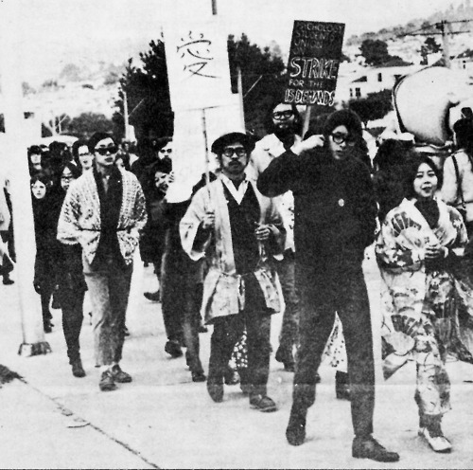
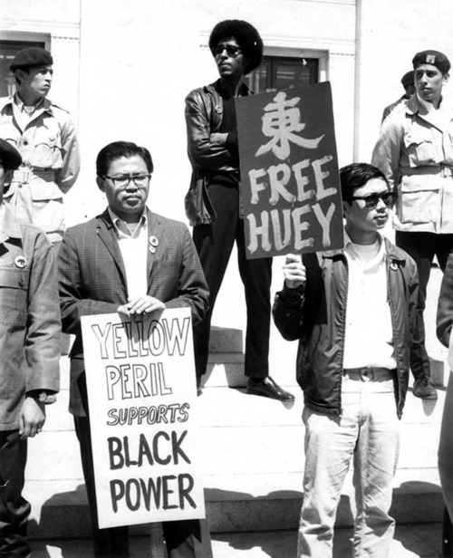

Slide 10
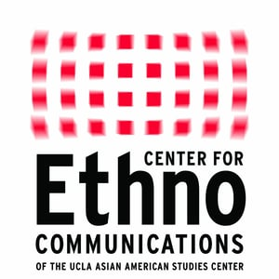
Ethno-Communications was a film production program founded at UCLA in the late 1960s and early 1970s by Asian, Chicano,
African American, and Native American students who were influenced by the social protest movements and counter culture of the time.

Slide 11
Its ethos was influenced by Third Cinema and other liberationist media movements, and especially by the films and writing of Latin American filmmakers including Glauber Rocha, Fernando Solanas, Octavio Getino, and Julio Garcia Espinosa.

Slide 12
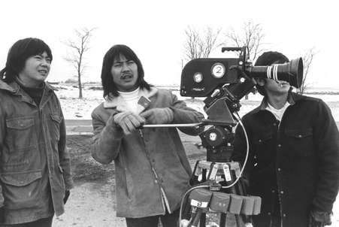
A number of Asian American graduates
of Ethno-Communications became the founders of Visual Communications (VC) the oldest Asian American media arts center, located in Little Tokyo in downtown Los Angeles.

Slide 13
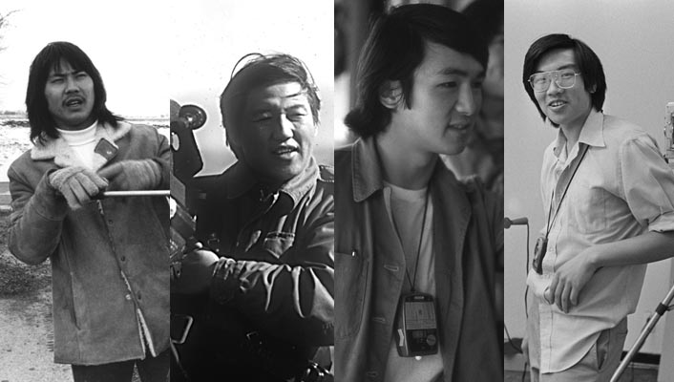
From left: Duane Kubo, Robert Nakamura, Alan Ohashi, and Eddie Wong

Slide 14
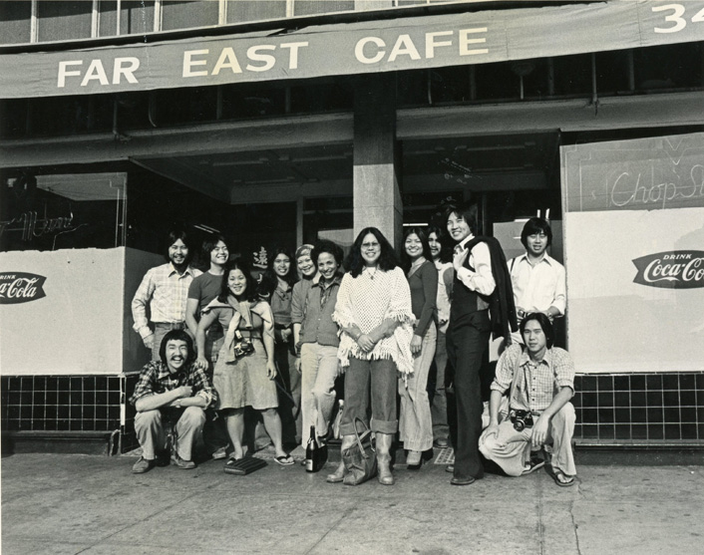

Slide 15
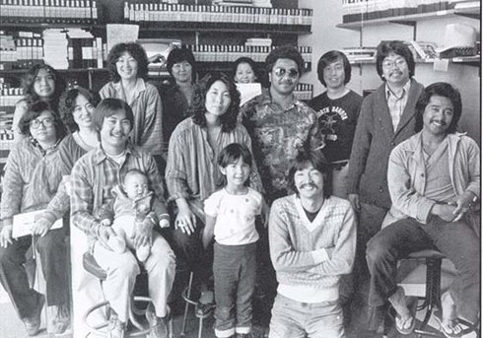

Slide 16
Other Asian American Media Arts Centers
Asian CineVision (New York)
King Street Media (Seattle)
Asian American Resource Workshop (Boston)
Asian American Arts and Media, Inc. (Washington DC)
Center for Asian American Media / National Asian American Telecommunications Association (San Francisco)

Slide 17
Asian American Film Festivals
Asian American International Film Festival (New York)
Los Angeles Asian Pacific Film Festival (Los Angeles)
CAAMFEST (San Francisco)
Seattle Asian American Film Festival (Seattle)
Boston Asian American Film Festival (Boston)
San Diego Asian Film Festival (San Diego)

Slide 18
DC Asian Pacific American Film Festival (Washington DC)
Philadelphia Asian American Film Festival (Phildelphia)
Related
Hawaii International Film Festival (Honolulu)
Indian Film Festival of Los Angeles (Los Angeles)
Vietnamese International Film Festival (Orange County, CA)

Slide 19
Myanmar (Burmese) Film Festival of Los Angeles (Los Angeles)
Toronto Reel Asian International Film Festival (Toronto, Canada)
Vancouver Asian Film Festival (Vancouver, Canada)

