Slide 1
INTRODUCTION TO FILM
Pre and Early Cinema

Slide 2
Key Terms:
Persistence of vision – a characteristic of human vision (first described scientifically by Peter Mark Roget in 1824) whereby the brain retains images cast upon the retina of the eye for approximately 1/20 to 1/5 of a second beyond their actual removal from the field of vision.
Emulsion – layers of gelatin containing light sensitive chemical, supported by an acetate base, that reacts to exposure to light to form tiny specks (grain) that corresponds to the light and dark areas in the scene filmed.

Slide 3
Diegesis (Greek word for recounted story) – the “world” of the film’s story, or the “total world of the story action”. The diegesis includes events that are presumed to have occurred and actions and spaces not shown on screen.
Form – a film has an overall organization, a pattern. Filmic conventions are established patterns. The style of a film = purposeful patterns.
Shot – one uninterrupted image taken by a static or mobile camera. The shot is the basic building block of modern continuity editing.

Slide 4
Eadweard Muybridge Motion Photographs
(Late 1800s, probably 1887)

Slide 5
Étienne-Jules Marey Motion Photograph
(1882)

Slide 7
Marey’s Chronophotographic Gun, invented in 1882, can shoot 12 consecutive frames per second

Slide 8
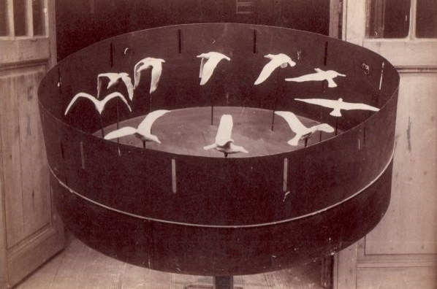
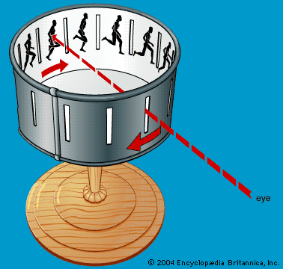
Examples of zoetropes: the one on the right was made by Marey in 1887 using sculptures instead of
2-D images

Slide 9
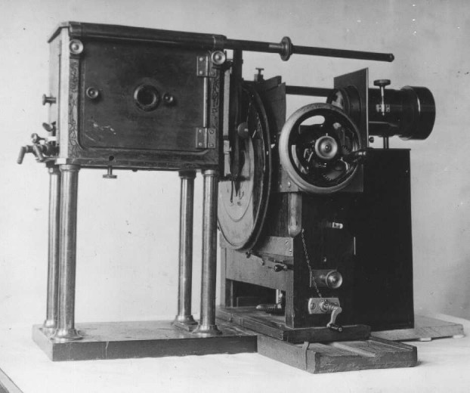
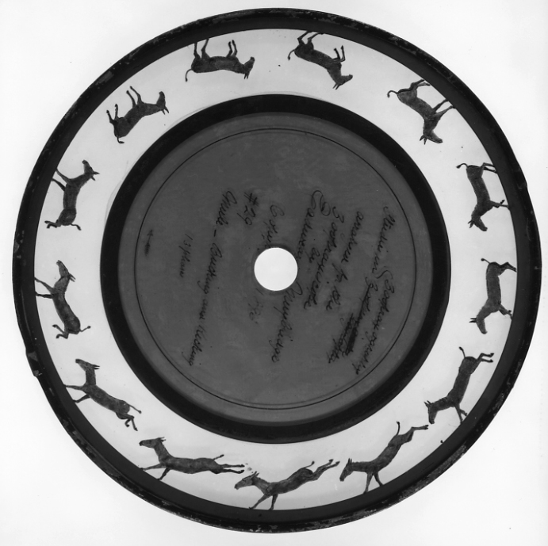
The zoopraxiscope was used by Muybridge
to animate his motion photography

Slide 10
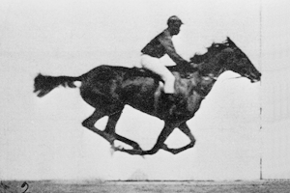
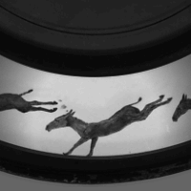

Slide 11
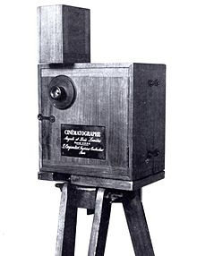
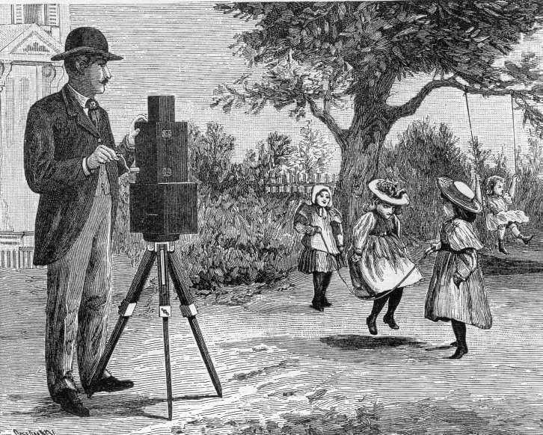
Cinematographe, as camera

Slide 12
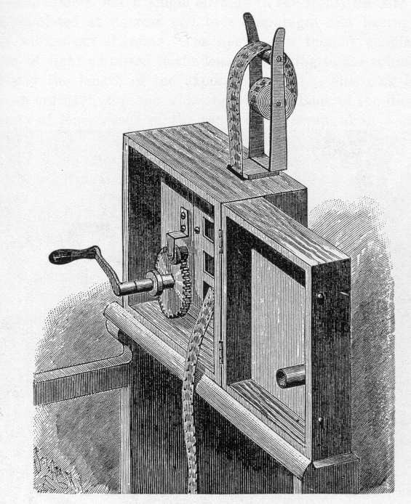
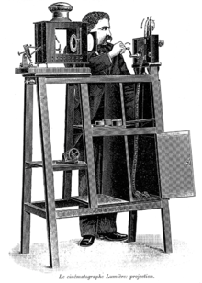
Cinematographe, as projector

Slide 13
Watch:
The Boxing Cats (Prof. Welton’s), 1894, Dir. W.K.L. Dickson & William Heise at Edison lab.
A Baby’s Meal, 1895, Dir. Lumière brothers
Equilibre Impossible (An Impossible Balancing Feat), 1902, Dir. Georges Méliès

Slide 14
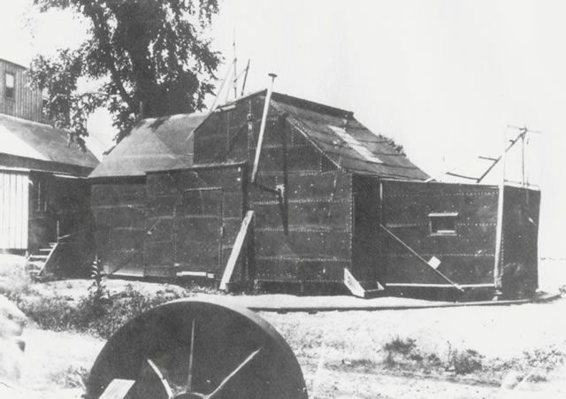
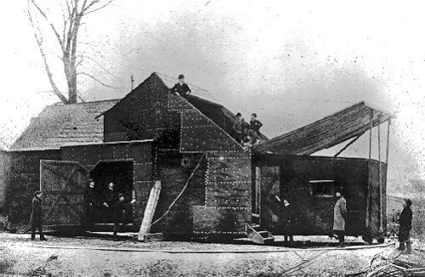
The Black Maria film studio, or cinematographic theater was used by Thomas Edison, as well as his staff at the Edison laboratories including William Kennedy-Laurie Dickson as a film production studio. It was built in 1893 at the Edison lab in West Orange, NJ, and demolished in 1903.

Slide 15
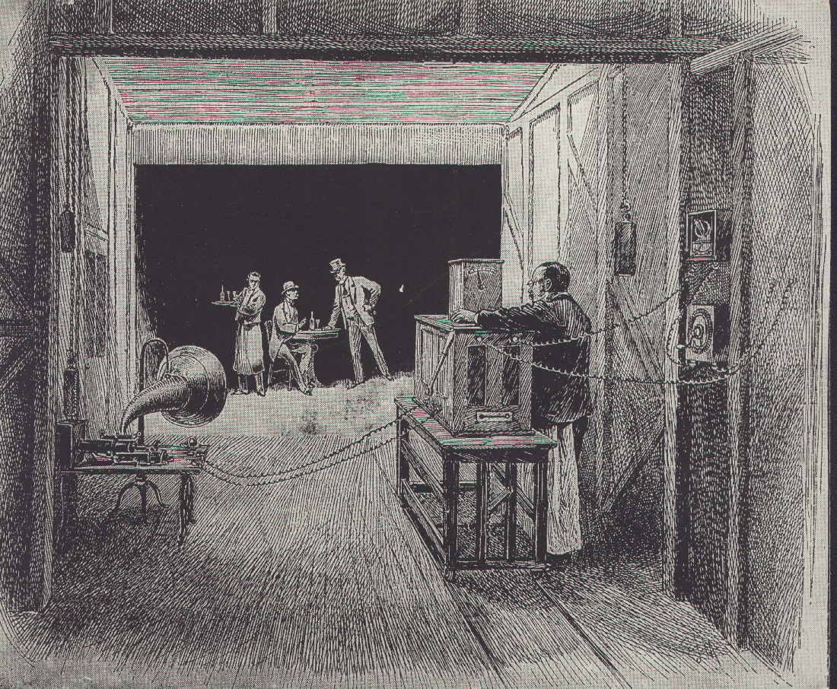
Interior of the Black Maria

Slide 16
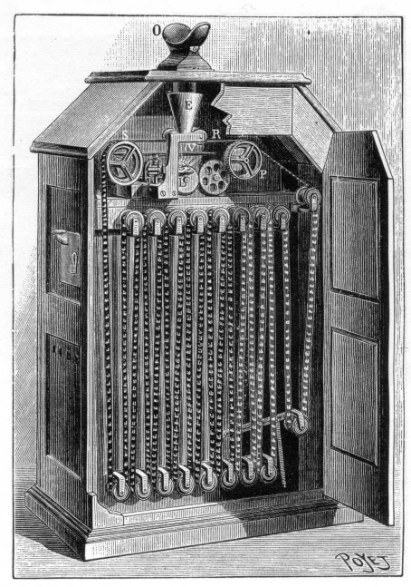
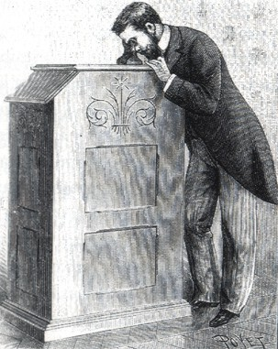
Kinetoscope

Slide 17
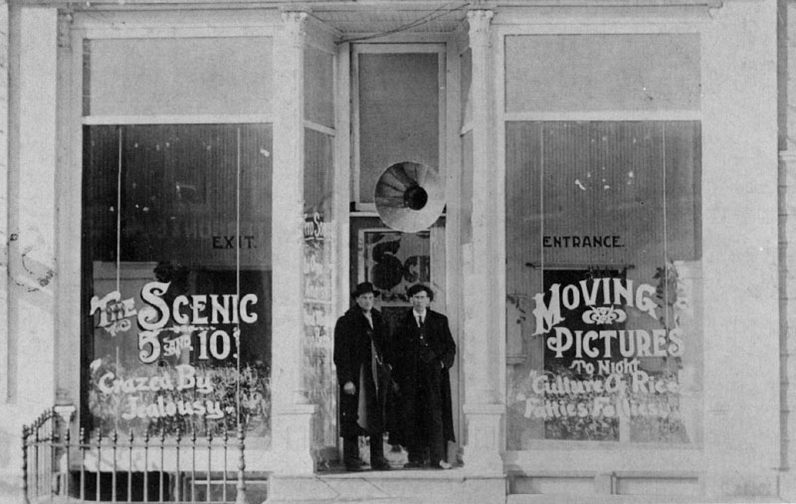
Nickelodeon in Iowa, early 1900s

Slide 18
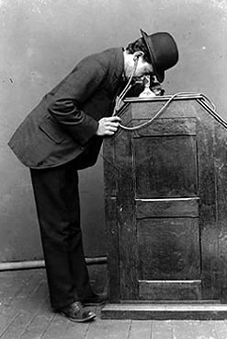
Kinetoscope with sound

Slide 19
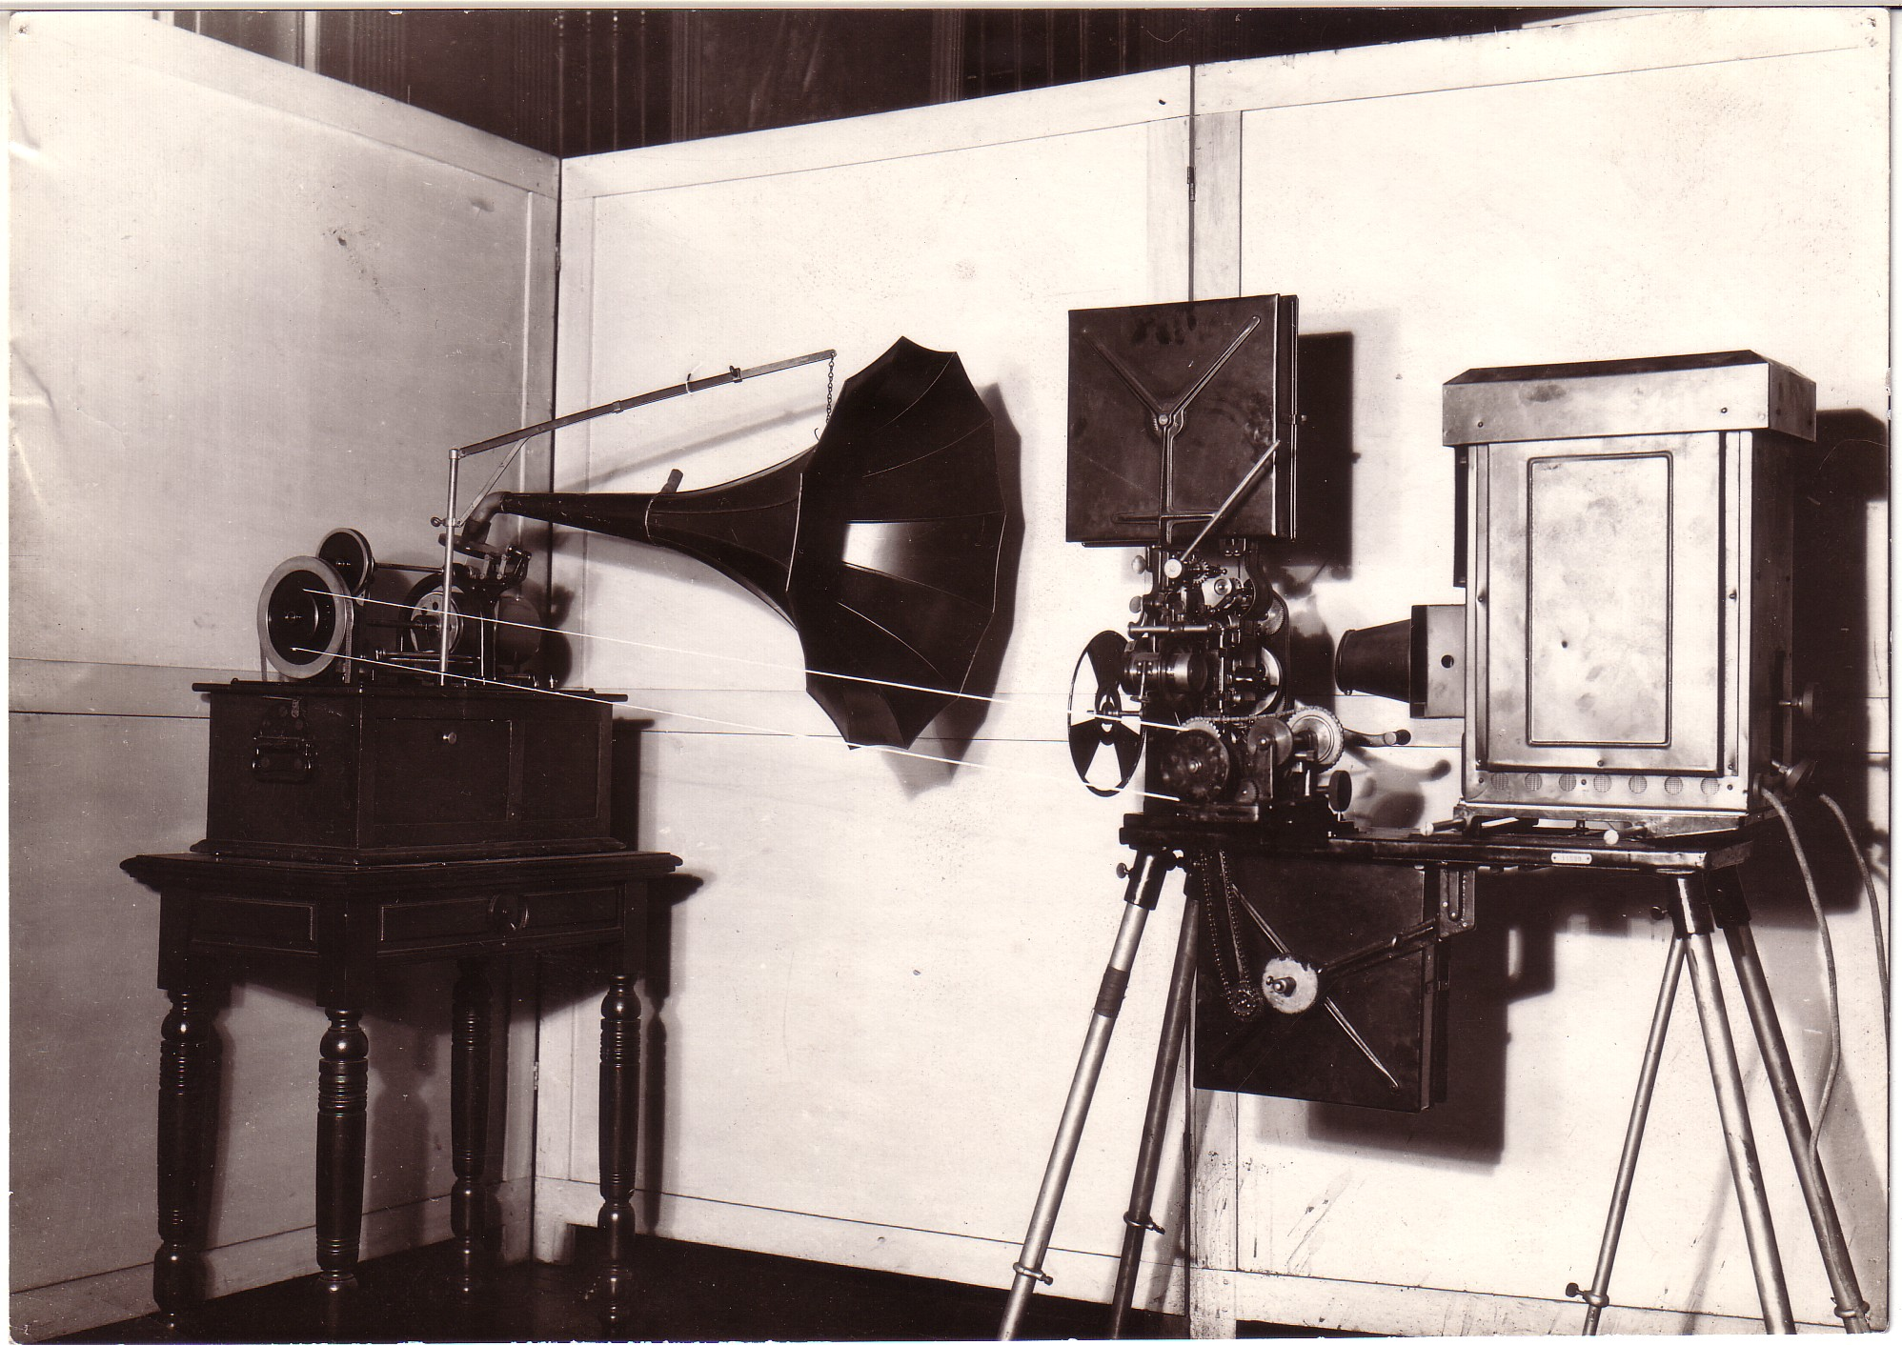
Edison Kinetophone

Slide 20
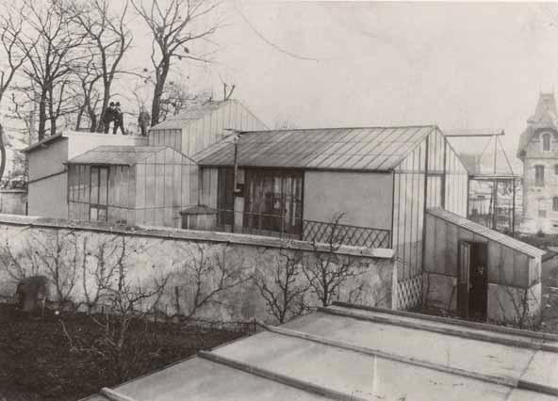
George Méliès studio in Montreuil, built in 1896

Slide 21
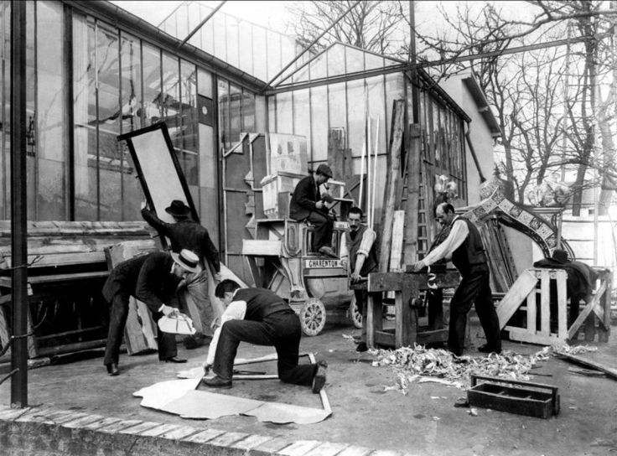
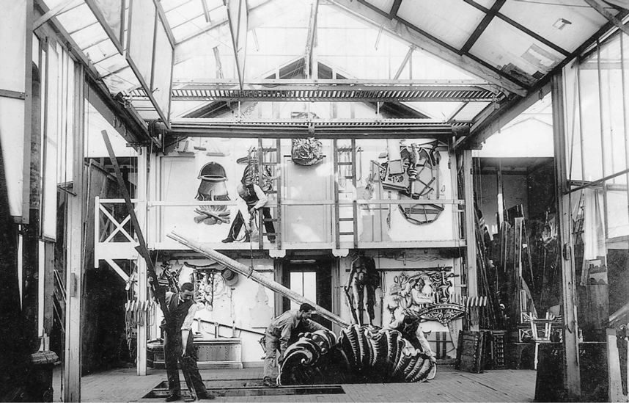
Interior of Méliès studio

Slide 22
Key Terms:
Long shot – a shot of landscape or setting.
Single shot – a shot containing one person.
Two shot – a shot containing two people.
Full shot – a shot of the full figure of a standing person or persons and about ¾ view of the set. Also called medium long shot.

Slide 23
Three quarter shot – a shot of a person or persons from the shins up. Also called plan américain.
Medium shot – a shot in which the scale of the object shown is of moderate size; a human figure seen from the waist up would fill most of the screen.

Slide 24
Medium close up – a shot in which the scale of the object shown is fairly large; a human figure seen from the chest up would fill most of the screen.
Close up – a shot in which the scale of the object shown is relatively large; most commonly a person’s head seen from the neck up, or an object of a comparable size that fills most of the screen.

Slide 25
Cinematography

Slide 26
Cinematography
Literally, “writing in movement”; dependent on photography, but camera are not absolutely necessary – “the filmmaker is creating patterns of light on celluloid.” (Film Art, P. 229)

Slide 27
Cinematography
Literally, “writing in movement”; dependent on photography, but camera are not absolutely necessary – “the filmmaker is creating patterns of light on celluloid.” (Film Art, P. 229)
Tonality (film stock, tinting, exposure, filters)

Slide 28
Cinematography
Literally, “writing in movement”; dependent on photography, but camera are not absolutely necessary – “the filmmaker is creating patterns of light on celluloid.” (Film Art, P. 229)
Tonality (film stock, tinting, exposure, filters)
Speed (frame rate, motion, time)

Slide 29
Cinematography
Literally, “writing in movement”; dependent on photography, but camera are not absolutely necessary – “the filmmaker is creating patterns of light on celluloid.” (Film Art, P. 229)
Tonality (film stock, tinting, exposure, filters)
Speed (frame rate, motion, time)
Lens (focal length, depth of field)

Slide 30
Cinematography
Literally, “writing in movement”; dependent on photography, but camera are not absolutely necessary – “the filmmaker is creating patterns of light on celluloid.” (Film Art, P. 229)
Tonality (film stock, tinting, exposure, filters)
Speed (frame rate, motion, time)
Lens (focal length, depth of field)
Special effects (projections, optical printing, CGI)

Slide 31
The Development of Feature Film as Industry
The founding of the MPPC (The Motion Picture Patents Company) in 1908 under the Edison / Biograph leadership
A protective trade association – resisted by independents
One reelers – released multi-reel films as serials

Slide 32
Feature = a multi-reel film
High priced admission
Longer runs
Cheaper and easier publicity
Higher volume sales to distributors
Longer formats, more complex narrative
New theaters (“Dream Palaces”)

Slide 33
1907-1913: massive migration west to Hollywood

Slide 34
1907-1913: massive migration west to Hollywood
Climate

Slide 35
1907-1913: massive migration west to Hollywood
Climate
Access to theatrical talent

Slide 36
1907-1913: massive migration west to Hollywood
Climate
Access to theatrical talent
Variety of scenery / locations

Slide 37
1907-1913: massive migration west to Hollywood
Climate
Access to theatrical talent
Variety of scenery / locations
Far from MPCC headquarters in NYC

Slide 38
By 1915, there were 15,000 workers employed by the motion picture industry in Hollywood
Over 60% of American production was centered there.
Investments exceeded $500 million.
The independent studios include Paramount Pictures, Universal, Fox, and Goldwyn Pictures

Slide 39
By 1915, there were 15,000 workers employed by the motion picture industry in Hollywood
Over 60% of American production was centered there.
Investments exceeded $500 million.
The independent studios include Paramount Pictures, Universal, Fox, and Goldwyn Pictures

Slide 40
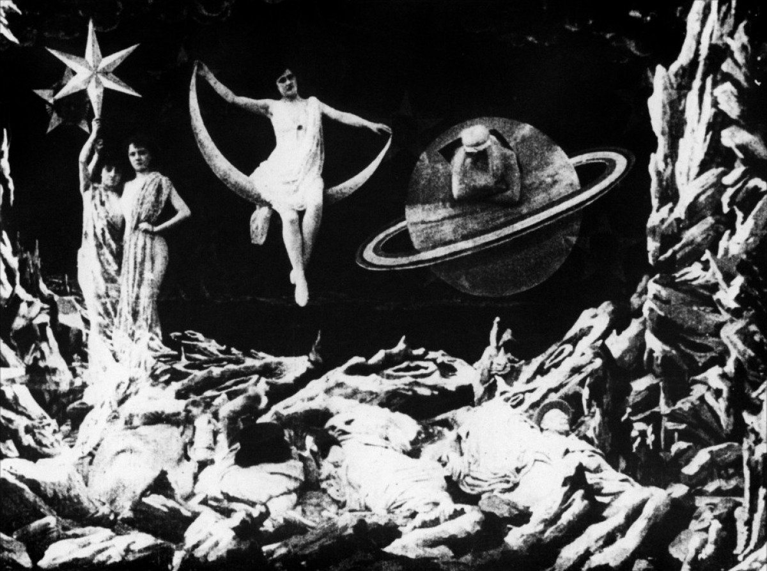
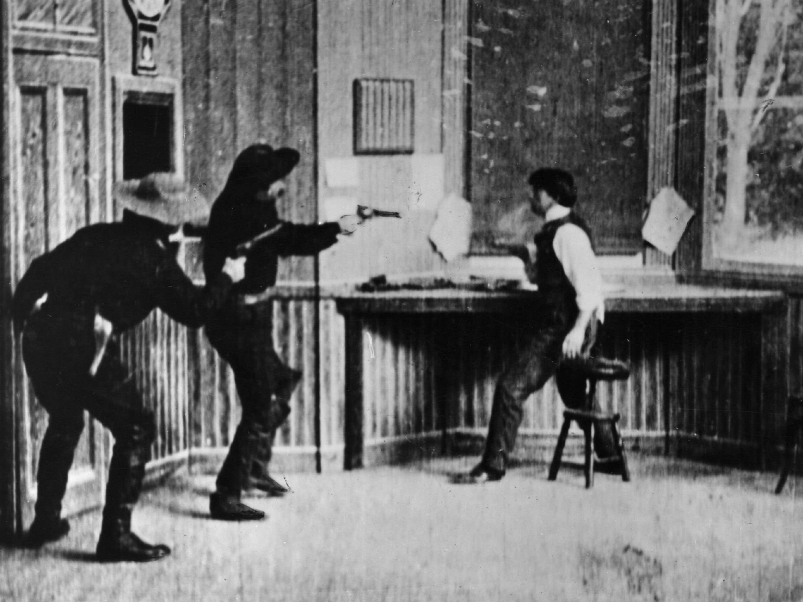
The development of narrative: A Trip to the Moon (1902, Dir. Georges Méliès) & The Great Train Robbery (1903, Dir. Edwin S. Porter)

Slide 41
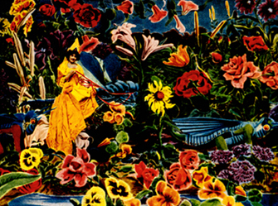
Cinema of attractions: an alternative argument

Slide 42
“Rather than narrative development based on active characters within detailed fictional environments, the cinema of attractions presented a series of curious or novel views to a spectator.” (OGFS, p. 258)

Slide 43
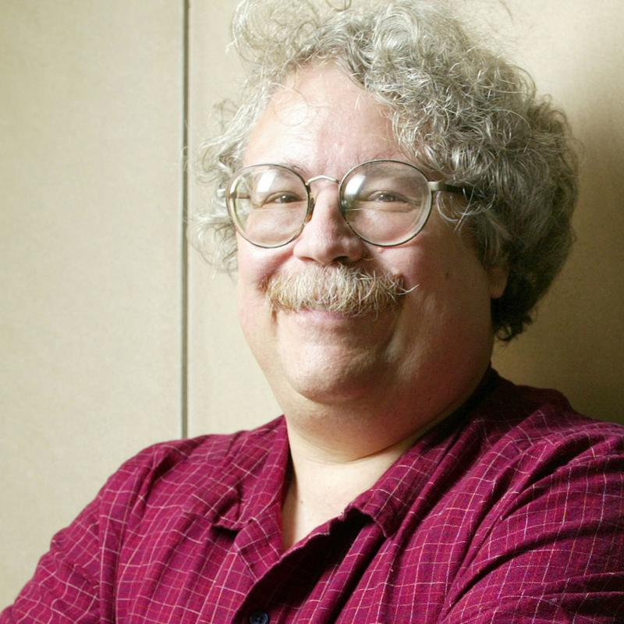
Tom Gunning
Gunning is the Edwin A. and Betty L. Bergman Distinguished Service Professor in Cinema and Media Studies, and Art History at University of Chicago.
His scholarship focuses on problems of film style and interpretation, film history and film culture. He has approximately one hundred publications concentrating on early cinema as well as on the culture of modernity from which cinema arose.

Slide 44
Gunning’s concept of the "cinema of attractions" has tried to relate the development of cinema to other forces than storytelling, such as new experiences of space and time in modernity, and an emerging modern visual culture.
His books include D.W. Griffith and the Origins of American Narrative Film (1993) and The Films of Fritz Lang: Allegories of Vision and Modernity (2000)

Slide 45
Gunning is challenging the “pejorative connotations of describing early film as ‘primitive’, maintaining that this era possessed a different approach to filmmaking than that of later cinema, so often considered the norm.” (OGFS, p. 255)
Noël Burch - IMR (institutional mode of representation) vs. PMR (primitive mode of representation
Narrators (cinematic devices which narrate a story, e.g. edited sequence) vs. monstrators (display or showed things, e.g. single shot)

Slide 46
Gunning is challenging the “pejorative connotations of describing early film as ‘primitive’, maintaining that this era possessed a different approach to filmmaking than that of later cinema, so often considered the norm.” (OGFS, p. 255)
Noël Burch - IMR (institutional mode of representation) vs. PMR (primitive mode of representation
Narrators (cinematic devices which narrate a story, e.g. edited sequence) vs. monstrators (display or showed things, e.g. single shot)

Slide 47
“In this cinema, characterization was unimportant and the spatial and temporal relations essential to narrative development were basically irrelevant.”
“Like all binary oppositions, the contrast between attractions and narrative can lead to unfortunate simplification. These aspects should never be seen as mutually exclusive, but need to be dialectically interrelated.” (OGFS, p. 263)

Slide 48
“In this cinema, characterization was unimportant and the spatial and temporal relations essential to narrative development were basically irrelevant.”
“Like all binary oppositions, the contrast between attractions and narrative can lead to unfortunate simplification. These aspects should never be seen as mutually exclusive, but need to be dialectically interrelated.” (OGFS, p. 263)

Slide 49
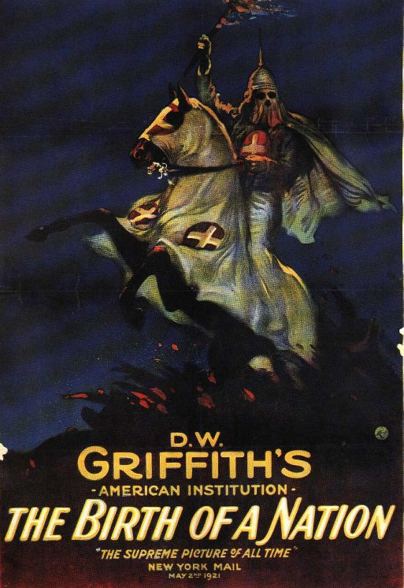
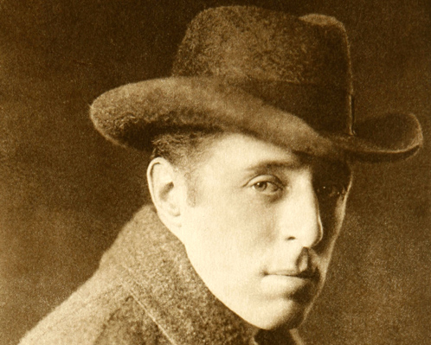
The Birth of A Nation (1915)
Directed by D.W. Griffith

Slide 50
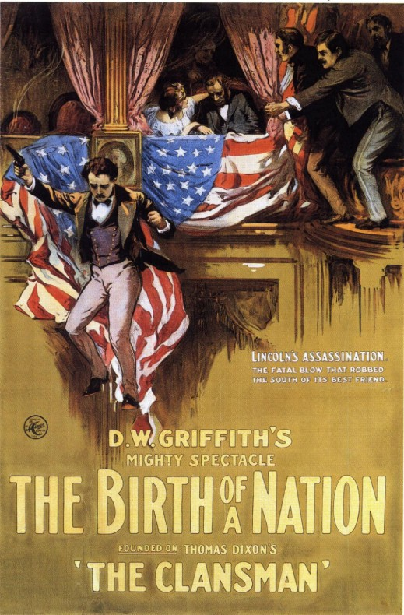
The Birth of A Nation – The Film
Opened as The Clansman in Los Angeles’ Clune Auditorium in Feb. 8, 1915 for a 22 week run
On March 8, open in NYC’s Liberty Theatre with a new title The Birth of A Nation
Screened at the Liberty till the end of 1915 – set a record – tickets cost $2
Boycotted by the NAACP

Slide 51
Comparative Analysis:
Watch and compare these sequences from The Birth of A Nation (2:40:50 – 2:48:50) and Within Our Gates (1:07:52-1:10:10)
How do similar actions and narrative structure function in these films? Are they the same, or different?
What decisions have the filmmakers made in their respective films to represent these images and actions?

Slide 52
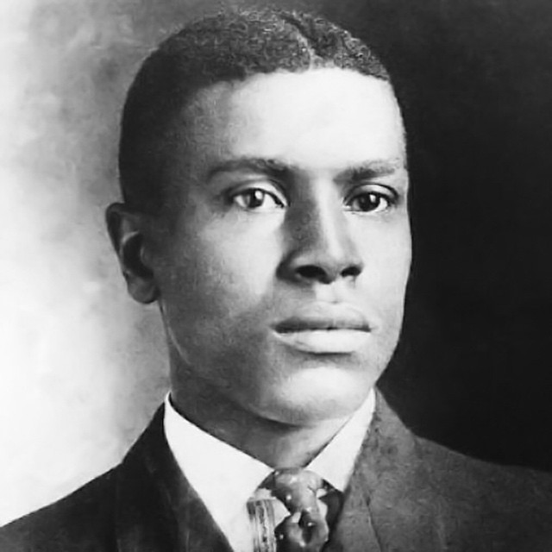
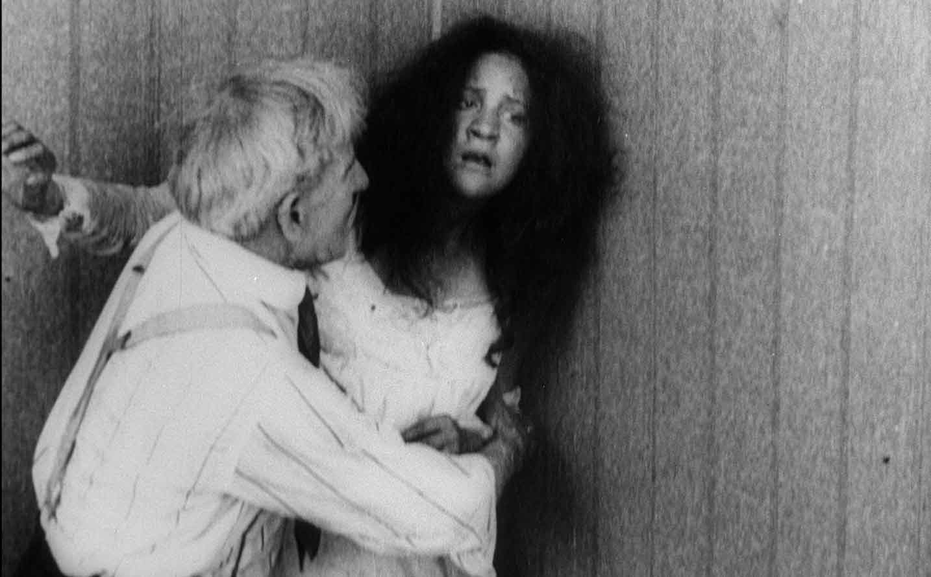
Within Our Gates (1920)
Dir. Oscar Micheaux

Slide 53
Multi-Perspectival Analysis of The Birth of A Nation
Its visual language and narrative structure

Slide 54
Multi-Perspectival Analysis of The Birth of A Nation
Its visual language and narrative structure
Race, gender, stereotypes, ideology

Slide 55
Multi-Perspectival Analysis of The Birth of A Nation
Its visual language and narrative structure
Race, gender, stereotypes, ideology
Its musical score as representative of the “golden era of silent film music”

Slide 56
1. Visual Language and Narrative Structure

Slide 57
1. Visual Language and Narrative Structure
What do you see when you watch the film?

Slide 58
1. Visual Language and Narrative Structure
What do you see when you watch the film?
What kind of shots?

Slide 59
1. Visual Language and Narrative Structure
What do you see when you watch the film?
What kind of shots?
How are the different shots connected through editing?

Slide 60
1. Visual Language and Narrative Structure
What do you see when you watch the film?
What kind of shots?
How are the different shots connected through editing?
Do you see anything else?

Slide 61
1. Visual Language and Narrative Structure
What do you see when you watch the film?
What kind of shots?
How are the different shots connected through editing?
Do you see anything else?
How does its filmic language support or determine its narrative structure?

Slide 62
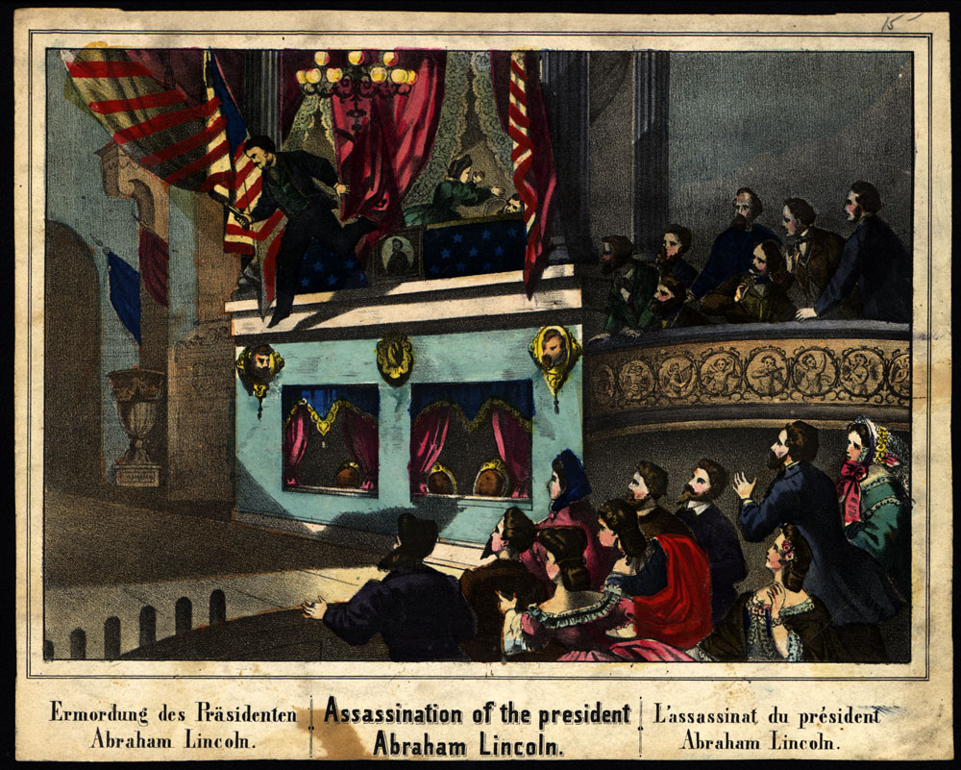
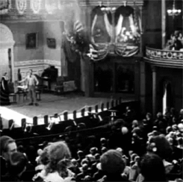
Griffith’s use of historical “facsimile”
Press image
Film image

Slide 63
2. Stereotypes and Ideology

Slide 64
2. Stereotypes and Ideology
What are stereotypes? Do you see any in the film?

Slide 65
2. Stereotypes and Ideology
What are stereotypes? Do you see any in the film?
How do stereotypes contribute to the film’s narrative structure, its ideology?

Slide 66
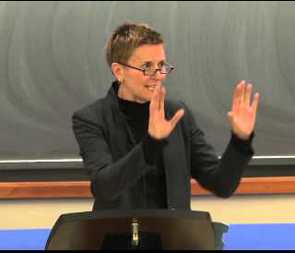
Robyn Wiegman
Wiegman is Professor of Literature and Women's Studies and formerly the Margaret Taylor Smith Director of Women's Studies at Duke, from 2001-2007.
Her research interests include feminist theory, queer theory, American Studies, critical race theory, and film and media studies.

Slide 67
Wiegman’s publications include Object Lessons (2012) and American Anatomies: Theorizing Race and Gender (1995)

Slide 68
2. Stereotypes and Ideology
Racial stereotypes show us the pervasiveness of racism as an institutionalized element in Hollywood film, which have been present since its beginning

Slide 69
2. Stereotypes and Ideology
Racial stereotypes show us the pervasiveness of racism as an institutionalized element in Hollywood film, which have been present since its beginning

Slide 70
“In filmic structure and forms of visual pleasure (narrative, setting, cosmetology, and camera technique) as well as industry labor practices and ‘morality’ codes, we witness the full arsenal of the stereotype’s production.” (OGFS, p. 164)

Slide 71
“In filmic structure and forms of visual pleasure (narrative, setting, cosmetology, and camera technique) as well as industry labor practices and ‘morality’ codes, we witness the full arsenal of the stereotype’s production.” (OGFS, p. 164)

Slide 72
2. Stereotypes and Ideology
According to Wiegman, what are some of the problems with stereotype analysis?

Slide 73
3. Silent Film Music

Slide 74
3. Silent Film Music
What do you hear when you watched The Birth of A Nation?

Slide 75
3. Silent Film Music
What do you hear when you watched The Birth of A Nation? How does the film’s music make you feel?

Slide 76
3. Silent Film Music
What do you hear when you watched The Birth of A Nation? How does the film’s music make you feel?
Does the music in the film interact with its images? If yes, how so?

Slide 77
3. Silent Film Music
What do you hear when you watched The Birth of A Nation? How does the film’s music make you feel?
Does the music in the film interact with its images? If yes, how so?
What are the role(s) of music in film form, narrative, and ideology?

Slide 78
Within Our Gates (1920)
Dir. Oscar Micheaux

Slide 79
Comparative Analysis:
Watch and compare these sequences from The Birth of A Nation (2:40:50 – 2:48:50) and Within Our Gates (1:07:52-1:10:10)
How do similar actions and narrative structure function in these films? Are they the same, or different?
What decisions have the filmmakers made in their respective films to represent these images and actions?

Slide 80
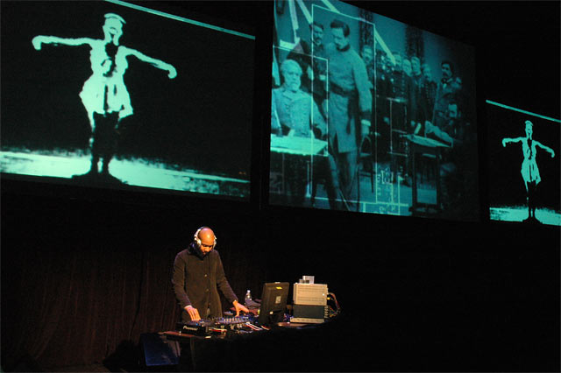
DJ Spooky performing Rebirth of a Nation (2005-8) at Chicago Museum of Contemporary Art November 2004

Slide 81
Further Analysis:
How does DJ Spooky’s re-scoring of the music in The Birth of A Nation alter and/or affirm the meaning of the images, narrative, and other elements in the film?
Do you think the live performances (do a search for images and clips on the web) of Rebirth of A Nation is the same as the single-channel version (which you can watch on Sakai)? What about the album (on Spotify and other platforms)?

