Slide 1
INTRODUCTION TO FILM
Long Take, Deep Focus

Slide 2
Long Take
Plan séquence (sequence shot) – an entire scene rendered only in one shot.
Emphasis on camera movement, performance, mise-en-scène instead of editing
Focus on the actor’s sustained performance
Influence of expressionist film in the use of mise-en-scène to tell the story

Slide 3
Deep Focus
André Bazin – the importance of deep focus and the sequence shot; cinema as filmed theater (Welles was a theater director first) and “artist as witness”

Slide 4
Deep Focus
André Bazin – the importance of deep focus and the sequence shot; cinema as filmed theater (Welles was a theater director first) and “artist as witness”
Maintains dynamic unity of a scene

Slide 5
Deep Focus
André Bazin – the importance of deep focus and the sequence shot; cinema as filmed theater (Welles was a theater director first) and “artist as witness”
Permits objects to have a residual being beyond the pure instrumentality demanded of them by the plot

Slide 6
Deep Focus
André Bazin – the importance of deep focus and the sequence shot; cinema as filmed theater (Welles was a theater director first) and “artist as witness”
Allows the spectator a certain freedom of choice following the action

Slide 7
Key Terms:
Long take – a shot that continues for an unusually lengthy time before the transition to the next shot.
Deep focus – the use of camera lens and lighting to keep both the foreground plane and background plane of a shot in sharp focus.
Depth of field – the distance between the foreground and background of a shot which is in sharp focus.

Slide 8
Deep space – an arrangement of the mise-en-scène which establishes a considerable distance between the foreground plane and the background plane of a shot.
Focus – the degree to which light rays coming from the same part of an object through different part of the lens re-converge at the same point on the film frame, creating sharp outlines and distinct textures.
Focal length – the distance from the center of the lens to the point at which the light rays meet in sharp focus. The focal length determines the perspective relations of the space represented on flat screen.

Slide 9
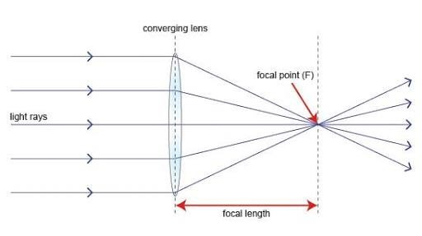

Slide 11
Focus plane – the plane at which the lens forms an image when focused on a given scene, measured as the distance from the film plane (the front surface of the film in a camera or projector).
Racking focus – shifting the area of sharp focus from one plane to another during a shot; the effect on screen is called rack-focus.
Shallow focus – a restricted depth of field, which keeps only one plane in focus, the opposite of deep focus.
Tracking shot – a mobile framing in which the camera glides horizontally on a moving support guided by rails, forward or back, left or right.

Slide 12
Dolly shot – a camera movement in which the camera attached to a moving support (on wheels) moves smoothly but in an irregular direction.
Tilt – camera movement in which the camera swivels vertically on its axis, up or down.
Pan - camera movement in which the camera swivels horizontally on its axis, from left to right or right to left.
Crane shot – camera movement in which the camera appears to move freely above the ground.
Aspect ratio – the relationship of the frame’s width to its height.

Slide 13
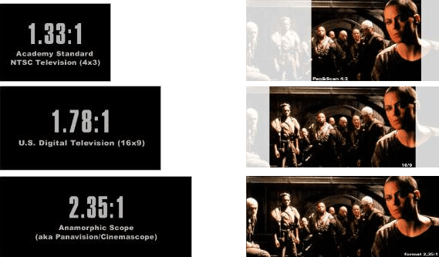
Academy ratio – standardized shape of film frame established by the Academy of Motion Picture Arts and Sciences. In the original ratio, the frame was 1 1/3 times as wide as it was high (1.33:1); later the width was normalized at 1.85 times the height (1.85:1).

Slide 14
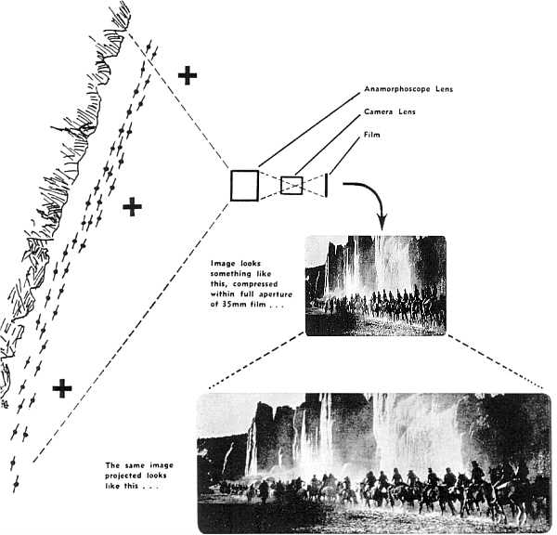
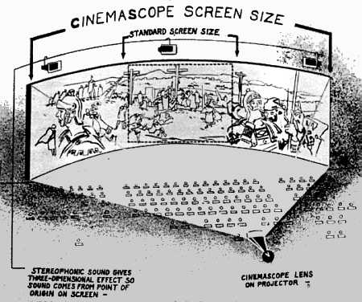
Widescreen – aspect ratio wider than (1.33:1), standard widescreen ratio US (1.85:1), GB (1.66:1), Cinemascope (2.35:1)
Anamorphic lens – a lens for making wide screen films using regular Academy ratio frame size. The camera lens takes in a wide field of view and squeezes it onto the frame, and a similar projector lens un-squeezes the image onto a wide theater screen.

Slide 15
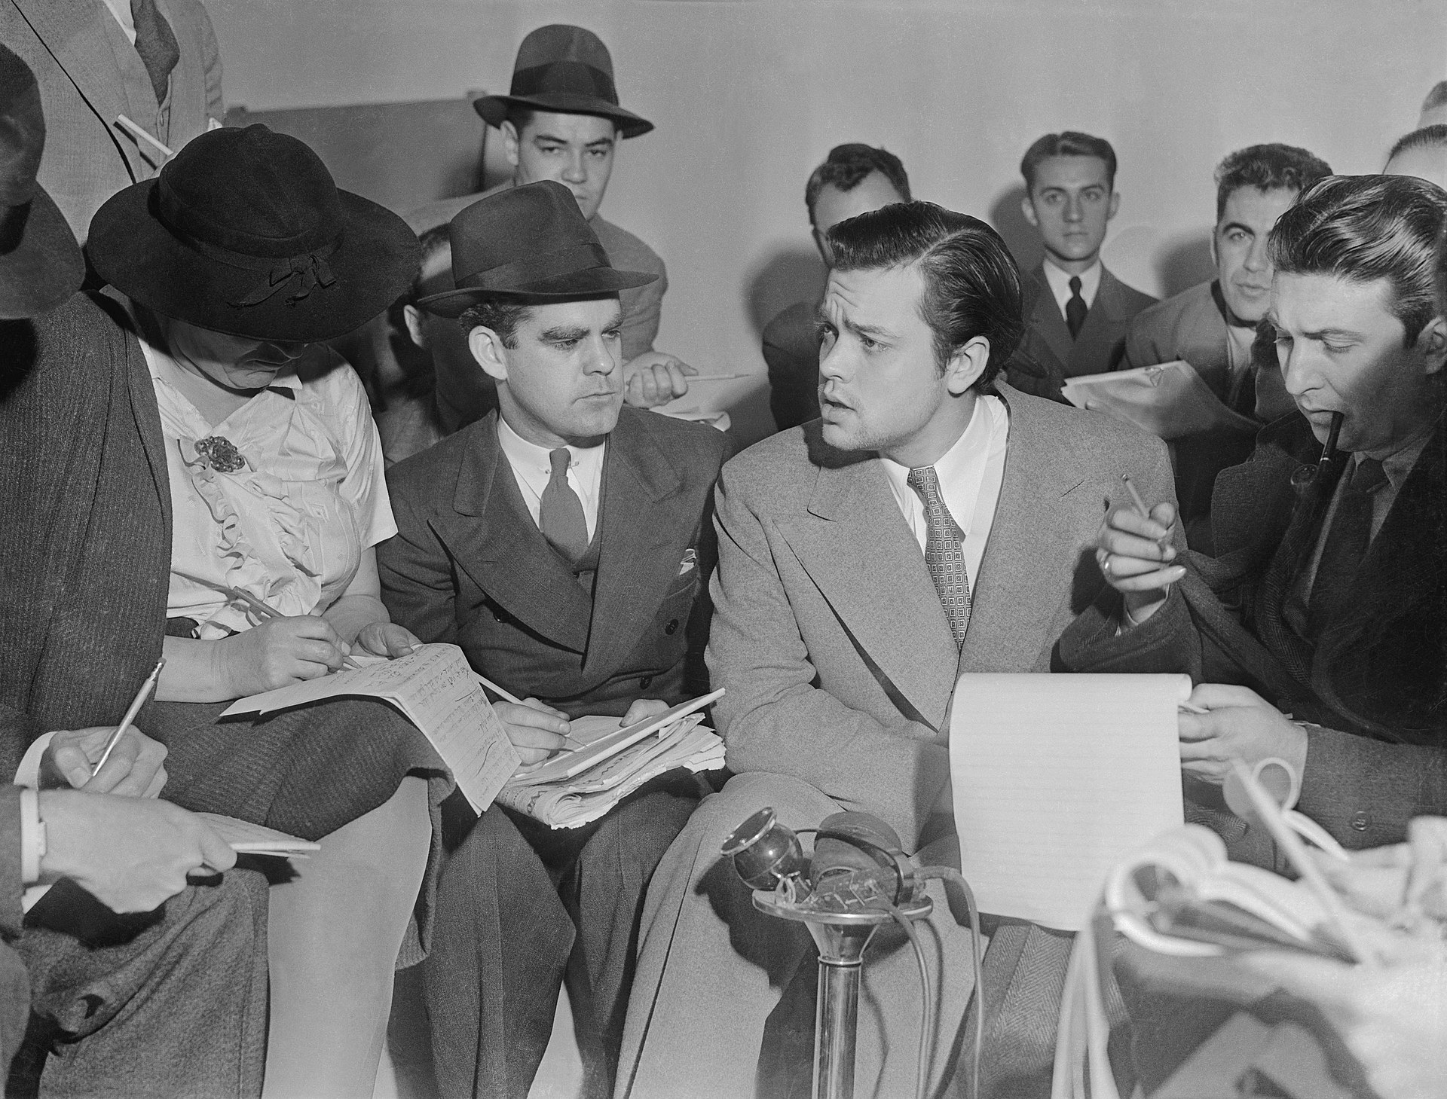
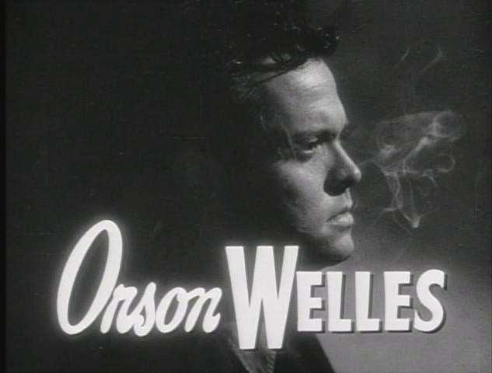
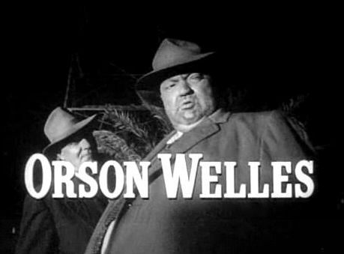
Orson Welles (1915-1985)
Actor, director, and writer who began acting and directing theatre in his mid teens to early 20s, directed his first feature film at age 24.
Know for his works Macbeth (Federal Theatre Project), The War of the Worlds (radio), Citizen Kane (film)
Considered an auteur
Images from 1938, 1947, 1958

Slide 16
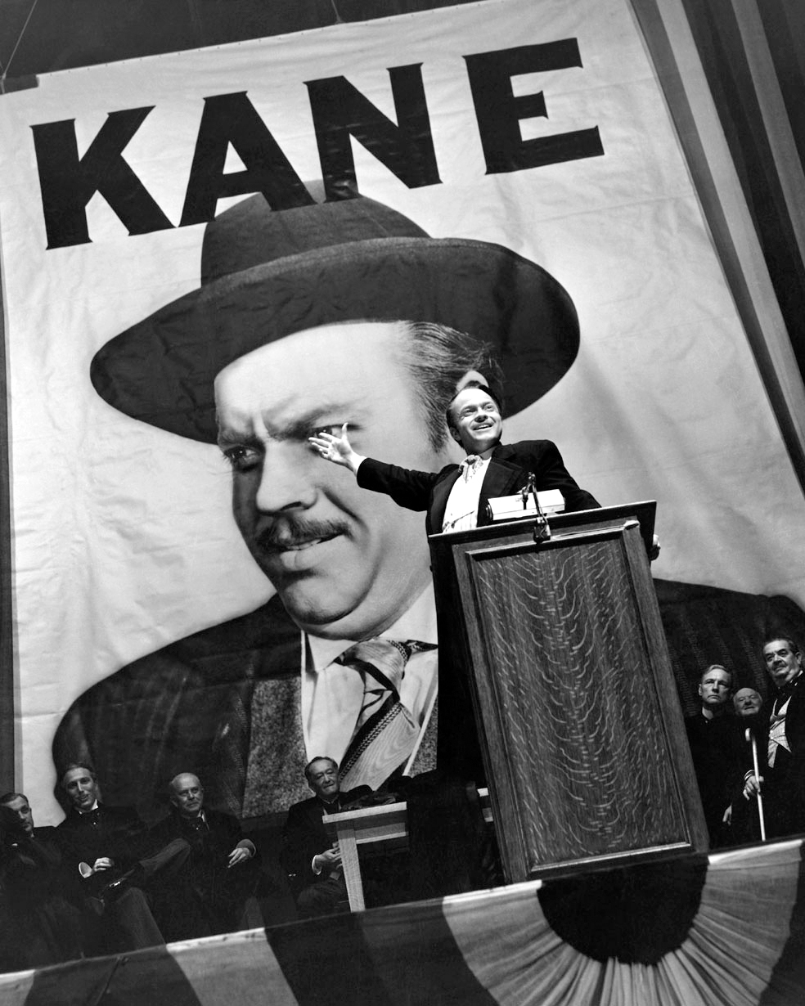
Citizen Kane (1941)
Welles’s first film, in which he was producer, co-screenwriter (with Herman Mankiewicz), director, and star.
Consistently topped critics' polls for “greatest film of all time”, also 2 polls with film directors in 1992 and 2002 ran by the British Film Institute.

Slide 17
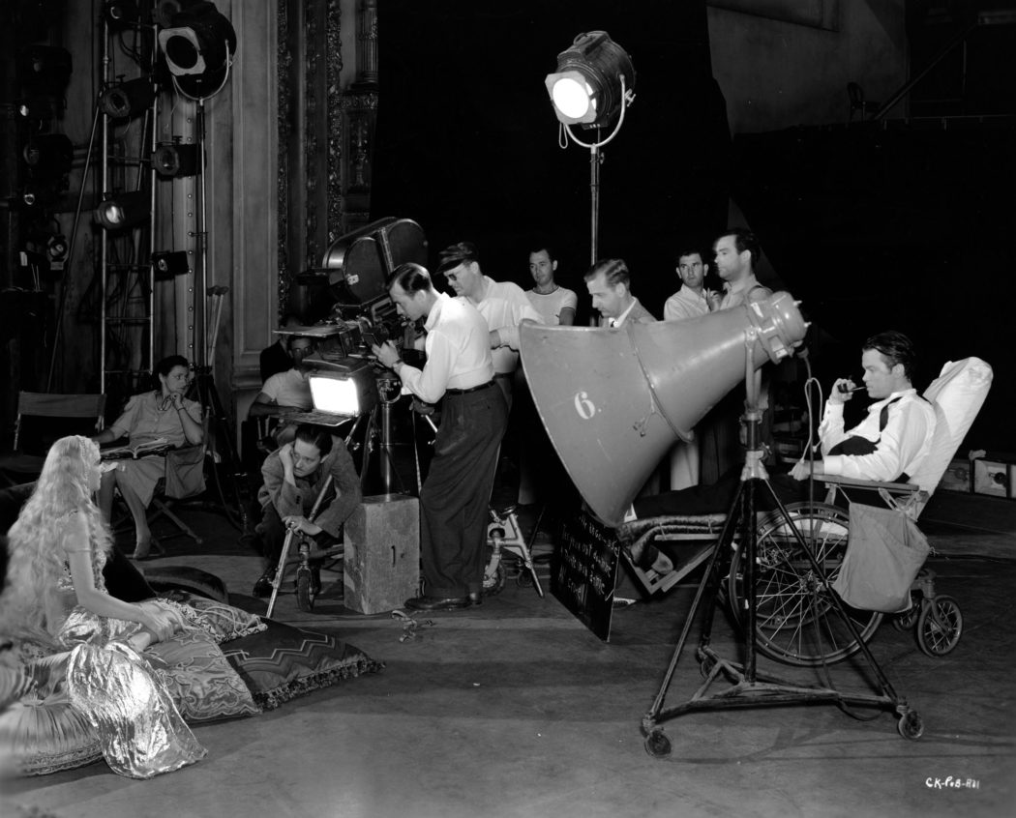
Welles collaborated with cinematographer Gregg Toland to perfect the method of deep-focus photography
Welles casted mostly
theatre and radio actors from his repertory company
Hearst ban and censorship attempts
First fake documentary? Or fictional biography?

Slide 18
Citizen Kane narrative analysis:
Working in groups, and starting with the film’s formal elements – analyze, discussion, and formulate the following narrative elements:
Story and characters
Time and space
Plot type(s)
Narration and narrator

Slide 19
Citizen Kane narrative analysis:
Relate the analysis your group came up with to the specific scene shown.

Slide 20
Citizen Kane narrative analysis:
Relate the analysis your group came up with to the specific scene shown.
How do they match up?

Slide 21
Citizen Kane narrative analysis:
Relate the analysis your group came up with to the specific scene shown.
How do they match up?
Are there surprises, exceptions, contradictions?

