Slide 1
II. Histories of Sound
3. Acoustic Archives

Slide 2
Sound recording as archival medium (Sterne)
Women and telephony: Two Archives (Martin, Martel)
Sonification (Sterne and Akiyama)

Slide 3
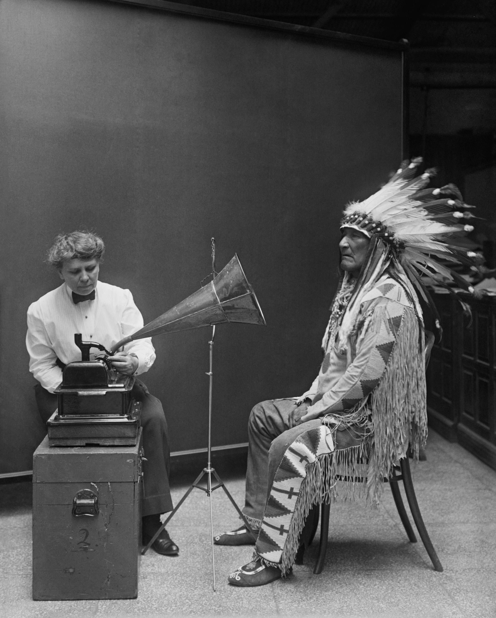
Preserving Sound in Modern America
(Sterne)

Slide 4
“From the moment of its public introduction, sound recording was understood to have great possibilities as an archival medium.” (p. 295)

Slide 5
Sound recording as an archival medium :

Slide 6
Sound recording as an archival medium :
Preserving the voices of the dead

Slide 7
Sound recording as an archival medium :
Preserving the voices of the dead
Ephemerality of the records

Slide 8
Sound recording as an archival medium :
Preserving the voices of the dead
Ephemerality of the records
Abstracted from one’s body / a figure of exteriority

Slide 9
Sound recording as an archival medium :
Preserving the voices of the dead
Ephemerality of the records
Abstracted from one’s body / a figure of exteriority
Victorian culture and death

Slide 10
Sound recording as an archival medium :
Preserving the voices of the dead
Ephemerality of the records
Abstracted from one’s body / a figure of exteriority
Victorian culture and death
Bourgeois modernity

Slide 11
Sound recording as an archival medium :
Preserving the voices of the dead
Ephemerality of the records
Abstracted from one’s body / a figure of exteriority
Victorian culture and death
Bourgeois modernity
“The ethos of preservation described and prescribed the cultural and technical possibilities of sound recording.” (p. 298)

Slide 12
Sound recording as an archival medium :
Preserving the voices of the dead
Ephemerality of the records
Abstracted from one’s body / a figure of exteriority
Victorian culture and death
Bourgeois modernity
“The ethos of preservation described and prescribed the cultural and technical possibilities of sound recording.” (p. 298)

Slide 13
A Resonant tomb:
Canning technology (1850s-1880s)
Embalming
His Master’s Voice (1899)
Phonographical messages to the future
Audio ethnography

Slide 14
A Resonant tomb:
Canning technology (1850s-1880s)
Embalming
His Master’s Voice (1899)
Phonographical messages to the future
Audio ethnography

Slide 15
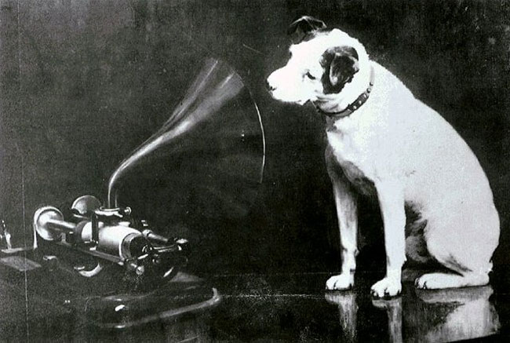
Francis Barraud’s painting of Nipper, dog of his deceased brother Mark Henry, painted around 1893. Barraud titled it Dog looking at and listening to a Phonograph

Slide 16
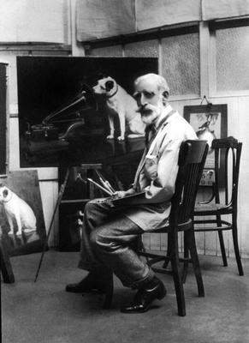
Barraud copying his painting for William Barry Owens (Emile Berliner’s manager) who bought the rights to it in 1899.

Slide 17
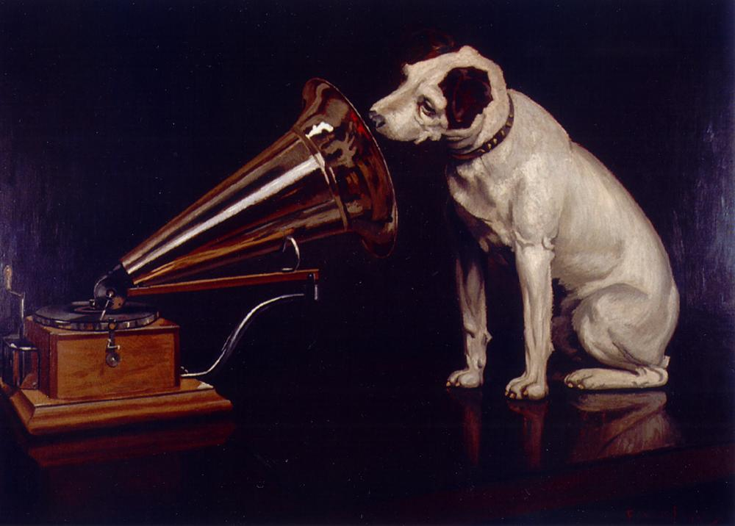
Burraud’s revised painting His Master’s Voice

Slide 18
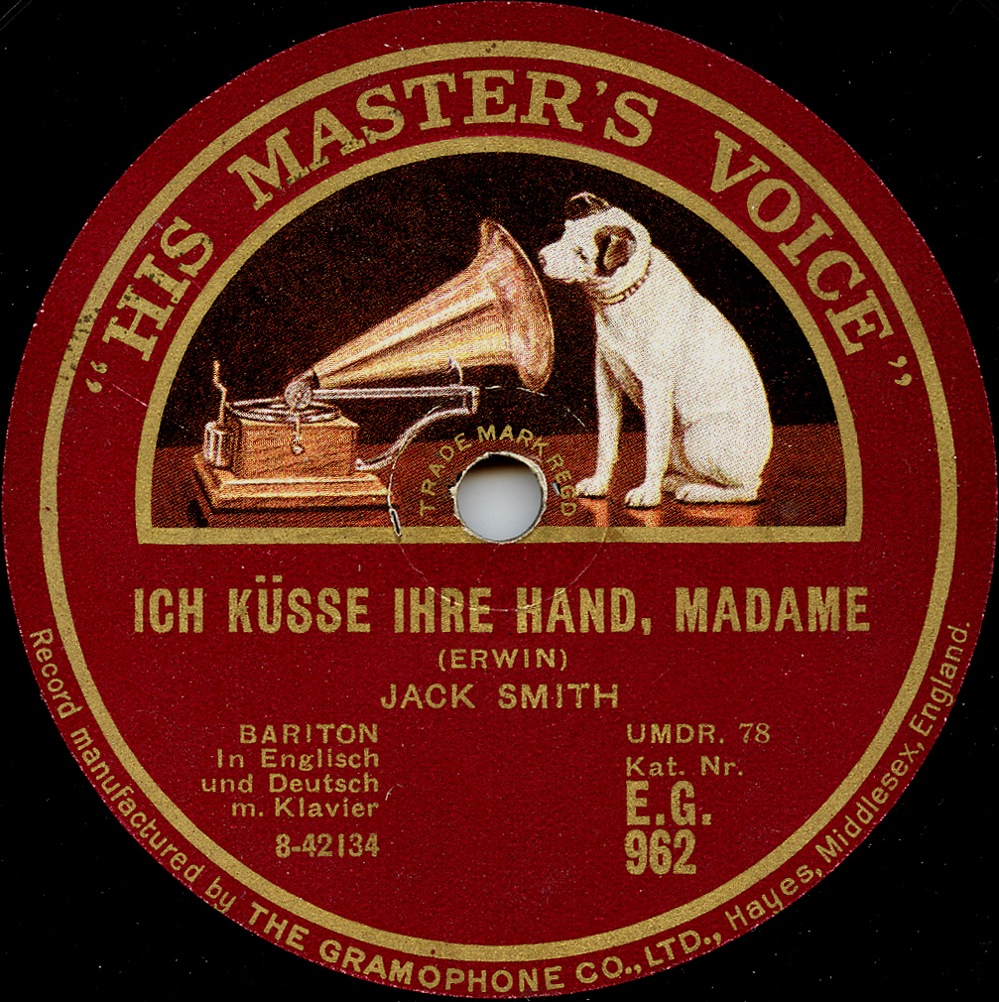
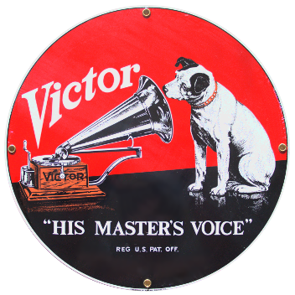
The His Master’s Voice trademark was granted to Emile Berliner in 1900

Slide 19
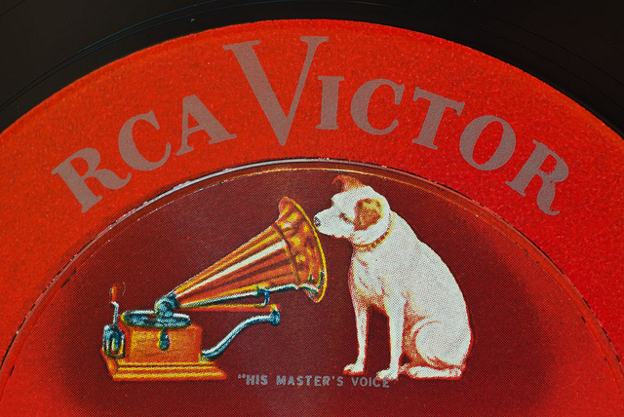
Nipper became known as the “RCA dog”

Slide 20
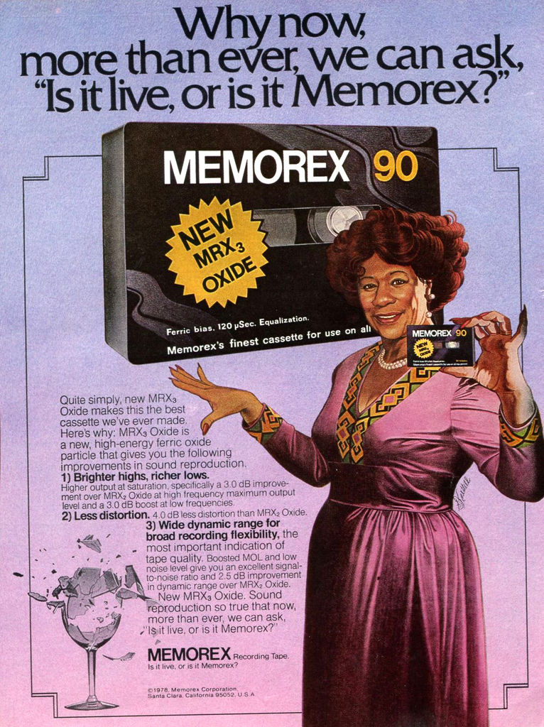

Slide 21
Frances Densmore recording Blackfoot chief Mountain Chief on a cylinder phonograph for the Bureau of American Ethology in 1916

Slide 22
Tanya Tagaq performing a new soundtrack to Robert Flaherty’s Nanook of the North (1922) at Dark Mofo Festival, Hobart, Australia, 2018

Slide 23
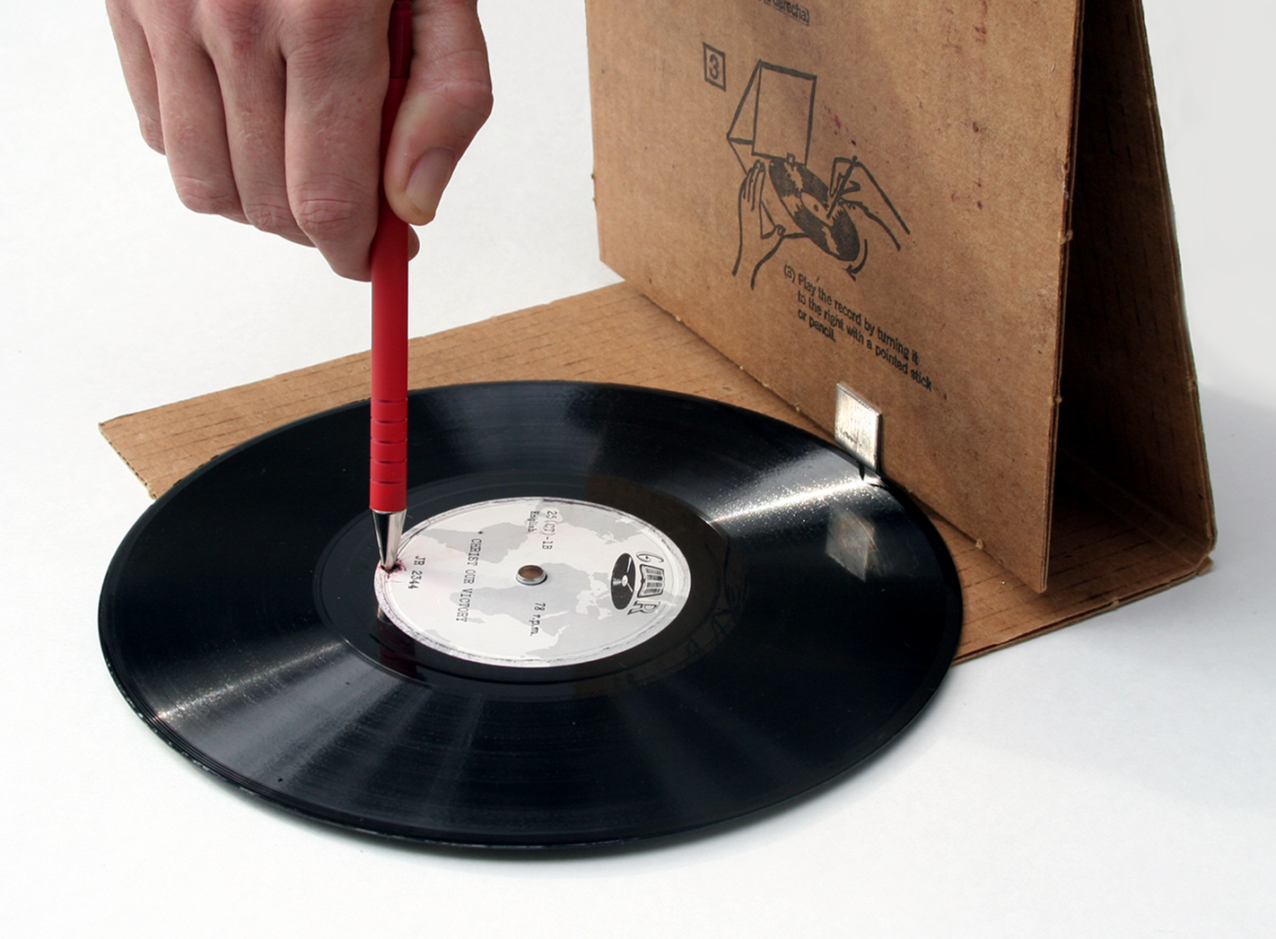
Global Recordings Network, founded in Los Angeles,1939, in the documentary Tailenders (2006) Dir. Adele Horne

Slide 24
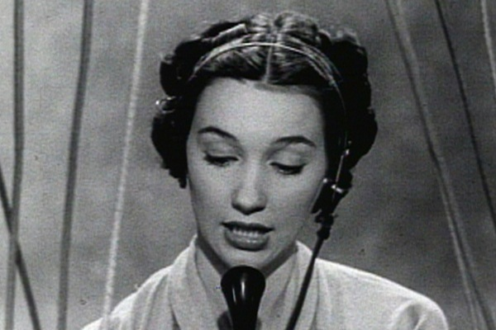
WOMEN AND TELEPHONY:
TWO ARCHIVES

Slide 25
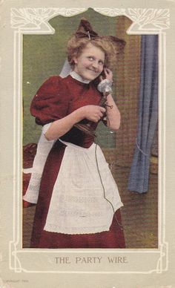
1. Gender and Early Telephone Culture (Martin)

Slide 26
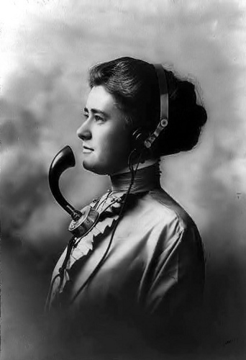
2. Phantom of The Operator (Canada, 2004) Dir. Caroline Martel

Slide 27
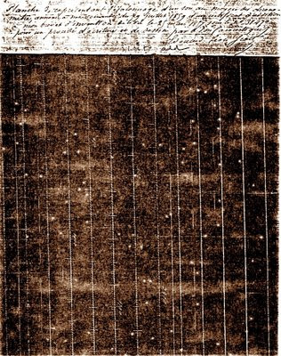
THINKING ABOUT SONIFICATION: SCOTT’S PHONAUTOGRAM

Slide 28
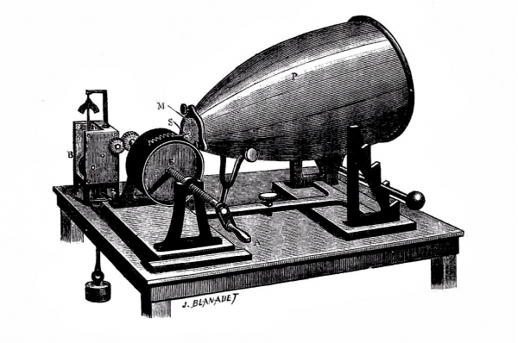
Édouard-Léon Scott de Martinville’s Phonautograph, 1857

Slide 29
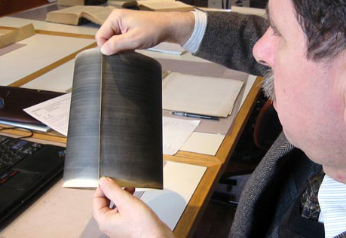

Slide 30
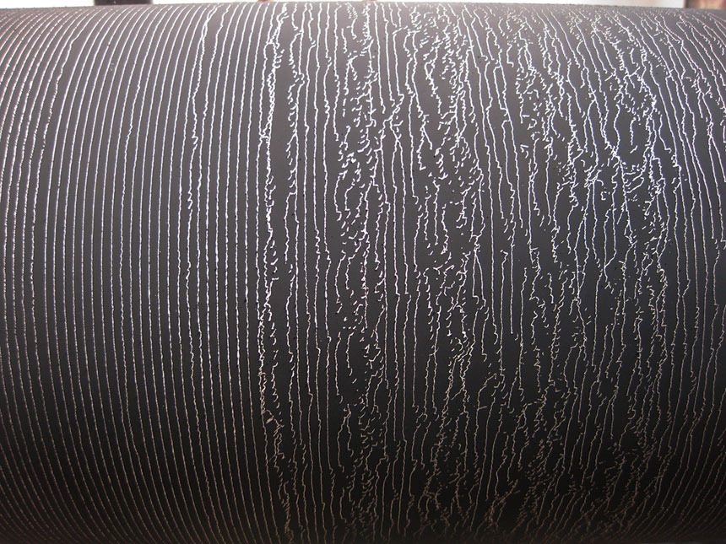

Slide 31
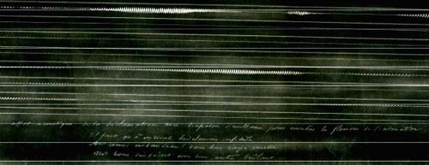
A phonautogram scanned from one of Scott’s originals in the archive of the Institut de France and published by First Sounds

Slide 32
What does it mean to play back sound recordings that were never meant for playback?

Slide 33
What does it mean to play back sound recordings that were never meant for playback?
What implications does the practice of sonification have on sound studies as a field?

Slide 34
For Thursday: Look for an acoustic archive, think about it in relation to Sterne and Akiyama’s discussions, and what it can offer an aural historian based on the examples of Martin and Martell.
Formulate your discussion question around these considerations.

