Slide 1
EXPERIMENTAL MEDIA STUDIO
Topic Five: Community

Slide 2
Key Concepts & Genres
Relational aesthetics
Relational art
Collaboration
Social interstice
Micro-utopias
Context
Audience
Antagonism
Relational antagonism

Slide 3
Artists and Movements
Rirkrit Tiravanija, Santiago Sierra, Jorge Pardo, Michael Lin, Liam Gillick, Apolonia Sustersic, Phillippe Parreno, Pierre Huyghe, Carsten Höller, Christine Hill, Vanessa Beecroft, Maurizio Cattelan, Thomas Hirschhorn, Dominique Gonzales-Foerster, Noritoshi Hirakawa, Fareed Armaly, Philippe Parreno, Henry Bond, Julia Sher

Slide 4
Rirkrit Tiravanija, Untitled 1992 (Free), various versions

Slide 9
Rirkrit Tiravanija, untitled 1999
(tomorrow can shut up and go away)

Slide 10
Rirkrit Tiravanija, untitled (demo station no. 5), 2006

Slide 11
un-Prom fashion show, staged in
untitled (demo station no. 5)

Slide 12
Karaoke battle, staged in untitled (demo station no. 5)

Slide 13
Gulgun Kayim’s Skewed Visions project

Slide 14
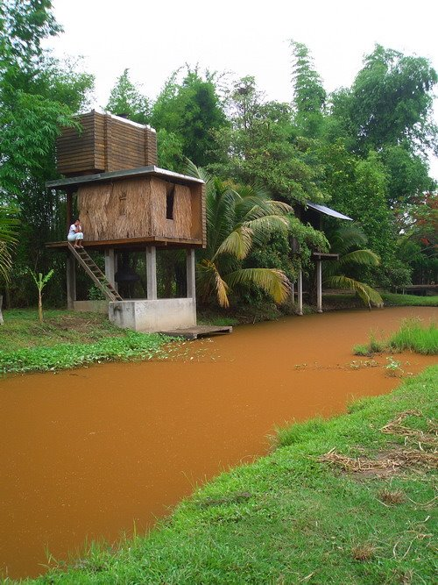
Rirkrit Tiravanija, The Land, on-going project since 1998

Slide 15
Rirkrit Tiravanija's house at The Land, as inhabited by Laura Ayers, February 2004

Slide 16
Santiago Sierra, Line of 250cm Tattooed on Six Paid People, 1999

Slide 18
Santiago Sierra, 160 cm Line Tattooed on Four People, 2000

Slide 19
Santiago Sierra, 4 Workers Who Cannot Be Paid Remunerated to Remain Inside Cardboard Boxes, 2000

Slide 21
Santiago Sierra, Person Remunerated for a Period of 360 Consecutive Hours, 2000

Slide 22
Santiago Sierra, Nine Forms of 100x100x600cm Each, Constructed to Be Supported Perpendicular to A Wall, 2002

Slide 25
Santiago Sierra, Space Closed by Corrugated Metal, 2002

Slide 26
Santiago Sierra, Wall Enclosing a Space, 2003

